Slide 1
Employee management system
Presented by
Dhinisha w(43130849)-jfs(st02)

Slide 2
ABSTRACT
This project is an Employee Management System (EMS) designed to manage employee details efficiently. It allows adding, editing, viewing, and deleting employee information using a simple and clean user interface. The system is developed using Java (Spring Boot) for backend and React.js for frontend with MySQL database.

Slide 3
EXISTING SYSTEM
• Manual entry of employee details leads to errors.
• No centralized database for record keeping.
• Difficult to update or retrieve employee information quickly.

Slide 4
PROPOSED SYSTEM
• Centralized employee management through
EMS.
• Add, edit, and delete employee records easily.
• User-friendly interface built with React.js.
• Data stored securely in MySQL database.

Slide 5
ADVANTAGES
• Easy employee data handling
• Accurate and fast data processing
• Secure storage and quick retrieval
• Reduces manual workload

Slide 6
DISADVANTAGES
• Requires internet connection
• Dependent on system maintenance
• Initial setup may take time

Slide 7
HARDWARE REQUIREMENTS
• Processor: Intel i3 or higher
• RAM: 4 GB or above
• Hard Disk: Minimum 100 GB
• System: Windows/Linux OS

Slide 8





SOFTWARE REQUIREMENTS
• Frontend: React.js
• Backend: Spring Boot (Java)
• Database: MySQL
• Tools: VS Code, IntelliJ IDEA, Postman, GitHub

Slide 9
MODULES
1. Add Employee Module
2. Edit Employee Module
3. View Employee List Module
4. Delete Employee Module

Slide 10
MODULE DESCRIPTION
• Add Employee: Allows users to add new employee details.
• Edit Employee: Enables updating existing employee data.
• View Employee: Displays all employee information.
• Delete Employee: Removes unwanted employee records.

Slide 11
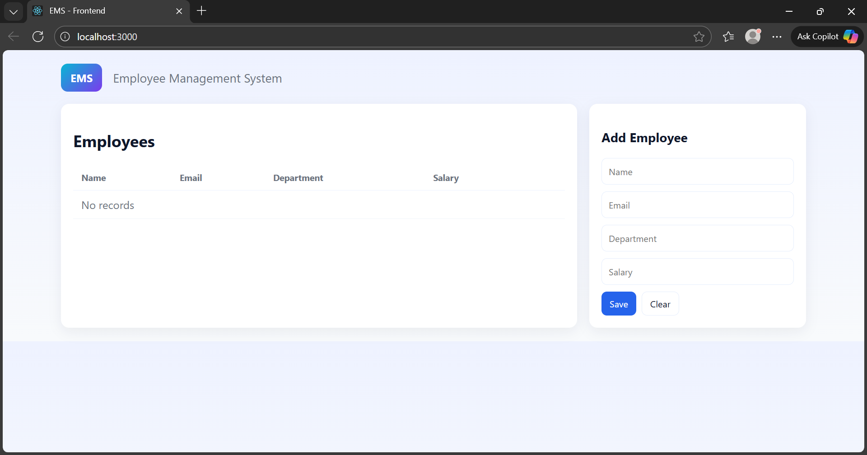
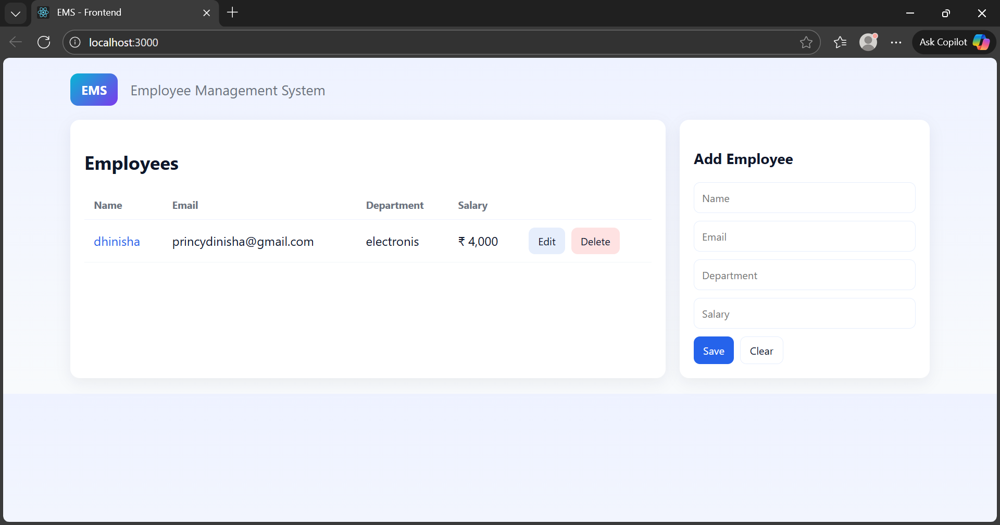
1.ADD MODULE

Slide 12
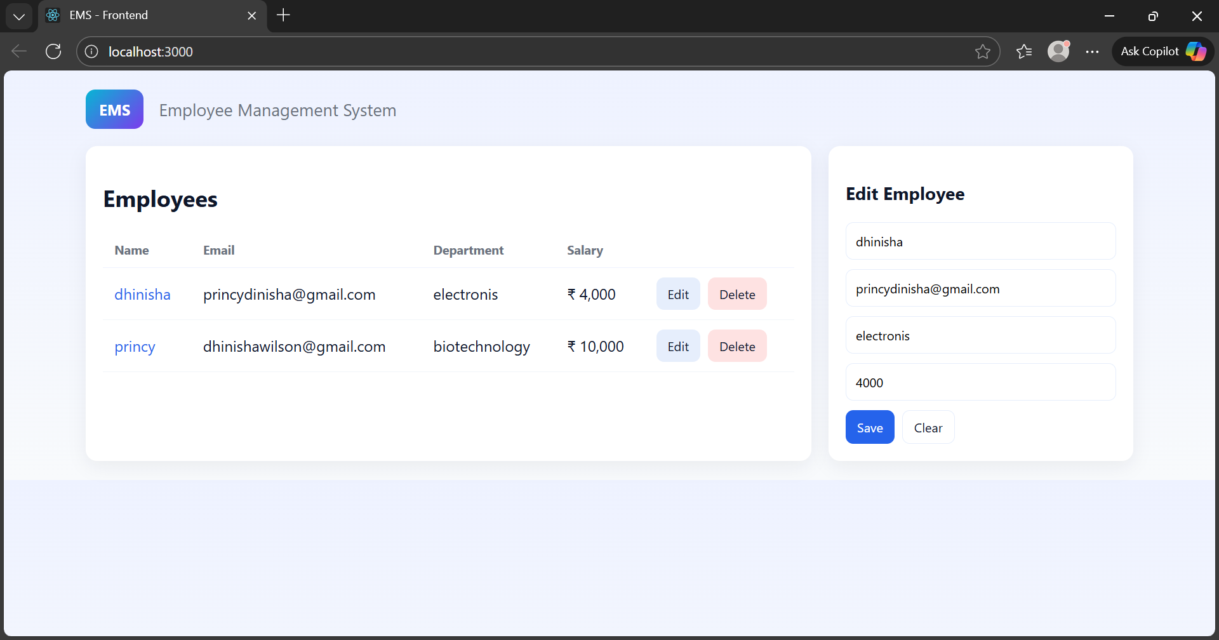
Edit module

Slide 13
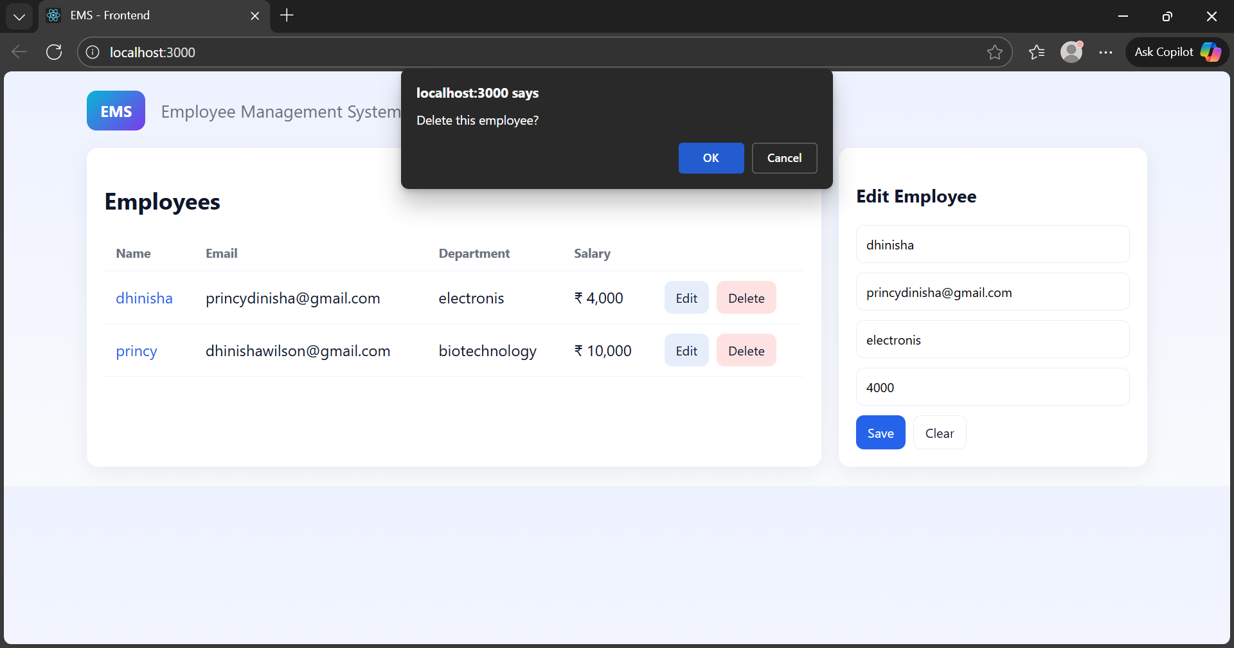
DELETE MODULE

Slide 14
CONCLUSION
The Employee Management System simplifies managing employee details efficiently. It ensures smooth data handling, better record keeping, and reduces manual work through automation.

