Slide 1
Unnecessary Presentation

Slide 2
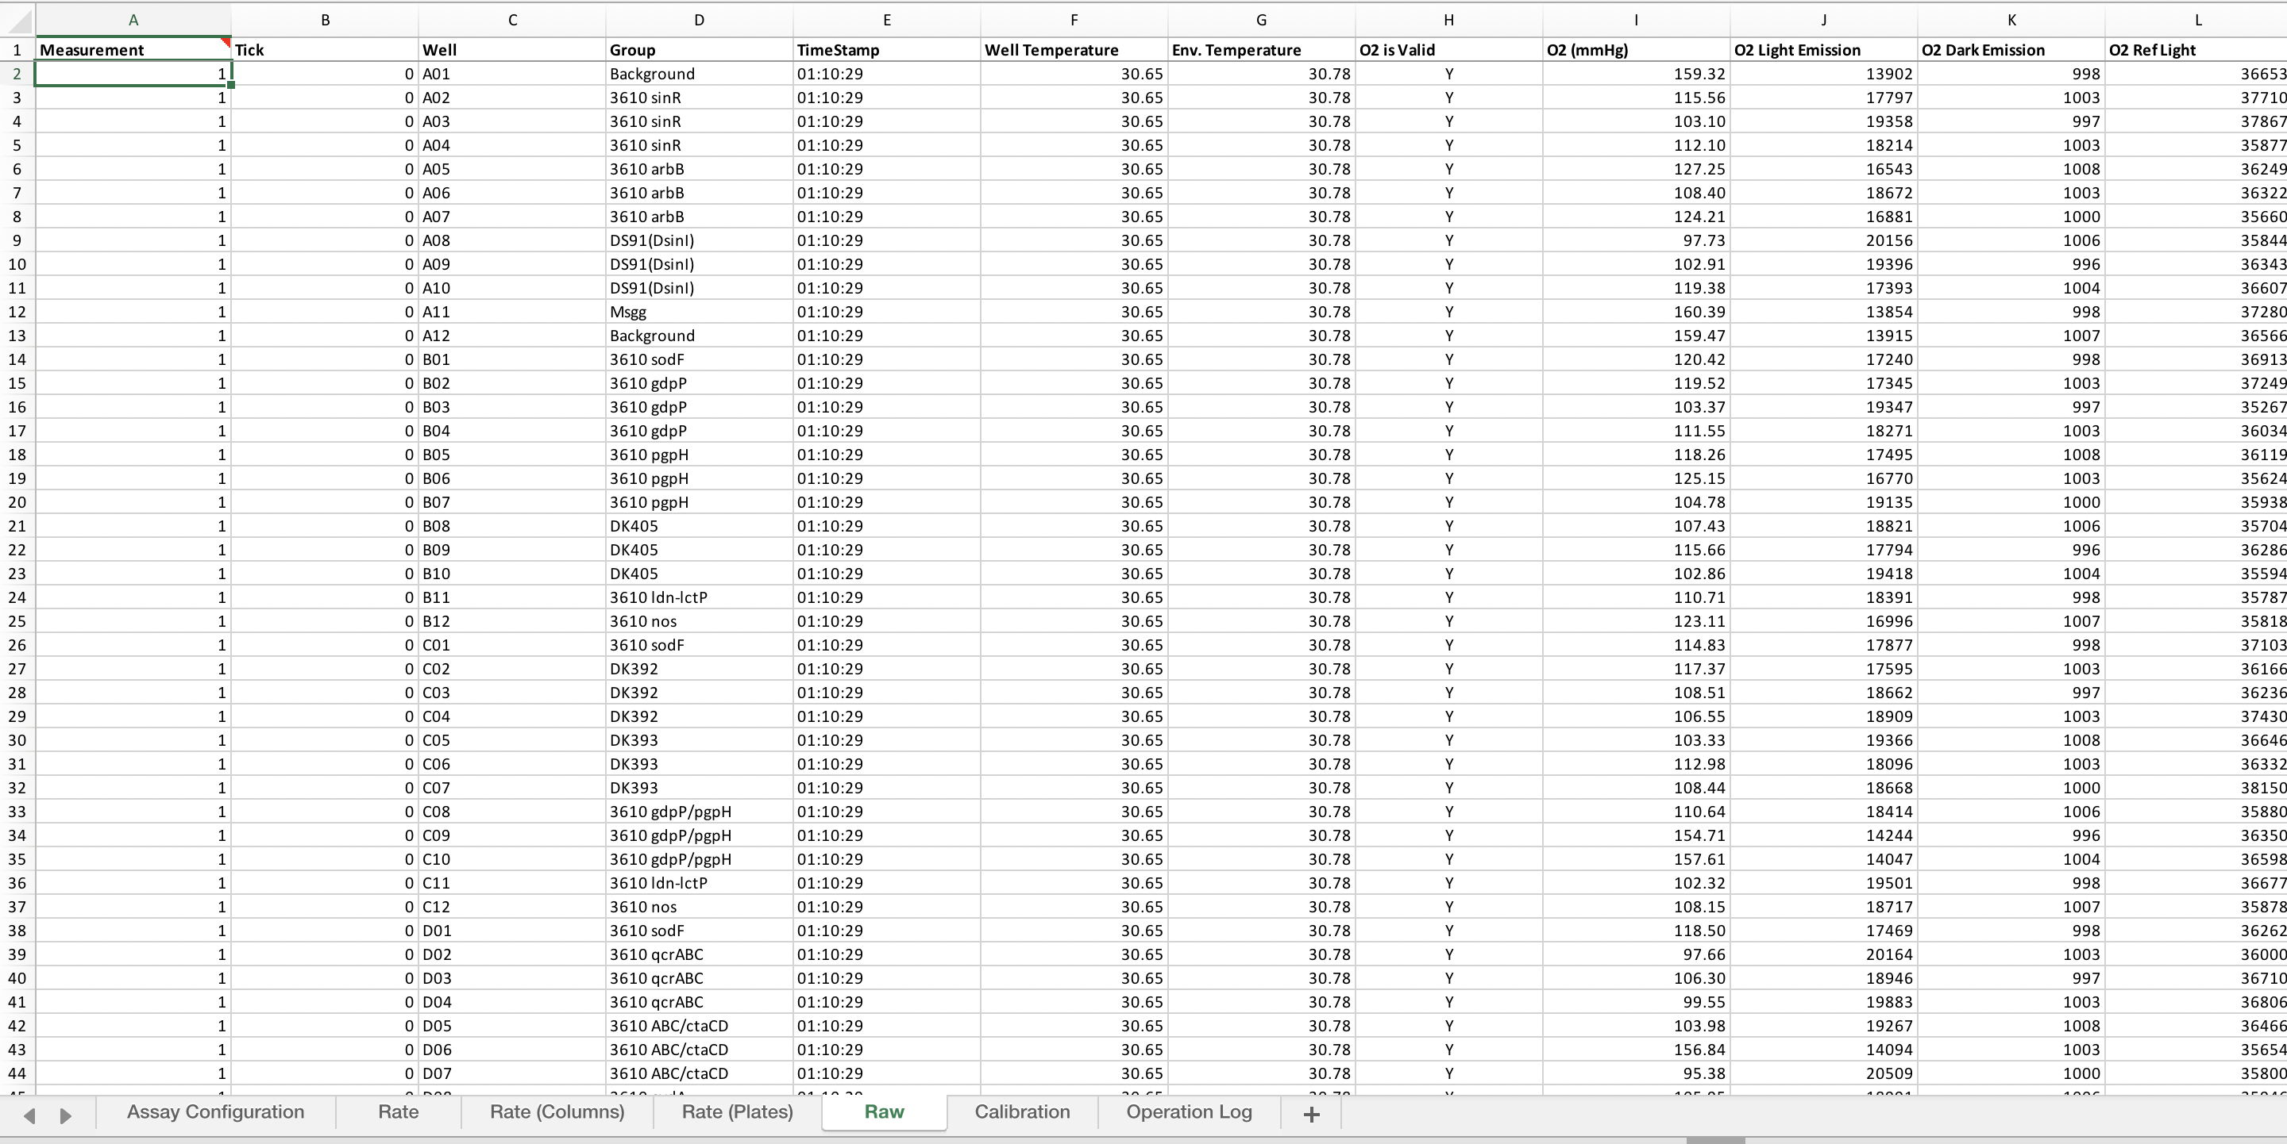
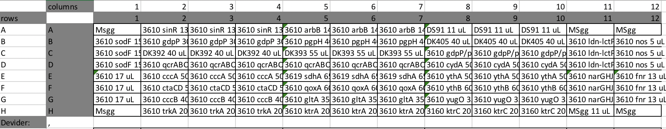
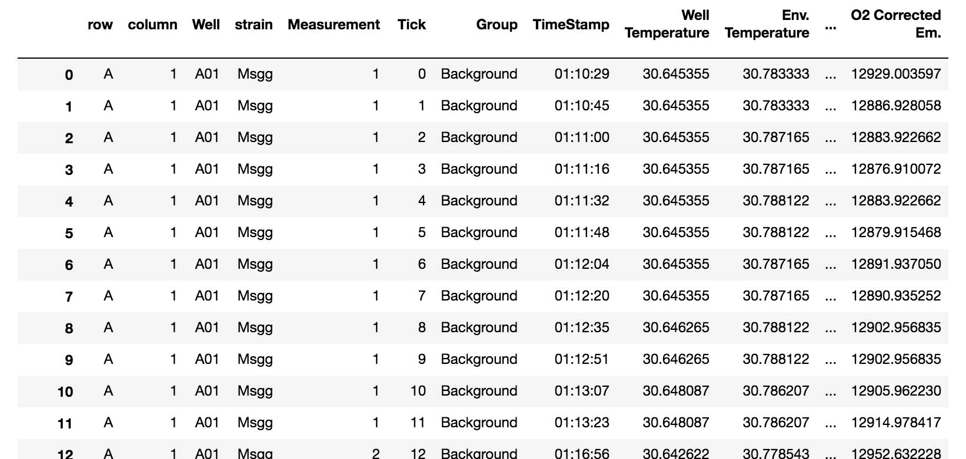
Seahorse output
Platemap
+
Location (for row/column effects)
Annotation, can be multiple
Annotated dataframe
Hours since start are also calculated from the timestamp

Slide 3
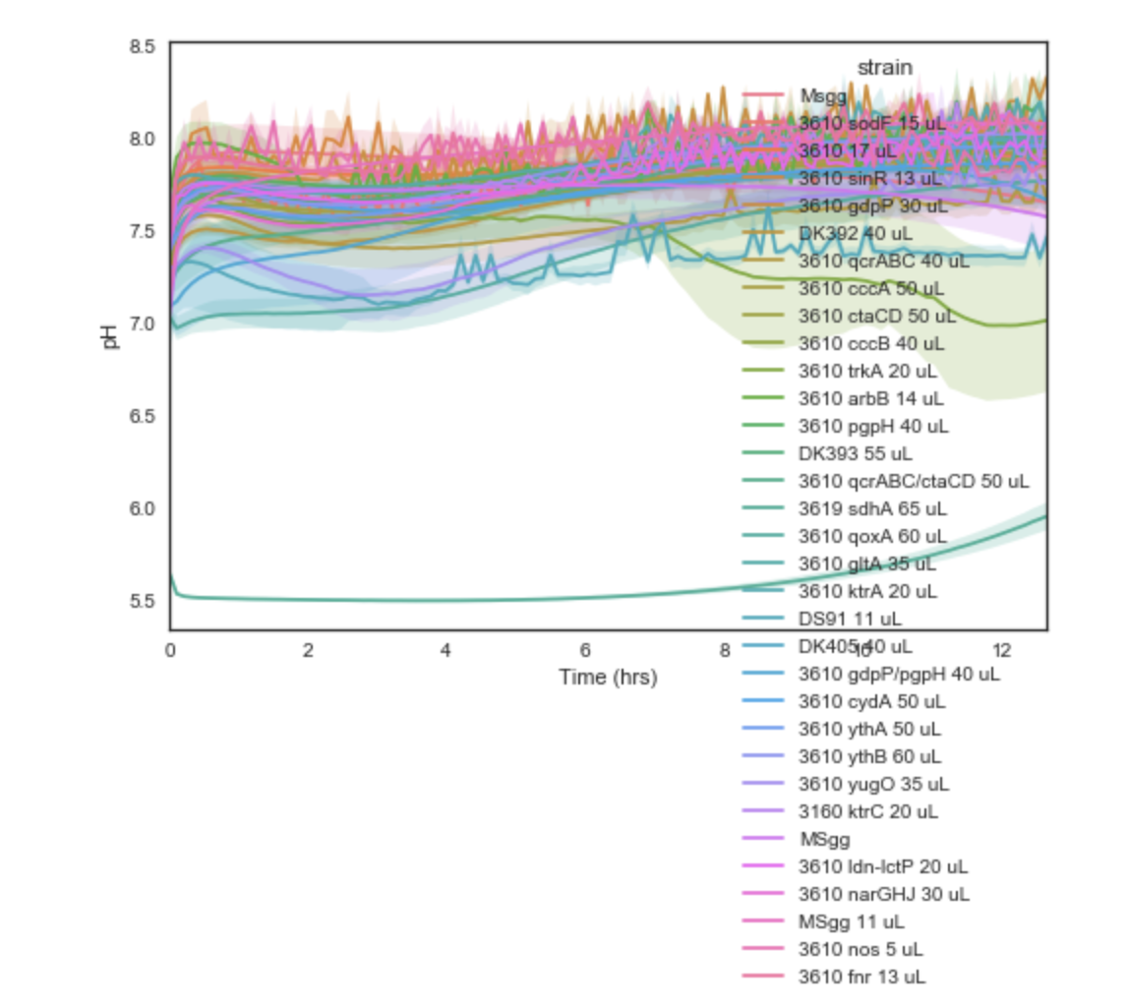
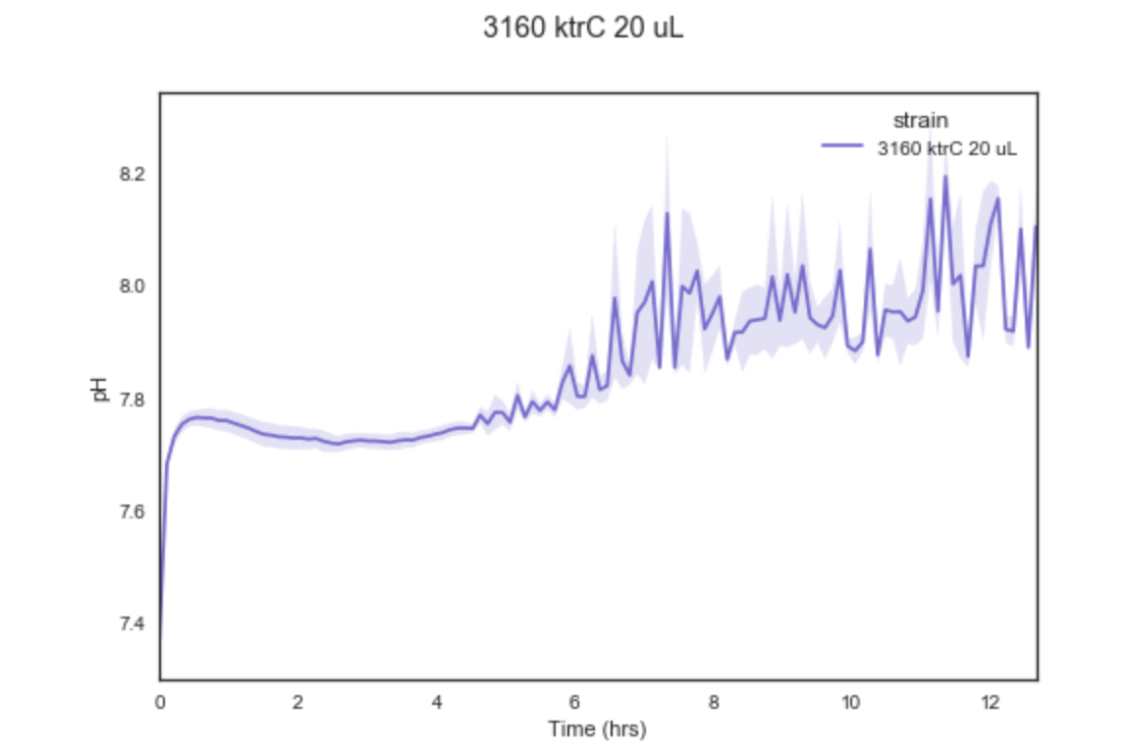
Inputs: Annotated dataframe, column to group by (in this case “strain”), and column to plot (in this case pH)
First point of each 6 measurement ECAR timepoint extracted
Replicates grouped,
mean plotted
95% confidence interval from bootstrap
Multiple conditions plotted simultaneously
(only looks good for dose-response or smaller subsets)

Slide 4
Futurology
Derivatives (differences)
Finding local/global maxima/minima → barchart/scatter/linear regression (probably need more reps)
Comparisons vs control (subtract background? WT?)
Individual traces of replicates

