Slide 1
Unnecessary Presentation

Slide 2
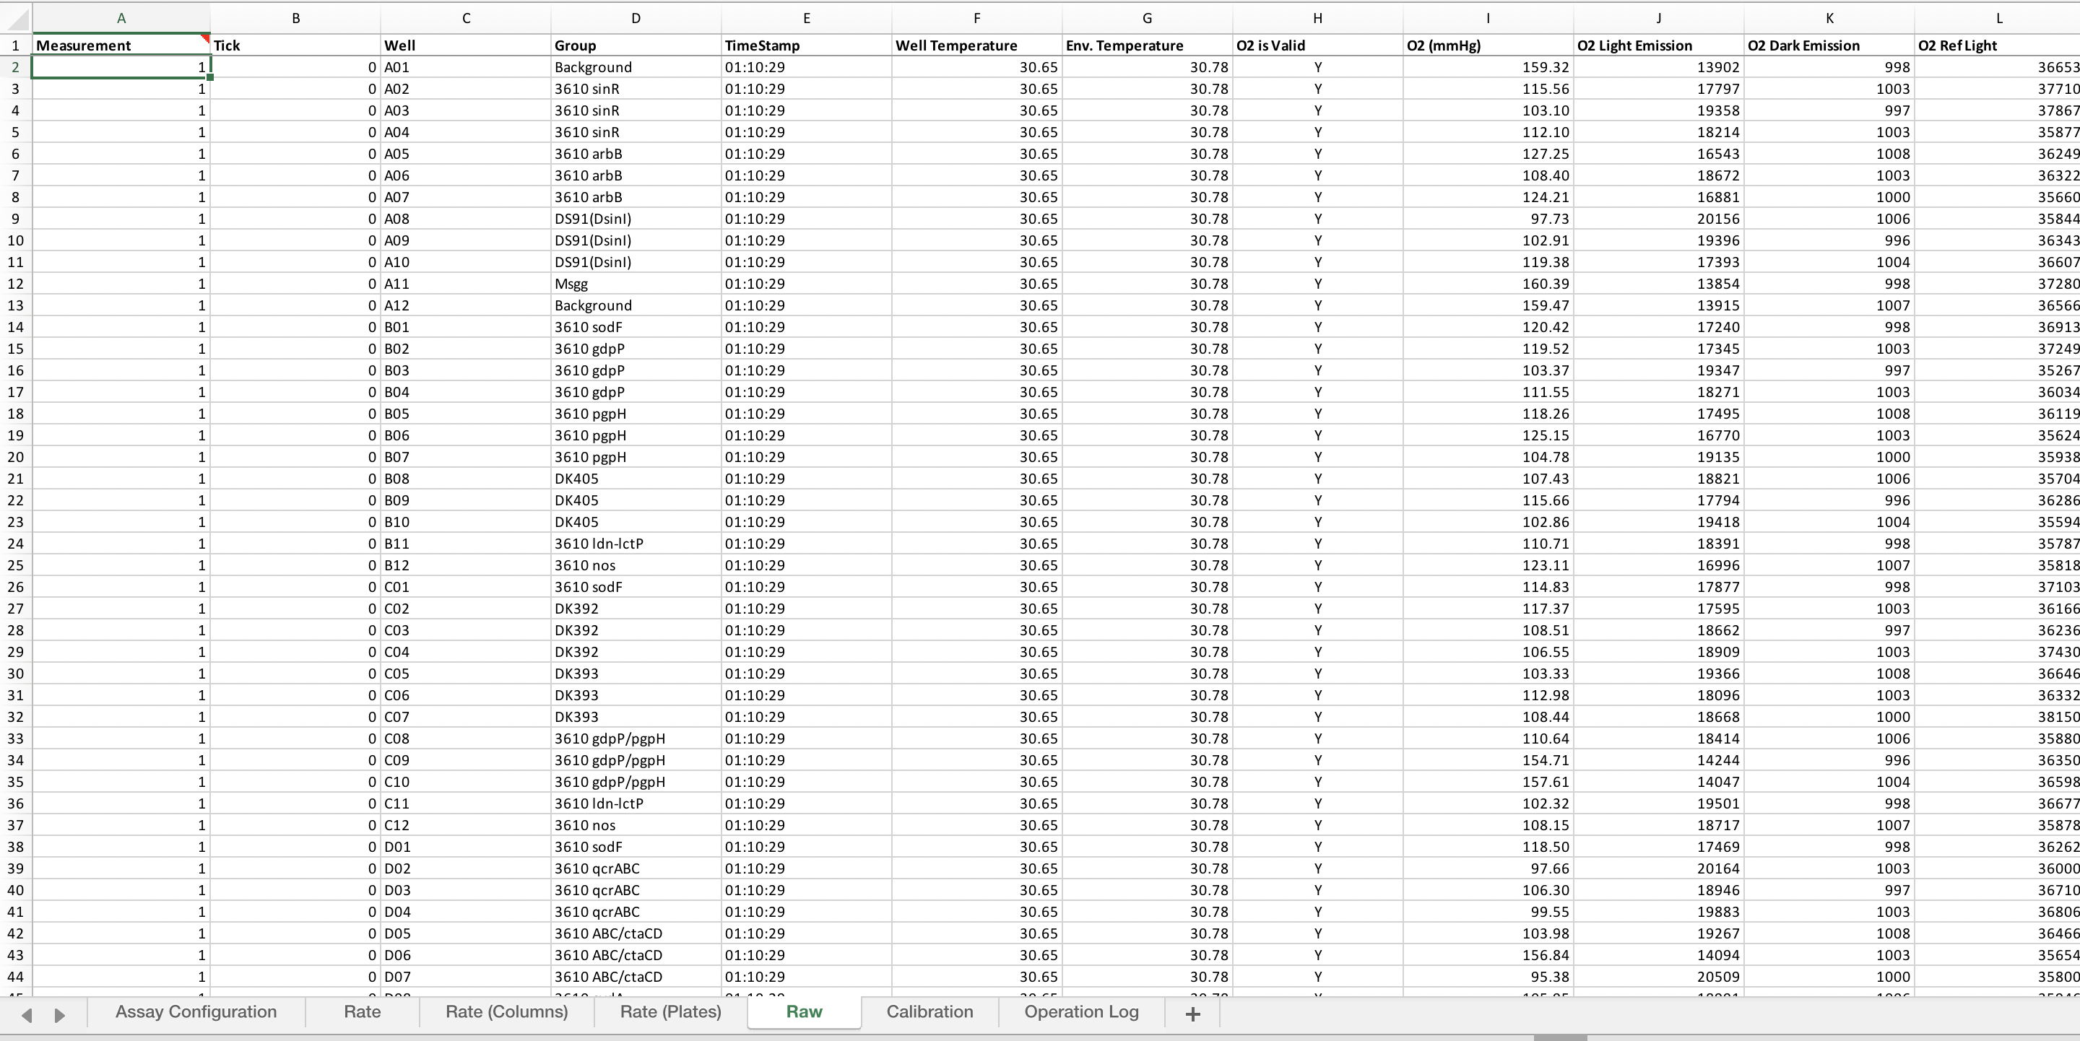
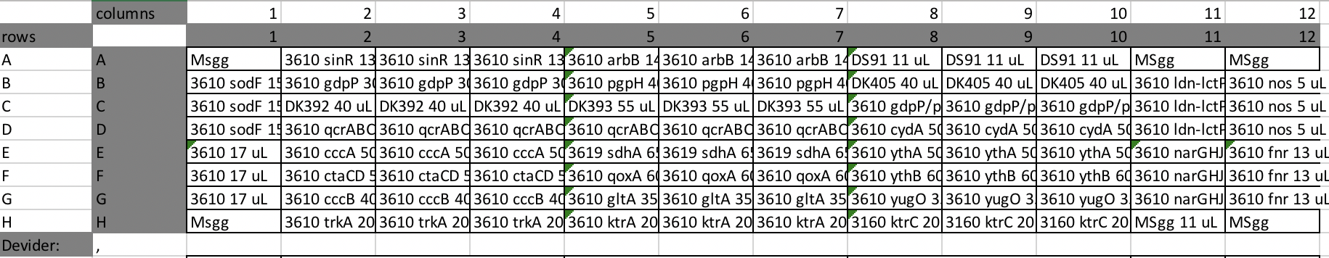
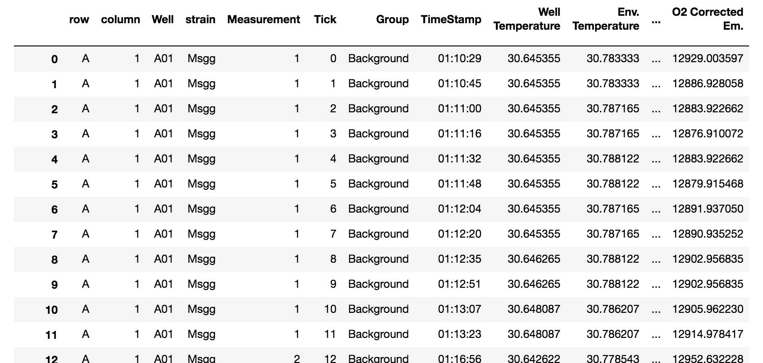
Seahorse output
Platemap
+
Location (for row/column effects)
Annotation, can be multiple
Annotated dataframe
Hours since start are also calculated from the timestamp

Slide 3
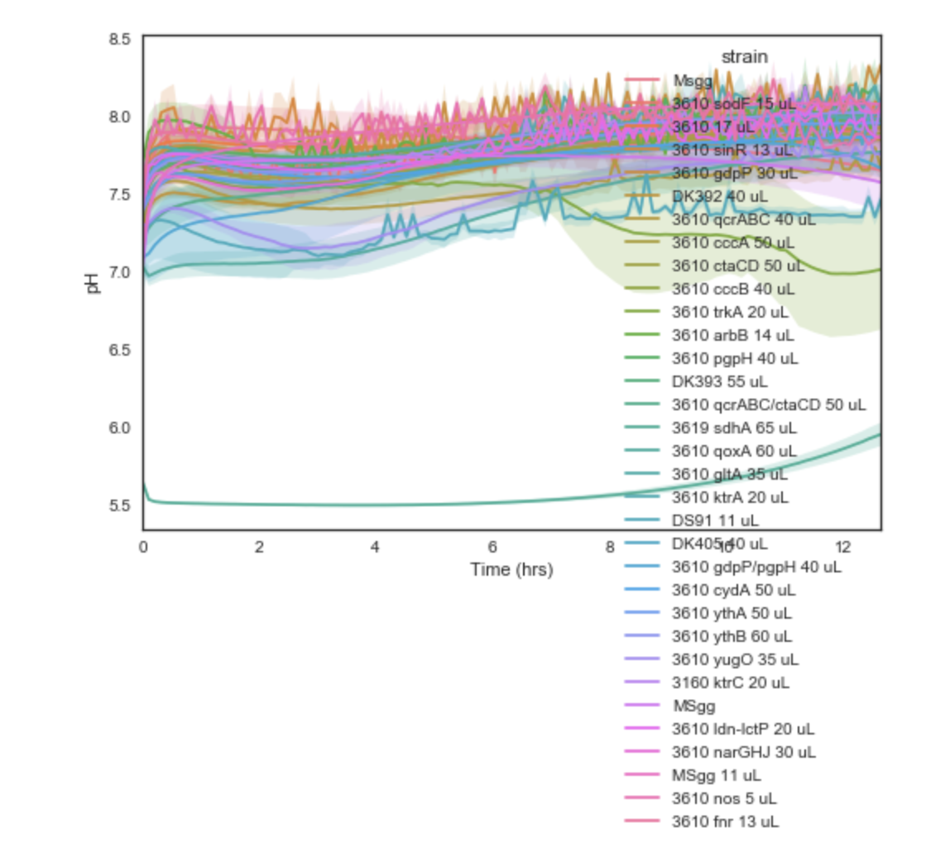
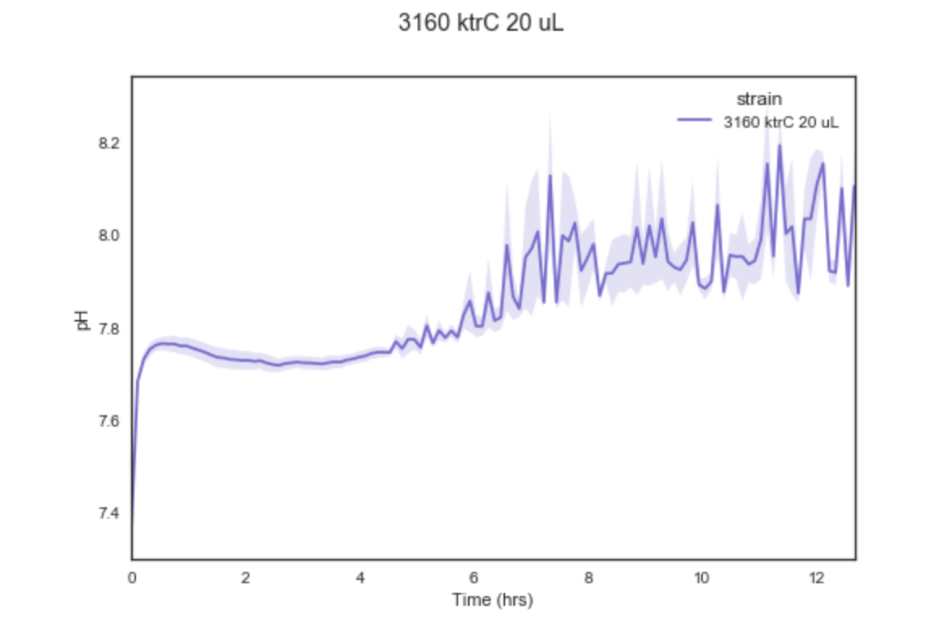
Inputs: Annotated dataframe, column to group by (in this case “strain”), and column to plot (in this case pH)
First point of each 6 measurement ECAR timepoint extracted
Replicates grouped,
mean plotted
95% confidence interval from bootstrap
Multiple conditions plotted simultaneously
(only looks good for dose-response or smaller subsets)

Slide 4
Futurology
Derivatives (differences)
Finding local/global maxima/minima → barchart/scatter/linear regression (probably need more reps)
Comparisons vs control (subtract background? WT?)
Individual traces of replicates
P.S. GitHub, it’s a good thing that I’m trying to get better at.
Notes:
Pull out freq of each replicate, correlation between OCAR and ECAR. Is that true always, is it true in different conditions.
10min sampling, 4min sampling, is the frequency the same for oscillating wells? You hope it is.
Extract out oscillating traces, line them up for the 10, 4 experiment.
Look for local maxima, require amplitude to be above maxima.
Pick a few key traces and test it on them.
Frequency in minima ocar, maxima ecar (maybe look in raw data)
Even just raw pH, O2
OCAR vs ECAR correlation
Sampling time vs frequency
In legend add well locations
Heatmaps of evaporation of oscillation v. nonoscillation
Heatmap animations of oxygen level, could see edge effect. Could see that they’re not synchronized.

