Slide 1
Time series analysis and forecasting of Austrian electricity prices using ARIMA/ARIMAX modeling
Capstone Project for the 2025 „Data Practicioner“ Class
at neuefische
Paul Ringler | 27.10.2025

Slide 2
Business Case: Power Consumers
Following the russian full-scale invasion of Ukraine in 02/2022, Austrian energy prices experienced significant increases and have also become very volatile.
Large power producers (e.g. wind/solar parks, public utility companies) and power consumers (e.g. manufacturing companies, data centers) need planning security.
This is best achieved by securing over-the-counter supply contracts. These are sold at fixed prices for different durations (e.g. 1-6 months-ahead).
Forecasting these prices yields benefits in terms of risk-management as well as cost optimization in procurement planning for power consumers.
This project explores the cornerstones of a light-weight, continuous forecasting application designed for use by small-scale manufacturing companies in Austria.
2
Notes:
Post-Ukraine invasion: Austrian energy prices surged and became highly volatile
- Target audience: Small manufacturing companies, power suppliers
- Over-the-counter contracts: fixed prices for 1-6 months ahead
- Forecasting enables: (1) Risk hedging, (2) Optimal contract timing
- This project: Lightweight forecasting tool prototype using ARIMA/ARIMAX

Slide 3
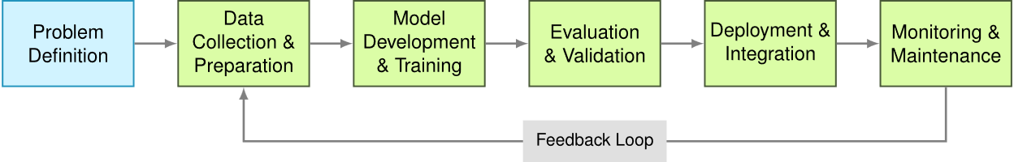
Project Scope
Data sources: Current real-world sources only! Historical data as stand-in for daily-updated market data
Data Engineering: Development of a semi-automatic ETL-pipeline prototype
Data Preparation & Analysis: EDA including time-series decomposition + basic Feature Engineering
Model building: Design and Evaluation of prognosis model (ARIMAX & Regression).
Tableau Story for Visualisation
Architecture, analytics, methodology, model building decisions by author. Code developed using AI-assisted pair programming (AI-generated, manually validated and documented code).
✓
✓
✓
✓
Source: https://www.mlsysbook.ai/contents/core/workflow/workflow_files/mediabag/9b58b3aa72de00d638019e0cdf45f488ecf3911f.svg
3
Notes:
Classic ML workflow: Problem Definition → Data → Model → Evaluation
This project covers: ✓ Data Engineering, ✓ EDA, ✓ Model Building, ✓ Evaluation
Out of scope: Deployment, Monitoring (future work)
6 data sources: Electricity prices, CO2, Gas, Climate, Production Mix, Economy
Semi-automated ETL pipeline designed for continuous updates. I.e: Data extraction, then transformation and finally shaping into a data file for further work. Code once, and then analyse.
(vs. loading the data into a raw file and only transforming it whenever it is needed for analysis) Transformation Code for each analysis.

Slide 4
Project Workflow and Architecture
1. Data Acquisition EXAA, ICAP, EUROSTAT, E-Control, AUSTRIAN ENERGY AGENCY
2. Technical Planning Understanding data, planning data model & analysis
Start of September:
Development
Phase ~2 Weeks
Development
Phase
3. Building Data Pipeline DRY, Scalability, Future-Proofing
4. Missing Values Treatment: „price_combined“, climate data, dropping non-usable-columns
Mid-September to End of October
4 Weeks
+
~2 Weeks for
documentation
5. EDA
Visualisations, Time Series Decomposition, Structural Breaks, Multicollinearity
6. Model-Building & Evaluation
4
Notes:
ausgeblendet

Slide 5
Data Overview
Data granularity: Monthly
Outcome Variable: Average of day-ahead electricity prices (EXAA / Vienna Stock Exchange)
Input Variables:
Natural gas prices - Average of 1-month ahead futures (Austrian Energy Agency)
Price of carbon emission credits in European Trading Area (ICAP)
Climate data for austria (EUROSTAT)
Proportion of renewables in energy production (E-Control)
Economic indicators (STATISTIK Austria)
5

Slide 6
Central EDA Finding
Three distinct periods in electricity price data:
Period | ~ Timespan | No. of months | Mean (EUR/MWh) | SD | Stationary?
Pre-Shock | 2015-2020 | 72 | 35,94 | 9,6 | Yes (ADF p= ,034)
Price Shock | 2021-2023 | 26 | 181,92 | 112,44 | No
Post-Shock | 2023-2025 | 30 | 89,27 | 22,7 | Yes (ADF p= ,027)
Why is stationarity relevant?
Stationarity = Constant mean, variance, autocorrelation structure over time
ARIMA models need stable patterns from the past
Stationarity was detected using forwards/backwards expanding ADF and KPSS tests
Sparse Data! Most important exogenous variable (gas price) available only from 2020 Trained on all three Periods (n=108 / n=48), tested on Post Shock (2024+ n=18)
6
Notes:
Research ADF and KPSS tests again, short explanation for those
The ADF (Augmented Dickey-Fuller) test assumes non-stationarity, that a unit root exists (H₀: non-stationary).
It tests whether the series reverts to its mean using lagged values. Low p-value (<0.05) = reject H₀ = stationary.“
A unit root is a property of a time series where shocks in a system don´t fade away but remain.
The behavior in such a period is unpredictable.
The KPSS Test (Kwiatkowski-Phillips-Schmidt-Shin) tests more directly if mean and variance remain statistically constant over time
The KPSS test assumes stationarity (H₀: stationary). High p-value (>0.05) = fail to reject H₀ = stationary.
Three regimes: Stable-Volatile-Stable sandwich structure
Pre-shock: Low prices, low volatility, stationary
Price shock: Mean jumped 5x, volatility exploded, non-stationary
Post-shock: Prices normalized at higher level, volatility decreased, stationary again
Modeling challenges:
Training on full period = learning from regime no longer valid
Solution: Train on Period (2020-2023) = 56 months with available exogenous data
n_months mean median std cv min max iqr
stationary_pre 72.0 35.94 33.50 9.60 0.27 18.0 62.0 10.00
price_shock 26.0 181.92 174.25 112.44 0.62 50.5 488.0 140.25
stationary_post 30.0 89.27 85.00 22.70 0.25 59.0 141.0 29.00

Slide 7
Model Comparion & Evaluation
Training Period | Model | RMSE (Test n=18)
2015-2023 (n=108) | Persistence (B) | 43,84
 | Seasonal Naive (B) | 56,42
 | ARIMA (2,1,0) | 28,40
2020-2023 (n=48) | ARIMA (3,0,0) (B) | 26,23
 | ARIMAX (3,0,1) + Gas price | 21,56
 | ARIMAX (0,0,0) + Gas price | 21,14
✓
Longer training periods bad for prediction (structural breaks)
Best true ARIMAX model still worse than pure regression (ARIMA is overfitting)
ARIMAX (0,0,0) / OLS + Gas wins:
RMSE
Parsimoniousness (OLS 16 obs./parameter v ARIMAX 8 obs./parameter)
7
Notes:
Ljung-Box tests: Residuals are uncorrelated → Model captured all predictable patterns
Shapiro-Wilk failure: Residuals have heavy tails → Extreme events harder to predict
Heteroskedasticity: Error variance not constant → CI widths are approximate
Bootstrap CI: Realistic uncertainty quantification → 95% CI = ±42 EUR/MWh = ±40-50% of typical price → Still useful for scenario planning, not point predictions
OLS: intercept, gas coefficient, error = 3 parameters = n=30
ARIMAX: intercept, 3 lag coefficients, gas coefficient, error = 6 parameters = n=60

Slide 8
Details of Final Model
ARIMAX (0,0,0) + Indexed Gas Price
Variable | Coef | Std Err | Beta | Significant?
Constant | 33,47 | 27,20 | - | No (p = ,219)
Gas price | 1,61 | 0,179 | 0,83 | Yes (p = < ,001)
Adjusted r² = 0.688
RMSE = 21.14 (only 0,42 better than true ARIMAX, but wins on parsimonousness)
Ljung-Box: no significant autocorrelations = no variance left to be explained by time series
Jarque-Bera: p < 0.001 = Non-normal residuals (price shock volatility)
Heteroskedasticity: H = 12.12, p < 0.01 = Residuals change over time (price shock volatility)
Gas price accounts for 69 % of explained variance (Beta² = 0,69) = useful predictor
Volatile data:
Intercept is not significant, mean is no useful predictor
Confidence intervals likely underestimated
8
Notes:
Ljung-Box tests: Residuals are uncorrelated → Model captured all predictable patterns
Shapiro-Wilk failure: Residuals have heavy tails → Extreme events harder to predict
Heteroskedasticity: Error variance not constant → CI widths are approximate
Bootstrap CI: Realistic uncertainty quantification → 95% CI = ±42 EUR/MWh = ±40-50% of typical price → Still useful for scenario planning, not point predictions
OLS: intercept, gas coefficient, error = 3 parameters = n=30
ARIMAX: intercept, 3 lag coefficients, gas coefficient, error = 6 parameters = n=60

Slide 9
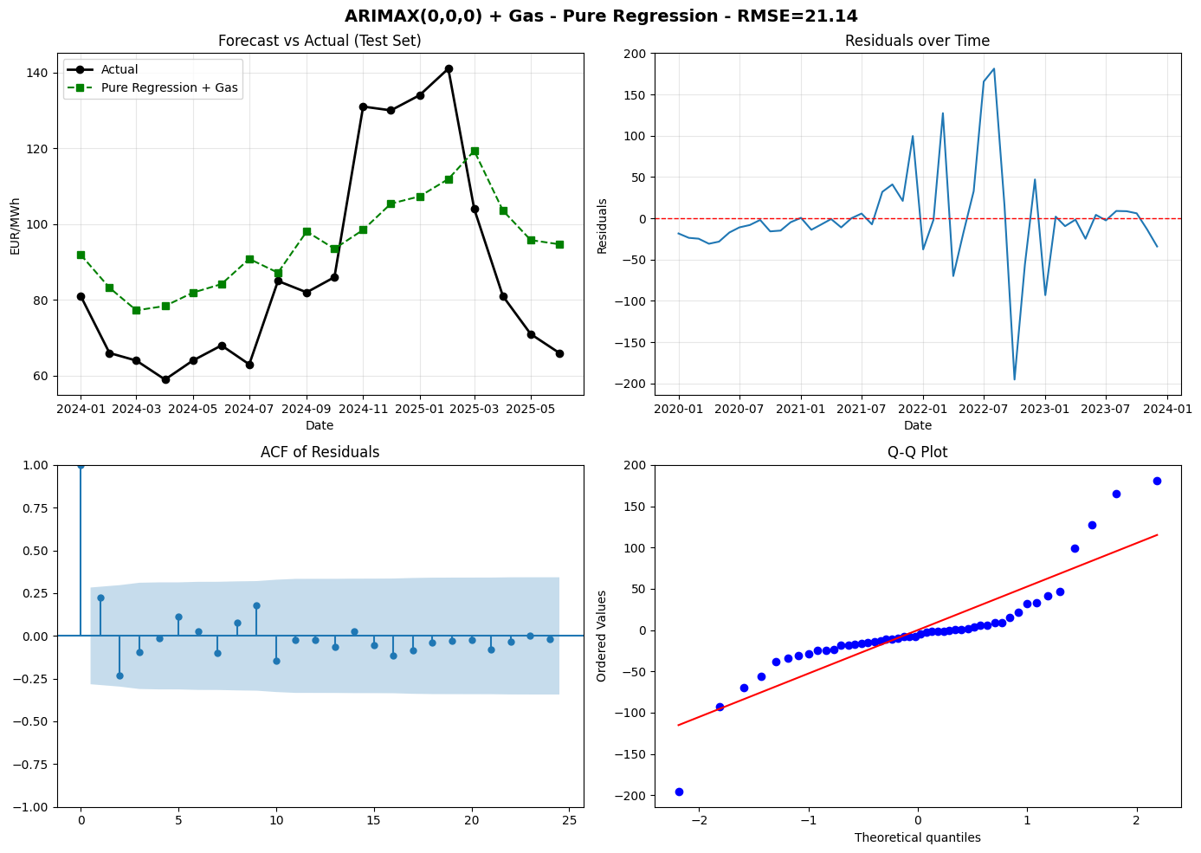
Details of Final Model
9
Notes:
Ljung-Box tests: Residuals are uncorrelated → Model captured all predictable patterns, see ACF of residuals
Heteroskedasticity in QQ Plot and Residuals over time, Error variance not constant → CI widths are likely understimated

Slide 10
Key Findings & Recommendations
Key Findings:
1 EUR drop in Gas prices ≈ 1,3 – 1,9 EUR drop in Electricity Price (95% CI)
Predicted future prices ≈ within +/- 17 EUR/MWh of prediction (95% CI)
True CIs likely higher, no verifiable trend
Contracting:
Monitor Gas Prices (OEGPI Indexed 1-month futures) as leading indicator for next 6 months.
Secure next long term (6 months+) contract at price below 89 EUR/MWh (Current mean).
Avoid shorter term contracts due to volatility
Test against (3,0,0) model, retrain in 12 month at the latest, log transform:
Current predictions are too inaccurate for precise forecasts
Changes in relationship between gas prices and electricity prices likely (regulatory changes, further exogenous shocks)
Longer training period will increase value of ARIMA(X) model again
Try log-transformation next time to better deal with variance
10

Slide 11
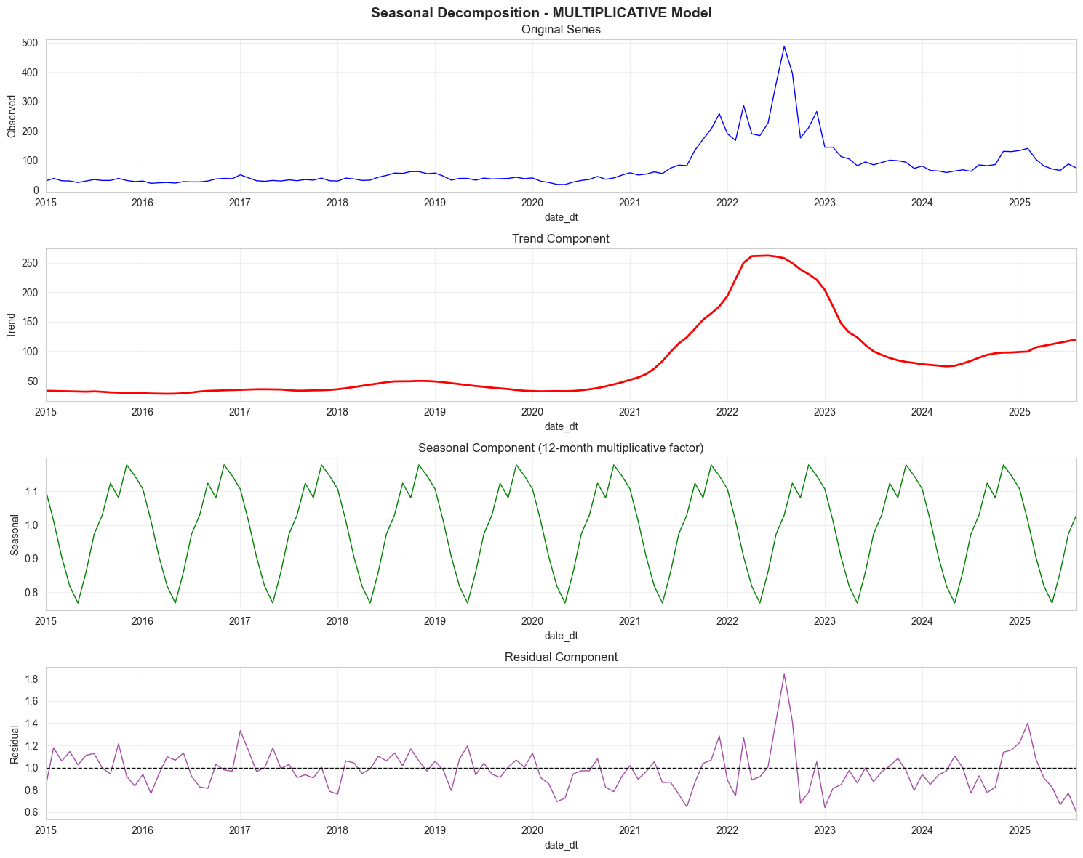
Time-Series Decomposition
<< longest possible >> training period ARIMAX
n=48
test
Period n=18
11
Notes:
You decompose a time series to get out the signal from the noise
Signals in time series are trends, or seasonal/cyclic patterns
To decompose you first find out: How does volatility look if the mean increases / if there is a trend?
If volatility increases with the mean, it´s most likely multiplicative, if it stays constant, its most likely additive.
Two tests comparing additive and multiplicative models:
1. See where residuals increase in trend an where they don´t (multiplicative model is marginally flatter).
2. See where fewer residuals remain after accounting for trend and seasonality (multiplicative model is better).
Electricity Price is multiplicative -> can be seen in increasing volatility with increasing means in all three phases
Then: Decomposition Trend Analysis
**Panel 2 - Trend:** > „decomposition_mult.trend() shows the 12m moving average price. And you can see the massive increase again
**Panel 3 - Seasonal:** > „decomposition_mult.seasonal() produces an average seasonal component over all years. Winter is on average 15% above Trend (1.15), Summer up to 25% below (0.75).
**Panel 4 - Residuals:** > „The residuals show the unexplained price movements in factors. In the stable periods they dont move above 0,8 or 1,2 around the expected value. During the price shock we have deviations of 80% above: So even after accounting for trend and seasonality there are massive residuals that need to be explained. A SARIMA model would not because it is my understanding that you model that using dummies and that means 12 additional parameters to estimate i.e. overfitting in my case

Slide 12
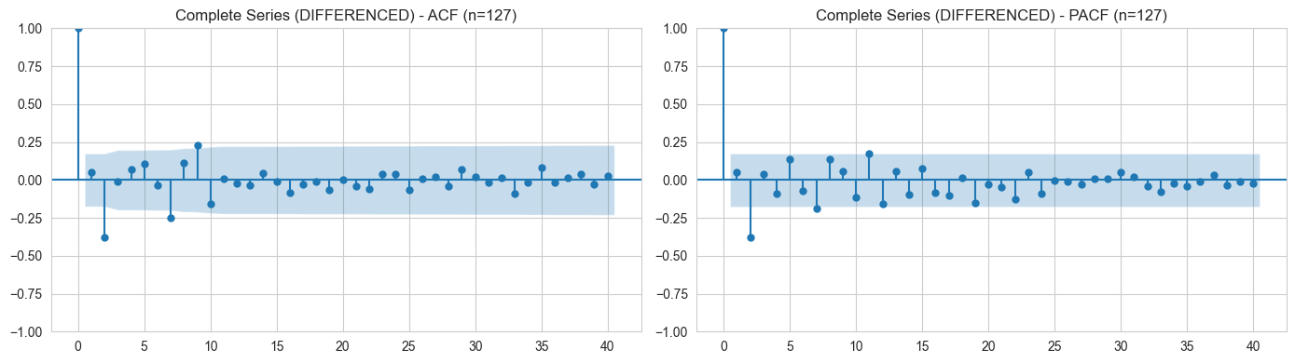
Determining (p,d,q)
Notes:
So, ARIMA are models written p, d, q
p… Autoregressive lag terms
d… differentiation (if you have non-stationary data)
q… Moving average lag terms
And you need to determine, how to model your predictions best.
I tested both models for the complete series and a reduced model over part of the non-stationary and the last stationary period to see what works better.
I differentiated the complete series for ACF and PACF (that´s why i only have n=127, differencing costs you the data point you use to establish the differences)
For the reduced model i differentiated the shock period only.
ACF: shows the total correlation that earlier prices have with my current price, but thaincludes both the direct effect of an earlier price as well as the indirect effects via all prices up to the current one. They are cumulative. So the further you go back, the more that specific influence gets „watered down“, as the effect decays.
PACF: only shows the direct correlation of each earlier price on current price. Directly inf. Of t-3 on t₀ or t-4 on t₀
The most prevalent rule of thumb i found was: If you need an AR model, you look at where the last lag cuts of sharply in the PACF, while ACF decays over time.
If you need an MA model, you look where the last lag cuts of sharply in the ACF while PACF decays over time.
ARMA models show complex behavior with decays over time.
How did I apply that?
This rule of thumb wasn´t very helpful for my messy, real-world data.
The differentiated complete time series showed very similar patterns in both cases, but significant coeff at lag 2.

Slide 13
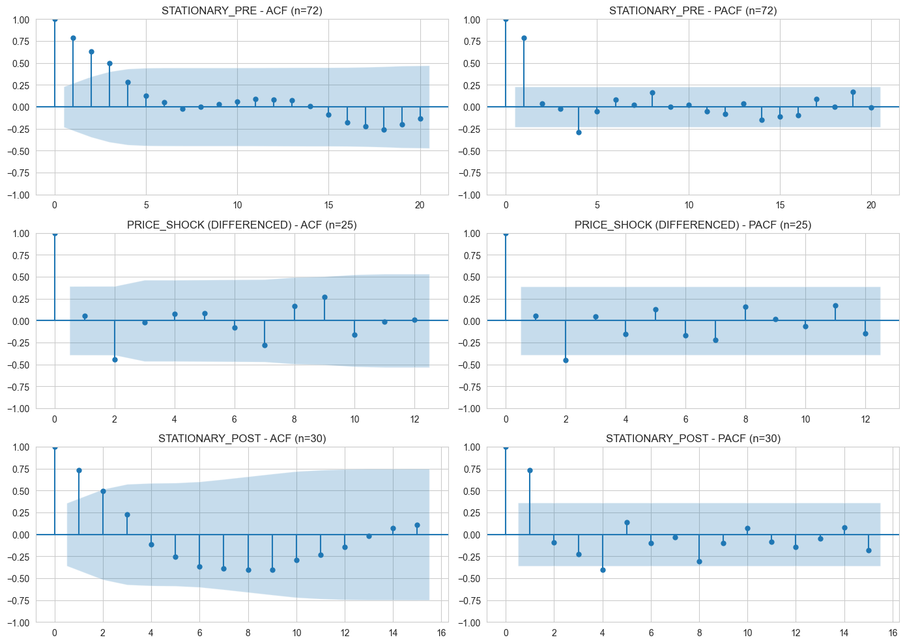
Determining (p,d,q)
Notes:
My test period has both a non-stationary and a stationary component.
The non-stationary component for the shock-period looks a lot like the complete time series, with a sig. negative coefficient at lag 2.
(i only have n=25 in the shock period, differencing costs you the data point you use to establish the differences)
The stationary post-shock component looks similar to the pre-shock-component: we have a nice decay in the ACF a significant coefficient at lag 1 and a negative one at lag 4.
That implies a AR model, but the negative lag 4 muddies the waters a bit. Is it that there is a seasonal component in there?
If it is a weak seasonal signal, maybe from some practice in the electricity market where you buy different products at the end of a business quarter, i couldn´t spot it in my EDA.
Also, i needed to account for the non-stationary component in my training data.
So once again, the rule-of-thumb wasn´t too helpful, because of my messy real-world data. So in the end i decided to do a grid search that would ensure that i accounted for both AR terms up to 3 and differencing terms.
And that got me the differenced ARIMA(2,1,0) for the complete time-series (not very good at dealing with volatility)
And the ARIMA(3,0,0) for the reduced model which to compare to the ARIMAX models.
(The most prevalent rule of thumb i found was: If you need an AR model, you look at where the last lag cuts of sharply in the PACF, while ACF decays over time.
If you need an MA model, you look where the last lag cuts of sharply in the ACF while PACF decays over time.
ARMA models show complex behavior with decays over time.)

Slide 14
Software Development – Pipeline
[01_electricity]
→ electricity_consolidated.csv (daily + weekly + monthly)
[02_carbon] + electricity → data_consolidated.csv (daily + weekly + monthly)
data_file
[notebook]
script.py
[03_climate]
+ consolidated → data_consolidated.csv (monthly only added)
[04_production] + consolidated → data_consolidated.csv (monthly only added)
manual
[05_gas] + consolidated → data_consolidated.csv (monthly only added)
[06_economy] + consolidated → data_consolidated.csv (monthly only added)
[EDA] + [feature_engineering]
data_consolidated.csv → data_analysis_ready.csv
[model_building] data_analysis_ready.csv → data_tableau.csv
2
12

Slide 15
Thank you!
paul.ringler@gmx.at https://github.com/Pringlebot/austrian_electricity_prices_capstone/tree/main

