Slide 1


SECURE AI-POWERED
PHISHING WEBSITE DETECTOR
Real-time Zero-Day Protection
A Multi-Modal Approach using Ensemble Learning and Explainable Intelligence (XAI).

Slide 2

Problem Statement :
Why existiions fail?
fas
dsaafTraditional blacklist-based systems cannot detect
There is able, and intelligent afdadfdphishing detection sy simultaafneously analyzes URL structure, webpage visual deasign, and provides transparent reasoning to the user. aeff
SECURE AI-POWERED
PHISHING WEBSITE DETECTOR
Real-time Zero-Day Protection
A Multi-Modal Approach using Ensemble Learning and Explainable Intelligence (XAI).
increasingly qerqwersophisticated, targeting users through:
Lookalike websiwefrqw
Fake
Xwofjwoagfn[q0wfj portals
Brand impersonation

Slide 3



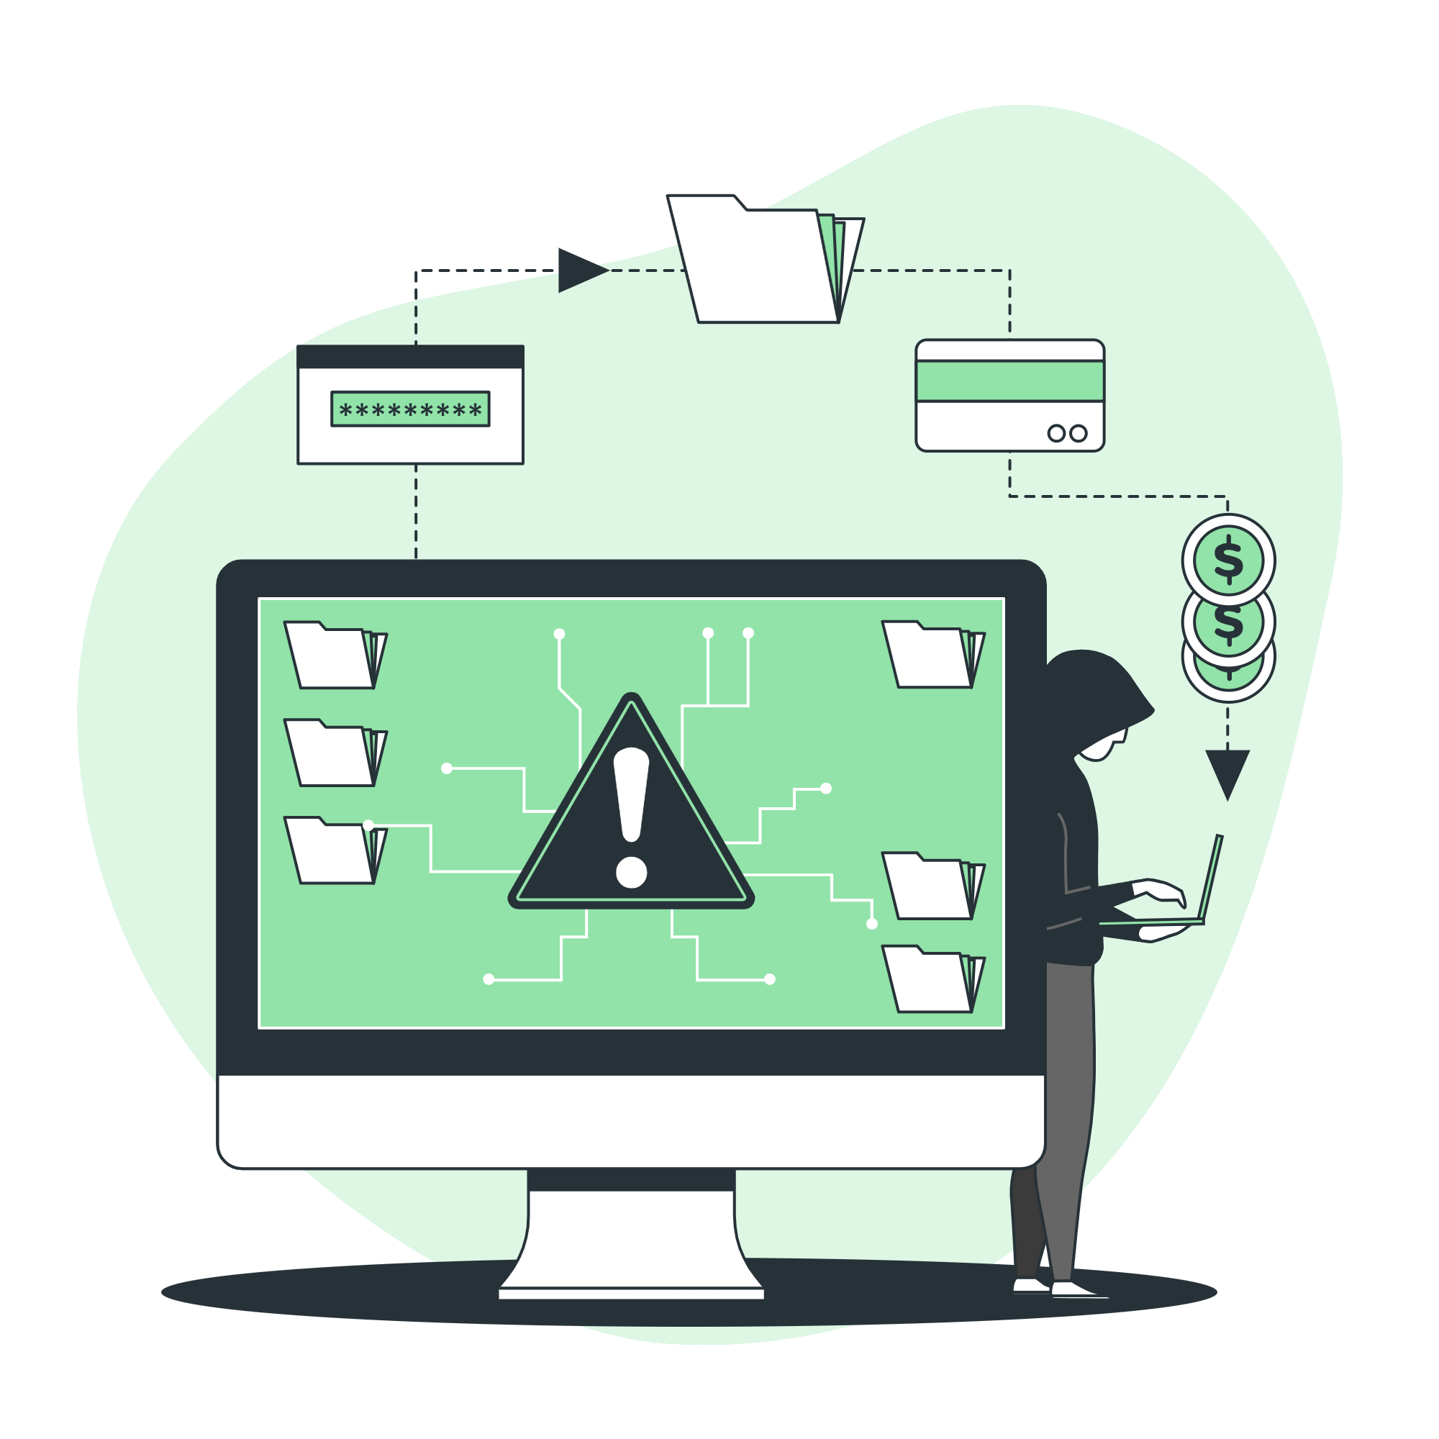

Problem Statement :
Why existing solutions fail?
Traditional blacklist-based systems cannot detect zero-day phishing websites
URL-only detection misses visual cloning
Browser warnings are non-explainable, reducing user trust
Indian users face phishing in regional languages and local brands
-------------------------------------------------------------
Core Problem?
There is no real-time, explainable, and intelligent phishing detection system that simultaneously analyzes URL structure, webpage visual design, and provides transparent reasoning to the user.
Phishing attacks are becoming increasingly sophisticated, targeting users through:
Lookalike websites
Fake login portals
Brand impersonation
URL obfuscation and shortening
AFTER
BEFORE

Slide 4
Proposed solution:
A hybrid AI-based phishing detection system that:
Works as a real-time Chrome Extension
Uses multi-modal AI analysis
Provides instant red/green warning
Explains why a website is suspicious using Explainable AI
Why existing solutions fail?
Traditional blacklist-based systems cannot detect zero-day phishing websites
URL-only detection misses visual cloning
Browser warnings are non-explainable, reducing user trust
Indian users face phishing in regional languages and local brands
-------------------------------------------------------------
Core Problem?
There is no real-time, explainable, and intelligent phishing detection system that simultaneously analyzes URL structure, webpage visual design, and provides transparent reasoning to the user.
BEFORE
AFTER
Phishing attacks are becoming increasingly sophisticated, targeting users through:
Lookalike websites
Fake login portals
Brand impersonation
URL obfuscation and shortening

Slide 5












System Architecture
Backend
URL & screenshot
Fast API
PYTHON
AI/ML
Safe
User Frontend
Suspicious
AFTER
BEFORE

Slide 6

















Tech Stack
● Scikit-learn
Tailwind
or
Backend
URL & screenshot
Fast API
PYTHON
AI/ML
Safe
User Frontend
Suspicious

