Slide 1
Implement Matrix Multiplication Using 8085 Assembly Language
WELCOME to OUR PROJECT

Slide 2
Our Project Group MemberS
Course Code : CSE360
Course Title : Computer Architecture
Section : 01
Submitted to :
Dr. Md. Nawab Yousuf Ali
Professor
Department of Computer Science & Engineering
East West University
Submitted By :
Name | ID | Roll
Tasmia Islam | 2021-2-60-062 | 26
Tasnim Israk Synthia | 2021-2-60-097 | 31
Prinom Mojumder | 2021-2-60-098 | 32
Jubaer Ahmed | 2021-2-60-139 | 39
Bahauddin Ahmed | 2020-1-60-271 | 3

Slide 3
Objective :
The main objective of this project is to implement an algorithm that multiplies two matrices and stores the resulting matrix.
To demonstrate the steps involved in performing arithmetic operations on matrix elements, which are accessed and stored in memory, and managing the indices to ensure the correct elements are accessed and stored during the computation.

Slide 4
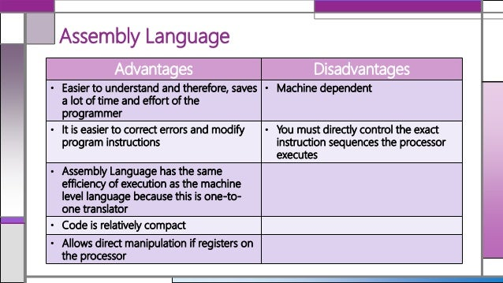
Theory

Slide 5
What Is 8085 Microprocessor ?
The 8085 microprocessor features an 8-bit architecture with a rich Instruction set for data manipulation and control operations.
What Is Matrix Multiplication?
It is the product of two matrices which produces a single matrix. It is a type of binary operation. To perform matrix multiplication, we should make sure that the number of columns of the 1st matrix is equal to the number of rows of the 2nd matrix. The algorithm is straightforward in high-level languages but needs careful handling of memory and registers in assembly language.

Slide 6
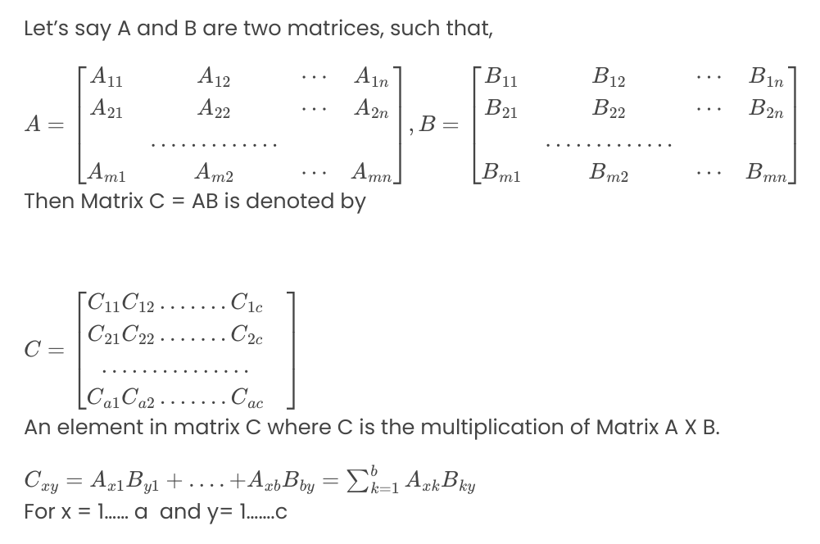
Formula :

Slide 7
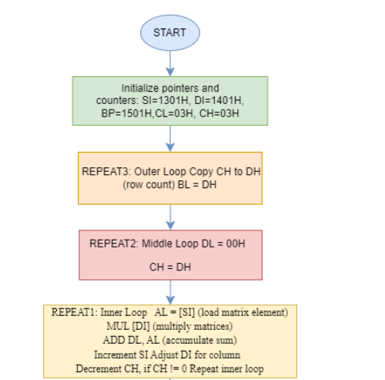
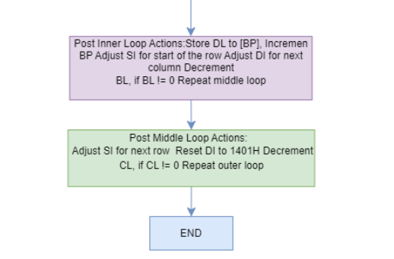
Design :

Slide 8
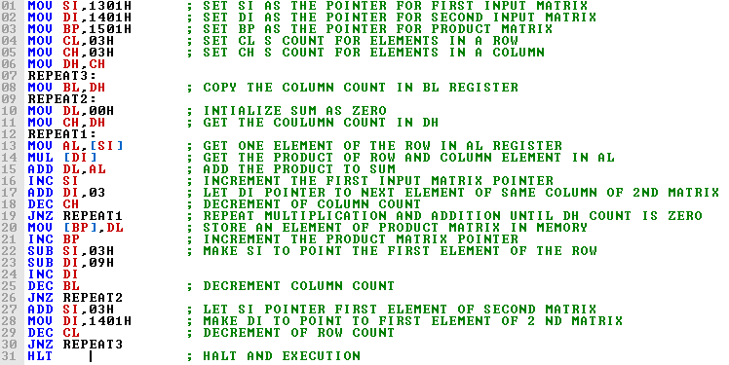
Implementation
In our project we used the emu8086 simulator software to perform the matrix multiplication. Which is the updated version of the 8085 assembly language.

Slide 9
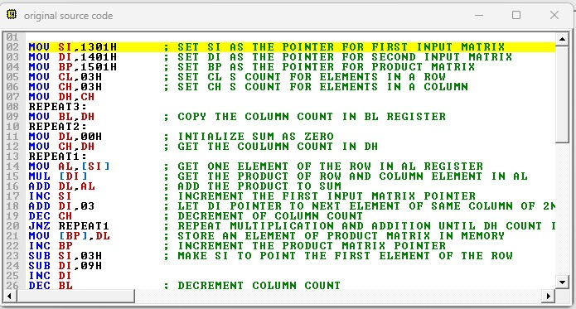
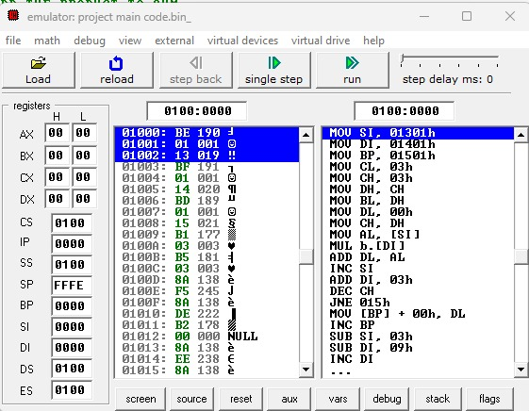
Debugging-Test-Run :
In the emu8086 compiler, we emulate the code. Then it shows two interfaces : ‘original source code’ and ‘emulator: project main code.bin_’.
fig 1 :1st interface of ‘orginal code source’
fig 2 : 2nd interface ‘emulator: project main code.bin_’

Slide 10
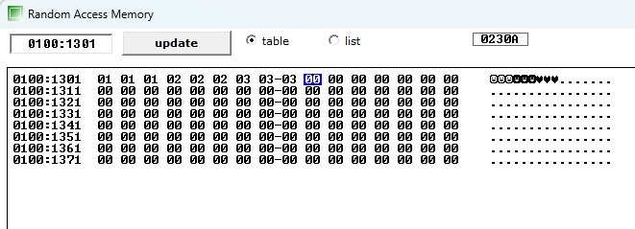
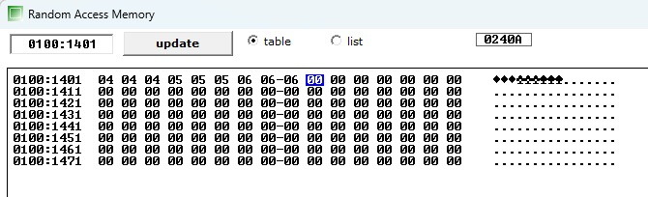
Input

Slide 11
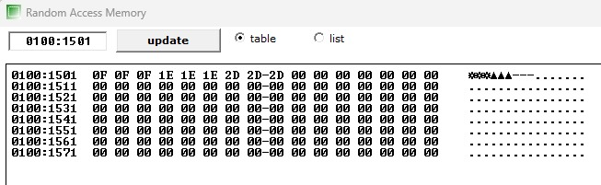
Output
we can see the changes in the ‘Random Access Memory’ that gives us the resultant matrix.

Slide 12

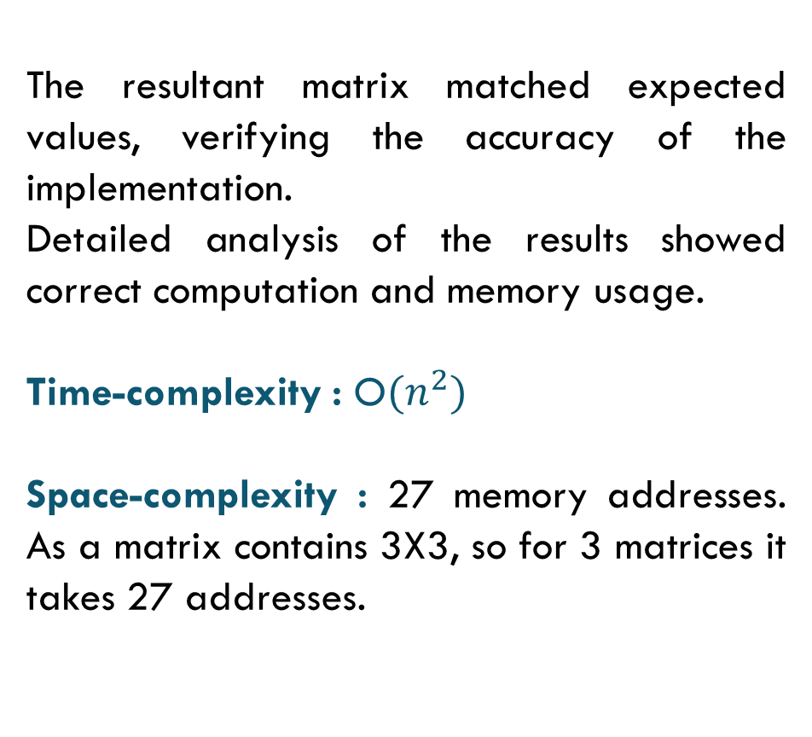
Result Analysis :
The resultant matrix matched expected values, verifying the accuracy of the implementation.
Detailed analysis of the results showed correct computation and memory usage.
Time-complexity : O$(n^{2})$
Space-complexity : 27 memory addresses. As a matrix contains 3X3, so for 3 matrices it takes 27 addresses.

Slide 13
Discussion :
Challenges :
Managing memory and registers efficiently within the constraints of the 8086 architecture.
Debugging and running assembly code.
Ensuring correct data handling and avoiding common issues like overwriting data.
Learnings :
Enhanced understanding of microprocessor architecture and low-level programming.
Appreciation for high-level programming languages that abstract these complexities, making programming more accessible and less error-prone.

Slide 14
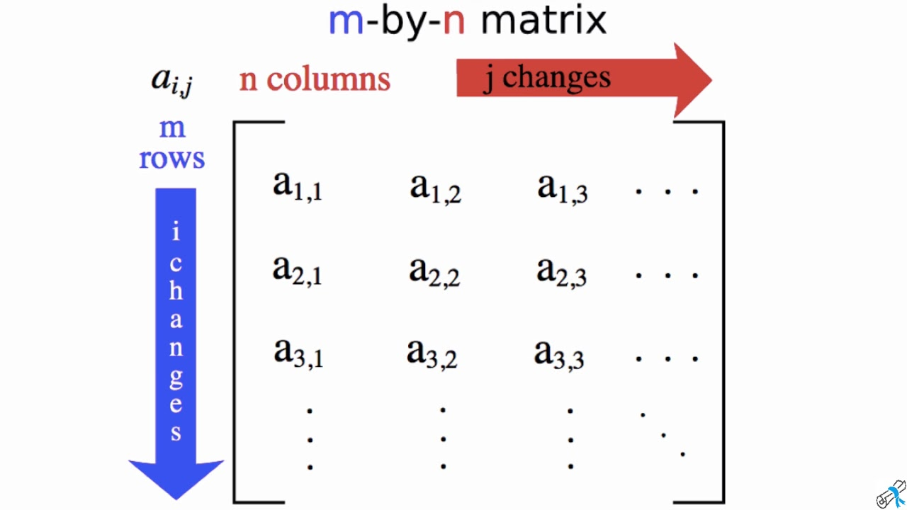
Conclution
The assembly language program for multiplying two 3X3 matrices show how basic concepts in low-level programming work, like using registers, accessing memory, and controlling loops. By writing and running this program, we learned how to multiply matrices directly using the hardware. The program passes through each row and column of the input matrices, performs the necessary calculations, and stores the results in the output matrix. This project highlights the need for careful planning and accuracy when programming in assembly language.

Slide 15
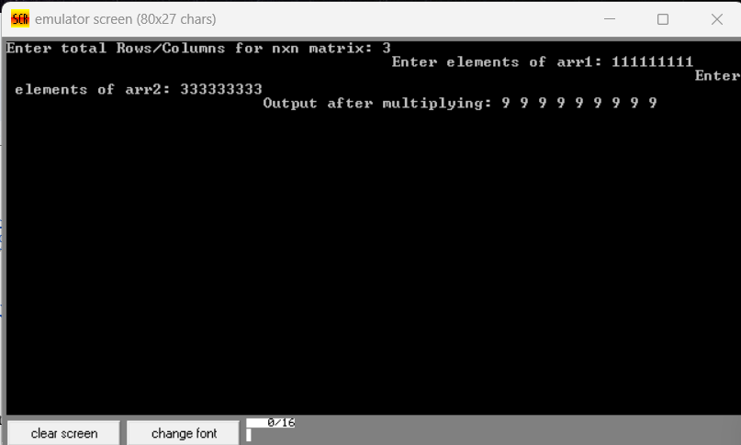
Future Improvements :
Handle different size of matrices, not only 3X3.
Speed can be optimized and Manage issues like memory overflow, invalid input sizes, etc.
Develop a library of common matrix operations in assembly language.
We can create a simple interface for users to input matrix values and see the results, using keyboard input and screen output

Slide 16

Thank you

