Slide 1

Submitted To: Md. Mozammel Huq Azad Khan Ph.D. Professor Department of Computer Science and Engineering
Mini Project- 2
Generating an Undirected Graph by Using a C Program
Group 6
SUBMITTED BY:
NAME | STUDENT ID
Prinom Mojumder | 2021-2-60-098
Ismail Mahmud Nur | 2021-2-60-052
Tithi Paul | 2021-2-60-057

Slide 2
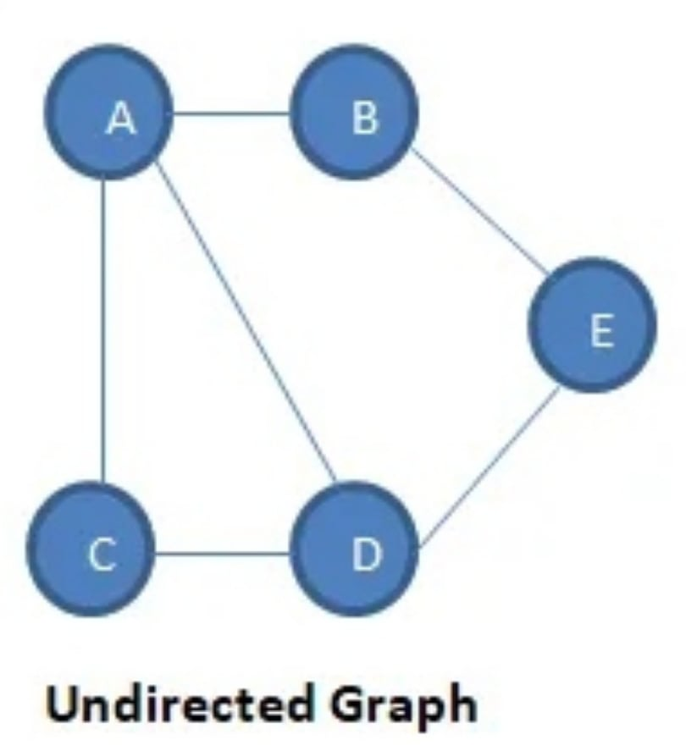
=>Undirected Graph
An undirected graph consists of a set of nodes and links connecting them. Each node is defined as a vertex, and each link is known as an edge, which links two vertices. The sequence in which the two connected vertices are connected is unimportant. An undirected graph is formed of a finite number of vertices and edges.

Slide 3
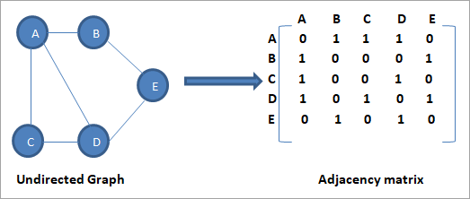
Adjacency matrix The adjacency matrix is a two-dimensional array of size V x V, where V is the number of graph vertices. A slot adj [i] [j] = 1 indicates that there is an edge from vertex i to vertex j in the 2D array adj [] []. For an undirected graph, the adjacency matrix is always symmetric. Weighted graphs are also represented using the adjacency matrix.

Slide 4

Handshaking Theorem Handshaking theorem states that the sum of degrees of the vertices of a graph is twice the number of edges.

Slide 5
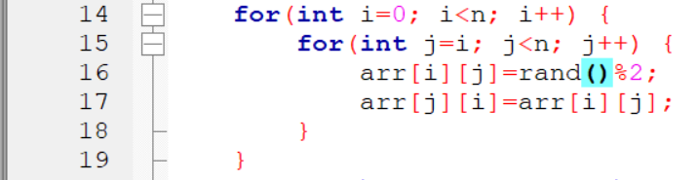
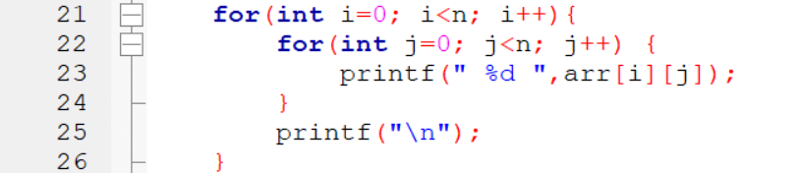
Analyzing some specific part of our C Code:
For generating a matrix with random number(0,1)
For printing the whole matrix

Slide 6
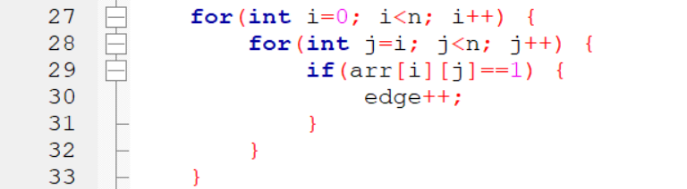
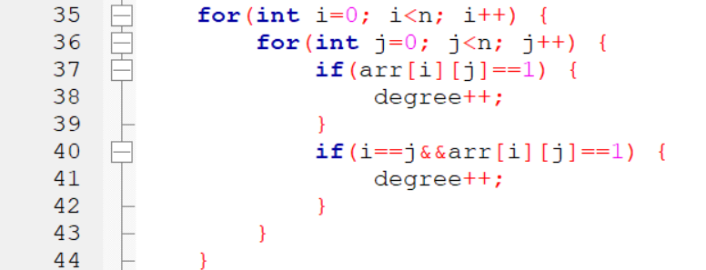
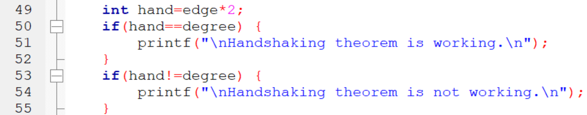
For calculating Edge-
For calculating Degree-
For proving that Handshaking Theorem is working -

Slide 7

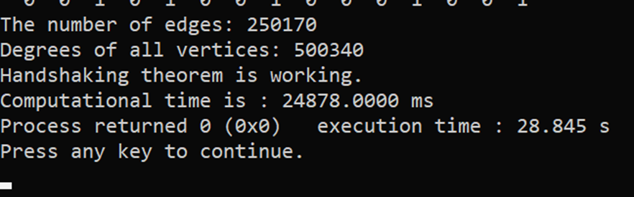

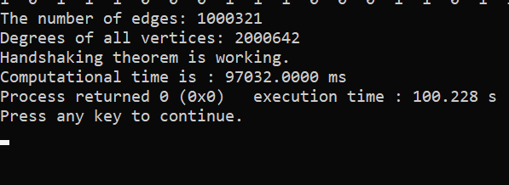
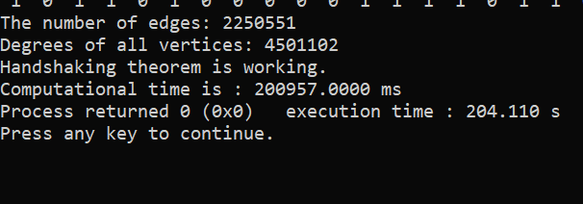
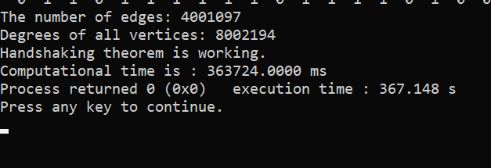
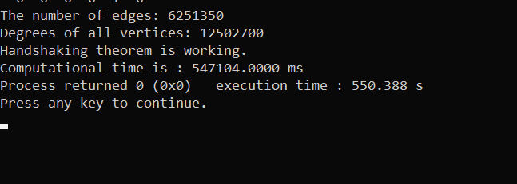
When, n=2000
When, n=3000
When, n=4000
When, n=5000

Slide 8
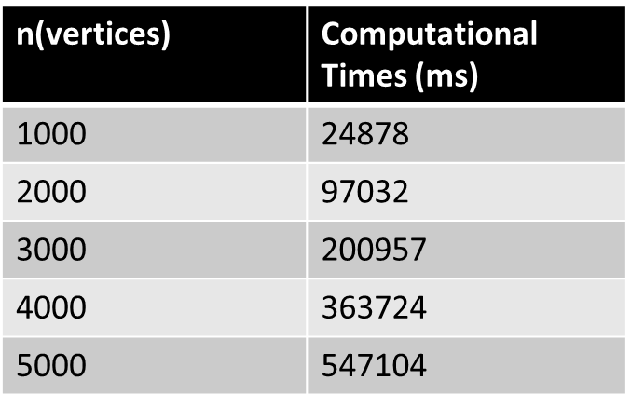
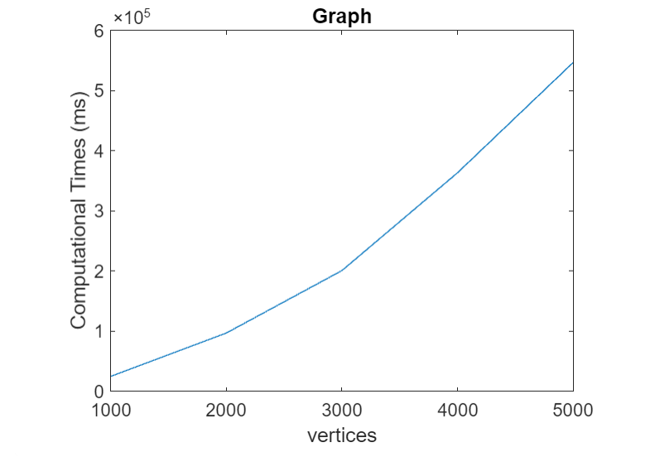
Graph of n(vertices) vs. Computational Time by using MATLAB
Data from Output of the program
(Graph- 1)

Slide 9
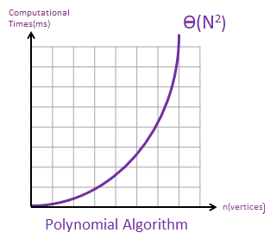
From this figure we see that, this graph has a similar increasing rate to a y = x² graph.
O(n²)
(Graph- 2)

Slide 10
Theoretical Computatiton of Time Complexity
For 1st nested for loop | Comparisons | Calculations
for i=0 to n-1 for j= i to n-1 | n + 1 n - i + 1 | n² + 2n - i.n – i + 1
For 2nd nested for loop | Comparisons | Calculations
for i=0 to n-1 for j=0 to n-1 | n+1 n+1 | n² + 2n + 1
For 3rd nested for loop | Comparisons | Calculations
for i=0 to n-1 for j=i to n-1 | n+1 n-i+1+1 | n²+3n-i.n-i+2
For 4th nested for loop | Comparisons | Calculations
for i=0 to n-1 for j=0 to n-1 | n+1 n+1+1+1 | n² + 4n + 3

Slide 11
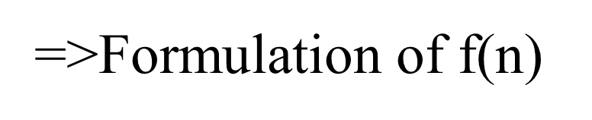
The total comparison of the function is,
f(n ) = f1 + f2 + f3 + f4
= n² + 2n - i.n – i + 1 + n² + 2n + 1 + n² + 3n - i.n – i +2+ n² + 4n + 3
= 4n²+12n - 2i.n - 2i + 7
Hence, we can say that the time complexity of our program is O(n) = n²

Slide 12
Comparison between two complexities
For every vertex(n), we found out a computational time in ms(milliseconds) from output of the code.
Using those data, we made the graph-1. The graph shows the vertex by x-axis and computational time by y-axis. We can measure a similar increased rate of y = x² in the graph.
From the calculation of f(n), we also found our computational time complexity which is O(n) = n²
From graph-2, we can see the increasing rate of O(n) = n² is approximate same as the increasing rate of y = x² curve.
Therefore, in both cases, we can see the same figure for the time complexity.

Slide 13
Thank You So Much For Your Time

