Slide 1
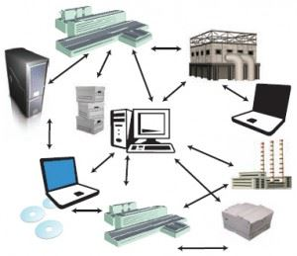

Unit-3
Synchronization and Naming
Distributed Operating System (DOS)
DU #2301CS718
Prof. Nidhi K Chitroda
Computer Engineering Department
Nidhi.chitroda@darshan.ac.in
9727747317

Slide 2

Outline
Synchronization
  Clock synchronization
  Logical Clocks
  Global State
  Mutual Exclusion
  Election Algorithms
  Deadlocks in DOS

Slide 3

Outline
Naming
  Features of Good naming
  Fundamental technologies and concepts
  System oriented names
  Object locating mechanism
  Human oriented names

Slide 4
Synchronization
Section - 1

Slide 5

Synchronization

Slide 6
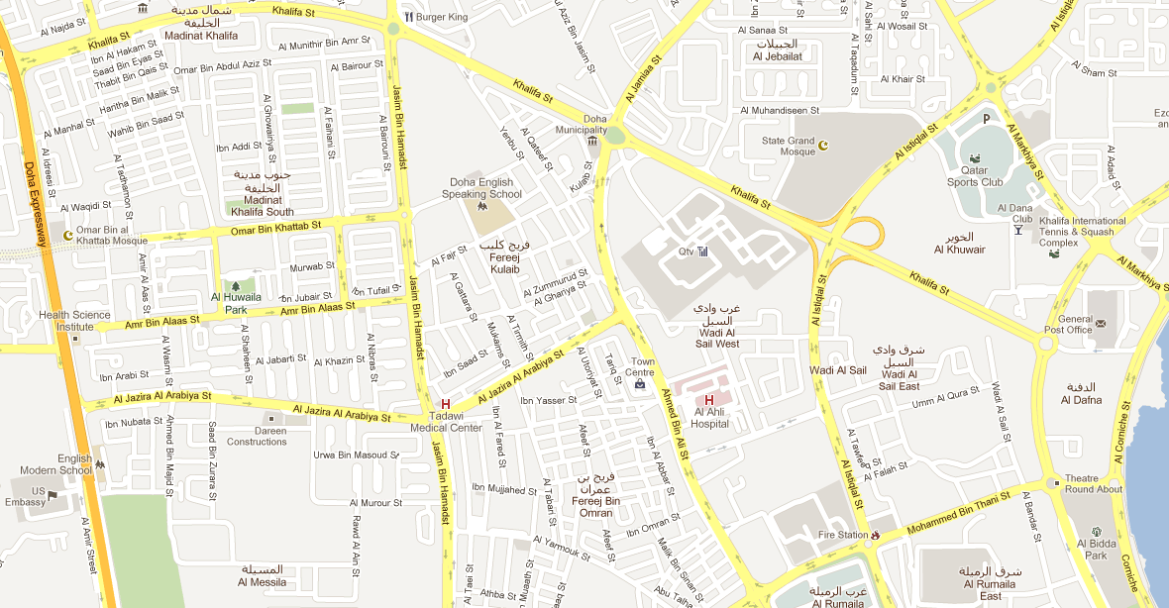

Need for Synchronization – An Example
Vehicle tracking in a City Surveillance System using a Distributed Sensor Network of Cameras
    Objective: To keep track of suspicious vehicles
    Camera Sensor Nodes are deployed over the city
    Each Camera Sensor that detects a vehicle reports the time to a central server
    Server tracks the movement of the suspicious vehicle
1:12 PM:
Car spotted
1:08 PM:
Car spotted
1:05 PM:
Car spotted
1:16 PM:
Car spotted
If the sensor nodes do not have a consistent version of the time, the vehicle cannot be reliably tracked
1:15 PM:
Car spotted
1:25 PM:
Car spotted
3:00 PM:
Car spotted
1:00 PM:
Car spotted
1:17 PM:
Car spotted
1:18 PM:
Car spotted

Slide 7
Need for Synchronization – An Example
Writing a file in a Distributed File System
Write data1 to file abc.txt at offset 0
Client A
Server
Client C
Distributed
File
abc.txt
Write data3 to file abc.txt at offset 1
Client B
Write data2 to file abc.txt at offset 1
  If the distributed clients do not synchronize their write operations to the distributed file, then the data in the file can be corrupted

Slide 8
Clock Synchronization
Section - 2

Slide 9
Clock Synchronization
Clock synchronization is a mechanism to synchronize the time of all the computers in a DS
It is often important to know when events occurred and in what order they occurred.
  Need to know when a transaction occurs.
  Online reservation system.
  E-mail sorting can be difficult if time stamps are incorrect.
In a non-distributed system dealing with time is trivial as there is a single shared clock, where all processes see the same time.
In a distributed system, on the other hand, each computer has its own clock.
Because no clock is perfect each of these clocks has its own skew which causes clocks on different computers to drift and eventually become out of sync.
  In centralized system, time is unambiguous
  In distributed system, time is not trivial

Slide 10
Coordinated Universal Time (UTC)
All the computers are generally synchronized to a standard time called Coordinated Universal Time (UTC)
    UTC is the primary time standard by which the world regulates clocks and time
UTC is broadcasted via the satellites
    UTC broadcasting service provides an accuracy of 0.5 msec
Computer servers and online services with UTC receivers can be synchronized by satellite broadcasts
    Many popular synchronization protocols in distributed systems use UTC as a reference time to synchronize clocks of computers

Slide 11
Tracking Time on a Computer
How does a computer keep track of its time?
    Each computer has a hardware timer
    The timer causes an interrupt ‘H’ times a second
    The interrupt handler adds 1 to its Software Clock (C)
    Issues with clocks on a computer
    In practice, the hardware timer is imprecise
It does not interrupt ‘H’ times a second due to material imperfections of the hardware and temperature variations
The computer counts the time slower or faster than actual time
    Loosely speaking, Clock Skew is the skew between:
The computer clock and the actual time (e.g., UTC)

Slide 12



Clock Skew
Clock Skew: Difference between two clocks at one point in time.
When the UTC time is t, let the clock on the computer have a time C(t)
Three types of clocks are possible
  Perfect clock:
    The timer ticks ‘H’ interrupts a second
    dC/dt = 1
  Fast clock:
    The timer ticks more than ‘H’ interrupts a second
    dC/dt > 1
  Slow clock:
    The timer ticks less than ‘H’ interrupts a second
    dC/dt < 1
$$\frac{dC}{dt}>1$$
$$\frac{dC}{dt}=1$$
15
Perfect clock
Fast Clock
10
Clock time, C_{p}(t)
Slow Clock
7
$$\frac{dC}{dt}<1$$
0
10
UTC, t
UTC= Coordinated Universal Time

Slide 13

Clock Skew
Frequency of the clock is defined as the ratio of the number of seconds counted by the software clock for every UTC second
Frequency = dC/dt
Skew of the clock is defined as the extent to which the frequency differs from that of a perfect clock
Skew = dC/dt – 1
Hence,
$$\frac{dC}{dt}>1$$
$$\frac{dC}{dt}=1$$
15
Perfect clock
Fast Clock
10
Clock time, C_{p}(t)
Slow Clock
7
$$\frac{dC}{dt}<1$$
0
10
UTC, t

Slide 14


Drifting of Clock
Synchronization techniques
    External Synchronization : Synchronization with real time (external) clocks.
    Mutual (Internal) Synchronization : For consistent view of time across all nodes of the system
8:01:24
8:01:48
Skew = +84 seconds
+84 seconds/35 days
Drift = +2.4 sec/day
Oct 23, 2016
8:00:00
Skew = +108 seconds
+108 seconds/35 days
Drift = +3.1 sec/day

Slide 15
Dealing with Drift
Assume we set computer to true time. (It is not good idea to set clock back.)
    Illusion of time moving backwards can confuse message ordering and software development environments.
There should be go for gradual clock correction.
    If fast: Make clock run slower until it synchronizes.
    If slow: Make clock run faster until it synchronizes.
Operating System can change rate at which it requests interrupts.
    if system requests interrupts every 14 msec but clock is too slow: request interrupts at 12 msec.
Software correction: Redefine the interval.

Slide 16
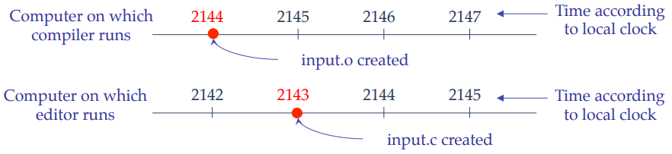
Dealing with Drift
In a distributed system, achieving agreement on time is not easy.
Assume no global agreement on time. Let’s see what happens:
Assume that the compiler and editor are on different machines
  input.o has time 2144 msec
  input.c is modified but is assigned time 2143 msec because the clock on its machine is slightly behind.
  Make will not call the compiler.
The resulting executable will have a mixture of object files from old and new sources.

Slide 17
Physical Clocks
It is impossible to guarantee that crystals in different computers all run at exactly the same frequency. This difference in time values is clock skew.
“Exact” time was computed by astronomers
    The difference between two transits of the sun is termed a solar day.
    Divide a solar day by 24*60*60 yields a solar second.
However, the earth is slowing! (35 days less in a year over 300 million years)
There are also short-term variations caused by turbulence deep in the earth’s core.
    A large number of days (n) were used to the average day length, then dividing by 86,400 to determine the mean solar second.

Slide 18
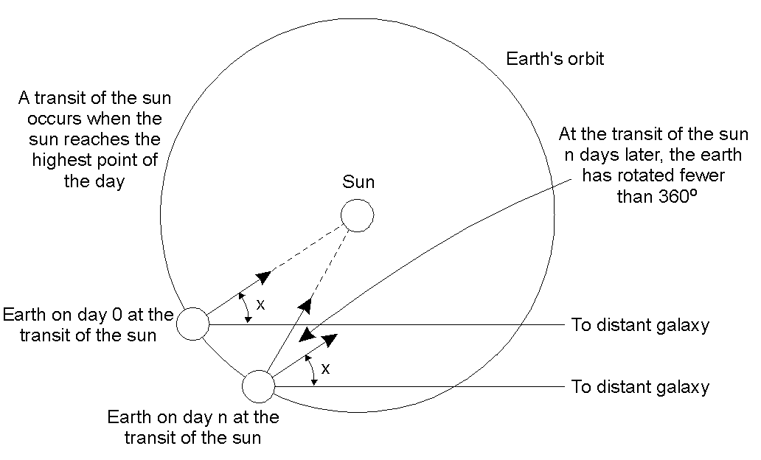
Physical Clocks
Computation of the mean solar day.

Slide 19
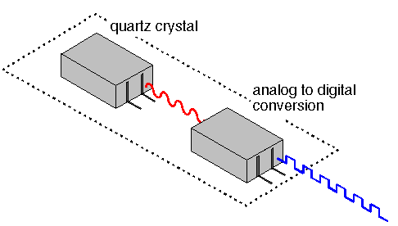
Physical Clocks
How Computer Clocks Are Implemented ?
A computer clock usually consists of three components
    A quartz crystal that oscillates at a well-defined frequency,

Slide 20
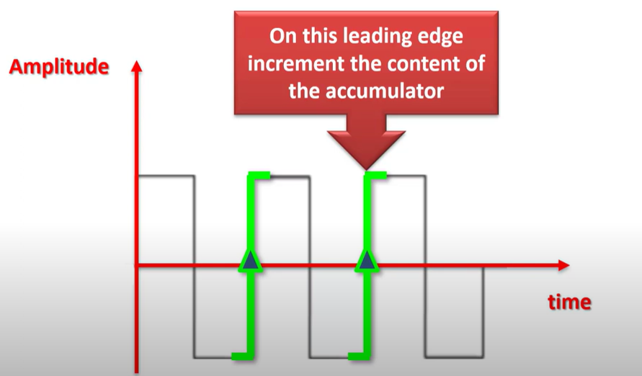
Physical Clocks
How Computer Clocks Are Implemented ?
A computer clock usually consists of three components
    A quartz crystal that oscillates at a well-defined frequency,
    A constant register - used to store a constant value that is decided based on the frequency of oscillation of the quartz

Slide 21
Physical Clocks
How Computer Clocks Are Implemented ?
A computer clock usually consists of three components
    A quartz crystal that oscillates at a well-defined frequency,
    A constant register - used to store a constant value that is decided based on the frequency of oscillation of the quartz
    A counter register - is used to keep track of the oscillations of the quartz crystal.
The value in the counter register is decremented by 1 for each Oscillation of the quartz crystal. When the value of the counter register becomes zero, an interrupt is generated and its value is reinitialized to the value in the constant register.
Each interrupt is called a clock tick.

Slide 22


Synchronization to a time server
Suppose a server with an accurate clock (e.g., GPS-receiver)
    Could simply issue an RPC to obtain the time:
But this doesn’t account for network latency
    Message delays will have outdated server’s answer
Client
Server
Time of day?
2:50 PM
Time ↓

Slide 23
Cristian’s Algorithm
Flaviu Cristian (in 1989) provided an algorithm to synchronize networked computers with a time server
The basic idea:
    Identify a network time server that has an accurate source for time (e.g., the time server has a UTC receiver)
    All the clients contact the network time server for synchronization
However, the network delays incurred when the client contacts the time server results in outdated time
    The algorithm estimates the network delays and compensates for it

Slide 24
Cristian’s Algorithm
Client Cli sends a request to Time Server Ser, time stamped its local clock time T1
Ser will record the time of receipt T2 according to its local clock
  dTreq is network delay for request transmission
Server
Time Server Ser
T2
T3
T1
T1, T2, T3
Client
Client Cli
T1
T4
dTreq
dTres
Ser replies to Cli at its local time T3, piggybacking T1 and T2
Cli receives the reply at its local time T4
    dTres is the network delay for response transmission
Now Cli has the information T1, T2, T3 and T4
Assuming that the transmission delay from Cli→Ser and Ser→Cli are the same
T2-T1 ≈ T4–T3

Slide 25
Cristian’s Algorithm
Note times:
    Request sent: T0
    Reply received: T1
Assume network delays are symmetric.
Client sets time to:
T_{server}
server
request
reply
client
T₀
T₁
time
$$\frac{T_{1 }−T_{0}}{2}$$
= estimated overhead
in each direction
$$T_{new }=T_{server }+\frac{T_{1 }−T_{0}}{2}$$

Slide 26
Cristian’s Algorithm
T_{server}
server
request
reply
client
T₀
T₁
time
I = server processing time
$$T_{new }=T_{server }+\frac{T_{1 }−T_{0}−I}{2}$$

Slide 27
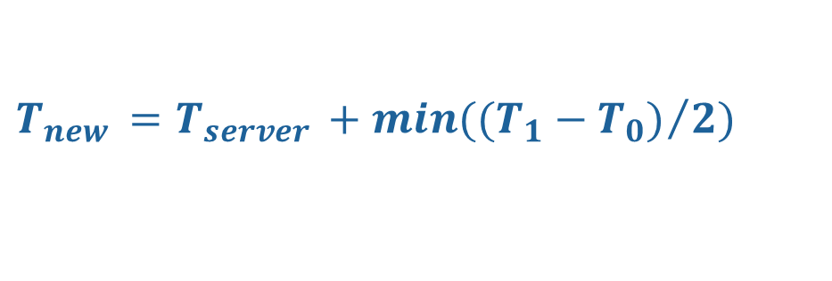
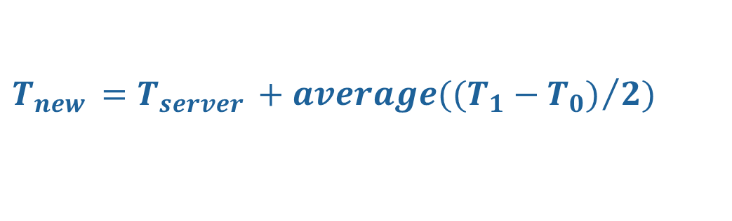
Cristian’s Algorithm
T_{server}
server
request
reply
client
T₀
T₁
time
Several measurements of $\left(T_{1}−T_{0}\right)$ are made, those measurements for which $\left(T_{1}−T_{0}\right)$ exceeds some threshold value are considered to be unreliable and discarded.
Average of the remaining measurements is then calculated.
Alternatively, the measurement for which the value of $\left(T_{1}−T_{0}\right)$ is minimum is considered to be the most accurate one.
$$min({(T_{1}−T_{0})}/2)$$
$$T_{new }=T_{server }+min({(T_{1}−T_{0})}/2)$$
$$average({(T_{1}−T_{0})}/2)$$
$$T_{new }=T_{server }+average({(T_{1}−T_{0})}/2)$$

Slide 28
Error Bounds in Cristian’s Algorithm
T_{server}
server
request
reply
client
T₀
T₁
time
T_{min}
T_{min}
Earliest time message arrives
Latest time message leaves
range = T₁-T₀-2T_{min}
Accuracy of Result =
$±\frac{T_{1 }−T_{0}}{2} −$ $T_{min }$

Slide 29
Cristian’s Algorithm
Assumption about packet transmission delays:
    Cristian’s algorithm assumes that the round-trip times for messages exchanged over the network are reasonably short
    The algorithm assumes that the delay for the request and response are equal
    Cristian’s algorithm is intended for synchronizing computers within intranets
A probabilistic approach for calculating delays:
    There is no tight bound on the maximum drift between clocks of computers
Time server failure or faulty server clock:
    Faulty clock on the time server leads to inaccurate clocks in the entire DS
    Failure of the time server will render synchronization impossible

Slide 30
Berkeley Algorithm
A single time server can fail, blocking timekeeping
The Berkeley algorithm is a distributed algorithm for timekeeping
Assumes all machines have equally-accurate local clocks
Obtains average from participating computers and synchronizes clocks to that average
Time server periodically sends a message (“time=?”) to all computers in the group.
Each computer in the group sends its clock value to the server.
Server has prior knowledge of propagation time from node to server.
Time server readjusts the clock values of the reply messages using propagation time & then takes fault tolerant average.
The time server readjusts its own time & sends the adjustment (positive or negative) to each node.

Slide 31

Berkeley Algorithm
Approach:
A time server periodically (approx. once in 4 minutes) sends its time to all the computers and polls them for the time difference
The computers compute the time difference and then reply
The server computes an average time difference for each computer
The server commands all the computers to update their time (by gradual time synchronization)
3:05
3:00
3:00
3:00
+0:00
+0:05
  At 3:00, the time daemon tells the other machines its time and asks for theirs.
  They respond with how far ahead or behind the time daemon they are.
  The time daemon computes the average and tells each machine how to adjust its clock
Time server
+0:15
-0:20
-0:10
+0:25
3:05
2:50
3:05
3:25

Slide 32
Network Time Protocol (NTP)
NTP is an Application layer protocol
  The NTP service is provided by a network of servers located across the Internet.
  Uses standard UDP Internet transport protocol
  Adjust system clock as close to UTC as possible over the Internet.
  Enable sufficiently frequently resynchronizations
  Primary servers are connected directly to a time source (e.g. a radio clock receiving UTC, GPS) of clients and servers.
  The servers are connected in a logical hierarchy called a synchronization subnet.
T₁
T₂
B
req
resp
A
T₀
T₃
Δ₁
Δ₂

Slide 33
Network Time Protocol (NTP)
NTP defines an architecture for a time service and a protocol to distribute time information over the Internet
In NTP, servers are connected in a logical hierarchy called synchronization subnet
The levels of synchronization subnet is called strata
    Stratum 1 servers have most accurate time information (connected to a UTC receiver)
    Servers in each stratum act as time servers to the servers in the lower stratum

Slide 34
Hierarchical organization of NTP Servers
Stratum 1
  This stratum contains the primary servers that are directly connected to the UTC receivers
Stratum 2
  Stratum 2 are secondary servers that are synchronized directly with primary servers
More accurate time
Stratum 3
  Stratum 3 synchronizes with Stratum 2 servers
Last stratum
  End user computers synchronize with the servers in the upper layer stratum

Slide 35
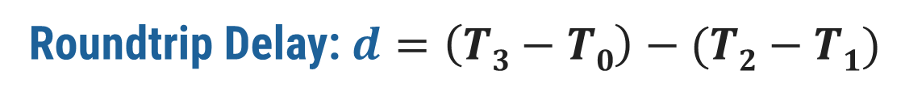
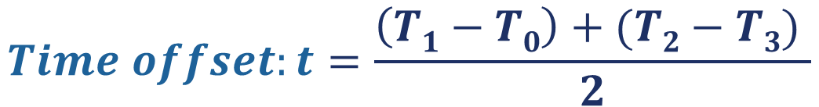
Network Time Protocol (NTP)
Let’s consider the following example with 2 machines A and B:
  First, A sends a request timestamped with value T₀ to B.
  B, as the message arrives, records the time of receipt T₁ from its own local clock and responses with a message timestamped with T₂, piggybacking the previously recorded value T₁.
  Lastly, A, upon receiving the response from B, records the arrival time T₃.
  To account for the time delay in delivering messages, we calculate Δ₁ = T₁-T₀, Δ₂ = T₃-T₂.
  Now, an estimated offset of A relative to B is:
  Based on t, we can either slow down the clock of A or fasten it so that the two machines can be synchronized with each other.
T₁
T₂
B
Roundtrip Delay: $d=\left(T3−T0\right)−(T2−T1)$
req
resp
$$Time offset:t=\frac{\left(T1−T0\right)+(T2−T3) }{2}$$
A
T₀
T₃
Δ₁
Δ₂

Slide 36
Logical Clocks
Section - 3

Slide 37
Logical Clocks
If two machines do not interact, there is no need to synchronize them.
    What usually matters is that processes agree on the order in which events occur rather than the time at which they occurred
Many times, it is sufficient if processes agree on the order in which the events have occurred in a DS
    For example, for a distributed make utility, it is sufficient to know if an input file was modified before or after its object file
    Logical clocks are used to define an order of events without measuring the physical time at which the events occurred
    Two types of logical clocks:
    Lamport’s Logical Clock (or simply, Lamport’s Clock)
    Vector Clock

Slide 38
Lamport’s Logical Clock
Lamport advocated maintaining logical clocks at the processes to keep track of the order of events
To synchronize logical clocks, Lamport defined a relation called “happened-before”
The expression a → b (reads as “a happened before b”) means that all entities in a DS agree that event a occurred before event b

Slide 39
The Happened-before Relation
The happened-before relation can be observed directly in two situations:
  If a and b are events in the same process, and a occurs before b, then a→b is true
  If a is an event of message m being sent by a process, and b is the event of m (i.e., the same message) being received by another process, then a→b is true
  The happened-before relation is transitive
    If a→b and b→c, then a→c

Slide 40
Properties of Logical Clock
From the happened-before relation, we can infer that:
    If two events a and b occur within the same process and a → b, then C(a) and C(b) are assigned time values such that C(a) < C(b)
    If a is the event of sending message m from one process (say P1), and b is the event of receiving m (i.e., the same message) at another process (say, P2), then:
    The time values C1(a) and C2(b) are assigned in a way such that the two processes agree that C1(a) < C2(b)
The clock time C must always go forward (increasing), and never backward (decreasing)

Slide 41

Synchronizing Logical Clocks
    Three processes P1, P2 and P3 running at different rates
    If the processes communicate between each other, there might be discrepancies in agreeing on the event ordering
    Ordering of sending and receiving messages m1 and m2 are correct
    However, m3 and m4 violate the happened-before relationship
P1
P2
P3
0
0
0
6
m1
8
10
12
16
20
18
24
m2
30
24
32
x
40
30
40
50
36
x
48
m3
60
42
56
70
48
m4
64
80
54
72
90
60
80
100

Slide 42
Lamport’s Clock Algorithm
    When a message is being sent:
    Each message carries a timestamp according to the sender’s logical clock
    When a message is received:
    If the receiver logical clock is less than the message sending time in the packet, then adjust the receiver’s clock such that:
    currentTime = timestamp + 1
P1
P2
P3
0
0
0
6
8
10
12
16
20
18
24
30
24
32
40
30
40
m3:60
50
36
48
60
42
56
m4:69
61
70
48
64
69
80
54
54
70
72
77
90
60
76
80
85
100

Slide 43
Implementation of Lamport’s Clock
Each process Pi maintains a local counter Ci and adjusts this counter according to the following rules:
For any two successive events that take place within Pi, Ci is incremented by 1
Each time a message m is sent by process Pi , m is assigned a timestamp ts(m) = Ci
Whenever a message m is received by a process Pj, Pj adjusts its local counter Cj to max(Cj, ts(m)) + 1

Slide 44
Implementation of Lamport’s Clock
Each process P_{i} maintains a local counter C_{i} and adjusts this counter according to the following rules:
  For any two successive events that take place within P_{i}, C_{i} is incremented by 1
  Each time a message m is sent by process P_{i} , m is assigned a timestamp ts(m) = Ci
  Whenever a message m is received by a process P_{j}, P_{j} adjusts its local counter C_{j} to max(Cj, ts(m)) + 1
C₀=0
C₀=1
C₀=2
P₀
m:2
C₁=0
C₁=3
P₁
C₂=0
P₂

Slide 45
Vector Clocks
  Vector clock was proposed to overcome the limitation of Lamport’s clock
    The property of inferring that a occurred before b is known as the causality property
A vector clock for a system of N processes is an array of N integers
Every process P_{i} stores its own vector clock VC_{i}
    Lamport’s time values for events are stored in VC_{i}
    VC_{i} (a) is assigned to an event a
If VC_{i}(a) < VC_{i}(b), then we can infer that a→b (or more precisely, that event a causally preceded event b)

Slide 46
Updating Vector Clocks
Vector clocks are constructed as follows:
  VC_{i}[i] is the number of events that have occurred at process P_{i} so far
      VC_{i}[i] is the local logical clock at process P_{i}
  If VC_{i}[j]= k, then P_{i} knows that k events have occurred at P_{j}
      VC_{i}[j] is P_{i}’s knowledge of the local time at P_{j}
Increment VC_{i} whenever a new event occurs
Pass VC_{j} along with the message

Slide 47
Vector Clock Update Algorithm
Whenever there is a new event at P_{i}, increment VC_{i}[i]
When a process P_{i} sends a message m to P_{j}:
  Increment VC_{i}[i]
  Set m’s timestamp ts(m) to the vector VC_{i}
When message m is received process P_{j} :
  VC_{j}[k] = max(VC_{j}[k], ts(m)[k]) ; (for all k)
  Increment VC_{j}[j]
VC₀=(0,0,0)
VC₀=(1,0,0)
VC₀=(2,0,0)
P₀
m:(2,0,0)
VC₁=(0,0,0)
VC₁=(2,1,0)
P₁
VC₂=(0,0,0)
P₂

Slide 48
Inferring Events with Vector Clocks
Let a process P_{i} send a message m to P_{j} with timestamp ts(m), then:
  Pj knows the number of events at the sender Pi that causally precede m
    ts(m)[i] denotes the number of events at P_{i}
  Pj also knows the minimum number of events at other processes Pk that causally precede m
    ts(m)[k] denotes the minimum number of events at P_{k}
VC₀=(0,0,0)
VC₀=(1,0,0)
VC₀=(2,0,0)
P₀
m:(2,0,0)
VC₁=(0,0,0)
VC₁=(0,1,0)
VC₁=(2,2,0)
VC₁=(2,3,0)
P₁
VC₂=(0,0,0)
m’:(2,3,0)
VC₂=(2,3,1)
P₂

Slide 49
Enforcing Causal Communication
Assume that messages are multicast within a group of processes, P₀, P₁ and P₂
To enforce causally-ordered multicasting, the delivery of a message m sent from P_{i} to P_{j} can be delayed until the following two conditions are met:
  ts(m)[i] = VCj[i] + 1 (Condition I)
  ts(m)[k] <= VCj[k] for all k != i (Condition II)
Assuming that P_{i} only increments VC_{i}[i] upon sending m and adjusts VC_{i}[k] to max{VC_{i}[k], ts(m)[k]} for each k upon receiving a message m’
P₀
VC₀=(0,0,0)
VC₀=(1,0,0)
VC₀=(2,2,0)
m:(1,0,0)
m:(1,2,0)
P₁
VC₁=(0,0,0)
VC₁=(1,1,0)
VC₁=(1,2,0)
P₂
VC₂=(0,0,0)
VC₂=(1,0,1)
VC₂=(1,2,2)
VC₂=(1,2,1)
Condition II does not hold ➔ Delay delivery

Slide 50
Mutual Exclusion
Section - 4

Slide 51






Critical Section & Mutual Exclusion

Slide 52



Critical Section & Mutual Exclusion
Example
  Printer is used by Process P1.
  Before this process release printer.
  Process P2 comes and it also wants to use printer
  But it should not be allowed to use printer.
  As Printer is used by Process P1.
P2
P1

Slide 53
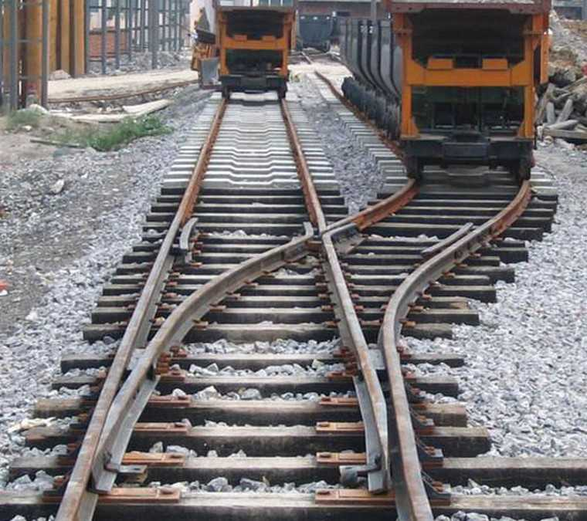

Mutual Exclusion
Mutual Exclusion: Way of making sure that if one process is using a shared variable or file; the other process will be excluded (stopped) from doing the same thing.

Slide 54
Mutual Exclusion
In single-processor systems, critical regions are protected using semaphores, monitors, and similar constructs.
In distributed systems, since there is no shared memory, these methods cannot be used.
Mutual exclusion: Concurrent access of processes to a shared resource or data is executed in mutually exclusive manner.
Only one process is allowed to execute the critical section (CS) at any given time.
In a distributed system, shared variables (semaphores) or a local kernel cannot be used to implement mutual exclusion.
Message passing is the sole means for implementing distributed mutual exclusion

Slide 55
Critical Section
The sections of a program that need exclusive access to shared resources are referred to as critical sections.
Mutual Exclusion : Prevent processes from executing concurrently with their associated critical section.
Requirement :
Mutual exclusion: At anytime only one process should access the resource.
  A process can get another resource first releasing its own.
No starvation: if every process that is granted the resource eventually release it, every request must be eventually granted.

Slide 56
Types of Distributed Mutual Exclusion
Mutual exclusion algorithms are classified into two categories
Request to access
  1. Permission-based Approaches
    A process, which wants to access a shared resource, requests the permission from one or more coordinators
  2. Token-based Approaches
    Each shared resource has a token
    Token is circulated among all the processes
    A process can access the resource if it has the token
Coordinator
C1
Client 1
Grant
Server
P1
Resource
Access
Server
Resource
Access
Access
Access
Client 1
Client 2
Client 3
P1
P2
P3
Token
Token
Token

Slide 57
Permission-based Approaches
There are two types of permission-based mutual exclusion algorithms
  Centralized Algorithms
  Decentralized Algorithms

Slide 58
Centralized Mutual Exclusion Algorithm
One process is elected as a coordinator (C) for a shared resource
Coordinator maintains a Queue of access requests
Whenever a process wants to access the resource, it sends a request message to the coordinator to access the resource
When the coordinator receives the request:
  If no other process is currently accessing the resource, it grants the permission to the process by sending a “grant” message
  If another process is accessing the resource, the coordinator queues the request, and does not reply to the request
The process in action releases the exclusive access after accessing the resource
Afterwards, the coordinator sends the “grant” message to the next process in the queue
P0
P1
P2
Rel
Grant
Access
Req
Grant
Access
Req
Resource
C
P2
P1
Queue

Slide 59
Centralized Mutual Exclusion Algorithm
Coordinator coordinates entry to critical section.
Allows only one process to enter critical section.
Ensures no starvation as uses first come, first served policy.
Simple implementation
Three messages per critical section
  Request
  Reply
  Release
Single point of failure & performance bottleneck.

Slide 60
Centralized Mutual Exclusion Algorithm
Process P₂ then asks permission to enter the same critical region. The coordinator does not reply.
$$P_{2}$$
P_{c} sends back a reply message granting permission to P₁ as critical section is free.
On receiving release message, P_{c} takes the first request from the queue and sends a reply message.
6 Reply
3 Request
7 Release
5 Release
9 Release
$$P_{1}$$
2 Reply
$$P_{C}$$
8 Reply
$$P_{3}$$
1 Request
4 Request
Process P₁ wants to enter a critical section for which it sends a request to P_{c}
When process P₁ exits the critical section sends a release message to P_{c}
Initial state
$$P_{2}$$
Status after 3
$$P_{3}$$
$$P_{2}$$
Status after 4
$$P_{3}$$
Status after 5
Status after 7

Slide 61
A Centralized Algorithm – Advantages and Disadvantages
Advantages
Flexibility : Blocking versus non-blocking requests
  The coordinator can block the requesting process until the resource is free
  Or, the coordinator can send a “permission-denied” message back to the process
  Simplicity : The algorithm guarantees mutual exclusion, and is simple to implement
Disadvantages
Fault-Tolerance Deficiency : Centralized algorithm is vulnerable to a single-point of failure (at coordinator)
  If processes normally block after making a request, they cannot distinguish a dead coordinator from ‘‘permission denied’’ since no message comes back.
  Performance Bottleneck : In a large-scale system, single coordinator can be overwhelmed with requests

Slide 62
Distributed Mutual Exclusion Algorithm
When a process wants to enter the CS (critical section) , it sends a request message to all other processes, and when it receives reply from all processes, then only it is allowed to enter the CS.
The request message contains following information:
  Process identifier
  Name of CS
  Unique time stamp generated by process for request message

Slide 63
Distributed Mutual Exclusion Algorithm
The decision whether receiving process replies immediately to a request message or defers its reply is based on three cases:
  If receiver process is in its critical section, then it defers its reply.
  If receiver process does not want to enter its critical section, then it immediately sends a reply.
  If receiver process itself is waiting to enter critical section, then it compares its own request timestamp with the timestamp in request message
      If its own request timestamp is greater than timestamp in request message, then it sends a reply immediately.
      Otherwise, the reply is deferred.

Slide 64
Distributed Mutual Exclusion Algorithm
TS=6
OK
P₁
P₂
P₁
P₂
$$P_{1}$$
TS=4
Defers sending a reply to P₁
TS=6
TS=4
OK
OK
TS=4
TS=6
P₄
P₃
$$P_{2}$$
$$P_{1}$$
P₄
P₃
Already in CS
Defers sending a reply to P₁ and P₂
(a)
(b)
P₁
P₁
OK
Exits CS
P₂
$$P_{1}$$
P₂
Enters CS
Enters CS
OK
OK
P₄
P₃
P₄
P₃
Exits CS
(c)
(d)

Slide 65
A Token Ring Algorithm
With a token ring algorithm:
  Each resource is associated with a token
  The token is circulated among the processes
  The process with the token can access the resource
How is the token circulated among processes?
  All processes form a logical ring where each process
  knows its next process
  One process is given the token to access the resource
  The process with the token has the right to access
  the resource
  If the process has finished accessing the resource
  OR does not want to access the resource:
  It passes the token to the next process in the ring
Access
T
Resource
P0
P1
P2
P3
P4
P5
P6
P7
T
T
T
T
T
T
T

Slide 66
Failure in Token Ring Algorithm
Two types of failure can occur:
Process failure
Lost token

Slide 67
Failure in Token Ring Algorithm
Process failure: A process failure in the system causes the logical ring to break.
  Requires detection of failed process & dynamic reconfiguration of logical ring.
  Process receiving token sends back acknowledgement to neighbor.
  When a process detects failure of neighbor, it removes failed process by skipping it & passing token to process after it.
  When a process becomes alive after recovery, It informs the neighbour previous to it so that it gets the token during the next round of circulation.
Lost token: If the token is lost, a new token must be generated.
  Must have mechanism to detect & regenerate token.
  Designate process as monitor. Monitor periodically circulates “who has token”.
  Owner of token writes its process identifier in message & passes on.
  On receipt of message, monitor checks process identifier field. If empty generate new token & passes it.
  Multiple monitors can be used.

Slide 68
Comparison of Mutual Exclusion Algorithms
Number of messages
Delay before a process
required for a process
Algorithm
can access the resource
Problems
to access and release
(in message times)
the shared resource
3
2
•
Coordinator crashes
Centralized
•
Crash of any process
-
2(n
1)
2(n
1)
Decentralized
-
•
Large
number of messages
•
Token may be lost
1 to ∞
(n
Token
Ring
0
to
-
1)
•
Ring can cease to exist since
processes crash

Slide 69
Need for a Coordinator
Many algorithms used in distributed systems require a coordinator
  For example, see the centralized mutual exclusion algorithm.
In general, all processes in the distributed system are equally suitable for the role
Election algorithms are designed to choose a coordinator.

Slide 70
Election Algorithms
Section - 5

Slide 71



Election in Distributed Systems
Many distributed algorithms require one process to act as a coordinator
Typically, it does not matter which process is elected as the coordinator
Coordinator
Time server
C1
Client 1
P1
Server
Resource
Home Node Selection in Naming
Berkeley Clock Synchronization Algorithm
A Centralized Mutual Exclusion Algorithm

Slide 72

Election Algorithms
What is Election?
In a group of processes, elect a leader to undertake special tasks.
What happens when a leader fails (crashes)
  Some process detects this (how?)
  Then what?
Any process can serve as coordinator
Any process can “call an election” (initiate the algorithm to choose a new coordinator).
  There is no harm (other than extra message traffic) in having multiple concurrent elections.
Elections may be needed when the system is initialized, or if the coordinator crashes or retires.
An algorithm for choosing a unique process to play a particular role.

Slide 73
Assumptions
Any process can call for an election.
A process can call for at most one election at a time.
Every process/site has a unique ID; e.g.
  The network address
  A process number
Every process in the system should know the values in the set of ID numbers, although not which processors are up or down.
The process with the highest ID number will be the new coordinator.
Multiple processes can call an election simultaneously.
  All of them together must yield a single leader only
  The result of an election should not depend on which process calls for it.
Messages are eventually delivered.
Process groups (as with ISIS toolkit or MPI) satisfy these requirements.

Slide 74
Election Algorithms
Bully Algorithm
Ring Algorithm

Slide 75
Bully Algorithm
Bully algorithm specifies the process with the highest identifier will be the coordinator of the group. It works as follows:
When a process p detects that the coordinator is not responding to requests, it initiates an election:
  p sends an election message to all processes with higher numbers.
  If nobody responds, then p wins and takes over.
  If one of the processes answers, then p’s job is done.
If a process receives an election message from a lower-numbered process at any time, it:
  sends an OK message back.
  holds an election (unless its already holding one).
A process announces its victory by sending all processes a message telling them that it is the new coordinator.
If a process that has been down recovers, it holds an election.

Slide 76
Bully Algorithm
A process (say, P_{i}) initiates the election algorithm when it notices that the existing coordinator is not responding
Process P_{i} calls for an election as follows:
Coordinator
1
5
6
3
7
0
4
2
P_{i} sends an “Election” message to all processes with higher process IDs
When process P_{j} with j>i receives the message, it responds with a “Take-over” message. P_{i} no more contests in the election
  Process P_{j} re-initiates another call for election. Steps 1 and 2 continue
If no one responds, P_{i} wins the election. P_{i} sends “Coordinator” message to every process
Election
Take-Over
Take-Over
Election
Election
Take-over
Election
Election
Election
X

Slide 77
Ring Algorithm
The ring algorithm assumes that the processes are arranged in a logical ring and each process is knowing the order of the ring of processes.
If any process detects failure, it constructs an election message with its process ID and sends it to its neighbor.
If the neighbor is down, the process skips over it and sends the message to the next process in the ring.
This process is repeated until a running process is located.
At each step, the process adds its own process ID to the list in the message and sends the message to its living neighbor.
Eventually, the election message comes back to the process that started it.
The process then picks either the highest or lowest process ID in the list and sends out a message to the group informing them of the new coordinator.

Slide 78
Ring Algorithm
This algorithm is generally used in a ring topology
When a process P_{i} detects that the coordinator has crashed, it initiates the election algorithm
1
2
3
4
5
6
7
0
E: 5,6,0
E: 5,6,0,1
P_{i} builds an “Election” message (E), and sends it to its next node. It inserts its ID into the Election message
When process P_{j} receives the message, it appends its ID and forwards the message
  If the next node has crashed, P_{j} finds the next alive node
When the message gets back to P_{i}:
  P_{i} elects the process with the highest ID as coordinator
  P_{i} changes the message type to a “Coordination” message (C) and triggers its circulation in the ring
C: 6
C: 6
E: 5,6,0,1,2
C: 6
X
E: 5,6
C: 6
E: 5,6,0,1,2,3
C: 6
E: 5,6,0,1,2,3,4
C: 6
E: 5
C: 6

Slide 79
Comparison of Election Algorithms
Algorithm | Number of Messages for Electing a Coordinator | Problems
Bully Algorithm
Ring Algorithm
O(n²)
Large message overhead
An overlay ring topology is necessary
2n
Assume that: n = Number of processes in the distributed system

Slide 80
Summary of Election Algorithms
Election algorithms are used for choosing a unique process that will coordinate certain activities
At the end of an election algorithm, all nodes should uniquely identify the coordinator
We studied two algorithms for performing elections:
  Bully algorithm
    Processes communicate in a distributed manner to elect a coordinator
  Ring algorithm
    Processes in a ring topology circulate election messages to choose a coordinator

Slide 81
Elections in Wireless Environments
Traditional algorithms aren’t appropriate.
  Can’t assume reliable message passing or stable network configuration
This discussion focuses on ad hoc wireless networks but ignores node mobility.
  Nodes connect directly, no common access point, connection is short term
  Often used in multiplayer gaming, on-the-fly file transfers, etc.
  Assumptions
  Wireless algorithms try to find the best node to be coordinator; traditional algorithms are satisfied with any node.
  Any node (the source) can initiate an election by sending an ELECTION message to its neighbors – nodes within range.
  When a node receives its first ELECTION message the sender becomes its parent node.

Slide 82
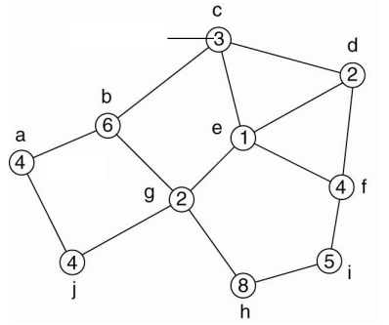
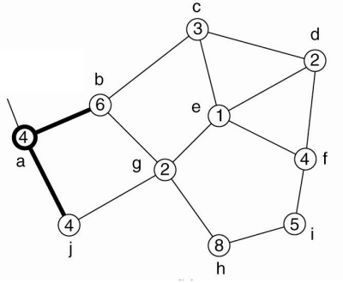
Elections in Wireless Environments
Node a initiates an ELECTION message by broadcasting to nodes b and j
Capacity
Broadcasting node
Source
Election algorithm in a wireless network, with node a as the source: Initial network
Election algorithm in a wireless network, with node a as the source: The build-tree phase

Slide 83
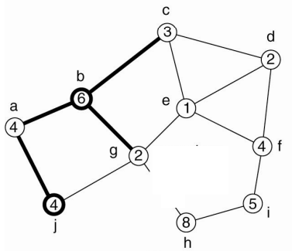
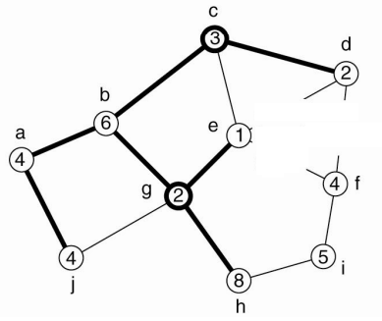
Elections in Wireless Environments
The Node b marks a as parent and passes the ELECTION message to node g
Election message it transmitted till the leaf nodes
Each nodes then transmit back the best available option to its parent node
e receives broadcast from g first
G receives broadcast from b first

Slide 84
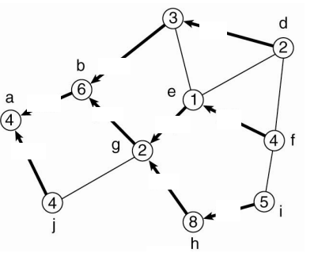
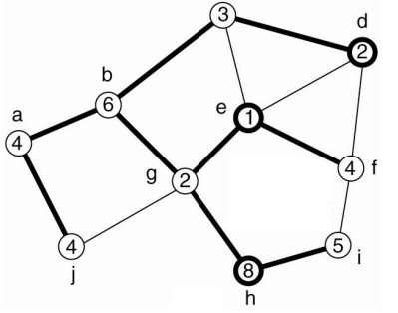
Elections in Wireless Environments
Node g has node e and h as child nodes but it will propagate only the best node i.e [h,8] back to its own parent.
When multiple elections are initiated, nodes tend to join the ones having highest identifier in the source tag
[d,2]
[c,3]
[h,8]
[h,8]
[f,4]
[f,4]
f receives broadcast from e first
[j,4]
[h,8]
[i,5]

Slide 85
Global State
Section - 6

Slide 86
Global State
Global state = current state of a distributed computation (called distributed snapshot)
Global state consists of
  local state of each process,
  together with messages which are in transit (sent but not delivered)
Knowing global state of system is useful
  i.e. at one time computation stopped and no progress can be made
  Analyzing global state indicates that either there is deadlock or that distributed system has correctly terminated

Slide 87
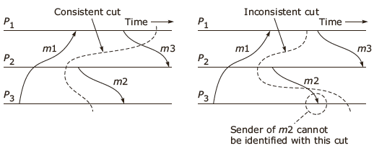
Global State
A distributed system snapshot reflects a state in which distributed system might have been
This snapshot reflects consistent state
  E.g. If snapshot records process A has received message from process B, it should have also recorded that B has actually sent the message
Inconsistent state – records either sender or receiver not both.

Slide 88
Algorithm for taking a Distributed snapshot
Any process P can initiate the algorithm of taking a distributed snapshot
  P starts by recording its own local state
  P subsequently sends a marker along each of its outgoing channels
  When Q receives a marker through channel C, its action depends on whether it has already recorded its local state:
    Not yet recorded: it records its local state and sends the marker along each of its outgoing channels
    Already recorded: the marker on C indicates that the channel’s state should be recorded, all the messages before this marker and the time Q recorded its own state
  Q is finished when it has received a marker along each of its incoming channels

Slide 89
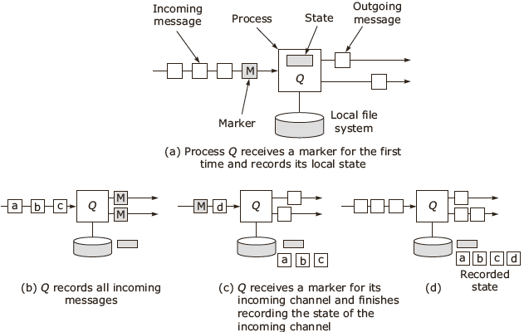
Algorithm for taking a Distributed snapshot

Slide 90
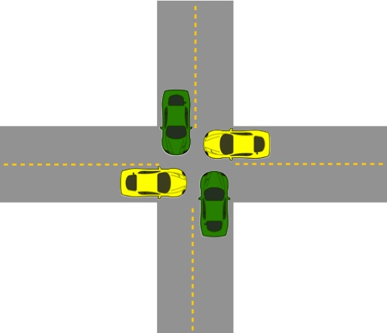
Deadlocks in DOS
Section - 7

Slide 91
Basic concepts
A resource is anything can be used by a single process at any instant of time.
Resource can be classified into two categories:
Preemptable resources can be taken away from a process with no ill effects (e.g. memory)
Non-preemptable resources will cause the process to fail if taken away (e.g. CD recorder)
The sequence of events required to use a particular resources are:
  Request the resource
  Allocate and use the resource
  Release the resource

Slide 92
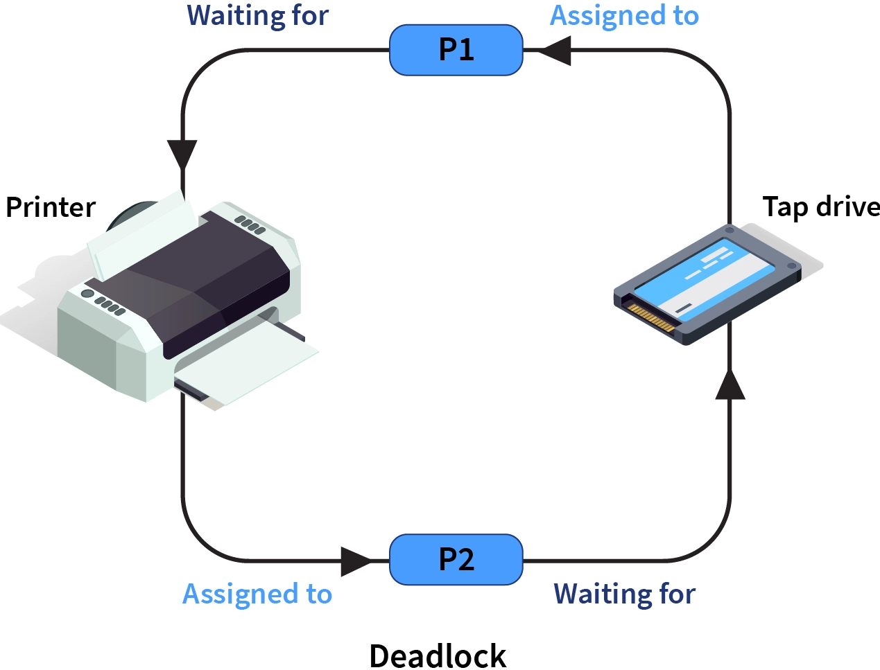
What is Deadlock?

Slide 93
Distributed deadlocks
Deadlock in distributed systems are similar to deadlocks in single processor system
This differ as:
  They are harder to avoid, prevent or even detect
  They are hard to cure when tracked down because all relevant information is scattered over many machines

Slide 94
Distributed deadlocks
Distributed Deadlocks are classified into two:
  Communication deadlocks
  Resource deadlocks

Slide 95
Distributed deadlocks
Distributed Deadlocks are classified into two:
  Communication deadlocks
    This deadlock occurs among a set of processes when they are blocked and waiting for messages from other processes in the set in order to start execution, but there are no messages in transit between them
    So none of the processes will ever receive a message
    All process in system are deadlocked
    Example - Process A waits to get a message from process B, Process B waits to get a message from process C and Process C waits to get a message from process A and hence a deadlock.
A
z
x
C
B
y

Slide 96
Distributed deadlocks
Distributed Deadlocks are classified into two:
  Communication deadlocks
  Resource deadlocks
    This deadlock occurs when two or more processes wait permanently for resources held by each other
    For example exclusive access on I/O device, files, locks, and other resources
Process
Process
P1
Hold
Request
R1
DEADLOCK
R2
Request
Hold
P2
Request
Hold
Resource
Resource

Slide 97
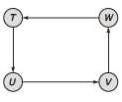
Distributed deadlocks
The following conditions are sufficient and necessary for deadlock to occur in system
  Mutual Exclusion condition
    Each resource is assigned to only one process or is available
  Hold and wait condition
    Process holding the resources can request additional resources without releasing the resources which are currently held
  No preemption condition
    Previously granted resources can not be forcibly taken away
  Circular and wait condition
    Must be a circular chain of two or more processes
    Each is waiting for a recourse held by the next member of chain

Slide 98
Deadlock avoidance
These methods use some advance knowledge of the resource usage of processes to predict the future state of the system
The possible states of process are:
  Deadlock
    No forward progress can be made
  Unsafe stare
    A state which does not have a safe sequence and that may allow a deadlock to occur
  Safe state
    A state is safe if it is not in deadlock state
    Any ordering of the processes which can guarantee the completion of all processes is called a safe sequence

Slide 99
Deadlock avoidance
Deadlock avoidance algorithm
  When a process requests for a resource, even if the resource is available for allocation, it is not allocated. But it is assumed the a request is granted
  With this assumption and an advance knowledge of resource usage of processes, the system performs analysis to decide whether granting the process’s request is safe or unsafe
  The resource is allocated to the process only if the analysis in step 2 shows that it is safe to do so, else the request is deferred

Slide 100
Deadlock avoidance
Deadlock avoidance Example
  There are total of 10 units of a resource type for which four processes p1, p2, p3 and p4 are competing
  Suppose the maximum units of the resource required by p1, p2, p3 and p4 are 3, 4 5, and 8 respectively
  Each of these processes is currently holding two units each of the resource
  Hence two units of each resource are free
 | p1 | p2 | p3 | p4
Max | 3 | 4 | 5 | 8
Holds | 2 | 2 | 2 | 2
Free | 2

Slide 101
Deadlock avoidance
Deadlock avoidance Example (Sequence p2 p1 p3 p4)
P2
 | p1 | p2 | p3 | p4
Max | 3 | 4 | 5 | 8
Holds | 2 | 2 | 2 | 2
Free | 2
 | p1 | p2 | p3 | p4
Max | 3 | 4 | 5 | 8
Holds | 2 | 4 | 2 | 2
Free | 0
P2 releases resource
P1
 | p1 | p2 | p3 | p4
Max | 3 | - | 5 | 8
Holds | 2 | - | 2 | 2
Free | 4
 | p1 | p2 | p3 | p4
Max | 3 | - | 5 | 8
Holds | 3 | - | 2 | 2
Free | 3

Slide 102
Deadlock avoidance
Deadlock avoidance Example (Sequence p2 p1 p3 p4)
P1 releases resource
P3
 | p1 | p2 | p3 | p4
Max | - | - | 5 | 8
Holds | - | - | 2 | 2
Free | 6
 | p1 | p2 | p3 | p4
Max | - | - | 5 | 8
Holds | - | - | 5 | 2
Free | 3
P3 releases resource
P4
 | p1 | p2 | p3 | p4
Max | - | - | - | 8
Holds | - | - | - | 2
Free | 8
 | p1 | p2 | p3 | p4
Max | - | - | - | 8
Holds | - | - | - | 8
Free | 2

Slide 103
Deadlock avoidance
Deadlock avoidance Example (Sequence p2 p1 p3 p4)
Sequence p2 p1 p3 p4 is safe
Exercise: From sequence p2 p1 p4 p3 and sequence p2 p3 p1 p4 , which are safe for above processes and given resources?
P4 releases resource
 | p1 | p2 | p3 | p4
Max | - | - | - | -
Holds | - | - | - | -
Free | 10

Slide 104
Deadlock avoidance
Deadlock avoidance Example 2
Total resources = 10, Sequence p1 p2 p3 is safe or not?
Sequence p2 p1 p3 and sequence p2 p3 p1 which are safe for above example?
 | p1 | p2 | p3
Max | 5 | 4 | 9
Holds | 3 | 2 | 3
Free | 2

Slide 105
Naming
Section - 8

Slide 106
Names, identifiers, and addresses
Name: set of bits/characters used to identify/refer to an entity, a collective of entities, etc. in a context
    Simply comparing two names, we might not be able to know if they refer to the same entity
Identifier: a name that uniquely identifies an entity
    The identifier is unique and refers to only one entity
Address: the name of an access point, the location of an entity
    e.g. phone number, or IP-address + port for a service

Slide 107
Features of Good naming
Section - 9

Slide 108
Features of Good naming
Naming system features
Location
Naming of objects
Usage
Replica management
Transparency
Performance
Replication transparency
Uniform naming convention
Allowing different names for some objects
Location independence
Fault tolerant
Locating nearest replicas
Scalability
Locating all replicas
Meaningful names
Group names

Slide 109
Features of Good naming
Location Transparency
  The name of the object must not indicate the physical location of object, directly or indirectly
Location Independency
  The name of object need not be changed when object’s location is changed
  Also the user must be able to access the object irrespective of the node from where it is being accessed
Scalability
  Any changes in system scale should not require any change in naming or location mechanism
Uniform naming convention
  Use some standard naming convention for naming different types of objects
  File names are named differently from user names and process names

Slide 110
Features of Good naming
Meaningful names
  Meaningful names indicate what the object actually contains
  They are easy to remember and use
Allow multiple user-defined areas
  In case of shared object, users must be allowed to use their own names for accessing the object
  It should be allowed to assign multiple user-defined names to the same object
Group Naming
  It must allow many different objects to be identified by the same name for broadcast facility
Performance
  Small number of message exchanges should be there for mapping object’s name to its attributes.
  So mapping time will be reduced and performance can be enhanced

Slide 111
Features of Good naming
Fault Tolerance
  It must be capable of tolerating faults like failure of node, network congestion
Replication transparency
  The user need not be aware that multiple copies exist in the system
Locating nearest replica
  When naming system supports replicas, the object location mechanism should locate the nearest replica of requested object
Locating all replicas
  The object-location mechanism must be able to locate all replicas, if need be

Slide 112
Fundamental Technologies and Concepts
Section - 10

Slide 113
Name Spaces
Structured names are organized into name spaces
A name space is a directed graph consisting of:
  Leaf nodes
  Directory nodes
Leaf nodes:
  Each leaf node represents an entity
  A leaf node generally stores the address of an entity (e.g., in DNS), or the state of (or the path to) an entity (e.g., in file systems)

Slide 114
Name Spaces
Directory nodes
  Directory node refers to other leaf or directory nodes
  Each outgoing edge is represented by (edge label, node identifier)
    Each node can store any type of data
    I.e., State and/or address (e.g., to a different machine) and/or path

Slide 115
Name Spaces - An Example
A path name is used to refer to a node in the graph
A path name is a sequence of edge labels leading from one node to another
    An absolute path name starts from the root node (e.g., /home/steen/mbox)
    A relative path name does not start at the root node (e.g., steen/mbox)
Looking up for the entity with name “/home/steen/mbox”
Data stored in n1
n0
keys
n2: “elke”
n3: “max”
n4: “steen”
home
n1
n5
elke
steen
max
n2
n3
n4
Leaf node
twmrc
mbox
Directory node

Slide 116
Name Resolution
Given a path name, it is easy to lookup information stored in the node for the entity in name space
The process of looking up a name is called name resolution.
Example:
    N:<label-1, label-2, …, label-n>
    Resolution starts at N, looking up the directory table returns the identifier for the node that label-1 refers to, N1
    Second, looking up the label-2 in directory table of the node N1, and so on
    Resolution stops at node referred to by label-n by returning the content of that node

Slide 117
Name Resolution
    Name resolution cannot be accomplished without an initial directory node
    The closure mechanism selects the implicit context from which to start name resolution
    Examples:
  www.qatar.cmu.edu: start at the DNS Server
  /home/steen/mbox: start at the root of the file-system

Slide 118
Name Server
    Name space are managed by name server
    A name server is a process that maintains information about named objects and facilitates users to access that information
    It acts to bind an object’s name to some of its properties (i.e. object’s location)
    The name servers that store the information about an object are called authoritative name servers
    To determine the authoritative name servers for every named object, the name service maintains authority attributes
authority attributes contain list of authoritative name servers for each object

Slide 119
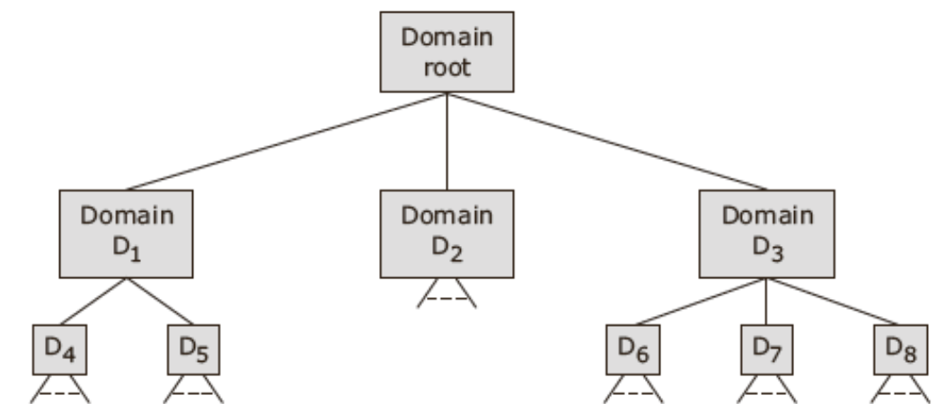
Name Server
    Authoritative name servers of domain should know the locations of the authoritative name servers branched out from that domain
    E.g. Authoritative name server of domain root need only know locations of authoritative name servers of domain D1, D2 and D3
    All name servers must know the location of authoritative name server of domain root

Slide 120
Name Agent
    The distribution of name service and the location of name servers should be transparent to the clients of name service
    This transparency is achieved through name agent that act between name servers and their clients
    The name agent maintains a knowledge of existing name servers
    When client requests for name service, the name agents uses the proper communication protocol to transfer the user’s request to proper name server
    On receiving reply from server, it forwards it to the client

Slide 121
Name Agent
    Name agents may be of two types:
      Private- which work for single client, structured as a set of subroutines that are linked to the client program
      Share- which work for several clients, structured as a part of an operating system kernel, with system calls to invoke name service operations or as a separate process
    Name agents are known by various names
      E.g in DARPA, Internet Domain Name service (DNS) the are called “resolvers”
      In DCE Directory Service they are called “clerks”

Slide 122
Context
    Names are always associated with some context
    Context can be thought of as environment in which a name is valid
    Context or name pair is said to form a qualified name
    Qualified name can be used for uniquely identifying an object
    Contexts are useful to partition a name space into smaller components
    Context represent a division of the name space along
    A name may occur in more than one context
    Context may also be nested as in case of hierarchical name space

Slide 123
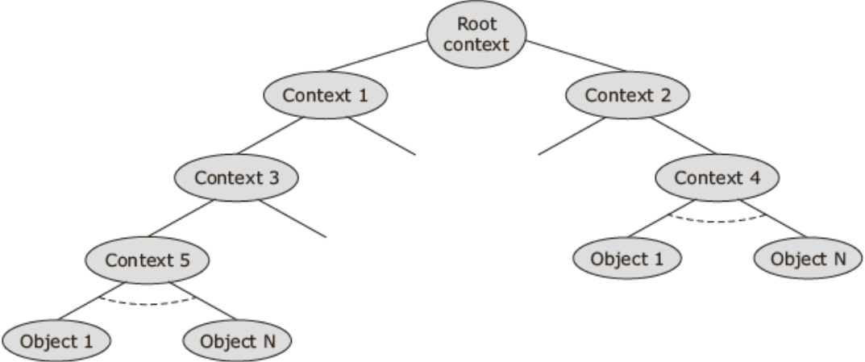
Context

Slide 124
Abbreviation/Alias
    A qualified name, which is normally a compound name may consist of several simple name and may be very long
    It may be inconvenient for user to specify qualified name every time
    So users are allowed to specify and use their own short form substitutes for qualified names are called abbreviation
    All abbreviation defined by a user form a private context of that user
    A mapping of abbreviation to qualified names is maintained on a per private context basis
    Different users may use the same abbreviation to identify different objects
    For example, two users, user-1 and user-2 may use the same abbreviation my-object-1 to identify their object with qualified name /user-1/project-1/group-1/object-1 and /user-2/project-5/group-3/object-1

Slide 125
Abbreviation/Alias
    User may wish to identify an object by one of two or more simple names
    A naming system may provide this flexibility to its users by allowing many-to-one bindings within a context
    So more than one simple name may be bound to the same qualified name within context
    The simple names bound to the same qualified name are called synonyms or nicknames

Slide 126
Absolute and Relative names
    A current working context is also known by shorter names current context or working context
    A user always associated with a context that is his or her current context
    A user can change his or her current context whenever he or she desires
    In this method, object names can be of two types- absolute or relative
    An absolute name begins at the root context of the name space tree and follows a path down to the specified object, giving the context names on the path
    A relative name defines a path from the current context to the specified object

Slide 127
Absolute and Relative names

Slide 128
Generic and multicast names
    The use of generic and multicast names requires the naming system to support one-to-many bindings
    The naming system must allow a simple name to be bound to a set of qualified names
    A generic name is mapped to any one of the set of objects which it is bound
    When user wants to request to be serviced by any of the servers capable of servicing that request and the user is not concerned with which server services his or her request

Slide 129
Descriptive/Attribute based name
    Descriptive/ Attribute based names allow an object to be identified by set of attributed or properties that describe the object
    It also allow uniquely to identify it among the group of objects in the name space

Slide 130
System Oriented Names
Section – 11

Slide 131
System Oriented Names
    System-oriented names are used primarily by the system itself rather than by users.
    These names uniquely identify resources, processes, or services within a distributed system.
    Unlike user-friendly names, these are often less readable and are optimized for system operations.
Types of System-Oriented Names:
  Flat Names: Unique identifiers with no hierarchy. Examples include MAC addresses or universally unique identifiers (UUIDs).
  Hierarchical Names: Structured names that reflect some organizational structure. Examples include DNS names, where each level in the hierarchy corresponds to a domain.
  Attribute-Based Names: These names are based on a set of attributes rather than a specific identifier, which allows more flexible and dynamic resource management.

Slide 132
Centralized Approach for Generating System-Oriented Names
    A centralized approach refers to a method where a single central authority or server is responsible for creating and managing the unique names or identifiers used across the distributed system
Central Authority:
  A single server or central authority is responsible for the generation, allocation, and management of names or identifiers in the system.
  This central server ensures that all names are unique within the system, preventing conflicts or duplication.

Slide 133
Centralized Approach for Generating System-Oriented Names
Simplicity and Consistency:
  The centralized approach simplifies the management of names because all naming activities are handled by one entity.
  This ensures a consistent naming convention across the entire system.
  It reduces the complexity that might arise in a decentralized or distributed naming system, where multiple entities might generate conflicting names.
Scalability Concerns:
  As the system grows, the central server may become a bottleneck due to the increasing load of name generation and management requests.
  The central server must be robust and capable of handling high volumes of requests without becoming a point of failure.

Slide 134
Centralized Approach for Generating System-Oriented Names
Single Point of Failure:
  One of the main disadvantages of a centralized naming system is that it introduces a single point of failure.
  If the central authority goes down, the entire system may lose the ability to generate or resolve names, leading to potential system-wide issues.
  This issue can be mitigated by implementing redundancy, backups, or failover mechanisms.
Examples of Centralized Naming Systems:
  Domain Name System (DNS): In its traditional form, DNS has a hierarchical structure, but within a particular domain, a centralized server (e.g., the primary DNS server) handles all name resolution requests.
  Active Directory: In Microsoft environments, Active Directory uses a centralized server to manage the names and identifiers for users, devices, and services within a network.

Slide 135
Distributed Approach for Generating System-Oriented Names
A distributed approach for generating system-oriented names is explored in large-scale distributed systems.
Decentralized Name Generation:
  In a distributed approach, no single central authority is responsible for generating names.
  Instead, multiple nodes or processes in the system can generate and manage names independently.
  This method enhances the system's scalability by distributing the load across many nodes, avoiding the bottlenecks and single points of failure associated with centralized systems.

Slide 136
Distributed Approach for Generating System-Oriented Names
Ensuring Uniqueness:
  A key challenge in distributed name generation is ensuring that names are unique across the entire system. Various techniques can be employed to achieve this:
  UUIDs (Universally Unique Identifiers): These are often used in distributed systems because they can be generated independently by different nodes while ensuring uniqueness.
  Hashing Algorithms: Nodes may use cryptographic hashing to generate names or identifiers based on unique input data, ensuring that each name is unique.
  Hierarchical Naming: Names may include prefixes or segments that indicate the node or domain that generated them, reducing the chance of conflicts.

Slide 137
Distributed Approach for Generating System-Oriented Names
Challenges and Solutions:
  Synchronization: Ensuring that all nodes are synchronized with the latest name mappings can be difficult, especially in large or highly dynamic systems. Protocols for eventual consistency are often used.
  Conflict Resolution: When two nodes inadvertently generate the same name, conflict resolution mechanisms are needed, such as assigning additional attributes to differentiate the names.
Examples of Distributed Naming Systems:
  Peer-to-Peer Networks: In systems like BitTorrent or Kademlia, distributed approaches are used for both name generation and resolution, where each node plays a role in maintaining the network's overall name structure.
  Blockchain-Based Naming: Systems like Namecoin use blockchain to implement a fully decentralized naming system, where names are securely managed and distributed across the network.

Slide 138
Object locating mechanism
Section – 12

Slide 139
Object locating mechanism
Object locating mechanisms ensure that when a client requests access to a particular object, the system can efficiently locate the object's current location and facilitate communication with it.
Concept of Object Location:
  Objects (resources, files, processes) are often not tied to a single physical location.
  Instead, they may move or be replicated across multiple nodes to improve performance, availability, and fault tolerance.
  Object locating mechanisms are the methods and protocols used to determine the physical or logical location of these objects when they are requested by clients or other system components.

Slide 140
Types of Object Locating Mechanisms:
Broadcasting and Multicasting:
  Broadcasting
    the request for an object's location is sent to all nodes in the system.
    Each node checks if it has the object and responds accordingly.
  Multicasting
    A more efficient version of broadcasting where the request is sent only to a specific group of nodes likely to have the object.
  Drawback
    These methods can generate significant network traffic and are generally not scalable for large systems.

Slide 141
Types of Object Locating Mechanisms:
Forwarding Pointers:
  When an object moves from one node to another, the original node retains a forwarding pointer to the new location of the object.
  Chaining
    In some systems, a chain of forwarding pointers is maintained if an object moves multiple times.
    The request follows the chain until it reaches the current location.
  Drawback
    If an object moves frequently, the chain can become long, leading to inefficiencies in locating the object.

Slide 142
Types of Object Locating Mechanisms:
Distributed Hash Tables (DHTs):
  DHTs are used in systems like peer-to-peer networks to distribute the responsibility for storing and locating objects across multiple nodes.
  Each object is assigned a unique key, and the DHT maps this key to a specific node in the network.
  Advantage
    DHTs provide an efficient and scalable way to locate objects in large distributed systems
Centralized Directory Services:
  A centralized directory maintains a mapping of object identifiers to their locations.
  When an object is needed, the system queries the directory to find the object’s current location.
  Advantage: Simplifies object location by centralizing the information.
  Drawback: It introduces a single point of failure and may become a bottleneck in large systems.

Slide 143
Types of Object Locating Mechanisms:
Hierarchical Location Services:
  The system is divided into regions, each with its own directory or name server.
  These local directories are responsible for objects within their region.
  For objects outside the region, the local directory can refer to higher-level directories until the object is located.
  Advantage: Reduces the load on any single directory and allows the system to scale more effectively.
Home-Based Approaches:
  Each object has a "home" node where it was originally created or registered.
  The home node keeps track of the object's current location and updates this information whenever the object moves.
  Advantage: Simplifies location management by providing a consistent reference point.
  Drawback: If the home node fails, the location information could be lost.

Slide 144
Human Oriented Names
Section – 13

Slide 145
Human Oriented Names
Human-oriented names are designed to be easily understood and remembered by humans, as opposed to system-oriented names.
These names are often used in user interfaces
It is used in interactions where ease of use and recall are more important than the efficiency of the system.
Examples include URLs, email addresses, and file names that are understandable to end-users.

Slide 146
Human Oriented Names
Characteristics:
  Readability: Human-oriented names are designed to be easy to read and interpret. They often use familiar words or phrases.
  Memorability: These names are constructed to be memorable, often reflecting the purpose or content of the resource they represent.
  Contextual Meaning: Human-oriented names often carry contextual or semantic meaning, making it easier for users to understand what the name refers to without needing additional information.
Examples:
  Domain Names: Domain names (e.g., www.example.com) are a classic example of human-oriented names.
  File Names: Files may be given human-oriented names that reflect their content or purpose (e.g., Annual_Report_2023.pdf).
  Email Addresses: An email address like john.doe@example.com is another example of a human-oriented name, combining a user-friendly identifier with a domain name.

Slide 147
Human Oriented Names
Mapping to System-Oriented Names
  Human-oriented names are often mapped to system-oriented names that the underlying system uses to locate and manage resources.
  This mapping is typically handled by a naming service or directory service.
  For example, a domain name like www.example.com is mapped to an IP address by the Domain Name System (DNS), allowing users to access websites without needing to remember numeric IP addresses.

Slide 148
Human Oriented Names
Challenges:
  Name Conflicts:
    In large distributed systems, ensuring that human-oriented names remain unique and meaningful can be challenging.
    Conflict resolution mechanisms may be required when different users or entities attempt to use the same name.
  Scalability:
    As the system grows, maintaining the mappings between human-oriented and system-oriented names in a scalable way is critical.
  User Expectations:
    Users expect human-oriented names to be consistent and persistent. If a name changes frequently or is reassigned, it can lead to confusion.

Slide 149
Important Questions
Define: Clock synchronization, clock skew, Drifting of clock, mutual exclusion and critical section
Explain Berkeley Algorithm for physical clock synchronization
Explain Lamport’s Algorithm for logical clock synchronization
How Centralized Mutual Exclusion Algorithm works in distributed system.
Determine how token ring algorithm works for mutual exclusion?
Describe Bully’s election algorithm by illustrating it for 7 processes group.

Slide 150
Important Questions
p1, p2 and p3 are processes of distributed system, Resource requirement of each process is shown in table. Using deadlock avoidance algorithm, check that sequence p1 p2 p3 and sequence p3 p1 p2 are safe or not? Total resources = 10
Write about name server, name agent and name resolution in naming system.
Determine how system oriented names are useful in distributed system?
 | p1 | p2 | p3
Max resources | 5 | 4 | 9
Holds resources | 3 | 2 | 3
Free resources | 2

Slide 151
Distributed Operating Systems (DOS)
Prof. Nidhi K Chitroda
Computer Engineering Department

