Slide 1
The System Today: One FGO, Joint Fault Handling, Rolling Integrity
How are estimation, fault exclusion and protection connected in the live UWB–IMU system?
20 Hz UWB / 200 Hz IMU • default LF/LI = 30/30 epochs • committed tag-position PL
Timestamped raw
UWB + IMU
source IDs / noise
Existing discrete
FGO
pre-UWB prepare
IMU preintegration
Unified physical
fault hypothesis
pool
UWB/IMU FDE
Candidate testing
exclude / bridge / repair
Single native commit
iSAM2 actual tag
+ commit receipt
Fault-aware tag PL
Raw set HPL / VPL
around committed tag
UWB slope RAIM screen
Rolling certificate / boundary B_k
p, v, R, ba, bg + historical fault carry
shared source / time-uniform risk
Risk / timeliness / AL
separate availability
gates
Raw IMU fault monitor
T-SIM: conditional raw integrity | T-REAL: engineering FDE only; raw unqualified
Retired raw epochs
Certified boundary B_k
Explicit active FGO / proof: 30 epochs
New epoch k+1
B_k → B_(k+1): state/error, possible faults and source/risk survive; risk horizon ≠ 30 epochs. No second FGO or all-history re-solve.
Raw measurements drive one incremental FGO and parallel fault monitors; the selector commits at most one native update. A rolling certificate carries state uncertainty, fault
consequences and source/risk identity across marginalization.
Takeaway: A coupled incremental estimator and rolling fault-aware position integrity layer goes beyond a per-epoch
UWB RAIM test.
Source: SC8_RESULTS, Architecture; frozen solver 61907ab; conditional SIM / empirical REAL separated
1/15
Notes:
• Follow the single estimator path and the two fault-monitor inputs into the hypothesis pool.
• Proof proposal precedes commit; final HPL/VPL are bound to the actual commit receipt and tag center.
• The boundary carries position, velocity, rotation, biases, historical faults and shared source/risk identity.
• The risk horizon is not the 30-epoch explicit window; no second FGO or all-history resolve is required.
Frozen solver: 61907ab417450d317e443e4ff10f2cce062deabe. Entry HEAD: fa5b3dc9ffe3c88492352491d79ba022f373bfb5. Result status: SC8_EVALUATED_WITH_EXECUTION_GAPS.
Figure provenance: FIGURE_SOURCES.json; metric details: NUMERICAL_CLAIMS.json; slide 1.

Slide 2
E00 — What Was Actually Tested, and Which Comparisons Are Valid?
Which datasets, ground truths and algorithm modes support a defensible comparison?
143 registered runs: 130 SUCCESS | 12 RESOURCE_LIMIT | 1 FAIL; 159 attempts + 1 ROS control
T-SIM
ID
Recording
Duration
Physical reference / boundary
Registered physical law → O-FULL / O-NOFDE
R1
ISAS-Walk2
76.09 s
tracker→IMU/tag OPEN; proxy
→ Known truth; conditional PL
R2
ISAS-Walk3
81.66 s
same reference OPEN
T-REAL
Original recordings → O-FDE-ENG /
O-ENG-NOFDE
R3
Own Vicon, no obstacle
73.39 s
GT-assisted segmented CAL/TEST
→ CAL disclosure; raw unqualified
R4
Own Vicon, obstacle
11.39 s
GT-assisted; short recording
T-SEMI
R5
STAR loop-3d-z_s3
150.10 s
gyro/rig input convention OPEN
Real + fixed overlay → Same engineering paths
R6
STAR loop-2d-fast_s3
55.40 s
same input concern
→ Injected label only; no raw PL
SFUISE: official rejection ON; ONLINE causal; FINAL same-run revised history.
Rows identify pre-registered real recordings, rather than six successful examples. The producer-to-estimator lanes keep conditional simulation integrity separate from
empirical real data and overlays.
Takeaway: Comparability comes before APE rankings: Walk reference and STAR input contracts remain open.
Source: SC8_RESULTS, E00; frozen solver 61907ab; conditional SIM / empirical REAL separated
2/15
Notes:
• SUCCESS is a process exit status, not proof of complete input or output coverage.
• Simulation is the only registered source with conditional raw qualification.
• Real recordings use O-FDE-ENG / O-ENG-NOFDE; semi-synthetic labels concern the added fault only.
• Own-Vicon calibration uses a disclosed segmented TEST-involved fit; SFUISE official rejection remains enabled.
Frozen solver: 61907ab417450d317e443e4ff10f2cce062deabe. Entry HEAD: fa5b3dc9ffe3c88492352491d79ba022f373bfb5. Result status: SC8_EVALUATED_WITH_EXECUTION_GAPS.
Figure provenance: FIGURE_SOURCES.json; metric details: NUMERICAL_CLAIMS.json; slide 2.

Slide 3
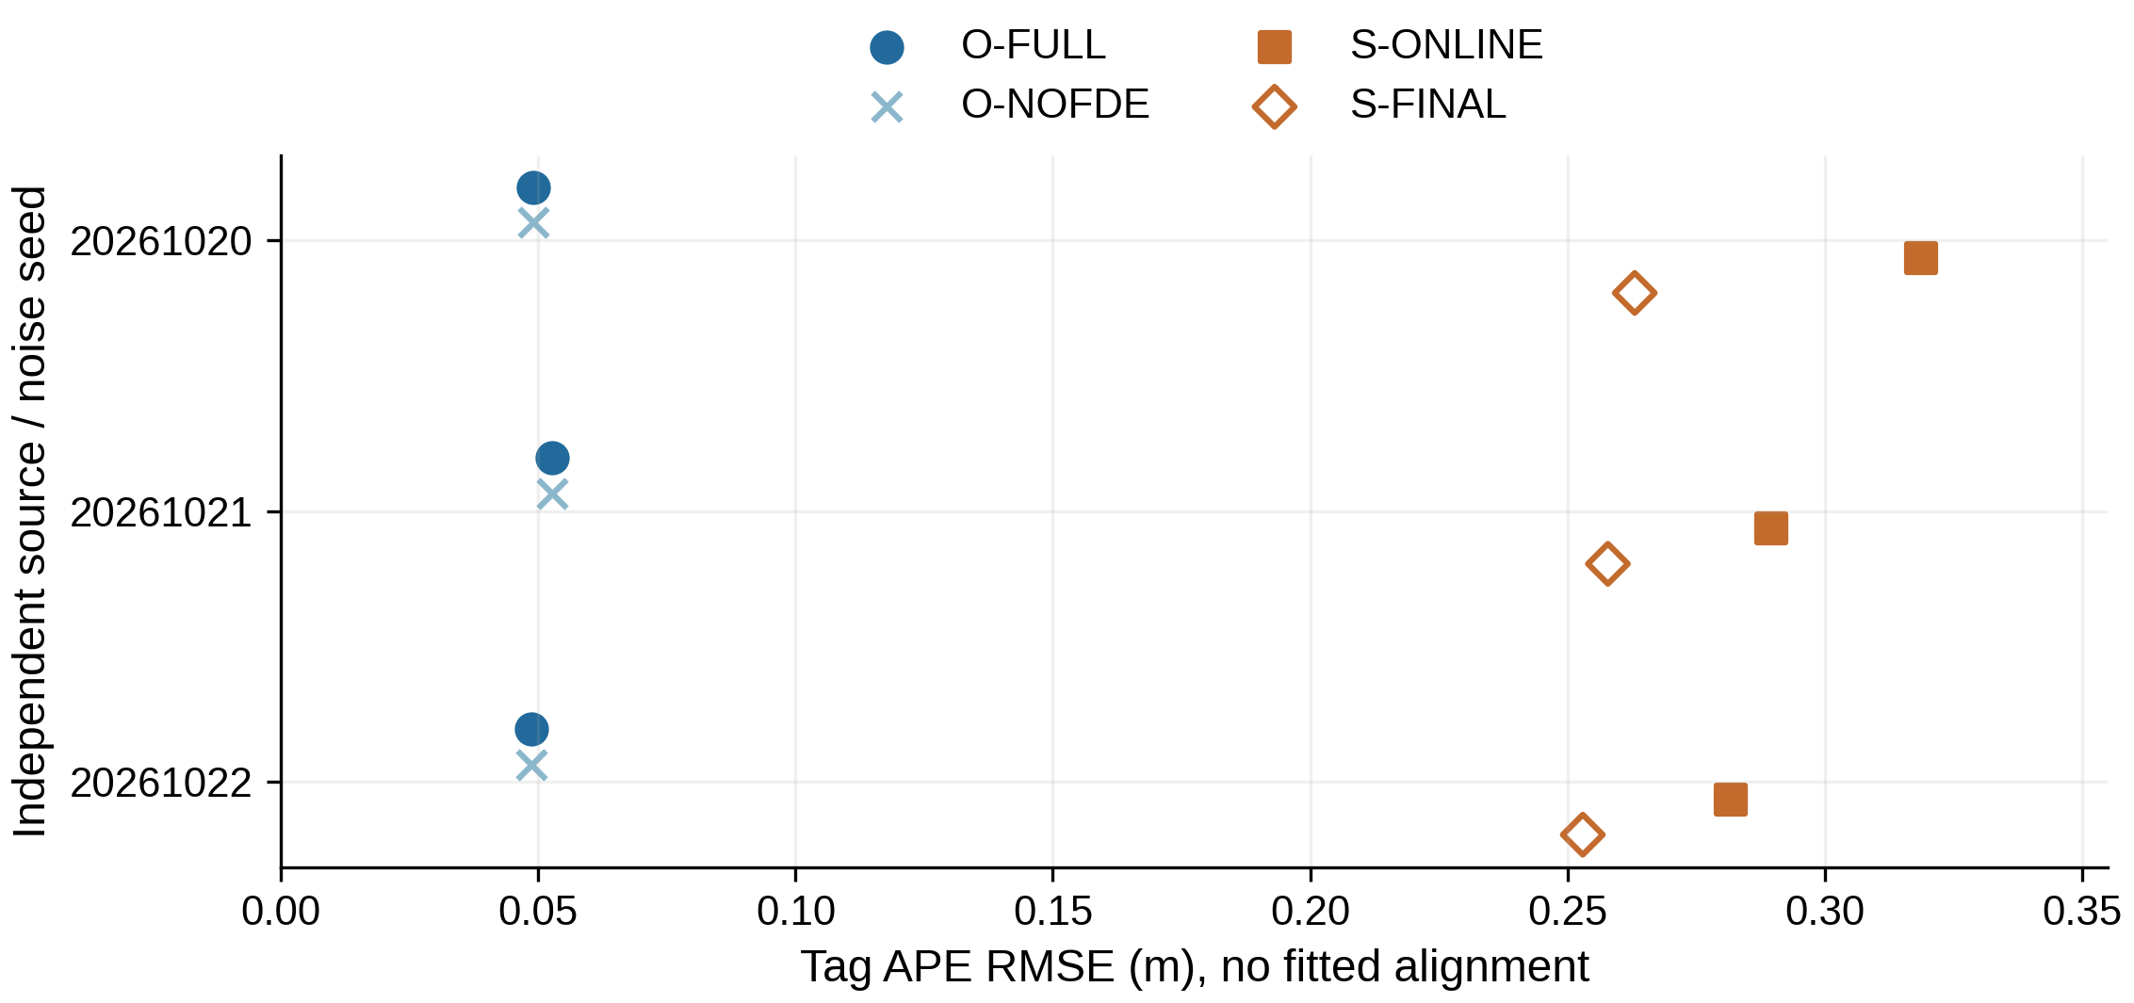
E01 — Healthy Simulation: Good Accuracy Under the Declared Model
How accurately does the coupled pipeline localize without imposed faults?
O-FULL tag APE RMSE 0.0487176–0.0526469 m; default timing / timely-spatial profile passes 3/3
Full path / model
Observed result
Tag APE RMSE (m)
0.0487176–0.0526469
Body ARE RMSE
0.0778–0.1454 rad
Seed20 core / sink P95
23.73 / 23.89 ms
Study limits
40 / 50 ms; timely ≥95%
Per-run output-stamp scoring.
FULL / NOFDE: 600 states each.
SFUISE: 300 online; 298 valid final.
Final history is not an online gain.
Each point is one independent seed; lower world-frame tag APE is better, without trajectory alignment. SFUISE uses sensor-only initialization, while ours receives an
independently noisy initial observation: this is not an optimizer-only comparison.
Takeaway: The healthy pipeline delivers approximately 5 cm tag RMSE in the registered simulated model.
Source: SC8_RESULTS, E01; frozen solver 61907ab; T-SIM: conditional tag-position PL
3/15
Notes:
• All three fixed healthy seeds are shown, without seed selection or fitted alignment.
• FULL and NOFDE coincide on the healthy source; SFUISE online and final are distinct views.
• Final history excludes the support-invalid bootstrap prefix; it is neither causal nor a full batch optimum.
• The approximate five-centimeter result is conditional on the registered simulation and initialization information.
Frozen solver: 61907ab417450d317e443e4ff10f2cce062deabe. Entry HEAD: fa5b3dc9ffe3c88492352491d79ba022f373bfb5. Result status: SC8_EVALUATED_WITH_EXECUTION_GAPS.
Figure provenance: FIGURE_SOURCES.json; metric details: NUMERICAL_CLAIMS.json; slide 3.

Slide 4
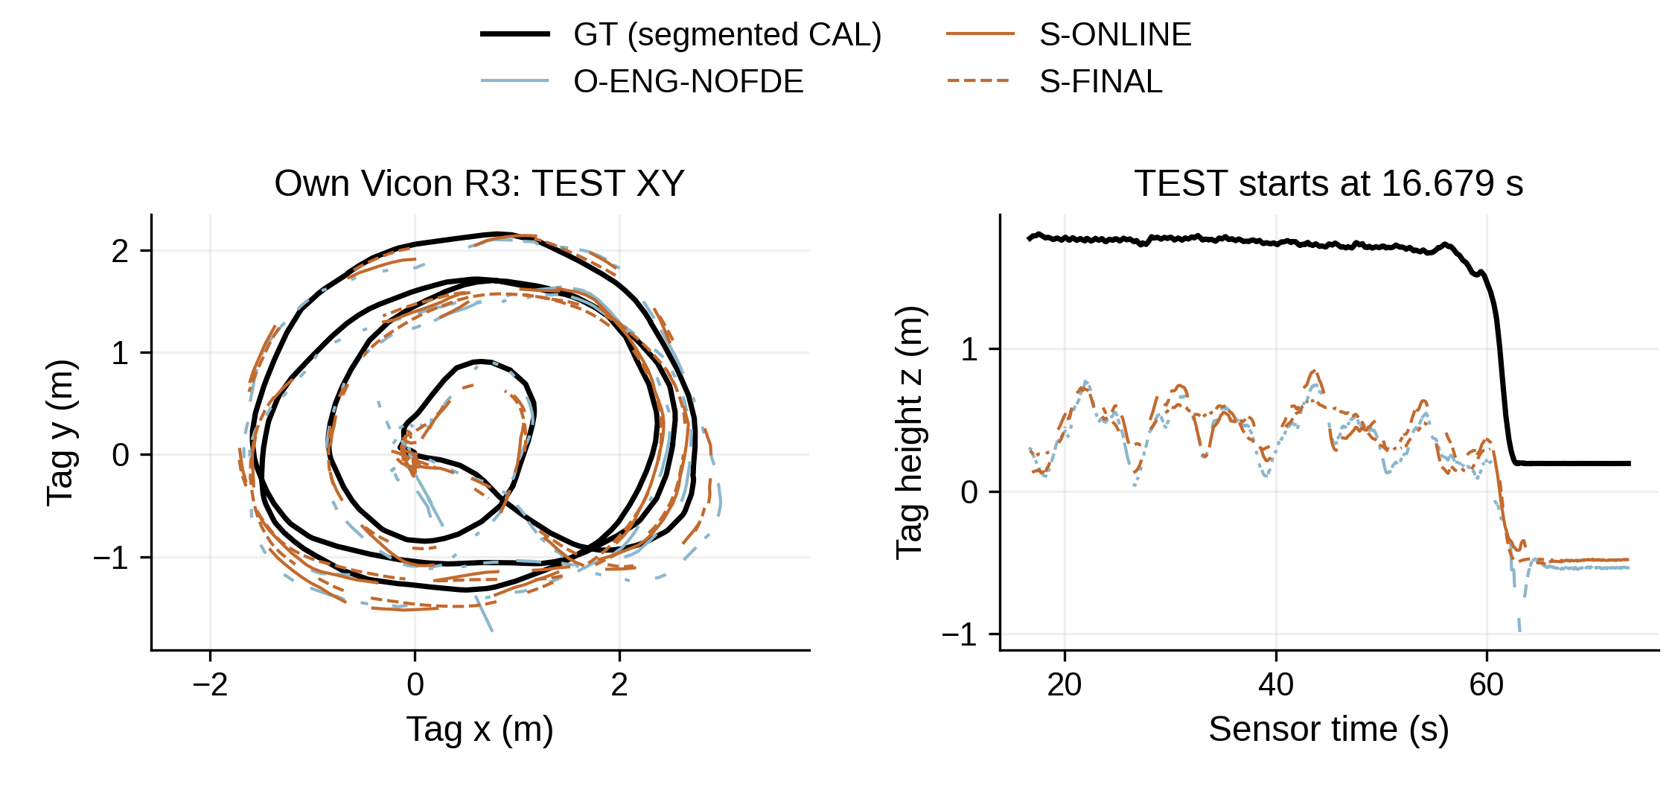
E02 — Real-Data Validation Is Currently an Interface Problem
Which real-data comparisons can we physically interpret?
Walk physical APE / ARE / RPE = NA; STAR input validation OPEN; own Vicon is GT-assisted
Family
Usable evidence
Open boundary
Walk
R1/R2
Time coverage;
proxy diagnostic
Tracker–body/tag
reference
Own
R3/R4
Empirical TEST;
CAL disclosed
TEST-involved fit; not
blind
STAR
R5/R6
Frozen-interface
behavior
Gyro/rig convention;
no intrinsic ranking
R3 FULL: no complete TEST trajectory.
STAR R5 S-ONLINE APE: 15.85 km.
Input OPEN: no intrinsic-method ranking.
Traces show the frozen own-Vicon TEST output and height reference, with its GT-assisted calibration disclosed. The matrix separates physically unresolved Walk references
and STAR input conventions from conditional empirical scoring.
Takeaway: Apparent algorithm failures cannot yet be separated from missing physical frame and timing validation.
Source: SC8_RESULTS, E02; frozen solver 61907ab; T-REAL: empirical, raw unqualified
4/15
Notes:
• Use R3 as an empirical example, not an independently calibrated blind test.
• Its registered TEST begins at 16.678774643 seconds; FULL has no complete TEST trajectory.
• Walk physical APE, ARE and RPE are unavailable despite saved numerical proxy distances.
• STAR kilometer-scale divergence is retained in the frozen report, but the gyro input contract prevents intrinsic method ranking.
Frozen solver: 61907ab417450d317e443e4ff10f2cce062deabe. Entry HEAD: fa5b3dc9ffe3c88492352491d79ba022f373bfb5. Result status: SC8_EVALUATED_WITH_EXECUTION_GAPS.
Figure provenance: FIGURE_SOURCES.json; metric details: NUMERICAL_CLAIMS.json; slide 4.

Slide 5
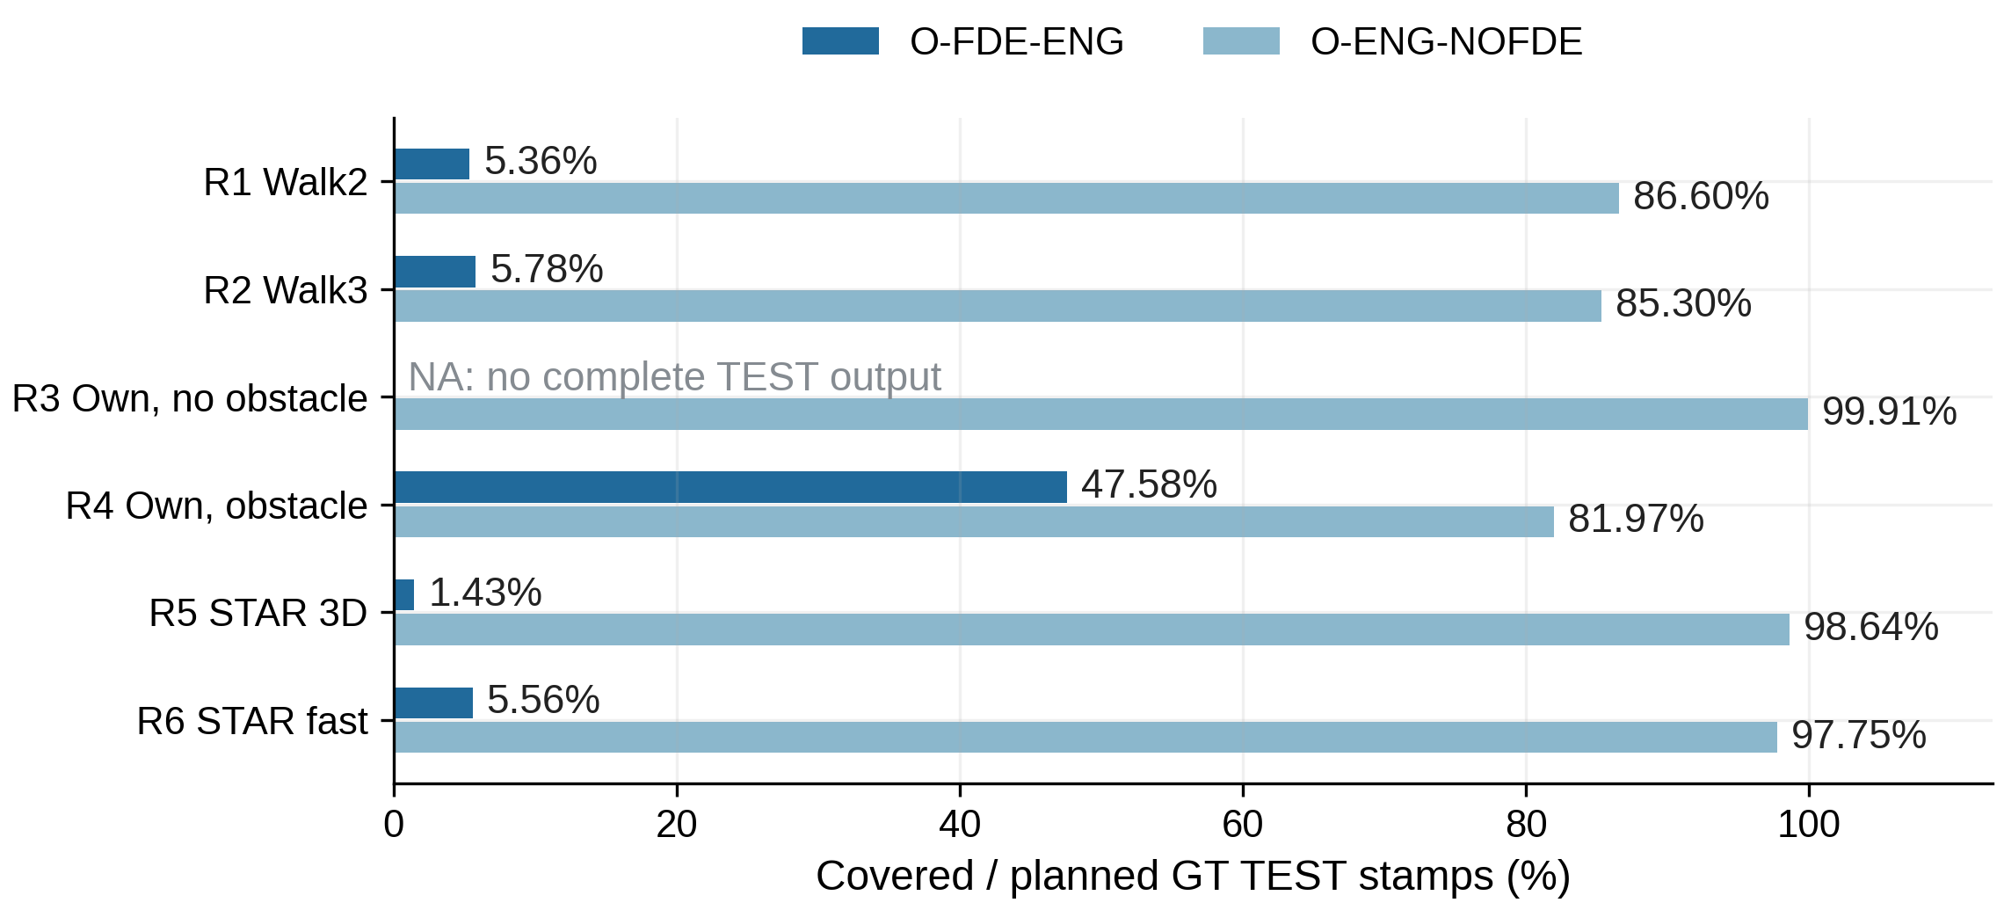
E02 — Real FDE Execution, Not Nominal Localization, Is the Bottleneck
Can the fault-handling pipeline sustain a complete real recording?
4/6 O-FDE-ENG real runs hit the resource limit; every real raw PL remains unqualified
GT grid
FDE covered/N
NoFDE covered/N
R1
204/3805
3295/3805
R2
236/4083
3483/4083
R3
NA
16602/16617
R4
1591/3344
2741/3344
R5
505/35342
34861/35342
R6
723/12993
12701/12993
Walk: temporal proxy grid only.
R3 FULL has no saved TEST output.
Rates differ from commit/attempt rate.
Bars show coverage of the registered GT TEST grid, with interpolation limited to 100 ms; NA is not zero. This measures emitted-output continuity, not accuracy or raw integrity,
and Walk coverage is temporal only.
Takeaway: The main real-data blocker is FDE execution continuity, beyond nominal FGO data loading.
Source: SC8_RESULTS, E02; frozen solver 61907ab; T-REAL: empirical, raw unqualified
5/15
Notes:
• The denominator is each original GT TEST grid within IMU source bounds, not successful matches or commit attempts.
• Walk percentages describe time coverage only; the physical reference is unresolved.
• The R3 FULL TEST coverage is unavailable and must not be drawn as a zero bar.
• Four of six engineering FULL runs hit the registered resource stop; all real raw PL remains unqualified.
Frozen solver: 61907ab417450d317e443e4ff10f2cce062deabe. Entry HEAD: fa5b3dc9ffe3c88492352491d79ba022f373bfb5. Result status: SC8_EVALUATED_WITH_EXECUTION_GAPS.
Figure provenance: FIGURE_SOURCES.json; metric details: NUMERICAL_CLAIMS.json; slide 5.

Slide 6
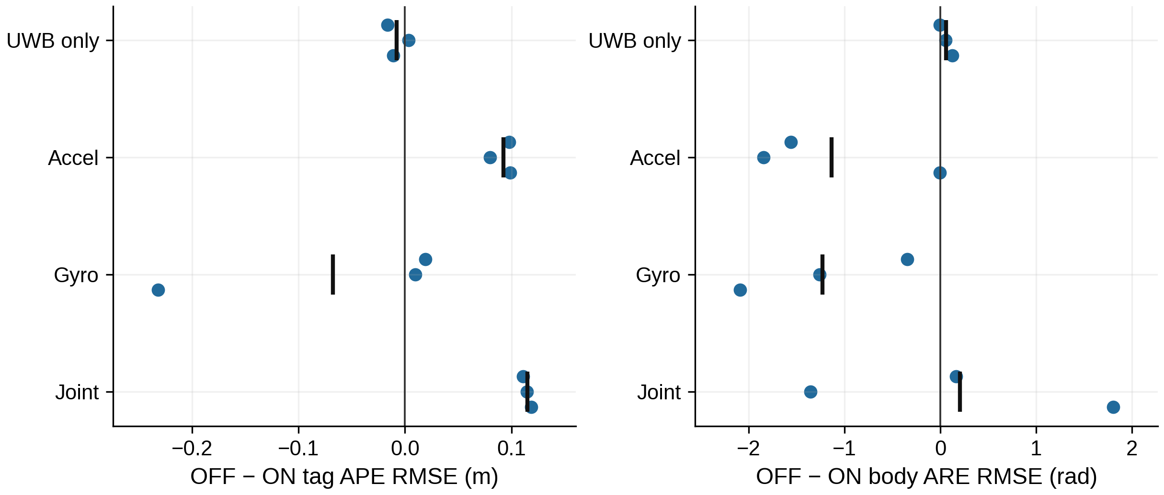
E03 — FDE Benefits Are Fault-Dependent, Not Uniformly Positive
Does FDE actually improve position and attitude accuracy?
OFF − ON: positive is improvement; negative is degradation; all three seeds remain visible
Fault
ΔAPE (m)
ΔARE (rad)
UWB
-0.007908
+0.05806
Accel
+0.092363
-1.13562
Gyro
-0.067733
-1.23141
Joint
+0.114792
+0.20435
Black ticks are seed means.
Accel: better position, worse attitude.
Gyro: both means deteriorate.
Joint: attitude gain varies by seed.
Each point is a matched seed; positive OFF−ON means FDE reduced RMSE, while negative values show degradation. Position improvement cannot cancel worsening body
attitude, particularly under accel or gyro faults.
Takeaway: Accel/joint positioning improves, but gyro-only accuracy and state recovery remain unresolved.
Source: SC8_RESULTS, E03; frozen solver 61907ab; T-SIM: conditional tag-position PL
6/15
Notes:
• Three independently registered seeds per fault class supply the matched ON/OFF gains.
• UWB-only is not uniformly positive; accelerometer positioning gains accompany worse attitude.
• Gyro-only has a large negative seed and negative mean position and attitude gains.
• Joint-fault mean attitude gain hides per-seed variation; no significance claim is made from three seeds.
Frozen solver: 61907ab417450d317e443e4ff10f2cce062deabe. Entry HEAD: fa5b3dc9ffe3c88492352491d79ba022f373bfb5. Result status: SC8_EVALUATED_WITH_EXECUTION_GAPS.
Figure provenance: FIGURE_SOURCES.json; metric details: NUMERICAL_CLAIMS.json; slide 6.

Slide 7
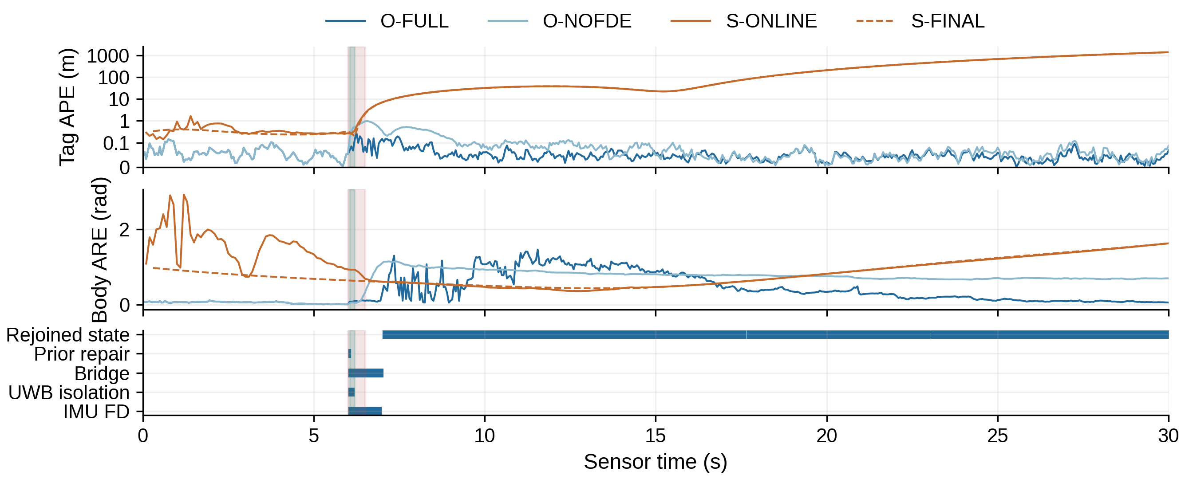
E03 — Real Isolation Can Still Be Followed by Estimation Drift
What happens before, during and after a detected joint fault?
T-SIM SC8-J / seed 20261020: actual prior repair + bridge + rejoined receipts; accuracy is separate
Source /
event
Magnitude / receipt
UWB bias
+2.25 m / 3 epochs
Raw accel
+20 m/s² / 500 ms
First FD /
bridge
Epoch 121 / 121
First rejoin4
Epochs 141–144
Burgundy: accel pulse.
Teal: UWB pulse.
Rejoined is a persistent state,
not an accuracy certificate.
Bands mark source-level injections and receipt rows mark actual detection, isolation, prior repair and rejoined state. The APE axis is linear below 0.1 m and logarithmic above;
a successful transaction does not certify state-error recovery.
Takeaway: Post-FDE state consistency and recovery determine net accuracy; isolation alone is insufficient.
Source: SC8_RESULTS, E03; frozen solver 61907ab; T-SIM: conditional tag-position PL
7/15
Notes:
• The title uses real isolation to mean actual native transactions; this example is T-SIM, not a real recording.
• The exact stream is SC8-J, seed 20261020, 600 epochs.
• The raw accel pulse is 20 m/s² for 500 ms and UWB bias is 2.25 m for three epochs.
• Rejoined is a persistent state flag; episode success requires actual prior replacement, bridge and consecutive post-bridge rejoined commits.
Frozen solver: 61907ab417450d317e443e4ff10f2cce062deabe. Entry HEAD: fa5b3dc9ffe3c88492352491d79ba022f373bfb5. Result status: SC8_EVALUATED_WITH_EXECUTION_GAPS.
Figure provenance: FIGURE_SOURCES.json; metric details: NUMERICAL_CLAIMS.json; slide 7.

Slide 8
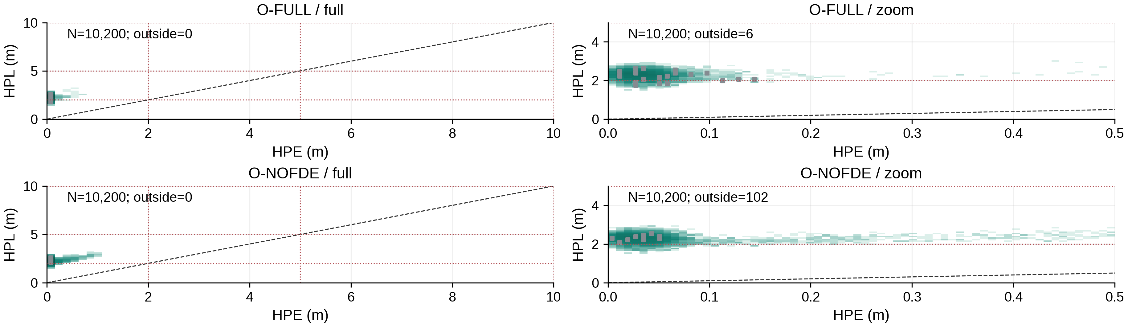
E04 — Horizontal Stanford:
Conservative Bounds, Conditional Coverage
How do horizontal position errors relate to the emitted HPL?
77,131 qualified T-SIM receipts overall; observed H/V underbounds = 0; correlated samples ≠ risk trials
HPE is horizontal and HPL vertical; darker teal log-count bins have more timely samples, and points above dashed y=x are empirically covered. Gray bins are late (excluded
from timely availability); dotted lines mark research ALs (2/5/10 m), and zero correlated violations do not establish empirical 10^-6 risk.
Takeaway: Horizontal bounds cover the registered errors but remain much wider than the observed error.
Source: SC8_RESULTS, E04; frozen solver 61907ab; T-SIM: conditional tag-position PL
8/15
Notes:
• The Stanford panels use actual histogram counts for the registered E01/E03 main cases.
• Overall qualified receipt total includes other experiments and must not be confused with this figure denominator.
• An HPL above HPE is coverage, whereas an HPL above HAL is unavailable at that alert limit.
• The conditional theorem comes from the declared source event, not independence of these correlated observations.
Frozen solver: 61907ab417450d317e443e4ff10f2cce062deabe. Entry HEAD: fa5b3dc9ffe3c88492352491d79ba022f373bfb5. Result status: SC8_EVALUATED_WITH_EXECUTION_GAPS.
Figure provenance: FIGURE_SOURCES.json; metric details: NUMERICAL_CLAIMS.json; slide 8.

Slide 9
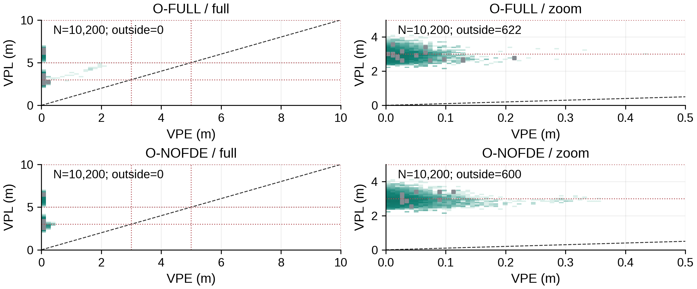
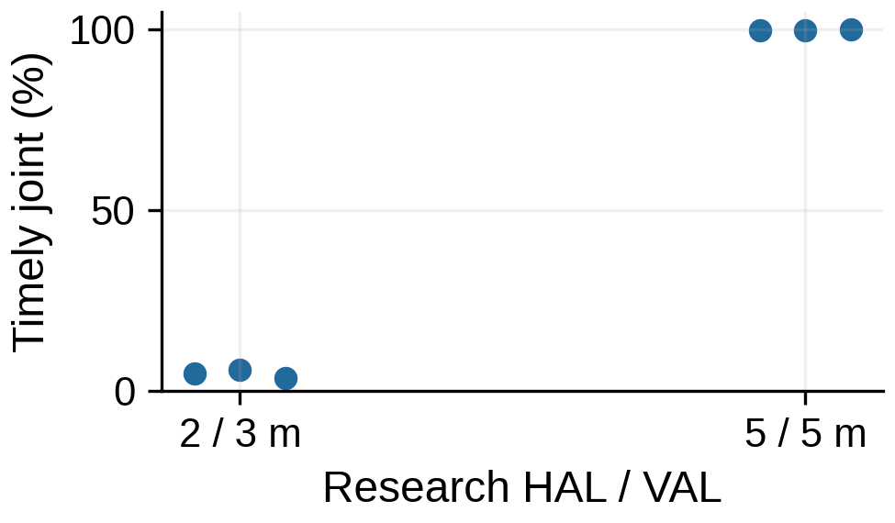
E04 — Vertical Stanford: Availability Depends on the Application AL
Why can a centimeter-level estimate still be unavailable?
Same estimates and PL: research AL (2,3) m gives 3.5–5.667%; (5,5) m gives 99.67–100%
HAL / VAL
Joint timely
2/3 m
3.5–5.667%
5/5 m
99.67–100%
O-FULL; 3 independent seeds.
Denominator: all 600 epochs / seed.
No application certification.
VPE is horizontal and VPL vertical; darker teal bins contain more timely samples, gray bins are late, and bins above dashed y=x have VPL≥VPE. Dotted research ALs (3/5/10
m) test admissibility; the healthy AL comparison changes evaluation only, not estimates or PL, and is not certification.
Takeaway: PL tightness and application availability are distinct from estimator accuracy, especially vertically.
Source: SC8_RESULTS, E04; frozen solver 61907ab; T-SIM: conditional tag-position PL
9/15
Notes:
• Vertical bounds can exceed the chosen VAL even when VPE is small.
• Healthy joint availability divides timely H/V-admissible receipts by all 600 planned epochs per seed.
• Research 2/3 and 5/5 meter ALs are post-processing diagnostics and do not alter solver parameters.
• No hardware safety requirement or real-data protection qualification is inferred.
Frozen solver: 61907ab417450d317e443e4ff10f2cce062deabe. Entry HEAD: fa5b3dc9ffe3c88492352491d79ba022f373bfb5. Result status: SC8_EVALUATED_WITH_EXECUTION_GAPS.
Figure provenance: FIGURE_SOURCES.json; metric details: NUMERICAL_CLAIMS.json; slide 9.

Slide 10
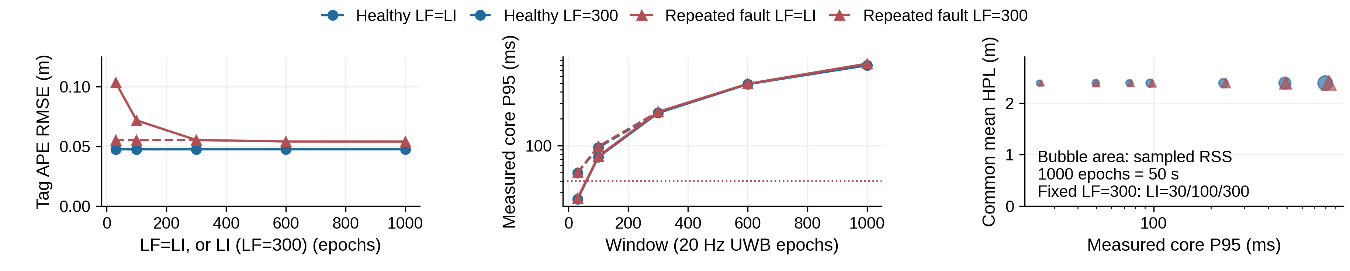
E05 — 30 vs 1000 Epochs: When Is a Longer Window Worth It?
Does retaining much more history improve accuracy or integrity enough to justify the cost?
7 unique configurations × 2 streams; common epochs 1101–2100; default core study target = 40 ms
Same common interval
30/30
1000/1000
Interpretation
Healthy APE (m)
0.04753682
0.04754147
No meaningful gain
Healthy core P95 (ms)
25.096
795.501
Higher measured cost
Fault APE (m)
0.10345833
0.05404642
Benefit in this stream
APE uses the same complete 1,000-epoch scoring interval; bubble area denotes sampled RSS, not process peak. LF, LI and recovery replay vary together in the coupled
sweep, so its fault benefit cannot be attributed to PL alone.
Takeaway: Keep 30/30 as the online reference; extend history only when measured recovery benefits justify cost.
Source: SC8_RESULTS, E05; frozen solver 61907ab; T-SIM: conditional tag-position PL
10/15
Notes:
• Every plotted configuration ran 2100 epochs and the common scoring interval is 1101 through 2100.
• Coupled LF=LI uses 30, 100, 300, 600 and 1000 actual UWB epochs; 1000 is 50 seconds.
• The fixed LF=300 sweep uses LI=30, 100 and 300, reusing the shared 300/300 result.
• The resource marker is a sampled RSS maximum, not the unknown between-sample peak; larger windows are intentionally allowed to miss real-time targets.
Frozen solver: 61907ab417450d317e443e4ff10f2cce062deabe. Entry HEAD: fa5b3dc9ffe3c88492352491d79ba022f373bfb5. Result status: SC8_EVALUATED_WITH_EXECUTION_GAPS.
Figure provenance: FIGURE_SOURCES.json; metric details: NUMERICAL_CLAIMS.json; slide 10.

Slide 11
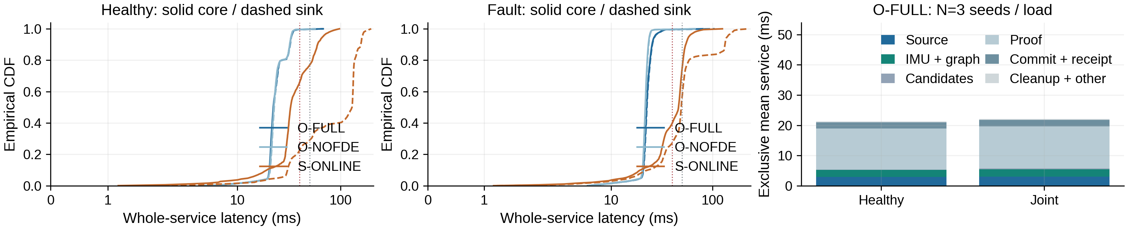
E06 — Runtime Breakdown: Fast Simulation, Expensive Real FDE
Where does the computation go, and which timing numbers are comparable?
Core P95 ≤40 ms + sink P95 ≤50 ms + timely spatial ≥95%; two E06 serial confirmations pass
Run / capability
Core P95 (ms)
Sink P95 (ms)
Boundary
E01 H / seed20 FULL
23.726
23.893
Full service
E06 J / seed20 FULL
24.893
25.162
Full service
E01 H / seed20 NOM
2.100
2.303
Nominal only; no matched PL
E02 real O-FDE-ENG
up to 13099.0
up to 1.14e+06
Measured prefix; 4/6 resource-limited
Curves show measured whole-service latency; solid is core and dashed is sink, while stacked bars contain additive exclusive means. Stage P95s are not additive, and
SFUISE buffering/software-clock timing represents different capabilities.
Takeaway: The small-window simulated full path meets study P95 targets; current real engineering FDE does not.
Source: SC8_RESULTS, E06; frozen solver 61907ab; conditional SIM / empirical REAL separated
11/15
Notes:
• Core and sink nearest-rank P95 targets remain 40 and 50 milliseconds; timely spatial fraction must also exceed 95 percent.
• The healthy seed20 main E01 profile and the E06 joint repeat have distinct run IDs.
• The nominal-only two-millisecond path lacks the full integrity capability and is not a like-for-like speed claim.
• All measurable slow and abort frames remain; censored suffixes have no imputed timing and no complete-stream throughput claim.
Frozen solver: 61907ab417450d317e443e4ff10f2cce062deabe. Entry HEAD: fa5b3dc9ffe3c88492352491d79ba022f373bfb5. Result status: SC8_EVALUATED_WITH_EXECUTION_GAPS.
Figure provenance: FIGURE_SOURCES.json; metric details: NUMERICAL_CLAIMS.json; slide 11.

Slide 12
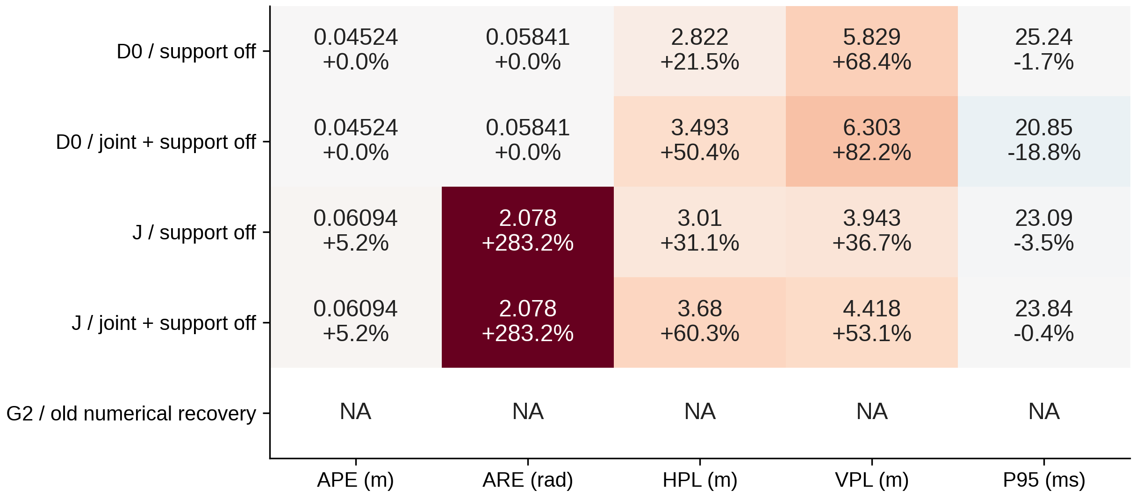
E07 — Ablations: Which Integrity Components Actually Matter?
Are rolling constraints and recovery logic causally necessary, or just complexity?
Removing support/joint constraints widens PL; the old G2 numerical candidate commits 0/80
M — same center
Old/new PL at one committed tag center: a
tightening witness.
A — full trajectory
Changing fault support can change the
subsequent state trajectory.
P — performance
Whole-service measurements; do not sum
module percentiles.
G2: 0/80; epoch1 abort = 4.874 ms.
APE / PL: NA; no common valid baseline.
Joint + support is a combined switch.
Cells show actual values and signed changes from matched FULL; red means increase and blue means decrease. G2 has no qualified output, so APE/PL are NA; the
joint/sample0 switch also removes support and cannot isolate both effects.
Takeaway: Set constraints and geometry-aware numerical recovery have measurable effects; failures remain visible.
Source: SC8_RESULTS, E07; frozen solver 61907ab; T-SIM: conditional tag-position PL
12/15
Notes:
• M means same committed center, A means full trajectory comparison and P means performance.
• Disabling terminal support reverts to a valid conservative box.
• The joint/sample0 ablation is a combined joint-plus-support reversion, not two independently isolated effects.
• G2 disables dedicated numerical recovery and commits zero of eighty epochs; its measured abort cost is retained in the report.
Frozen solver: 61907ab417450d317e443e4ff10f2cce062deabe. Entry HEAD: fa5b3dc9ffe3c88492352491d79ba022f373bfb5. Result status: SC8_EVALUATED_WITH_EXECUTION_GAPS.
Figure provenance: FIGURE_SOURCES.json; metric details: NUMERICAL_CLAIMS.json; slide 12.

Slide 13
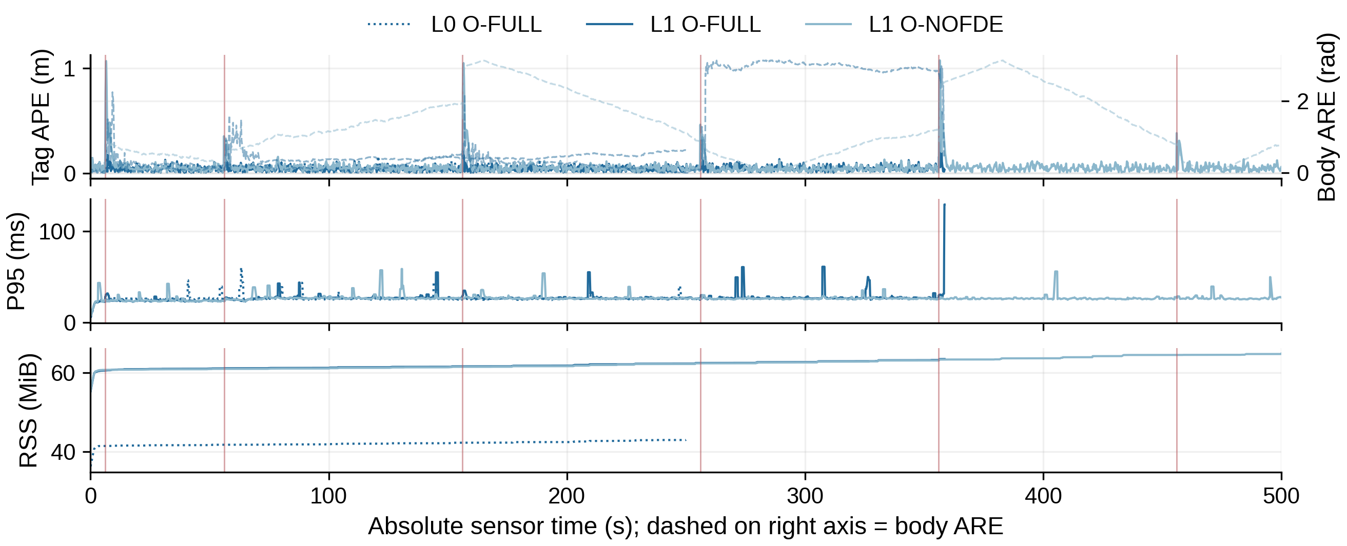
E08 — Long-Run Integrity:
Healthy Complete, Repeated-Fault Case Censored
Does the full pipeline sustain 10,000 epochs and process the last injected fault?
All three processes exit SUCCESS; actual FULL L1 coverage is 7171/10000, not full completion
Run
Committed /
plan
Queue
peak
L0 FULL
5000/5000
13
L1 FULL
7171/10000
80
L1 NOFDE
10000/10000
15
FULL L1: 2,829 refused epochs.
The final scheduled fault is unverified.
Slots grow; bounded active window
does not mean constant total memory.
Curves stop at actual committed output; a blank FULL suffix is unprocessed data, not zero error. Vertical marks are scheduled faults, and the final episode beyond epoch 7171
was not verified by FULL.
Takeaway: Continuous recovery at scale is unproven: FULL stops where the no-FDE route continues.
Source: SC8_RESULTS, E08; frozen solver 61907ab; T-SIM: conditional tag-position PL
13/15
Notes:
• Process SUCCESS does not imply the ten-thousand-epoch FULL plan completed.
• The producer released the full schedule but queue delivery and actual commits ended early for FULL.
• NOFDE continues to the final scheduled episode, but it implements a different fault-handling policy.
• Slots grow with time despite a bounded active state window; there is no constant-memory or perpetual full-state observability claim.
Frozen solver: 61907ab417450d317e443e4ff10f2cce062deabe. Entry HEAD: fa5b3dc9ffe3c88492352491d79ba022f373bfb5. Result status: SC8_EVALUATED_WITH_EXECUTION_GAPS.
Figure provenance: FIGURE_SOURCES.json; metric details: NUMERICAL_CLAIMS.json; slide 13.

Slide 14
Synthesis — What We Have Demonstrated, and What Remains Open
Which claims can we defend in a paper today?
Demonstrated: conditional method + measured simulation results; not hardware-qualified real integrity
Defensible claim
Direct SC8 evidence
Boundary / not established
Conditional rolling position PL
77,131 qualified receipts; 0 observed
underbounds
Registered source/noise/fault law only; correlated
observations
Healthy tag positioning ≈5 cm
3 fixed independent simulation seeds
Different initialization information from SFUISE
FDE benefit is fault-specific
Accel/joint position gains; gyro regression
Attitude / late recovery can deteriorate
Real comparison remains incomplete
Walk/STAR interface gaps; real FDE censoring
Engineering empirical results; no raw real
qualification
Default small window justified
25.096 → 795.501 ms healthy core P95
Longer lag helps this fault stream; not generally
real-time
Additional gaps: SFUISE velocity/bias export; invalid history prefix; weak-UWB and S1/S2 studies omitted.
Each row pairs a defensible claim with direct evidence and its limiting assumptions. Mathematical containment, empirical error, execution continuity and application
certification answer different questions.
Takeaway: The strongest current contribution is conditional rolling fault-aware position integrity; real execution remains
open.
Source: SC8_RESULTS, Synthesis; frozen solver 61907ab; conditional SIM / empirical REAL separated
14/15
Notes:
• The 77131 receipts span correlated scenarios and windows, rather than independent risk trials.
• State estimation, integrity validity, deadline passage and application availability are distinct results.
• Real calibration, engineering execution, historical export support and missing SFUISE state metrics remain explicit gaps.
• Weak-UWB amplitude and S1/S2 bias studies were not registered and are not filled with older SC7 data.
Frozen solver: 61907ab417450d317e443e4ff10f2cce062deabe. Entry HEAD: fa5b3dc9ffe3c88492352491d79ba022f373bfb5. Result status: SC8_EVALUATED_WITH_EXECUTION_GAPS.
Figure provenance: FIGURE_SOURCES.json; metric details: NUMERICAL_CLAIMS.json; slide 14.

Slide 15
Questions for the Advisor — Decisions Needed Before the Next Study
Which scope, resources and priorities should guide the next study?
Proposed next action: close independent calibration → stabilize real FDE → limited newly frozen rerun
1. Publication scope
2. Independent calibration resources
Should the near-term paper focus on the conditional rolling raw
position PL + joint FDE architecture, with honest
execution/real-data limitations, or is physically qualified real-data
integrity required before submission?
Can we obtain independent tracker↔IMU/body↔tag 6-DoF
extrinsics, timing and anchor-world references, or collect a new
calibration sequence with three-axis motion and independent
held-out TEST?
Decision: theory + qualified simulation first, or hardware validation first.
Decision: identify the hardware/protocol owner and available sensors.
3. State recovery or execution continuity
4. Application integrity requirements
Should we prioritize explaining and fixing gyro-induced attitude
degradation / long-term state recovery, or first make engineering
FDE process complete real recordings within a bounded
resource budget?
For the intended deployment, what HAL / VAL, TTA, covered
fault classes and failure action should determine meaningful
protected availability?
Decision: algorithmic research priority or engineering qualification
priority.
Decision: target application and first defensible safety requirements.
The four questions request concrete decisions on scope, calibration resources, recovery priorities and application requirements. The next protocol should follow those
decisions before a limited, newly frozen rerun.
Takeaway: Requested outcome: agree on the paper scope, calibration resource owner and research priority order.
Source: SC8_RESULTS, Decisions; frozen solver 61907ab; conditional SIM / empirical REAL separated
15/15
Notes:
• Ask for a near-term publication scope rather than an abstract endorsement.
• Identify an owner for independent extrinsics, clocks and held-out calibration data.
• Choose whether state-recovery research or bounded engineering execution comes first.
• Agree on application HAL, VAL, TTA, covered faults and failure action before the next protocol.
Frozen solver: 61907ab417450d317e443e4ff10f2cce062deabe. Entry HEAD: fa5b3dc9ffe3c88492352491d79ba022f373bfb5. Result status: SC8_EVALUATED_WITH_EXECUTION_GAPS.
Figure provenance: FIGURE_SOURCES.json; metric details: NUMERICAL_CLAIMS.json; slide 15.

