Slide 1
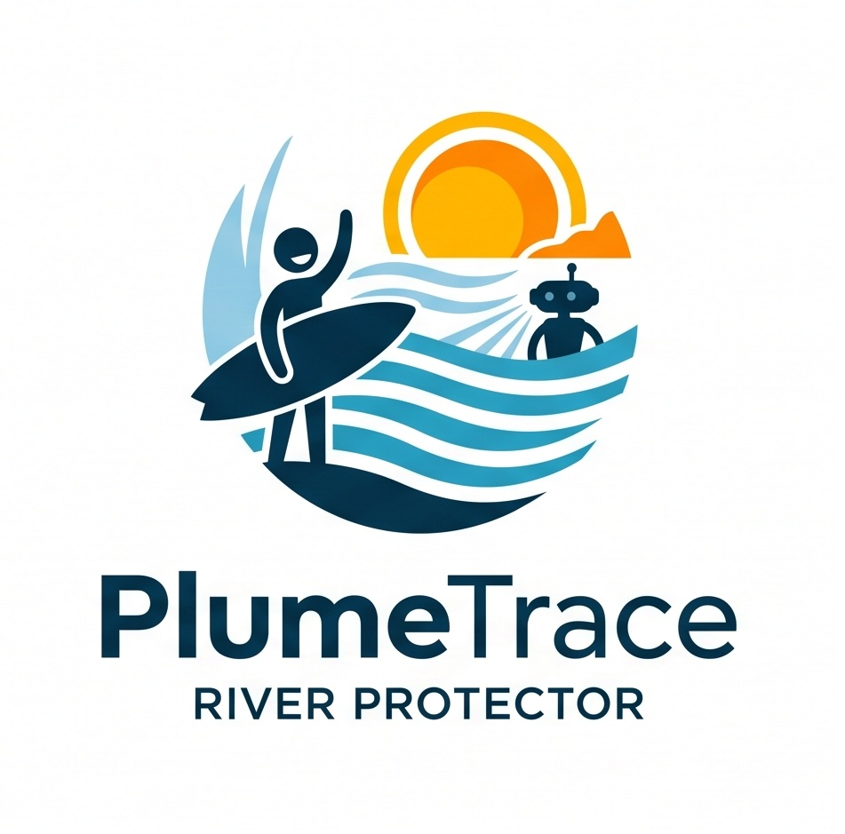
PlumeTrace
Autonomous Water Protection for the Pegnitz River
Notes:
Good morning members of the jury and mentors. Today, we present PlumeTrace - an autonomous, closed-loop Digital Twin system designed to protect urban rivers.
Across Europe, urban rivers are essential for recreation, drinking water, and ecology. Yet beneath the surface, they face sudden, unmonitored pollution events that traditional testing completely misses.
Using the Pegnitz River in Nuremberg as our testbed, we demonstrate how coupling an autonomous robotic agent with a real-time predictive Digital Twin transforms water quality monitoring from blind, infrequent sampling into actionable protection.

Slide 2




Why Pegnitz
Public Health
Sewer Overflows (CSOs)
- Raw sewage spikes after convective rainfall
- Instant health risk for surfers, waders, and park visitors
- 1,500 km municipal network overloaded by storms
- 1.5M - 5M+ EUR cost per retention basin
Knoblauchsland Agriculture
Summer Heat and Drought
- Nitrate leaching into drinking water aquifers
- Strict EU limits and compliance penalties
- Low flow concentrates urban pollutants
- Dissolved oxygen drops < 3 mg/L (fish kills)
Notes:
Why the Pegnitz River? Because it represents four urgent pressures colliding in one urban corridor:
First, Public Health: Surfers at the Fuchslochwelle wave and waders face raw sewage contamination after storms, creating immediate health risks.
Second, Urban Infrastructure: Nuremberg's 1,500 km sewer network overspills during heavy rains. Modernizing a single retention basin costs between 1.5 and 5 million euros - cities cannot afford to invest blindly.
Third, Agriculture: Intensive vegetable farming in Knoblauchsland leaches nitrates into alluvial drinking water aquifers under strict EU penalties.
And fourth, Climate Drought: Summer heat reduces river discharge, collapsing oxygen levels below 3 mg/L and killing fish.

Slide 3


Current Monitoring
Municipal Authorities
Stadtentwässerung Nürnberg (SUN) & WWA
The Sampling Gap
- Temperature, pH, conductivity, turbidity
- Dissolved oxygen and nutrients (Nitrate, Phosphate)
- Ammonium (NH4+): primary raw sewage tracer
- Automatic sensors: continuous, but confined to few fixed locations
- Manual grab sampling: often only 1x per month (24-48h lab delay)
- Convective storm overflows: last only 2 to 4 hours
The Result: Plume arrives, causes harm, and clears undetected.
Notes:
To address this, we looked at what municipal authorities currently measure.
In Nuremberg, the drainage service SUN tracks eight standard parameters: temperature, pH, conductivity, turbidity, dissolved oxygen, and nutrients like ammonium, nitrate, and phosphate. Ammonium is the critical chemical fingerprint of raw sewage.
The sampling gap is two-fold: automated sensors are confined to a few fixed points, while manual sampling happens as rarely as once a month with days of lab delay. The result: acute plumes arrive, cause damage, and clear completely undetected.

Slide 4


Key Stakeholders
Water Authorities (WWA, SUN)
Citizens and Surfers
- Cannot locate pollution origin (fixed stations lack spatial tracking)
- Blind infrastructure spending (1.5M - 5M+ EUR per basin without plume data)
- Chronic pipe seepage undetected until structural failure
- Lab results arrive 24-48 hours too late for emergency action
- Zero real-time visibility into water safety
- Unknowingly enter water during toxic overflow events
- High risk of gastrointestinal and skin infections
- Delayed municipal reports provide no immediate guidance
Notes:
This monitoring failure creates acute problems for our two key stakeholder groups today:
First, Water Authorities like SUN and WWA: They must invest millions of euros into retention basins, but without spatial plume tracking, they are forced to invest blindly without knowing which overflow pipes cause the greatest damage. Furthermore, laboratory delays mean they only learn of acute spills days after they have already washed away.
Second, Citizens and Surfers: People entering the Pegnitz at the Fuchslochwelle or in city parks have zero real-time warning. They unknowingly expose themselves to acute bacterial contamination because municipal data is either delayed by days or buried in complex chemical reports.

Slide 5



The PlumeTrace Architecture
Autonomous River Robot
Predictive Digital Twin
Municipal Command Center
- Autonomous Surface Vessel (ASV) on Pegnitz
- Continuous chemical payload (Ammonium, DO, pH)
- 360° LiDAR scans riverbank morphology & culverts
- Edge autonomy with fail-safe return-to-dock
- Hydrodynamic river advection-dispersion model
- Ingests live DWD storm radar & river discharge
- Multi-objective solver computes optimal sampling
- Continuously directs robot where to navigate next
- Geospatial 3D twin with Bavarian LOD2 data
- Real-time pollution heatmaps & outfall health
- Pinpoints exact sewer outfalls causing violations
- Automated statutory alerts (<60s) to WWA & SUN
Notes:
Here is our overarching technical solution: PlumeTrace connects physical robotics, cloud digital twinning, and municipal decision-making into one unified ecosystem.
First, on the water: An Autonomous Surface Vessel continuously patrols the Pegnitz corridor, equipped with chemical sensors for ammonium and dissolved oxygen, and 360-degree LiDAR mapping riverbank morphology.
Second, in the cloud: A predictive Digital Twin runs hydrodynamic advection-dispersion modeling. By assimilating real-time weather radar from the German Weather Service (DWD) and river discharge, the twin anticipates where storm runoff will arrive and tells the robot where to navigate next.
Third, in the city hall: A 3D geospatial dashboard built on CesiumJS and Bavarian LOD2 OpenData translates raw data into outfall asset health scores, enabling targeted infrastructure investment and immediate public warnings.

Slide 6


Autonomous Closed-Loop Guidance
4D Adaptive Retasking
Why Digital Twinning?
- Dynamically recomputes waypoints in real time
- Chemical Gradient: homes upstream to leaking pipe
- Storm Rain Radar: pre-positions vessel before runoff
- Data Freshness: prioritizes unvisited river reaches
- Dynamic goal updates dispatched in under 35 seconds
- Active Gradient Tracing overcomes point dilution
- Predictive storm anticipation replaces reactive lab lag
- One mobile vessel replaces 50+ biofouled static probes
- Continuous feedback synchronizes twin with physical state
- Empirical evidence justifies targeted retention investments
Notes:
The core innovation of PlumeTrace is its Autonomous Closed Loop.
Instead of driving a static patrol line, our system continuously recomputes waypoints based on a 4D objective function: tracking chemical gradients upstream, anticipating rain runoff via live weather radar, and ensuring older areas are revisited.
Why does digital twinning beat traditional static sensors? Static probes suffer from point dilution: they tell you pollution passed, but cannot identify where it originated. By coupling physical sensing with predictive twin simulation, we pinpoint the exact leaking outfall in minutes.

Slide 7

Stakeholder Action & AI Public Access
City & Authority Command
AI Public Access via MCP
- Outfall Asset Health: links chemical spikes to specific pipe IDs
- Targeted CapEx: empirical proof for 1.5M - 5M+ EUR basin upgrades
- Chronic Seepage: uncovers leaking pipes before structural collapse
- Automated compliance logs for EU Water Framework Directive & OGewV
- Model Context Protocol (MCP) connects AI models to live twin data
- Conversational Queries: 'Can I surf at Fuchslochwelle today?'
- Live Citizen Traffic Light: instant Green / Yellow / Red alerts
- Eliminates 48h lab delay with direct public health warnings
Notes:
Finally, how do stakeholders interact with PlumeTrace?
For Water Authorities (SUN & WWA): We provide concrete asset intelligence. By assigning health scores to specific outfall IDs, we provide the empirical justification needed to prioritize multi-million euro retention basin expansions.
For Citizens and Surfers: We expose the Digital Twin via the Model Context Protocol (MCP). Anyone can ask an AI assistant: 'Can I surf at the Fuchslochwelle wave today?' or 'Is the river safe for my dog right now?'. The AI queries live telemetry and forecasts, returning a clear traffic light advisory (Green, Yellow, or Red). This transforms complex environmental chemistry into immediate, transparent public safety.

