Slide 1
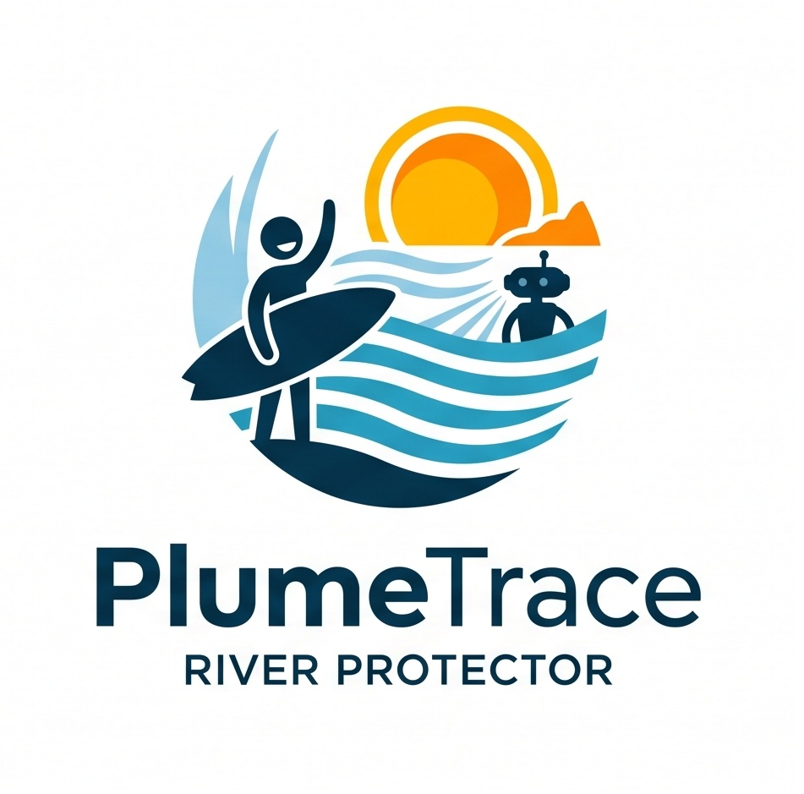
PlumeTrace
Autonomous Water Protection for the Pegnitz River
Notes:
Good morning members of the jury and mentors. Today, we present PlumeTrace - an autonomous, closed-loop Digital Twin system designed to protect urban rivers.
Across Europe, urban rivers are essential for recreation, drinking water, and ecology. Yet beneath the surface, they face sudden, unmonitored pollution events that traditional testing completely misses.
Using the Pegnitz River in Nuremberg as our testbed, we demonstrate how coupling an autonomous robotic agent with a real-time predictive Digital Twin transforms water quality monitoring from blind, infrequent sampling into actionable protection.

Slide 2
Why Pegnitz
Public Health
- Raw sewage spikes after rainfall
- Instant health risk for surfers, waders, and park visitors
Sewer Overflows (CSOs)
- 1,500 km municipal network overloaded by storms
- 1.5M - 5M+ EUR cost per retention basin
Knoblauchsland Agriculture
- Nitrate leaching into drinking water aquifers
- Strict EU limits and compliance pressure
Summer Heat and Drought
- Low flow concentrates pollutants
- Dissolved oxygen drops < 3 mg/L (fish kills)
Notes:
Why the Pegnitz River? Because it represents four urgent pressures colliding in one urban corridor:
First, Public Health: Surfers at the Fuchslochwelle wave and waders face raw sewage contamination after storms, creating immediate health risks.
Second, Urban Infrastructure: Nuremberg's 1,500 km sewer network overspills during heavy rains. Modernizing a single retention basin costs between 1.5 and 5 million euros - cities cannot afford to invest blindly.
Third, Agriculture: Intensive vegetable farming in Knoblauchsland leaches nitrates into alluvial drinking water aquifers under strict EU penalties.
And fourth, Climate Drought: Summer heat reduces river discharge, collapsing oxygen levels below 3 mg/L and killing fish.

Slide 3
Current Monitoring
Municipal Authorities
Stadtentwässerung Nürnberg (SUN) & Wasserwirtschaftsamt (WWA)
- Temperature, pH, conductivity, turbidity
- Dissolved oxygen and nutrients (Nitrate, Phosphate)
- Ammonium (NH4+): primary raw sewage tracer
The Sampling Gap
- Automatic sensors: continuous, but confined to few fixed locations
- Manual grab sampling: often only 1x per month (24-48h lab delay)
- Convective storm overflows: last only 2 to 4 hours
The Result: Plume arrives, causes harm, and clears undetected.
Notes:
To address this, we looked at what municipal authorities currently measure.
In Nuremberg, the drainage service SUN tracks eight standard parameters: temperature, pH, conductivity, turbidity, dissolved oxygen, and nutrients like ammonium, nitrate, and phosphate. Ammonium is the critical chemical fingerprint of raw sewage.
The sampling gap is two-fold: automated sensors are confined to a few fixed points, while manual sampling happens as rarely as once a month with days of lab delay. The result: acute plumes arrive, cause damage, and clear completely undetected.

Slide 4
Key Stakeholders
Water Authorities (WWA, SUN)
- Cannot locate pollution origin (fixed stations lack spatial tracking)
- Blind infrastructure spending (1.5M - 5M+ EUR per basin without plume data)
- Chronic pipe seepage undetected until structural failure
- Lab results arrive 24-48 hours too late for emergency action
Citizens and Surfers
- Zero real-time visibility into water safety
- Unknowingly enter water during toxic overflow events
- High risk of gastrointestinal and skin infections
- Delayed municipal reports provide no immediate guidance
Notes:
This monitoring failure creates acute problems for our two key stakeholder groups today:
First, Water Authorities like SUN and WWA: They must invest millions of euros into retention basins, but without spatial plume tracking, they are forced to invest blindly without knowing which overflow pipes cause the greatest damage. Furthermore, laboratory delays mean they only learn of acute spills days after they have already washed away.
Second, Citizens and Surfers: People entering the Pegnitz at the Fuchslochwelle or in city parks have zero real-time warning. They unknowingly expose themselves to acute bacterial contamination because municipal data is either delayed by days or buried in complex chemical reports.

Slide 5
System Architecture
Physical Platform
- TurtleBot3 surface robotics testbed
- ROS 2 Jazzy onboard computing
- LDS-02 LiDAR and overhead tracking
- Emulated chemical sensor payload
Simulation Mirror
- Gazebo Harmonic physics engine
- Bi-directional ROS-Gazebo bridge
- Ghost follower pose tracking
- Dynamic obstacle injection
3D Digital Twin
- CesiumJS with Bavarian LOD2 3D data
- Real-time WebSocket telemetry stream
- Geo-referenced pipe outfall health
- Interactive urban risk heatmaps
Notes:
To solve this, we designed the PlumeTrace System Architecture across three tightly synchronized tiers:
On the water, our Physical Platform is a robotic surface vessel equipped with ROS 2 Jazzy, 360-degree LiDAR, tracking cameras, and emulated real-time chemical payloads.
In the cloud, a Simulation Mirror running Gazebo Harmonic tracks physics and obstacles in real time, validating robot health and sensor sanity.
At the command level, our 3D Digital Twin in CesiumJS visualizes Bavarian LOD2 building and river geometry, streaming live WebSocket telemetry to generate actionable heatmaps and asset health scores for city managers.

Slide 6
Autonomous Closed Loop
4D Adaptive Retasking
- Dynamically recomputes waypoints in real time
- Chemical Gradient: homes upstream to leaking pipe
- Rain Radar: pre-positions robot before storm runoff
- Data Freshness: prioritizes unvisited river reaches
Safety and Resilience
- Dual obstacle cloud: reroute navigation vs collision stop
- Edge buffer: zero data loss during network dropouts
- Tri-fold sync: odometry, AMCL, and Gazebo alignment
- Dynamic Nav2 goal updates in under 35 seconds
Notes:
The core innovation of PlumeTrace is its Autonomous Closed Loop.
Instead of driving a static patrol line, our system continuously recomputes waypoints based on a 4D objective function: tracking chemical gradients upstream, anticipating rain runoff via live weather radar, and ensuring older areas are revisited.
Crucially, we build in industrial resilience: a dual obstacle cloud separates smooth rerouting from emergency collision stops, while onboard edge buffers guarantee zero telemetry loss even when wireless links drop.

Slide 7
Why Mobile Robotics?
Gradient Tracing
- Tracks concentration gradients upstream
- Locates exact leaking pipe instead of diluted mix
Asset Intelligence
- Links water chemistry to specific municipal outfall IDs
- Direct evidence for multi-million EUR basin upgrades
River Corridor Mapping
- LiDAR detects riverbank erosion and sediment build-up
- Supports EU renaturation compliance
Operational Economics
- One self-cleaning mobile robot replaces 50+ fixed probes
- Eliminates biofouling and flood destruction
Notes:
Why does mobile robotics decisively outperform traditional fixed monitoring networks?
First, Gradient Tracing: A static sensor only tells you pollution passed by. A mobile robot follows the plume upstream directly to the faulty outfall pipe.
Second, Asset Intelligence: We give water authorities concrete evidence to prioritize multi-million euro infrastructure budgets.
Third, Corridor Mapping: LiDAR scans detect physical bank erosion and siltation for EU river renaturation programs.
And fourth, Economics: Instead of maintaining hundreds of submerged probes prone to biofouling and flood destruction, one mobile platform delivers continuous, protected spatial coverage.

