Slide 1

Polyphonic SED with depth-wise separable and dilated convolutions
Riccardo Prinzivalle
A.A 2020/2021
  Neural Networks

Slide 2
Introduction
Monophonic SED
Polyphonic SED
TUT-SED Synthetic 2016
UrbanSound8k
Initial replacement
Main Focus
Polyphonic SED
March 2021
Pagina <number>

Slide 3
Dataset analysis
100 audio files of some minutes length.
16 classes.
Maximum polyphony is 5.
Total of 36326 events.
Data are labeled as One-Hot encode based on onset and offset.
Polyphonic SED
March 2021
Pagina <number>

Slide 4





Frameworks used
Data Preprocessing
Neural Network API
Keras back-end
Polyphonic SED
March 2021
Pagina <number>

Slide 5
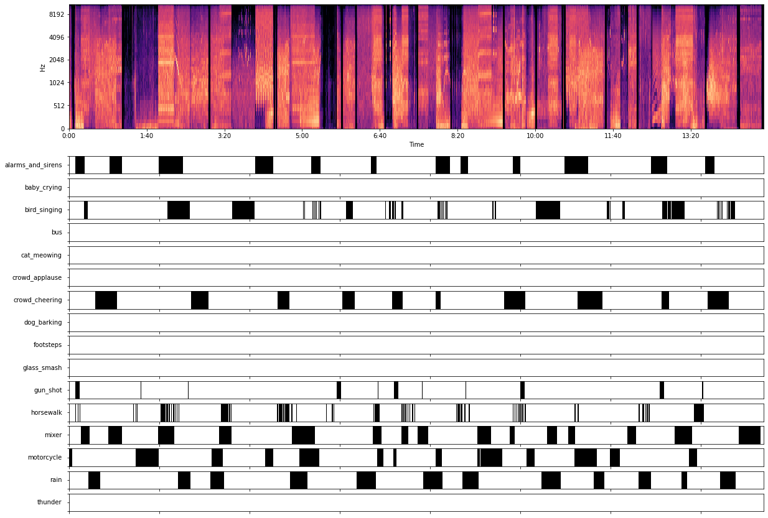
Data Pre-processing
Polyphonic SED
March 2021
Pagina <number>

Slide 6
Model Structure
Input
Baseline: standard convolutional layers
Proposed: Depth-wise separable convolutional layers
Feature Extractor
Baseline: Recurrent layer (GRU in this case)
Proposed: Dilated convolutional layer
Temporal Pattern Identification
Classifier
Dense layer in all the approaches
Output
Polyphonic SED
March 2021
Pagina <number>

Slide 7
Polyphonic results
Model | Accuracy | Loss | Training time | F1-score | Number of parameters | Dimension
Baseline | 0.962 | 0.1356 | 0:32 | 0.7156 | 3.7M | 43KB
Dilated | 0.966 | 0.115 | 7:30 | 0.7299 | 3.7M | 43KB
Dessed | 0.9532 | 0.1524 | 0:59 | 0.6332 | 0.5M | 6.5KB
Proposed model 1x1 conv | 0.9287 | 0.241 | 3:14 | 0.1245 | 0.5M | 6KB
Proposed model avg pooling | 0.9523 | 0.148 | 3:26 | 0.6281 | 0.5M | 6KB
Dessed stands for a model implementing depth-wise separable convolutions
Polyphonic SED
March 2021
Pagina <number>

Slide 8
Comparison with reference paper
This work
Reference paper
Higher scoring model is dilated.
Dilated convolutions need more time to be trained.
Proposed models have less parameters.
Higher scoring model is proposed one.
Slower model is baseline.
Proposed models have less parameters.
Polyphonic SED
March 2021
Pagina <number>

Slide 9
Thank You for
Your Attention
Polyphonic SED
March 2021

