Slide 1
Different types of network connectors

Slide 2
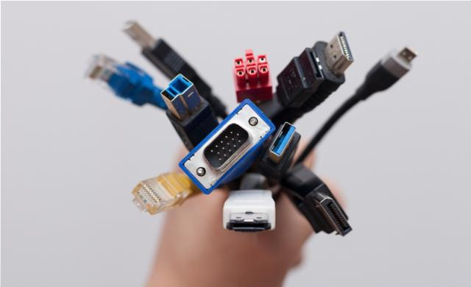
Types of Connectors
When you are installing a network, you need to have plenty of cable connectors for connecting patch panels to network switches and servers or computers. The types of wiring connectors used depends on the network cable types. When you are installing a network, you need to have plenty of cable connectors for connecting patch panels to network switches and servers or computers. The types of wiring connectors used depends on the network cable types. There are different connectors for Ethernet/twisted-pair, coaxial, USB and fiber optic cables. Ethernet Cable Connectors

Slide 3
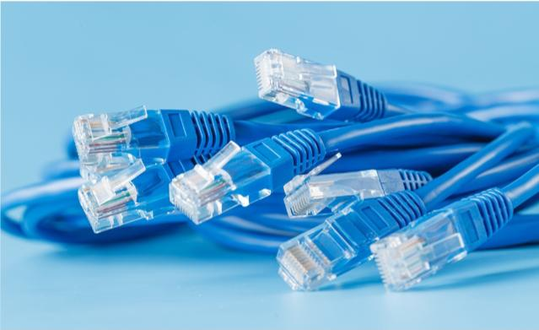
Ethernet Cable Connectors
These connectors for twisted-pair Ethernet cables are similar in appearance to a standard telephone cord connector. They are wider, however, because they have eight conductors compared to only four conductors on a telephone jack. To install these types of wiring connectors, a stripping tool is used to expose the twisted pairs of wires from the cable, which are then positioned into the appropriate slots on the terminal plug. The connector is then crimped to the cable using a crimping tool.

Slide 4
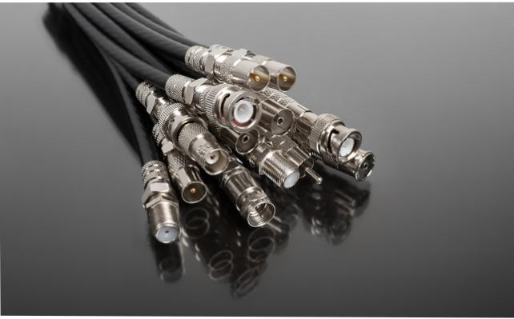
Coaxial Cable Connectors
BNC connectors are a type of F-series connectors commonly found in households. This type of connector for RG59 or RG6 coaxial cable is used for cable television equipment, broadcast TV antennas and CCTV security camera installations. They are easy to connect and disconnect from equipment and provide inexpensive, stable connections to these communications devices and other cables.
To install a BNC connector, use a stripping tool to remove protective shields from the cable. The connector is pushed onto the end and then squeezed around the conductive material using a special compression crimper.
Twist-on F-connectors are also available for making quick and easy repairs to TV equipment without the need for special tools.
BNC connectors are a type of F-series connectors commonly found in households. This type of connector for RG59 or RG6 coaxial cable is used for cable television equipment, broadcast TV antennas and CCTV security camera installations. They are easy to connect and disconnect from equipment and provide inexpensive, stable connections to these communications devices and other cables. To install a BNC connector, use a stripping tool to remove protective shields from the cable. The connector is pushed onto the end and then squeezed around the conductive material using a special compression crimper. Twist-on F-connectors are also available for making quick and easy repairs to TV equipment without the need for special tools.

Slide 5
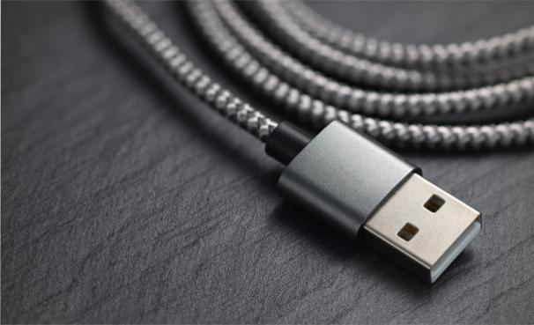
USB Connectors
USB connectors are the most familiar to the majority of people. USB (Universal Serial Bus) connectors typically join external devices to a personal computer or are used for mobile phone charging. There are adapters that will allow an Ethernet cable to connect directly to a USB port, though this type of setup would be a temporary solution for networking.

