Slide 1

OPTIMIZING PUBLIC TRANSIT OPERATIONS
An Exploratory Data Analysis of public transportation
By
Prisca Ndidi Muoghalu
MetroMove Transit Solutions is a public transportation service provider operating in multiple cities.
They manage and analyze thousands of daily trips taken via buses, trains, ferries, and trams.
The company's mission is to provide efficient, affordable, and timely public transportation services while leveraging data to improve passenger experience and optimize operations.
MetroMove has collected a large volume of trip data but lacks insights into trip performance, passenger behavior, and fare patterns due to messy, inconsistent, and incomplete records. As part of their new data-driven initiative, they want to clean, explore, and summarize their trip records to identify inefficiencies and patterns that can drive operational improvements.

Slide 2
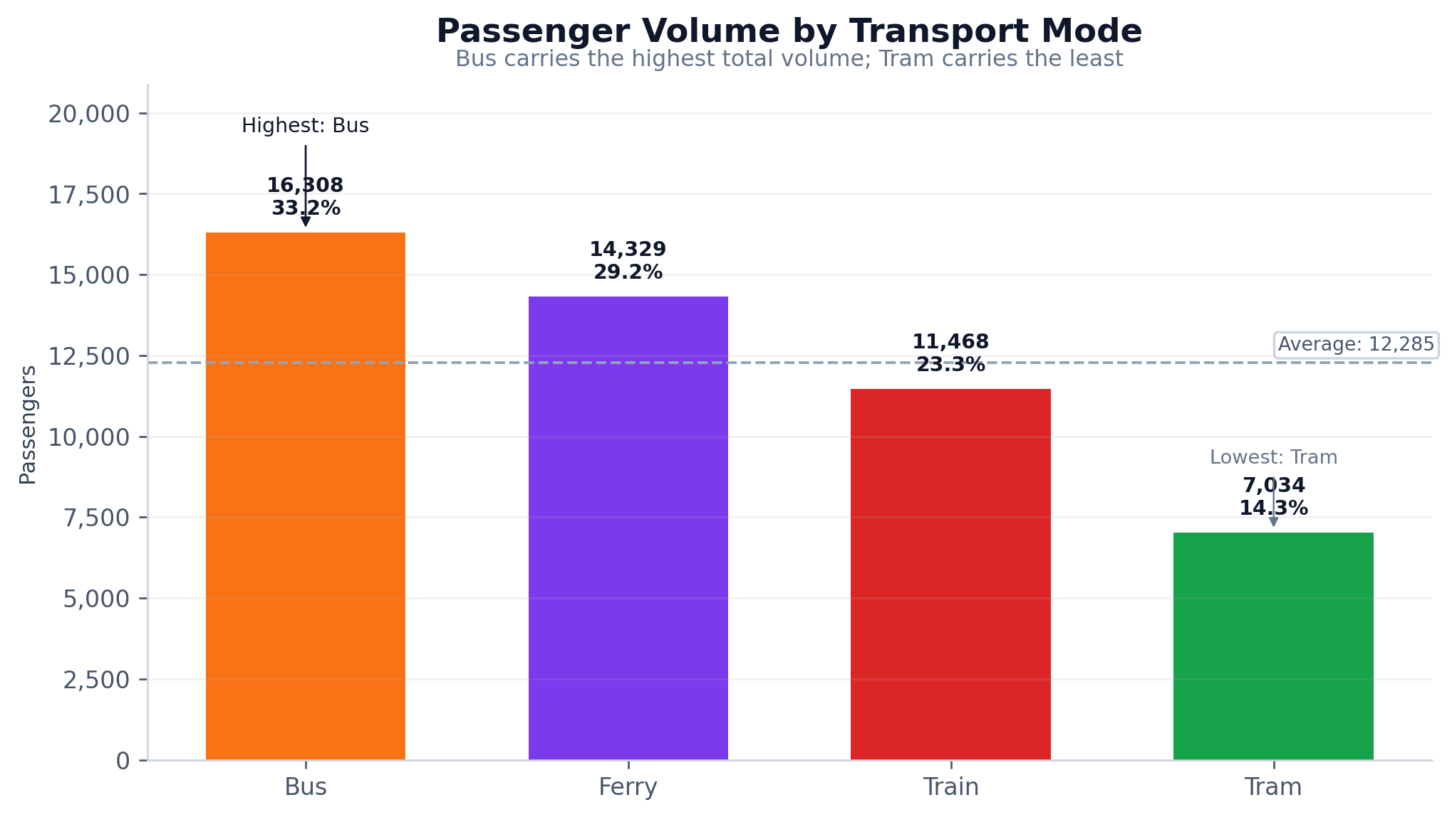
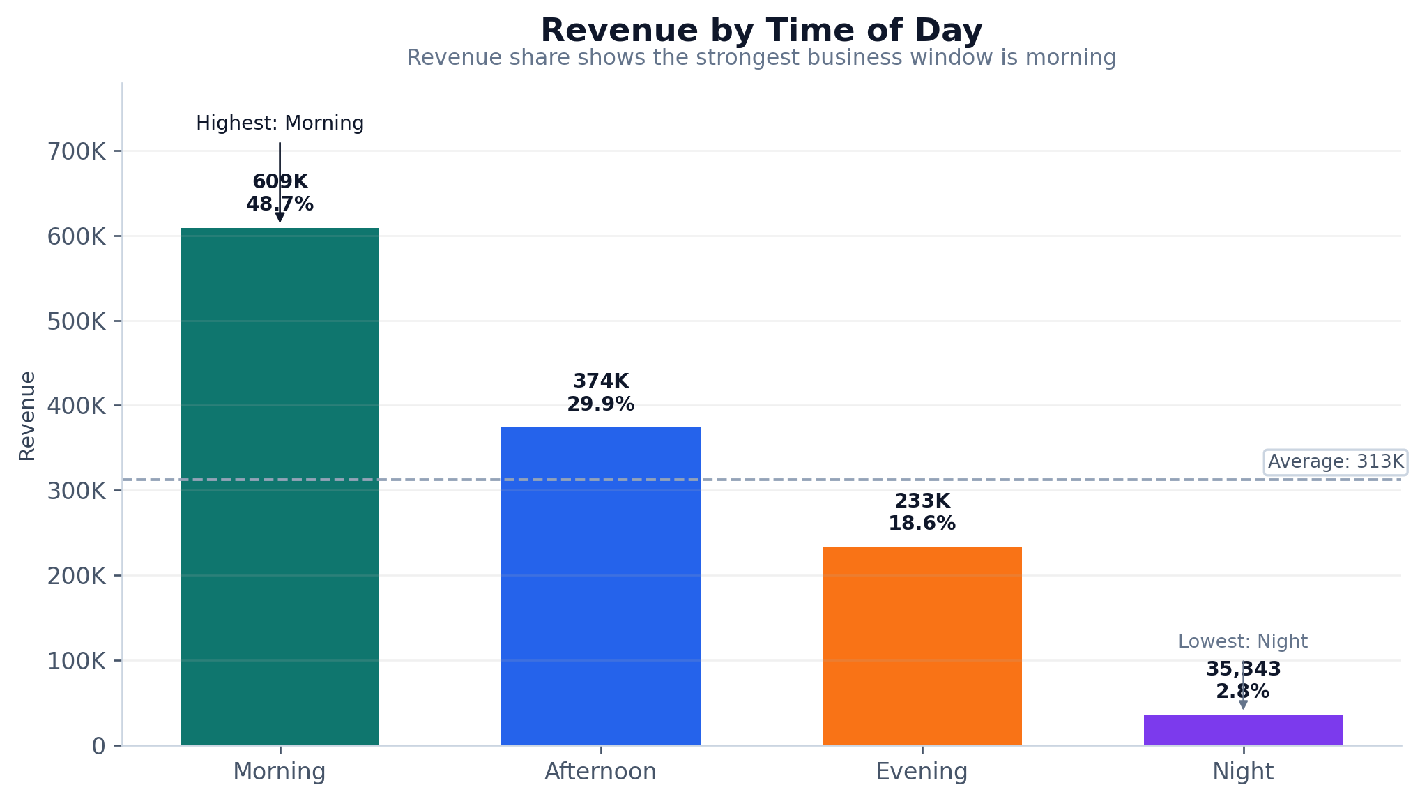
MetroMove Transit Solutions
Exploratory Data Analysis Capstone
Public transport trip performance, passenger behavior, fare patterns, and operational opportunities.
1,000
4
36
trip records analyzed
transport modes
origin–destination route pairs

Slide 3
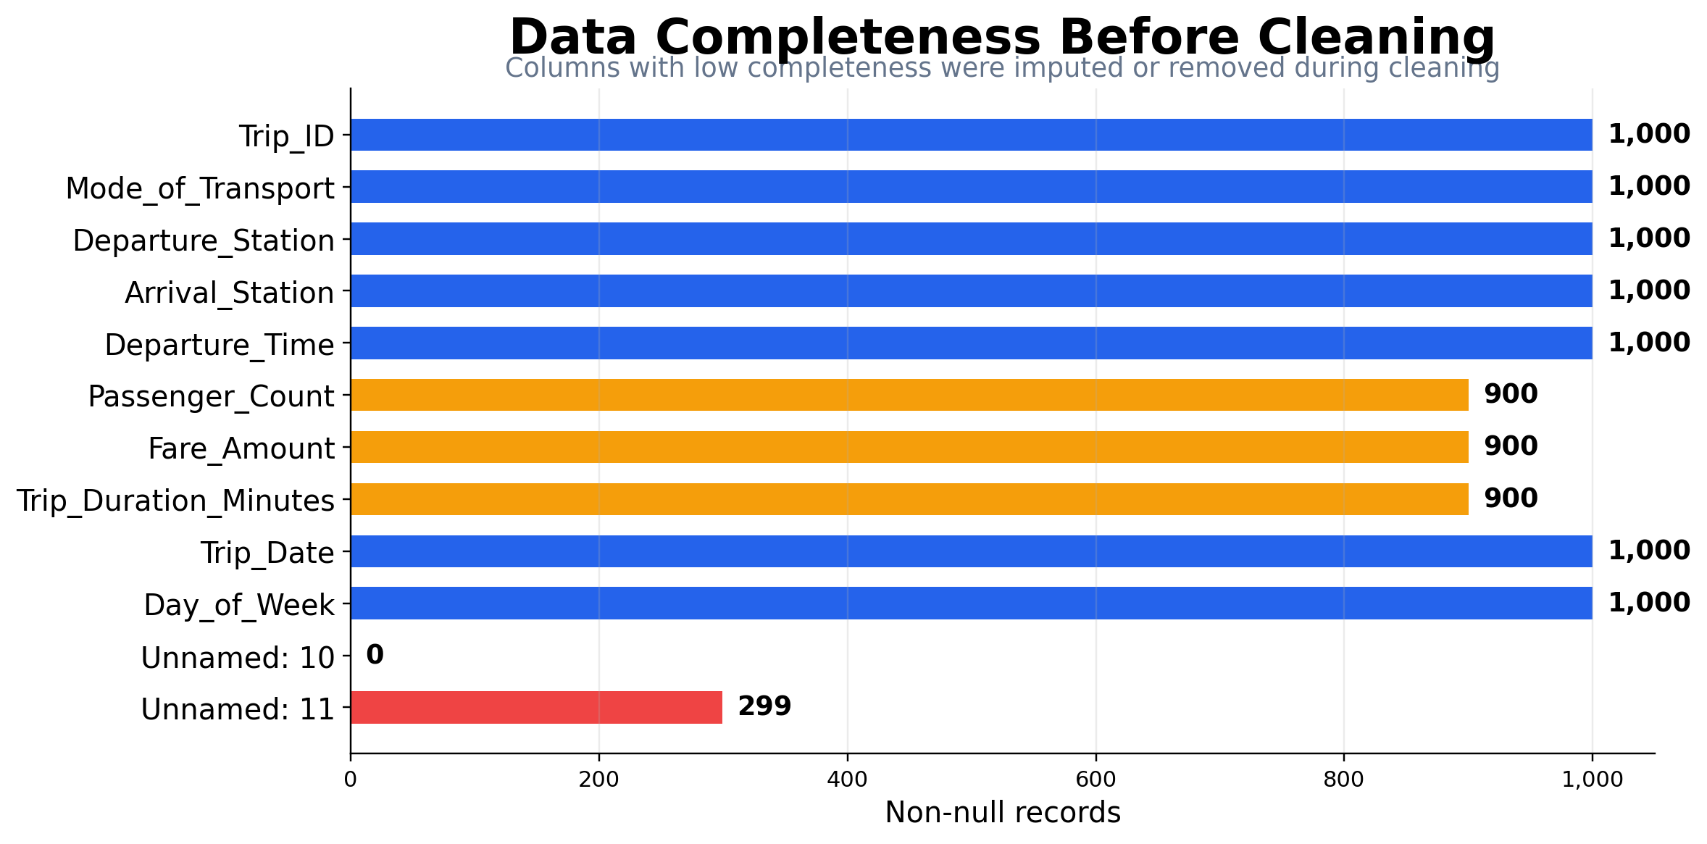
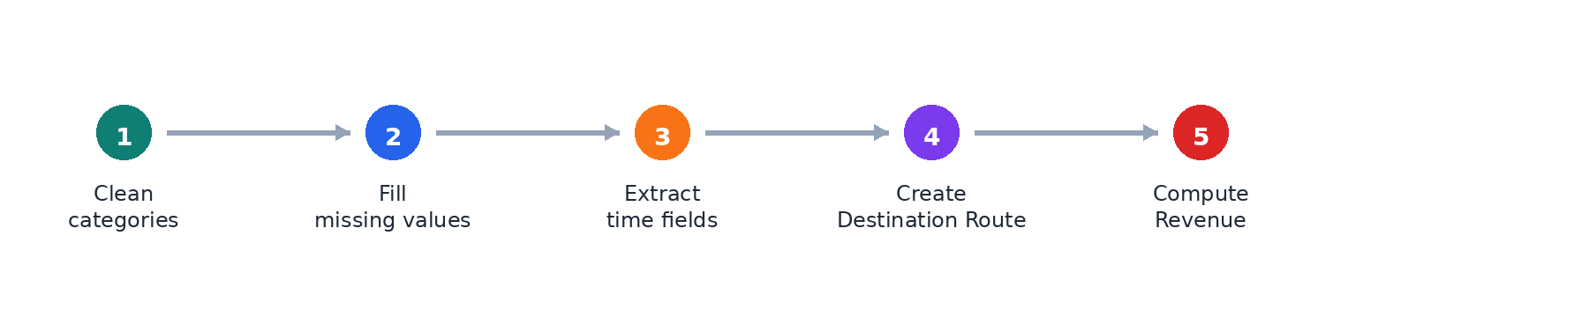
Cleaning & Preparation
EDA Capstone
The analysis first removed noise and standardized the operational fields.
Data quality fixes
1
Dropped two unnamed columns because they contained excessive missing data.
2
Filled Passenger Count, Fare Amount, and Trip Duration with rounded mean values.
3
Standardized inconsistent text labels such as FERRY/fErry and bus/BUS.
4
Cleaned station spelling and spacing, including Central and Airport variants.
After cleaning: no nulls remained across the final 10-column dataset.
5
Converted passenger count and trip duration to integer fields after imputation.
Source: EDA Capstone Project notebook
04

Slide 4
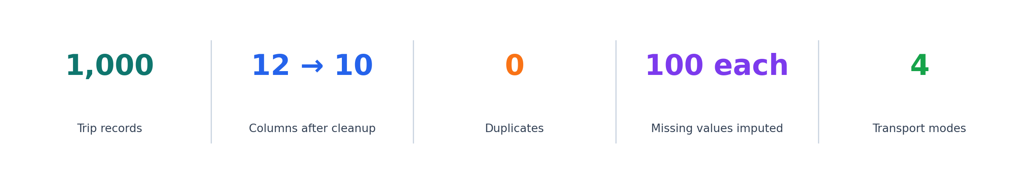
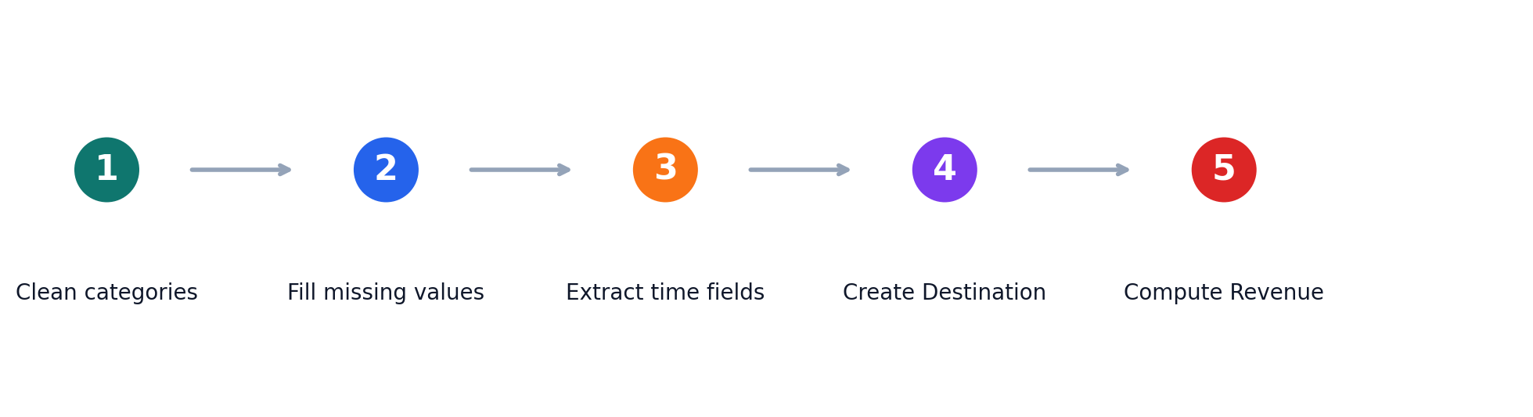
Business Context & Analysis Goal
EDA Capstone
Turning messy trip records into operational decisions.
MetroMove operates buses, trains, ferries, and trams across multiple cities. The capstone focuses on cleaning and exploring trip records to identify demand peaks, profitable routes, and service efficiency patterns.
Key questions
1
Where and when are passenger volumes highest?
2
Which transport modes carry the most demand and revenue?
3
Which routes are busiest or most valuable?
4
Do longer trips drive higher revenue?
Outcome: a cleaned dataset with derived time, route, and revenue features ready for business interpretation.
5
What data quality issues must be corrected first?
Source: EDA Capstone Project notebook
02

Slide 5
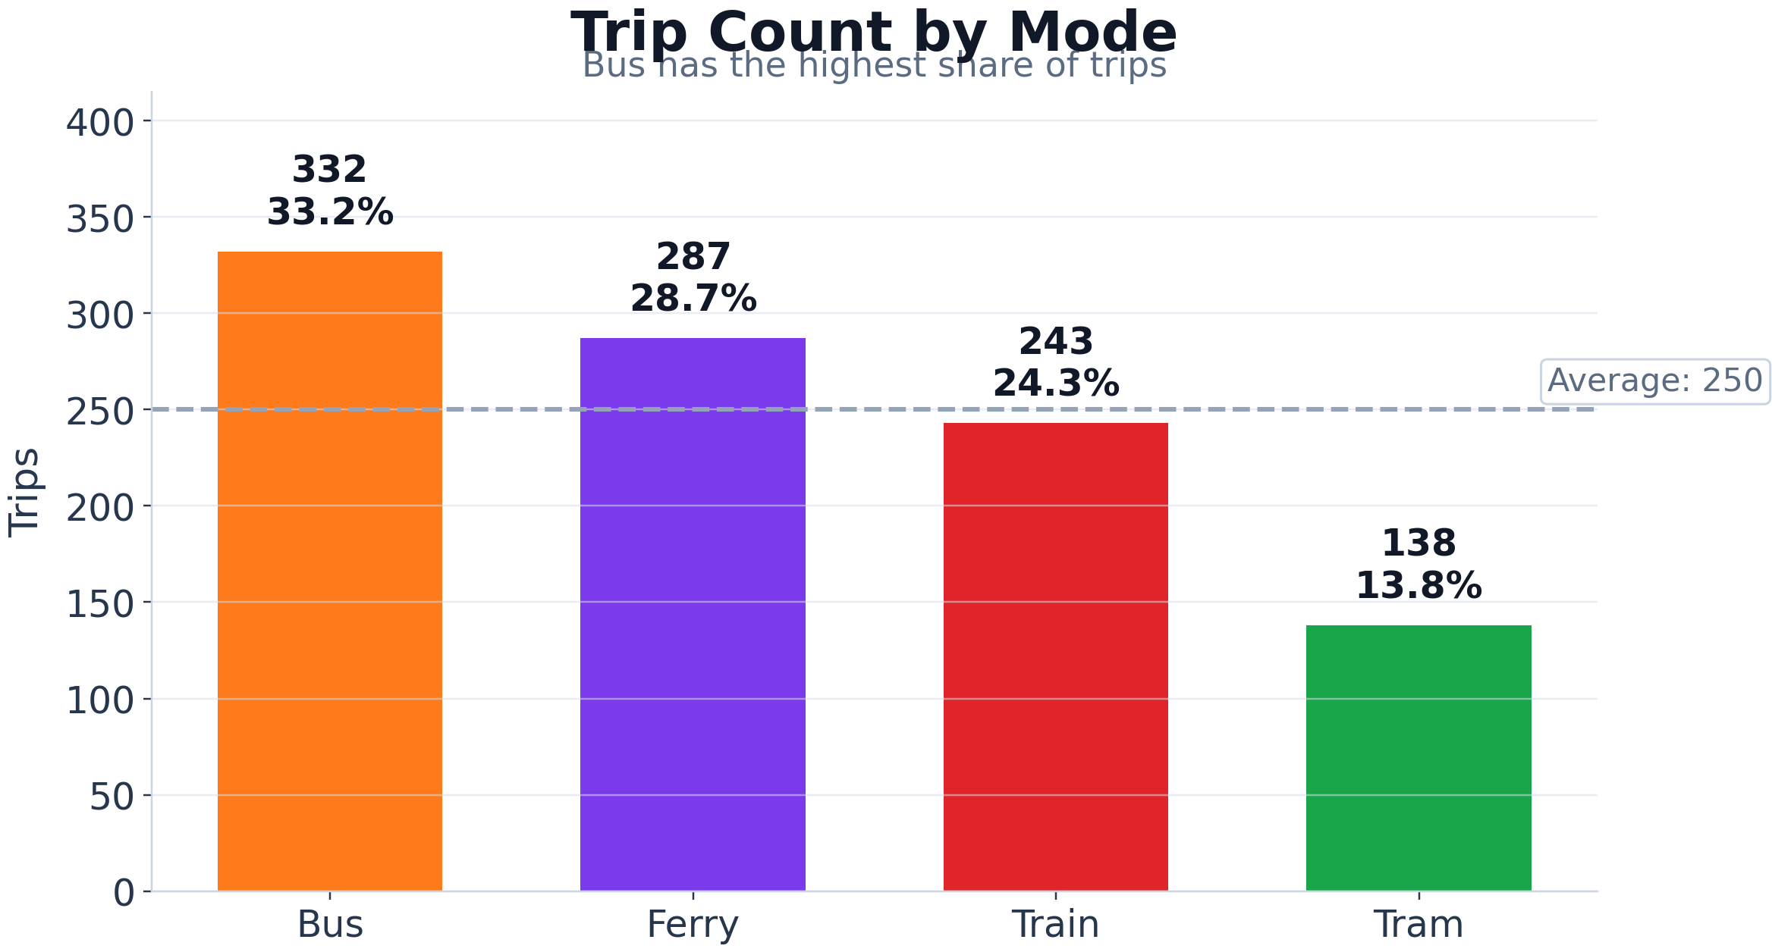
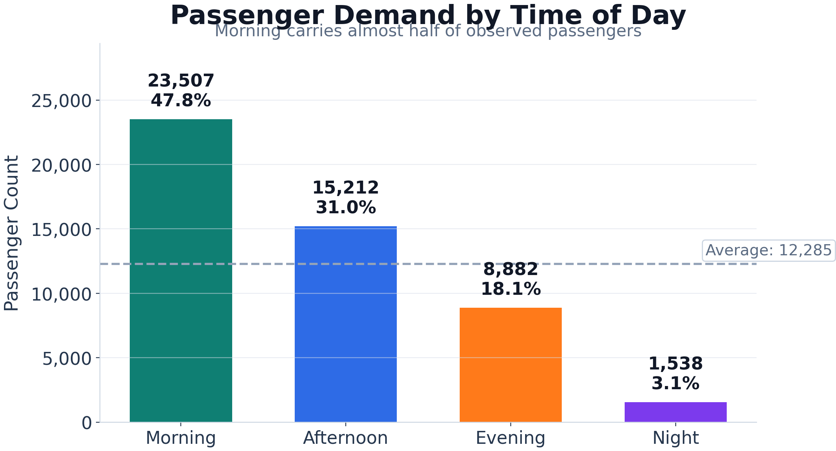
Dataset Snapshot
EDA Capstone
Core trip attributes used for cleaning, exploration, and feature engineering.
1,000
12
10
0
Rows / trip records
Original columns
Final cleaned columns
Duplicate rows
Fields analyzed: Trip ID, transport mode, departure/arrival stations, departure time/date, passenger count, fare amount, trip duration, and day of week.
Coverage: trip dates span January to February 2024; departure hours run from 06:00 to 22:00.
Source: EDA Capstone Project notebook
03

Slide 6
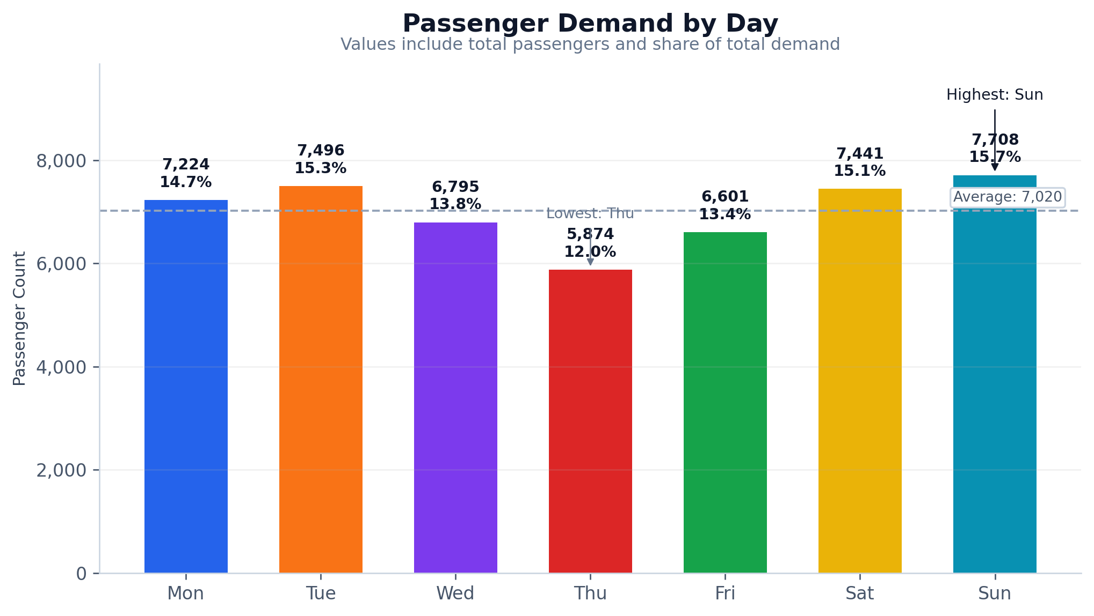
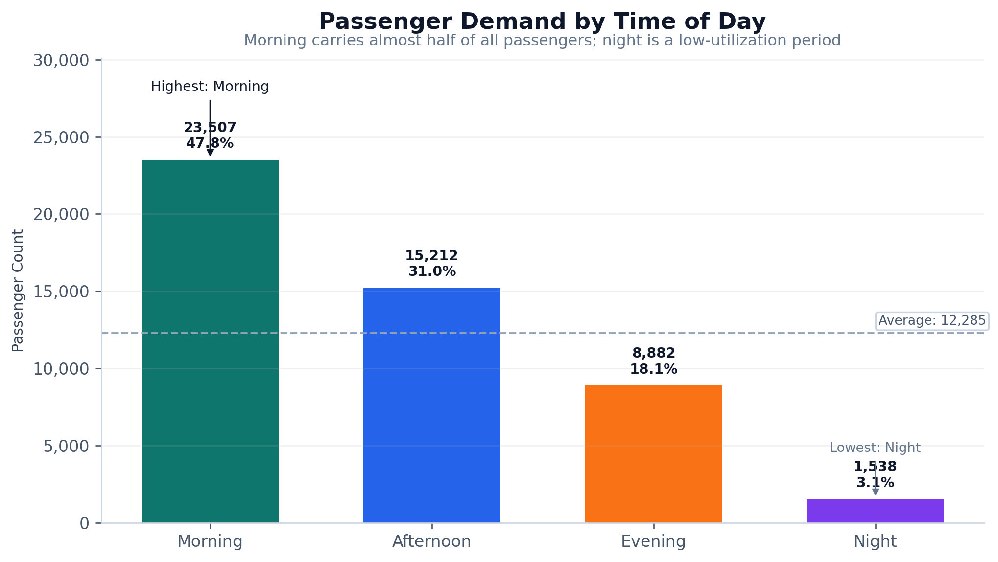
Passenger Demand Patterns
EDA Capstone
The detailed charts now show values, share of total demand, average lines, and highest/lowest callouts.
7,708
Sunday passengers: highest day
23,507
Morning passengers: 47.8% of demand
1,538
Night passengers: only 3.1% of demand
Operational reading
Demand is concentrated in the morning window, so capacity shortages are most likely during morning peak. Sunday should receive weekend-level staffing and fleet planning, while Thursday/night periods should be monitored for cost efficiency or targeted incentives.
Source: EDA Capstone Project notebook
05

Slide 7
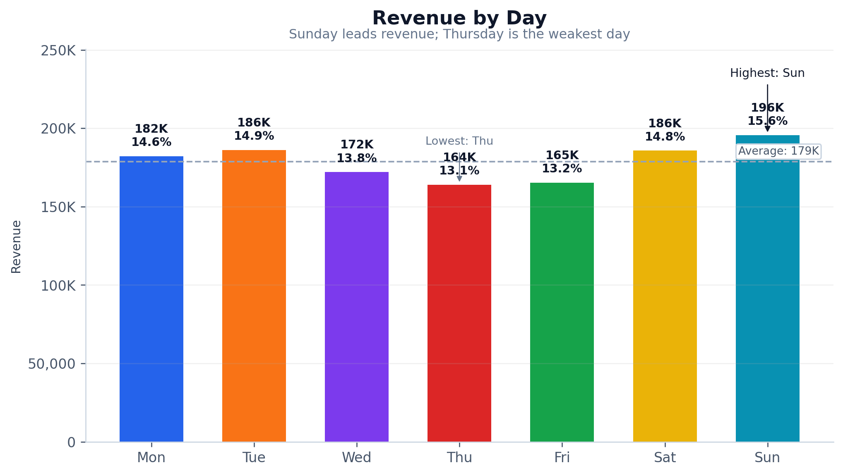
Revenue Patterns
EDA Capstone
Revenue detail is broken down by time, day, and month to show where earning power is concentrated.
Monthly Revenue Split
January dominates the observed period
January
938K | 75.0%
Revenue interpretation
Business implication
Morning trips generate 609K revenue, or 48.7% of total observed revenue. Sunday is the best revenue day at 195.7K, while Thursday is the weakest at 164.0K. January dominates the observed period with 75.0% of revenue, so month-to-month comparisons should be read carefully because February has fewer recorded trips in the dataset.
The best immediate revenue protection strategy is to keep service reliability high during morning and Sunday peaks. The best margin strategy is to assess whether low-revenue periods can be served with smaller vehicles, lower frequency, or demand-stimulating promotions.
February
312K | 25.0%
Source: EDA Capstone Project notebook
06

Slide 8
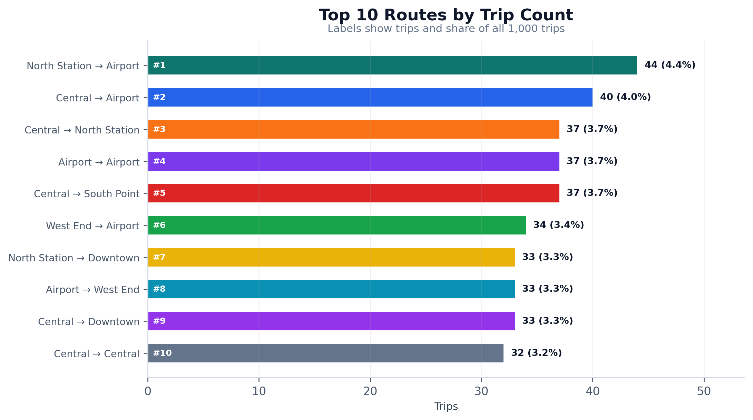
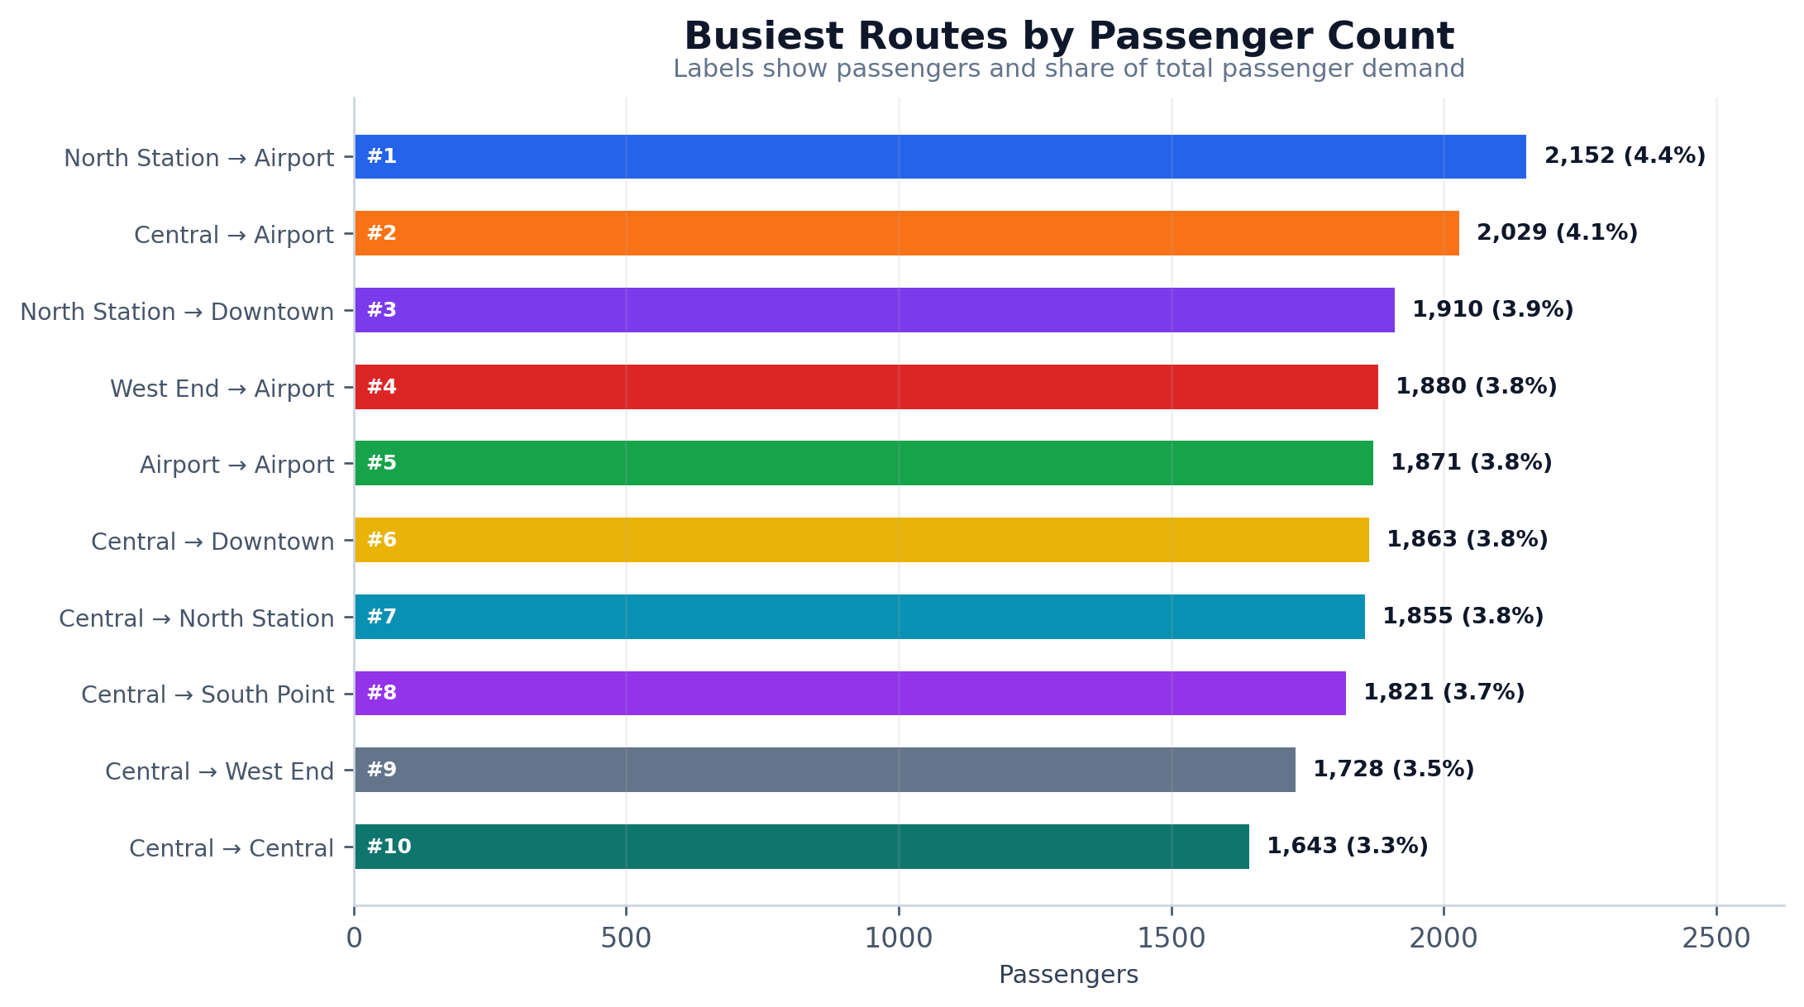
Route Hotspots
EDA Capstone
Route charts include ranking, counts, and share to show where demand is concentrated.
Priority corridor
Secondary corridors
North Station → Airport ranks #1 by trip count and passenger count, making it the strongest candidate for frequency protection, queue monitoring, and route-level service quality tracking.
Central → Airport and North Station → Downtown also show high passenger totals. These should be monitored as backup growth corridors, especially when allocating extra buses, dispatchers, or weekend capacity.
Source: EDA Capstone Project notebook
07

Slide 9
Transport Mode Performance
EDA Capstone
Mode-level charts compare volume, trip share, trip duration, and average revenue.
Trip Count by Mode
Passenger Volume
Values show trips and share of all 1,000 trips
Bus carries the highest passenger load
Readable mode interpretation
Bus
332 (33%)
Bus
16.3K (33%)
Ferry
287 (29%)
Ferry
14.3K (29%)
• Bus has the highest operating load: 332 trips and 16,308 passengers.
• Ferry is second for trips and passengers, so it should remain part of peak-capacity planning.
• Train and Tram have the strongest average revenue per trip at about 1,265 each.
• Duration is close across modes, ranging from about 92 to 96 minutes, so efficiency decisions should combine volume, revenue, and reliability.
Train
243 (24%)
Train
11.5K (23%)
Tram
138 (14%)
Tram
7.0K (14%)
Average Trip Duration
Average Revenue
Duration differences are small across modes
Train and Tram lead average revenue per trip
Bus
96 min
Train
1,265
Tram
95 min
Tram
1,265
Train
94 min
Ferry
1,246
Ferry
92 min
Bus
1,244
Main action: protect Bus capacity first, then test premium strategy on Train/Tram corridors.
Source: EDA Capstone Project notebook
08

Slide 10
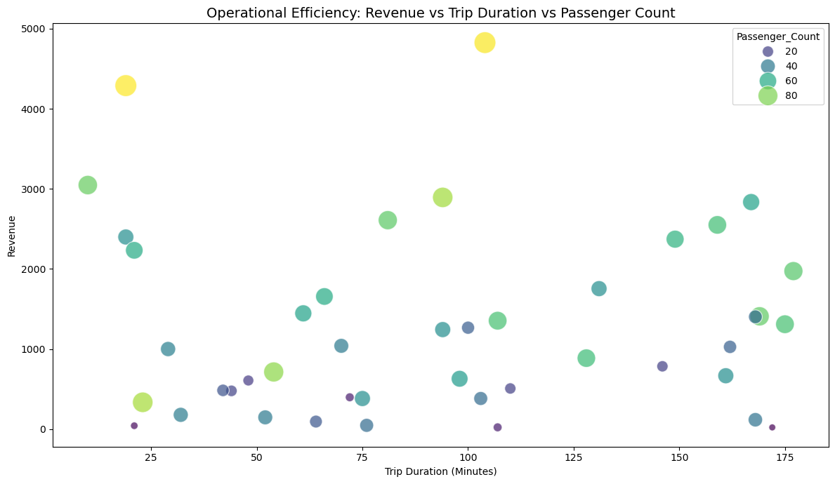
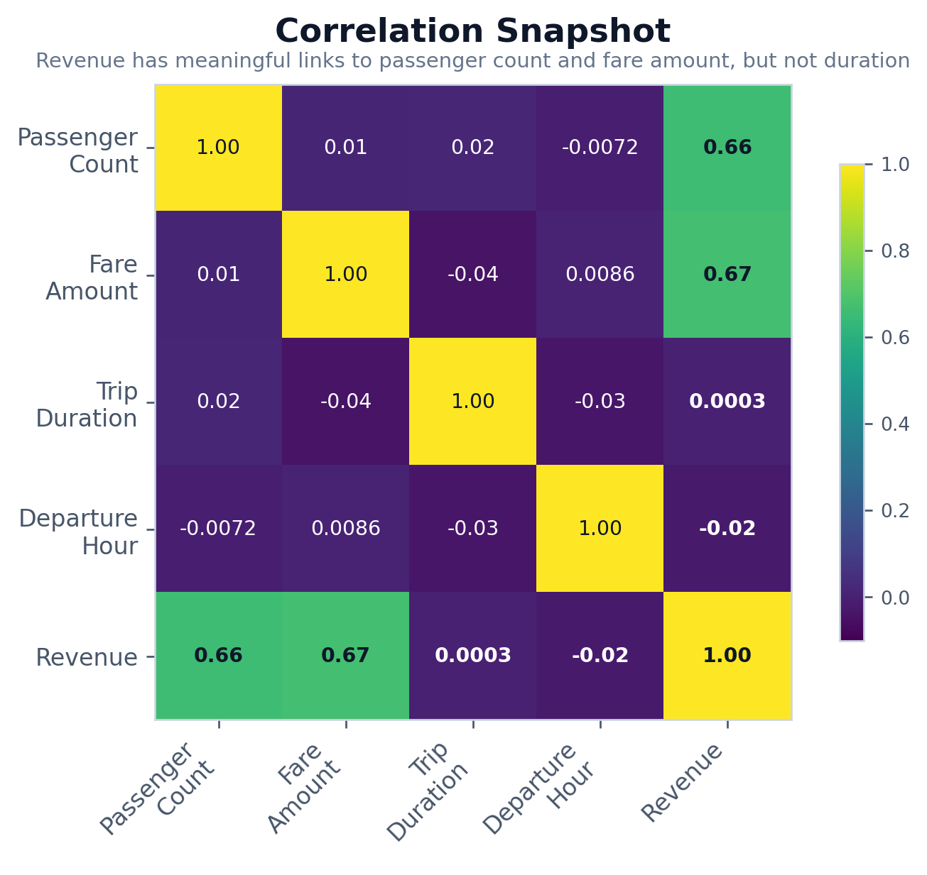
Operational Efficiency & Relationships
EDA Capstone
The strongest revenue relationships come from fare amount and passenger count, not trip duration.
~0.67
Revenue ↔ Fare Amount correlation
~0.66
Revenue ↔ Passenger Count correlation
~0.00
Revenue ↔ Trip Duration correlation
What this means
Revenue is not mainly explained by longer trips in this dataset. MetroMove should therefore prioritize passenger-loading efficiency, fare accuracy, and high-demand route performance before assuming longer trips are always more profitable.
Source: EDA Capstone Project notebook
09

Slide 11
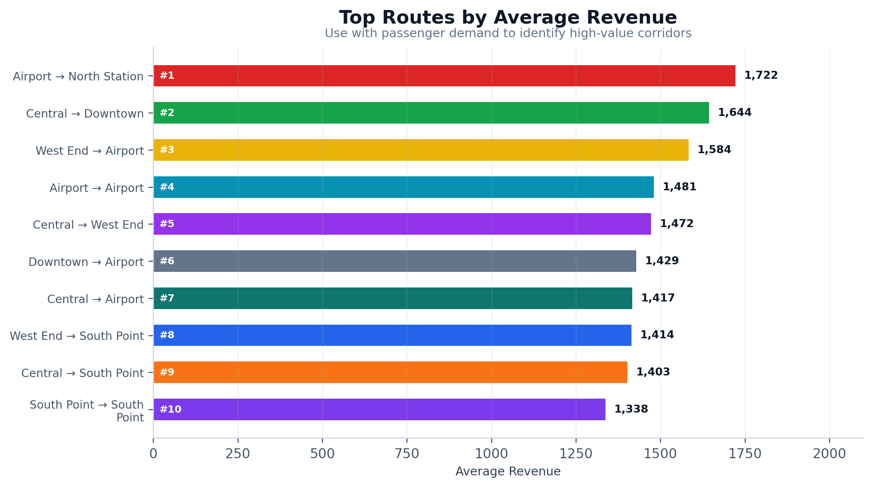
Key Insights from the Graphs
EDA Capstone
The strongest patterns are consistent across demand, revenue, route, and correlation views.
Insight summary
1
Morning is the single most important operating window: 47.8% of passengers and 48.7% of revenue.
2
Sunday is the strongest day for both passenger demand and revenue; Thursday is the weakest in both views.
3
Bus carries the highest operational load, while Train and Tram slightly lead average revenue per trip.
4
North Station → Airport is the leading route by both trips and passengers, making it a priority corridor.
5
Revenue has meaningful links to passenger count and fare amount, while trip duration shows almost no revenue relationship.
How to use the route revenue chart
Average revenue by route should be paired with passenger volume before final decisions. A route can have strong average revenue but still need validation on total passenger demand, capacity use, and service frequency.
Source: EDA Capstone Project notebook
10

Slide 12
Recommendations
EDA Capstone
1
Protect morning peak capacity
2
Treat Sunday as a high-demand service day
3
Prioritize North Station → Airport
Increase vehicle availability, station staff, dispatch monitoring, and queue control during the morning period because it carries nearly half of observed passengers and revenue.
Use weekend-specific scheduling for Sunday instead of treating it as low-intensity weekend service. Add standby capacity on routes with repeated Sunday crowding.
Create a corridor watchlist for North Station → Airport with on-time performance, boarding load, skipped passengers, and revenue per trip tracked weekly.
4
Rebalance low-demand periods
5
Separate volume and yield strategies
6
Strengthen data governance
Review Thursday and night schedules for lower utilization. Consider smaller vehicles, reduced frequency, or limited promotional pricing to lift demand without overspending.
Use buses to protect high-volume corridors. Use Train/Tram for routes where average revenue is stronger, but validate with passenger load and trip frequency before expansion.
Stop inconsistent text labels and missing values at source by enforcing dropdown categories, station-name validation, required fields, and daily data-quality checks.
Source: EDA Capstone Project notebook
11

