Slide 1
AI x CITY CLIMATE ACTION HACKATHON 2026
EVSwap
AI-guided e-mobility siting for African cities — from a data pipeline that ranks Nairobi's charging deserts, to a driver app built on the same real station data.
Where should Nairobi put its next charging station? We built a pipeline that answers this with data, not guesswork — and any city can run it.
Transportation Priority Theme · Nairobi, Kenya

Slide 2
THE PROBLEM
Infrastructure is being sited
by commercial visibility, not by need
▲
Growth outpaces planning
Nairobi's e-mobility sector (matatus, e-bikes, boda-bodas) is growing faster than infrastructure planning can track.
■
Commercial siting logic
Charging and swap stations are sited by private operators' commercial logic — retail forecourts, CBD visibility — not by where transport demand and population actually concentrate.
●
No unified view
The result: a citywide infrastructure map that no single city planning body currently holds.
2

Slide 3
CONTEXT
Why Nairobi
A representative “high-informality, high-growth” African city — the hard case, on purpose. If it works here, it generalizes.
4.6M
136
4,284
865
residents (WorldPop 2020,
verified in this project)
matatu routes —
headway-based, no fixed timetable
matatu stops
citywide
H3 hexagons
tessellating the city
Nairobi's matatu network runs on informal, driver-set headways rather than a published schedule — this project derives frequency directly from real GTFS trip data (Digital Matatus), not assumptions.
3

Slide 4
FRAMEWORK ALIGNMENT
Avoid – Shift – Improve, computed
Every infrastructure site in the analysis is weighted by this hierarchy — not cited on a slide, but built into the scoring formula.
priority_weight = 3
priority_weight = 2
priority_weight = 1
Public Buses
E-bikes / Motorcycles
Private Cars
Highest priority. Moves the most passengers per charging asset — the core of “Improve.”
Second priority. Displaces short car/boda petrol trips — the core of “Shift.”
Lowest priority. Serves individual car trips — the mode ASI seeks to avoid.
4

Slide 5
SOLUTION OVERVIEW
One pipeline, start to finish
Raw city data
(roads, population,
transit)
→
H3
tessellation
→
AI-assisted
need scoring
→
Growth-adjusted
phasing
→
Ranked, siteable
recommendations
→
Interactive
decision-support app
Every arrow above is a real, documented script in this repo (steps 01–15) — not a conceptual diagram.
5

Slide 6
METHODOLOGY
Every layer is open data
Roads
OpenStreetMap — Nairobi drivable road network (OSMnx)
Population
WorldPop 100m constrained gridded population, 2020, UN-adjusted
Transit
Digital Matatus GTFS — 136 routes, 4,284 stops, 3 time-bands (AM peak / midday / PM peak)
Tessellation
H3 resolution-8 — 865 hexagons, ~0.7 km² each
Existing infrastructure
29-site verified dataset — operator, type, coordinates, source URL for each
Reinforces feasibility and replicability — no proprietary feed required, anywhere.
6

Slide 7
AI INTEGRATION · 1 OF 4
Multi-Criteria Need-Analysis Model
demand_score = 0.6 × pop_norm + 0.4 × transit_norm
existing_coverage = Σ priority_weight (point stations in hex)
need_score = demand_score × (1 − coverage_norm)
865
hexagons ranked by
e-mobility infrastructure need
Real, auditable math — not a black box. This is a transparent, explainable multi-criteria decision model: a form of applied AI/decision-support, and that's a feature (auditable by city officials), not a limitation.
7

Slide 8
AI INTEGRATION · 2 OF 4
Growth-Forecasting & Phased Rollout
Per-hexagon population growth (WorldPop 2015→2020 CAGR, extrapolated to the pilot window) combines current need with predicted growth into a 3-phase pilot plan.
289
51
2
Phase 1
Phase 2
Phase 3
needed now
compounding demand
get ahead of growth
This is what turns a static map into a decision tool a pilot budget can actually be built around.
8

Slide 9
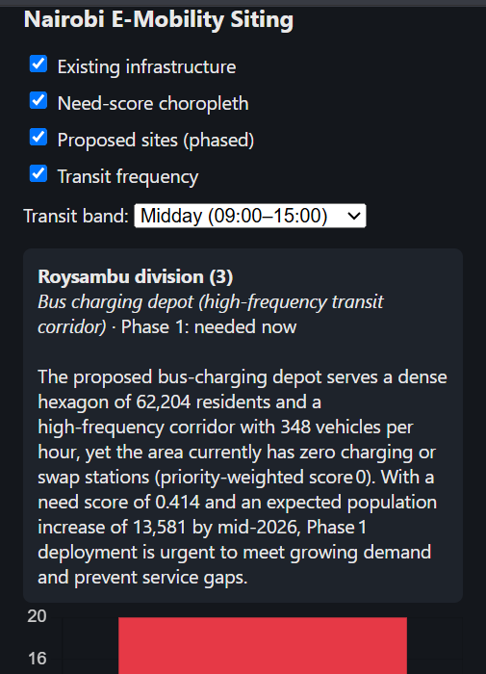
AI INTEGRATION · 3 OF 4
Live Decision-Support Insights (LLM Layer)
Each recommended site's stats — population, transit frequency, need score, growth trend, priority tier — are passed to an LLM, which generates a plain-language justification in the app in real time.
Turns a ranked spreadsheet into something a non-technical planning committee can read and defend.
LIVE IN APP — not a mock
9

Slide 10
AI INTEGRATION · 4 OF 4
The Pipeline Itself Is AI-Replicable
◆
Documented, sequential scripts
Every step — data pull, tessellation, scoring, phasing, export — is its own script, in order.
◇
Built for LLM coding assistants
Another city's planning team can hand this exact sequence to an LLM coding assistant and reproduce the analysis for their own city — swapping in local OSM/GTFS/population data — without a specialist GIS team.
✦
The core replicability ask, made concrete
This directly answers the brief's replicability requirement, not as an aspiration but as a working method.
Arguably the strongest, most honest AI claim in this deck.
10

Slide 11
KEY FINDING · 1 OF 2
The Coverage Gap
0
23
27
of the top-10 highest-need
hexagons have ANY existing
verified charging/swap infra
of 865 hexagons have
any existing coverage
at all
verified physical points
vs. operators' aggregate
claims of 50+ citywide
Existing infrastructure clusters around the CBD and the TotalEnergies retail network — a commercial siting pattern, not a needs-based one.
Caveat, stated plainly: “zero coverage” means “no verified station” — unmapped network_density rows are excluded from scoring by design, not overlooked.
11

Slide 12
KEY FINDING · 2 OF 2
Growth Will Widen the Gap
The hexagons with the highest current need are also, independently, among the fastest-growing (2015–2020 CAGR ~2.2–3.1%/year).
TOP SITE (hex 887a6e404bfffff)
+21,327
predicted new residents
by mid-2026
...on top of already being
the #1 need hexagon citywide.
Without intervention, the gap compounds rather than closes.
This is the urgency argument for funding a pilot now, not later.
12

Slide 13
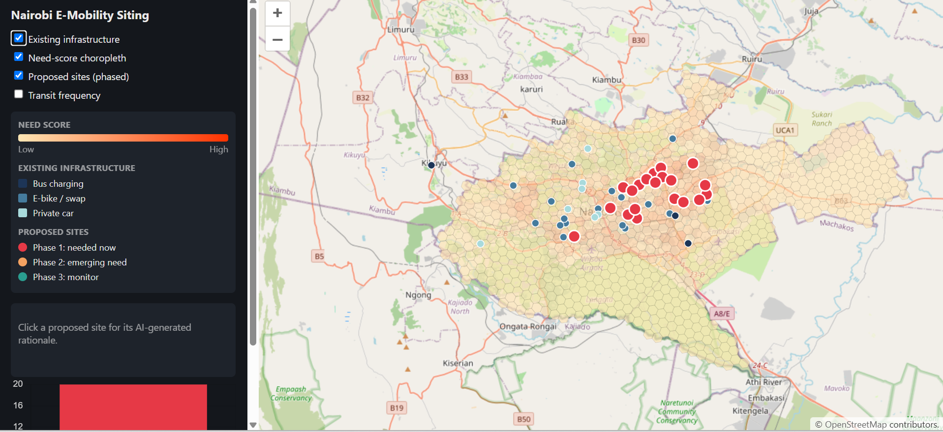
DEMO WALKTHROUGH · 1 OF 3
Existing Infrastructure Layer
All 29 catalogued sites, color-coded by ASI priority tier, with a live legend and need-score choropleth beneath.
13

Slide 14
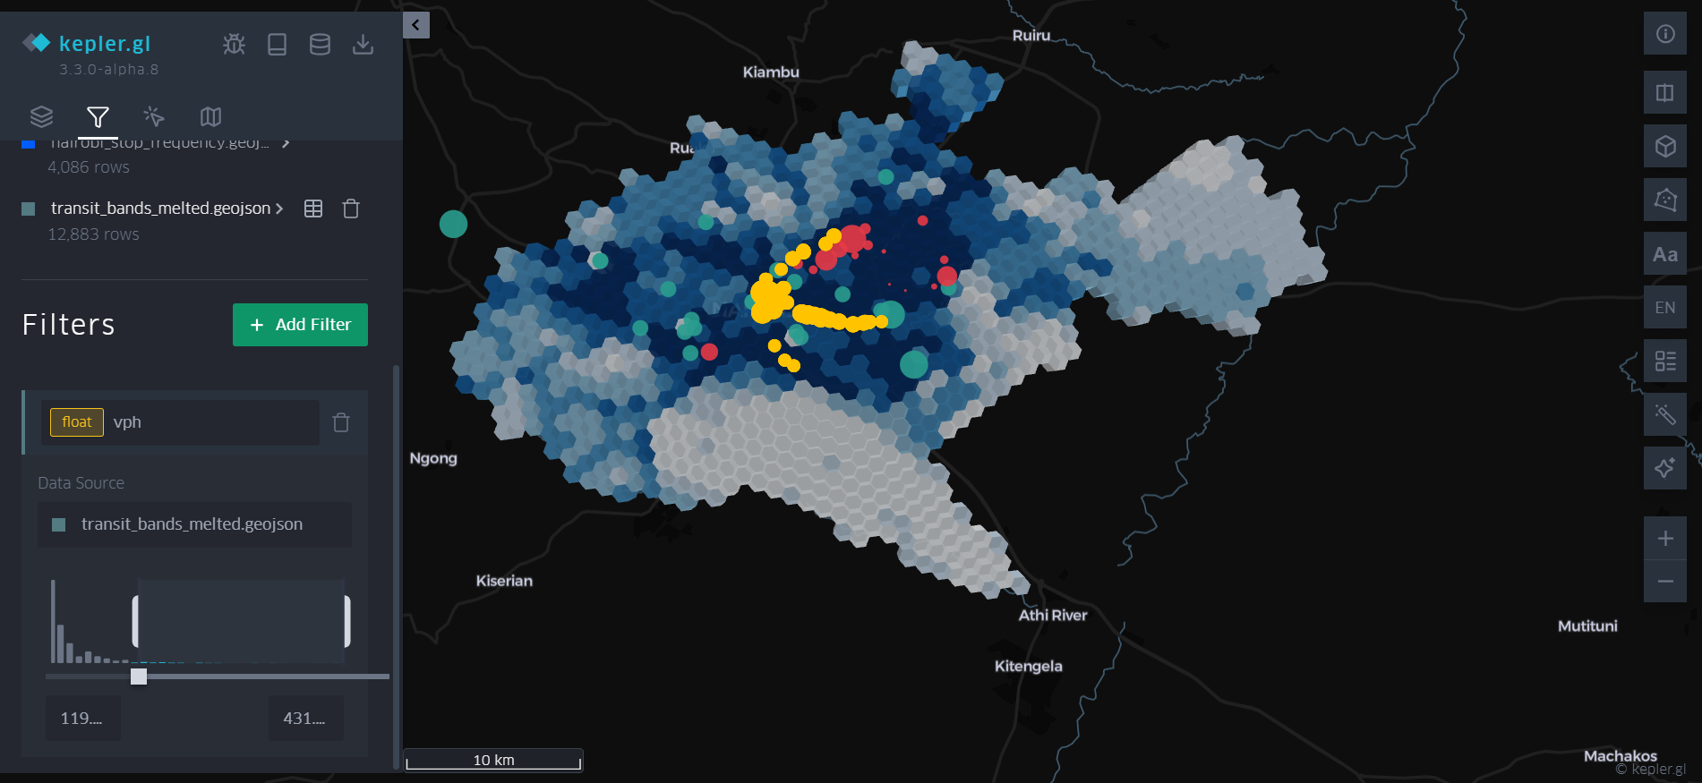
DEMO WALKTHROUGH · 2 OF 3
Animated Tessellation & Transit Patterns
Kepler.gl companion view: need-score choropleth beneath, transit-frequency pulses timed to AM peak / midday / PM peak — the transit operators' own scheduled headways, not simulated.
14

Slide 15
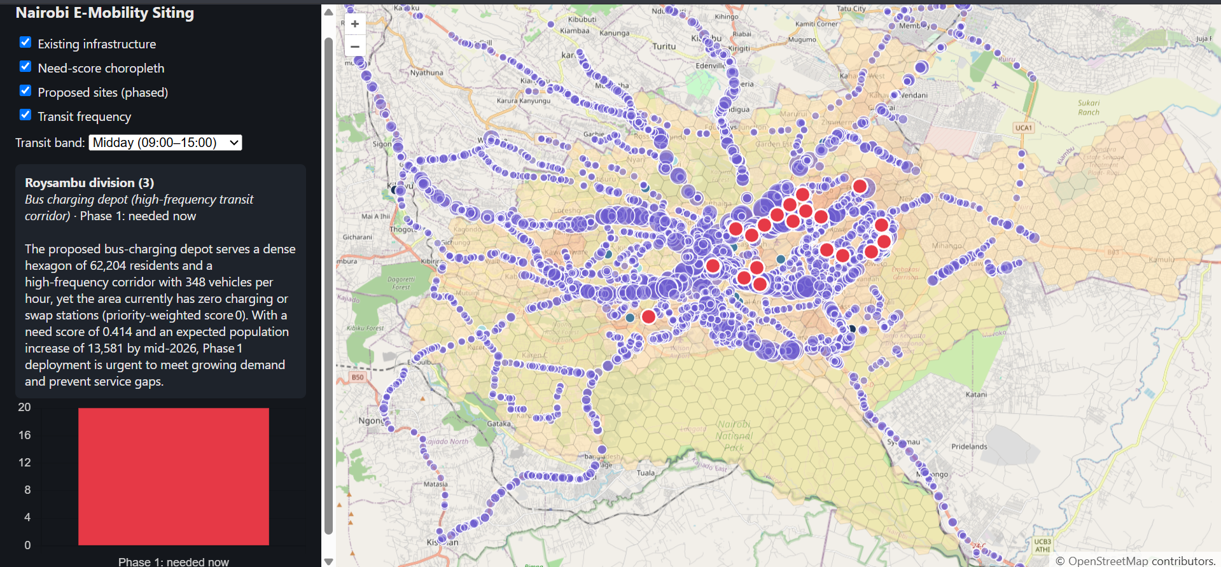
DEMO WALKTHROUGH · 3 OF 3
Proposed Sites + Live AI Insights
Top-20 ranked sites, phased by need + growth. Click any site — the panel populates with a real, grounded LLM rationale, live.
15

Slide 16
TARGET USERS
Who this is built for
Nairobi City County planning & transport departments
National/county e-mobility policy teams (Kenya's e-mobility policy is still forming)
C40 / I4C member cities seeking a replicable siting methodology
E-mobility operators — Roam, BasiGo, Ampersand, ARC Ride — for investment/expansion prioritization
Climate finance & impact investors evaluating e-mobility infrastructure deals
Naming real operators by name here — as data subjects, not partners — grounds this in the actual Nairobi ecosystem.
16

Slide 17
IMPACT FRAMING
The scale of this pilot
PHASE 1 SITES (first 20 recommendations)
CITYWIDE (all Phase 1 hexagons)
1,004,338
~4.14M
residents served today by the 20 recommended sites — growing to ~1.19M by mid-2026.
residents (≈90% of Nairobi's population) live in Phase 1 — “needed now” — hexagons.
463,908
Framed around ASI outcomes: enabling mode-shift from private car/petrol boda to electric bus/e-bike in the highest-need corridors first — directly tied to C40's transport-emissions goals.
people reached by just the first 7 sites, Months 1–2.
Population figures are per-hexagon residential population (WorldPop) — the service catchment of Phase 1 infrastructure, not a claim every resident personally uses it.
17

Slide 18
REPLICABILITY
Replicability is the product
1
Every data source is open
OSM, WorldPop, GTFS — no proprietary feed required, anywhere.
2
Parameterized by city
Scripts are parameterized by city name/boundary. Swapping “Nairobi” for another city's GTFS feed and boundary is the only required change.
3
A methodology + toolkit
Positioned as a methodology and toolkit, not a one-city dashboard — the answer to “how does this scale beyond Nairobi.”
18

Slide 19
PARTNER ALIGNMENT
Built on C40 / I4C's own framework
Organizing partners — AI x City Climate Action Hackathon 2026:
Global Covenant of Mayors for Climate & Energy (GCoM) — Innovate4Cities
Centre for Human-Inspired AI (CHIA), University of Cambridge — Knowledge Partner
Urban Transitions Mission (UTM)
C40 Cities — coalition partner
Explicit callouts in this project:
Avoid-Shift-Improve (C40) — operationalized as priority_weight in the scoring formula, not just cited
Transportation — I4C's bonus-point priority theme — is this project's entire subject
Urban Transitions Mission / GCoM city networks — potential pilot-scaling partners for the replicable pipeline
19

Slide 20
PILOT PLAN & ASK
A 6-month path to proof
Months 1–2
Months 3–4
Months 5–6
7 sites
7 sites
6 sites
Phase 1, highest need
Phase 1, continued
Phase 1 completion
THE ASK
Pilot funding and partnership to validate the top Phase-1 sites with on-ground siting surveys — turning 20 ranked recommendations into built infrastructure serving over a million Nairobi residents.
Team structure and detailed activities in the accompanying Pilot Plan document.
20

