Slide 1
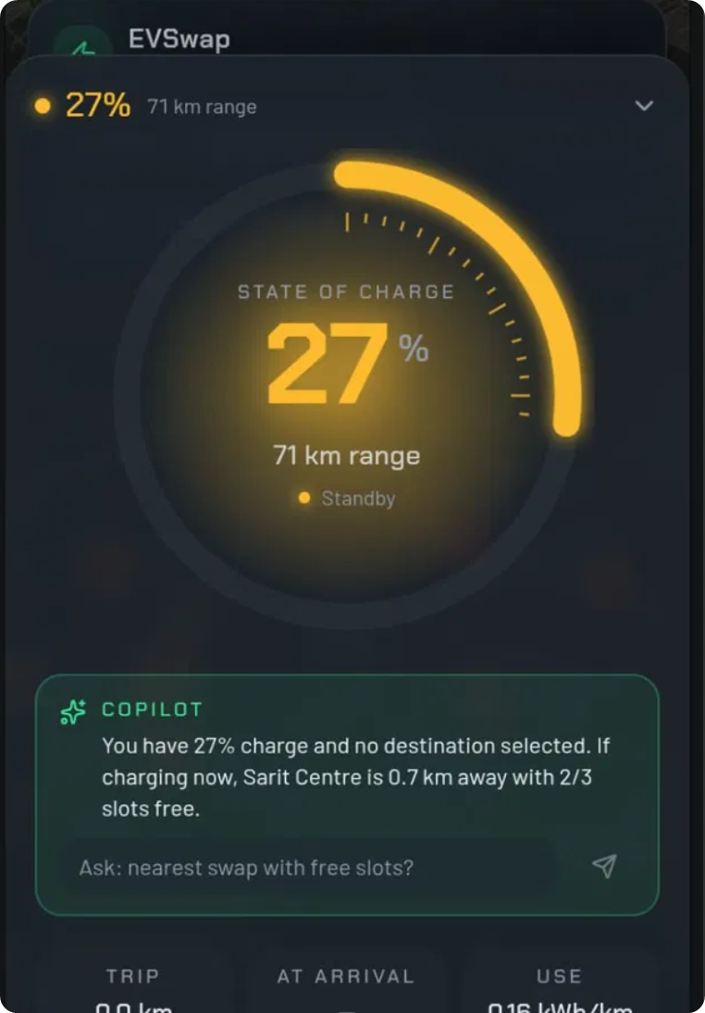




AIxCITY 14C
Demonstration
EVSWAPP
Real-time charge intelligence for EV drivers in Nairobi
YOUTUBE DEMO
EVSwapp Video

Slide 2
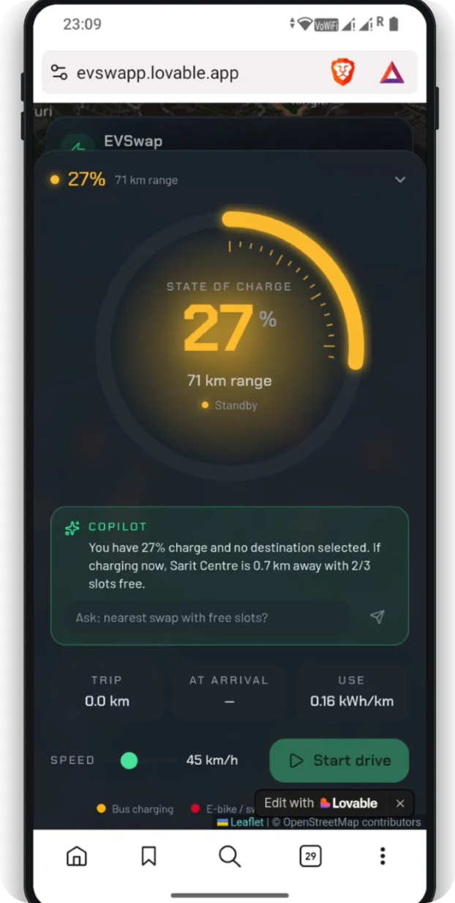


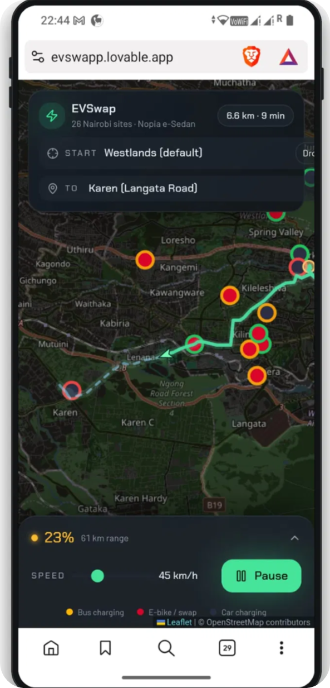


EVSwapp Product Overview
Simulates a driver's live battery, route, and position and recommends the single best charging or swap point
Less range anxiety accelerates EV adoption, and better-informed charging behaviour eases pressure on an already uneven grid.

Slide 3
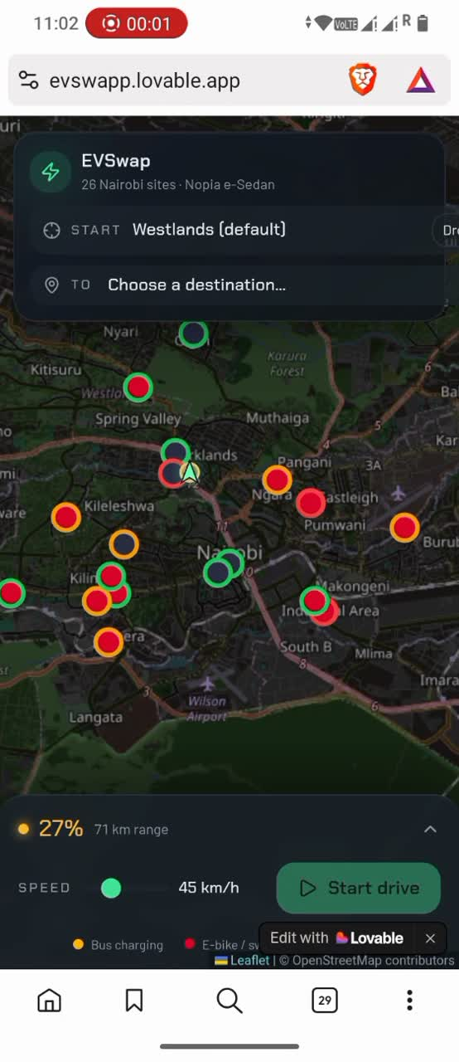





1
Start Drive
2
SoC draining live
Core Demo - Live Interaction
2
3
AI Copilot feature
4
Recommendation appears
EVSwapp combines a rule-based triage engine (distance, charge level, station reliability, wait time) with an AI Copilot that explains recommendations in plain language

Slide 4
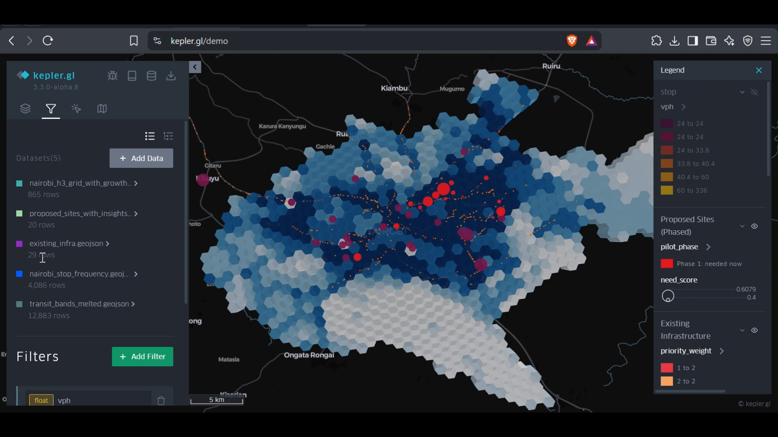

Geospatial Demand Layer - Kepler.gl
This visualization represents the demand-hotspot intelligence behind the business model — where charging demand is highest relative to existing coverage across Nairobi.

Slide 5
How The Triage Engine Works
const remainingKm = routeDistance - traveled;
const projectedSoC = soc -
(remainingKm * consumptionRate / capacity) * 100;
if (projectedSoC < SAFE_THRESHOLD) {
const best = stations
.filter(s => distanceAhead(s) <= 800)
.sort(byScore) // reliability, wait time, detour
[0];
triggerRecommendation(best);
}
Pure rule-based logic — no external calls
Recalculates every ~250m of simulated travel
Safety threshold: 20% projected charge on arrival
Ranks candidates by reliability, wait time, detour

Slide 6



AI Advisor — LLM-Phrased Recommendations
const advice = await callLLM({
station: best,
soc: projectedSoC,
location: currentPosition,
});
// LLM only writes the sentence —
// station selection stays rule-based
AI-ADVISED
“Charge drops to ~14% before Karen. Swap in 650m: Kilimani Fast-Charge — 96% reliability, no wait.”
Called only when the triage engine actually fires to keep usage minimal.

Slide 7
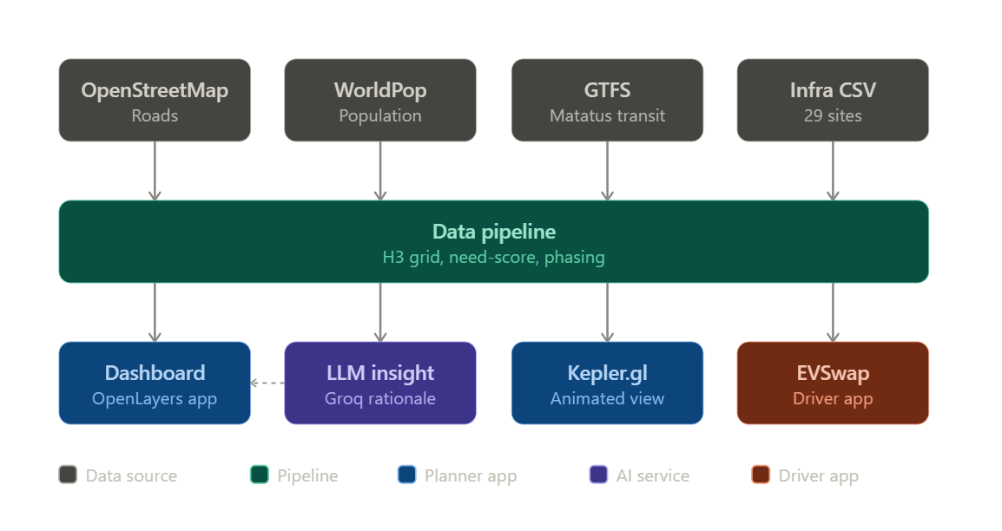
Architecture At A Glance

Slide 8




Try It Yourself
LIVE DEMO
evswapp.lovable.app
YOUTUBE
EVSwapp Video
CODE REPOSITORY
github.com/PriscahC/EVSwapp
GEOSPATIAL DATA
<<< Links
Kepler Live Map
EVSwapp — AI × City Climate Action Hackathon 2026

