Slide 1
DESIGN & ANALYSIS OF ALGORITHMS
(BSCS 2:1)
Introduction to Graphs as Data Structures
Ayebare Moses
Department of Computing & Technology
Faculty of Engineering, Design & Technology

Slide 2
Definition
Graphs are collections of nodes (or vertices) and edges connecting pairs of nodes.
They’re widely used to model complex relationships in computer science, such as social networks, road maps, and even networks in computer science like the web.
Graphs are represented as G=(V,E), where:
Order of a Graph: The number of vertices ∣V∣.
Size of a Graph: The number of edges ∣E∣.

Slide 3
Graph Terminology
Nodes (Vertices): Represent the entities in the graph (e.g., cities, people).
Edges: Connections between nodes. An edge can indicate a direct relationship, like a road between two cities.
Path: A sequence of edges connecting a series of vertices.
Neighbor: Nodes connected by an edge are neighbors.
Degree of a Vertex:
Degree (for undirected graphs): The number of edges connected to a vertex.
In-degree and Out-degree (for directed graphs): Number of edges entering and leaving a vertex.

Slide 4
Types of Graphs
Directed Graph
Edges have a direction, represented as ordered pairs (u,v) where u is the initial vertex and v is the terminal vertex.
Example: A directed graph with edges E={(1,2),(2,3)} has an edge from vertex 1 to vertex 2 and from vertex 2 to vertex 3.

Slide 5
Types of Graphs
Undirected Graph
Edges are bidirectional, represented as unordered pairs (u,v)=(v,u).
Example: If there is an edge between nodes 1 and 2, it implies connectivity in both directions.

Slide 6
Types of Graphs
Weighted Graph
Each edge has an associated weight (or cost), often used to represent distances, costs, or other values associated with connections.

Slide 7
Types of Graphs
Tree: A special type of undirected graph where any two vertices are connected by exactly one path and contain no cycles.
Properties:
An undirected tree with ∣V∣ vertices has ∣E∣=∣V∣−1 edges.
Acyclic and connected.

Slide 8
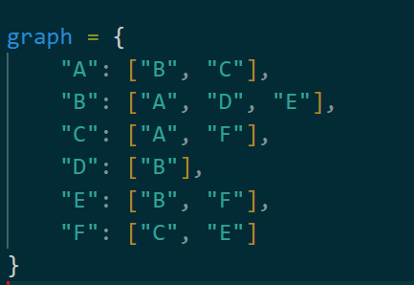
Graph Representations
Adjacency List: Each vertex stores a list of its neighboring vertices. This is memory efficient and ideal for sparse graphs (few edges compared to vertices). Below is an example of an undirected graph using an Adjacency List.

Slide 9
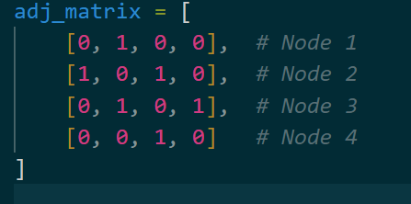
Graph Representations
Adjacency Matrix: A ∣V∣×∣V∣ matrix where each cell A[u][v] indicates if there is an edge between u and v.
Properties:
Symmetric for undirected graphs.
O(1) time for checking the presence of an edge.
Identifying all edges consumes O(|V|²) time.

Slide 10
Operations on Graphs
Add Vertex: Insert a new node into the graph.
Add Edge: Create a connection between two vertices.
Display Vertex: Display the vertex and its connections.

Slide 11
Graph Implementation in Python
Python Code implementing a graph using an Adjacency List:

Slide 12
Graph Traversal Algorithms
Traversal algorithms systematically visit nodes in a graph, often used to explore all paths or locate specific connections.
Depth-First Search (DFS): DFS explores as far as possible down each path before backtracking, using a stack or recursion. This method is useful for exploring all possible paths, such as finding connected components in a graph.

Slide 13
Depth-First Search (DFS)
DFS Steps:
Start at the initial node (source node).
Visit the node, mark it as visited, and explore each of its unvisited neighbors.
For each unvisited neighbor, move to the neighbor and repeat the process from step 2.
Backtrack when you reach a node with no unvisited neighbors, returning to the previous node in the search path.
Repeat the process until all nodes are visited.

Slide 14
Breadth First Traversal
Breadth-First Search (BFS) is a graph traversal algorithm that explores all the neighbor nodes at the present depth prior to moving on to the next depth level.
It starts at a source node and explores all reachable nodes level by level, ensuring that nodes closer to the source are visited before those farther away.

Slide 15
Breadth-First Search (BFS) Steps
Initialization:
Create a queue to store nodes to be visited.Mark the starting node as visited and enqueue it.
Exploration:
While the queue is not empty:
Dequeue a node from the front of the queue.
Visit the dequeued node (e.g., print its value).
For each unvisited neighbor of the dequeued node: Mark the neighbor as visited. Enqueue the neighbor.
Termination:
Repeat step 2 until the queue is empty.

Slide 16
Use of traversal order for both DFS and BFS
Understanding Graph Connectivity: BFS and DFS traversal orders allow us to see which nodes are reachable from a starting node. We can determine if there’s a path between nodes or if certain nodes are isolated.
Pathfinding and Shortest Paths: In BFS, the traversal order naturally follows a level-wise or "breadth-first" approach. This means that BFS can find the shortest path in an unweighted graph. e.g. if you’re navigating a maze or a road network, BFS traversal order will tell you the shortest route from the starting point to any reachable destination.

Slide 17
Use of traversal order for both DFS and BFS
Solving Puzzles and Games: BFS and DFS are widely used in puzzle-solving and AI for games. e.g. DFS can explore all possible configurations or paths, which is beneficial in search-based games like mazes and logic puzzles.
In summary, traversal orders from BFS and DFS reveal structure, connectivity, and relationships within a graph, enabling efficient solutions for a wide array of problems in networking, AI, data analysis, and other problems.

