Slide 1
STUDENT MANAGEMENT SYSTEM
NABASA ISAAC (M23B23/043)
ATWIJUKIRE APOPHIA M23B23/051)
MWEBEMBEZI NICOLE. (M23B23/026)
MUWANGUZI PRISCILA DENISE. (M23B23/010)
RUBAGUMYA ALVIN (M23B23/012)

Slide 2
PROBLEM STATEMENT
Educational institutions face inefficiencies, errors, and difficulties in managing student, teacher, course, enrolment, and grade data due to reliance on manual and fragmented systems.
This project aims to create a centralized, automated Student Management System using Python to streamline administrative tasks, reduce data errors, and provide quick, organized access to information, ultimately improving data management efficiency and accuracy.

Slide 3
Key Focus Areas
Centralized Data Management: Integrates information on students, teachers, courses, enrolments, and grades in a single system.
Improved Access and Organization: Provides easy, organized access to all records, simplifying data retrieval and administrative tasks.
Enhanced Data Accuracy: Reduces errors commonly found in manual entry and fragmented systems, improving overall data reliability.

Slide 4
Core System Components
The Student Management System is built on separate classes for each key element:
Students: Manages student registration details and personal information.
Teachers: Stores teacher information and associates them with courses.
Courses: Organizes course details, making it easy to add, view, and manage courses.
Enrolments: Validates and tracks student course enrolments to ensure accuracy.
Grades: Manages grade assignment and links them to student records for academic tracking.

Slide 5
Benefits of such a system
Centralized Data Consolidation:
Organized and accessible information in one system.
Efficient Registration:
Quick data entry for students and teachers.
Course Management:
Structured course handling for easy search and enrolment.
Enrolment Validation:
Secure and verified enrolment processes.
Grade Assignment:
Linked directly to student IDs for easy tracking.
Error-Handling Mechanisms:
Prevention of duplicate entries and data errors.
Scalability:
Modular design allows for future expansion.

Slide 6
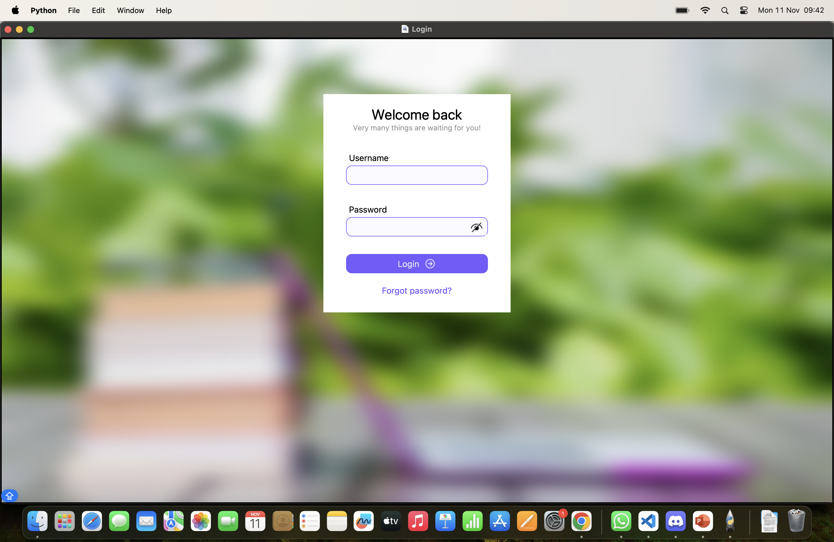
LOGIN PAGE

Slide 7
GITHUB REPOSITORY
https://github.com/nabasaisaac/StudentManagementSystem

