Slide 1
Content-Based Image Retrieval System for Chest X-ray Images using Multi-Feature Combination and Distance Metrics
Group Number: 13
Course: Digital Image Processing (ECE501)
Guided by: Prof. Mehul Raval

Slide 2
INTRODUCTION
The retrieval system for chest X-ray images are essential for analyzing visual patterns about diagnosing lungs and heart diseases.
Multiple similarity measures captures feature vectors and rank retrieved images.
CBIR overcomes this gap by using intrinsic image features such as texture, shape, and intensity.
Chest X-ray CBIR system proposed, has been developed using features like Histogram, GLCM, Gabor and evaluating retrieval performance through similarity measures and Precision.
Objective: To develop a non–ML CBIR system for Chest X-ray images that retrieves visually similar images using handcrafted features to support accurate and efficient medical diagnosis.

Slide 3
Work Completed Before Mid-Sem
Dataset
NIH ChestX-ray14 (via Kaggle)
112,000 images upload; used a subset for testing
Formats: PNG, JPG
Preprocessing
Grayscale conversion
Resize to 256×256

Slide 4
Work Completed Before Mid-Sem
Feature Extraction – Phase 1
Histogram: Global intensity distribution
GLCM: Texture features (contrast, correlation, energy, homogeneity)
Initial Insights
Histograms show intensity variations clearly
Smooth images → high homogeneity
Textured images → high contrast

Slide 5
UPDATED METHODOLOGY
Expanded Feature Set
Gabor Filters: Directional textures (4 orientations)
Wavelet Features: Multi-resolution frequency information
Statistical Features: Mean, variance, standard deviation
Why combine features?
Gabor → orientation
Wavelet → frequency
Stats → global structure

Slide 6
UPDATED METHODOLOGY
Feature Optimization
Cached features in .npy files
L2 normalization for accurate comparison
Similarity Measures
Euclidean Distance
Cosine Similarity
Chi-square Distance
Evaluation Metric
Precision@K for accuracy measurement

Slide 7
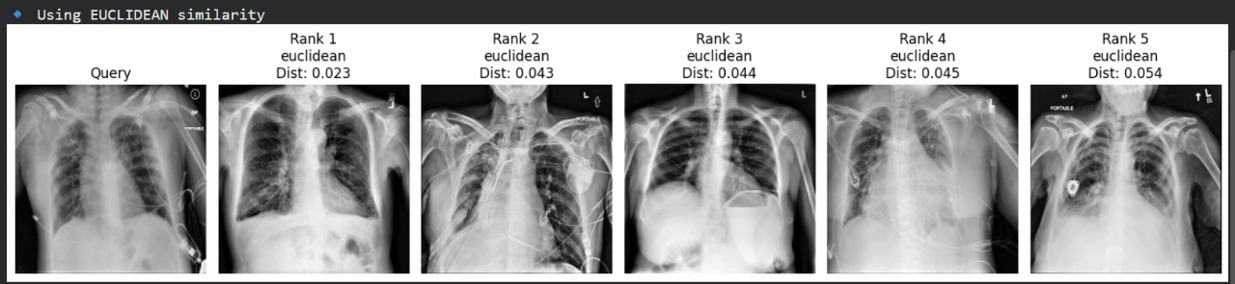
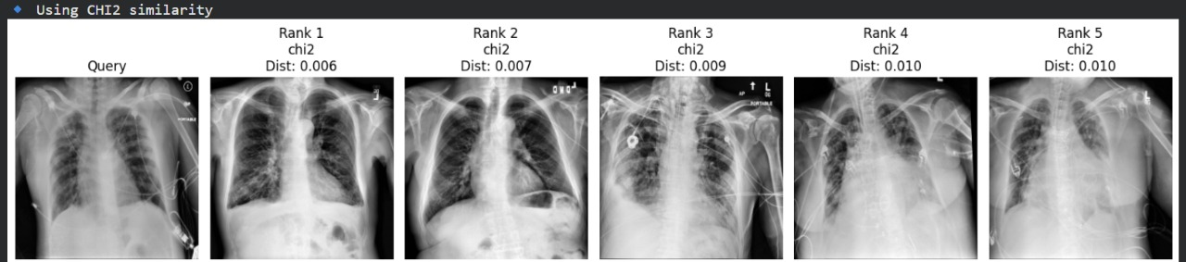
RESULTS
Feature Vector Composition
64 Histogram features
4 GLCM features
8 Gabor features
~20 Wavelet features
Statistical features
Observations
Low distance = high similarity
Cosine similarity provides stable ranking
Chi-square works well for intensity-based comparisons

Slide 8
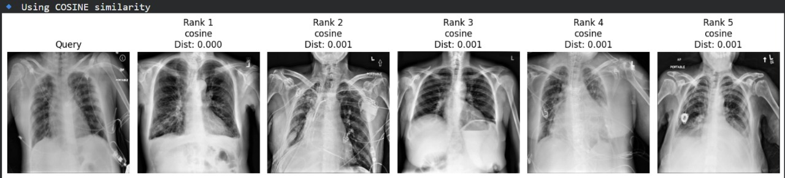
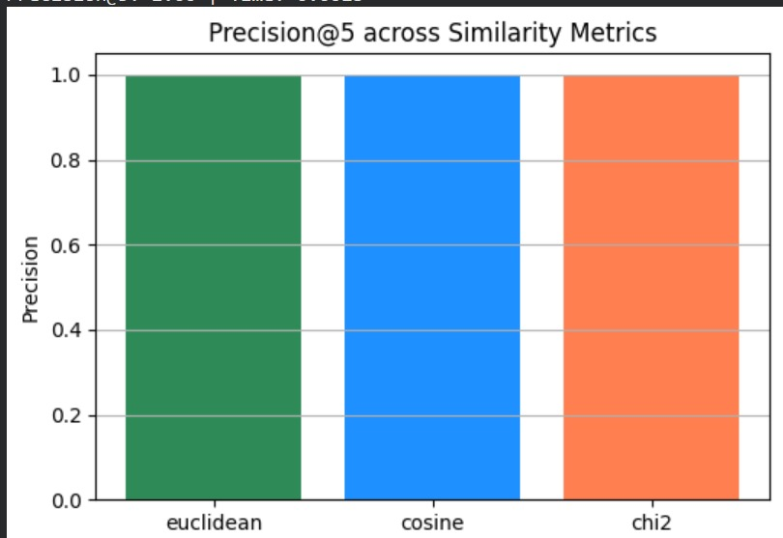
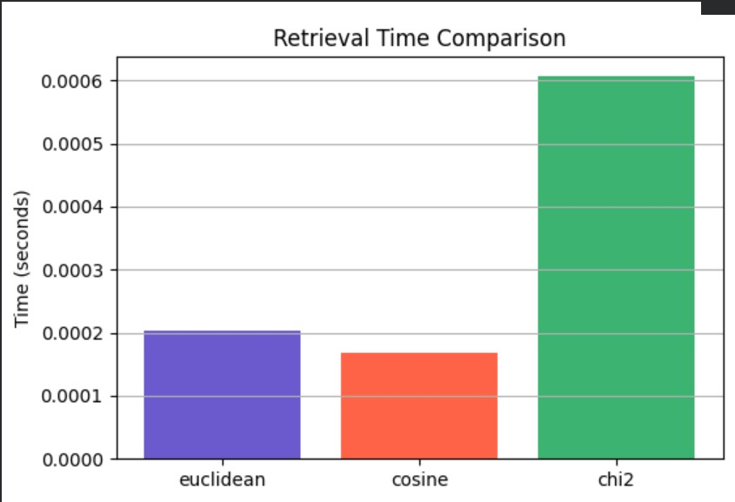
RESULTS
Precision@5 (Insert real values):
Euclidean: 1.00
Cosine: 1.00
Chi-square: 1.00
Average Retrieval Time:
Euclidean: 0.00017 s
Cosine: 0.00061 s
Chi-square: 0.00020 s
Cosine similarity offers best speed + accuracy balance

Slide 9
CONCLUSION
Successfully implemented a non-ML CBIR system for chest X-rays.
Combined features (Histogram + GLCM + Gabor + Wavelet) significantly improved retrieval accuracy.
Cosine similarity most efficient among tested metrics.
System can support radiologists in case comparison and diagnosis.
Scalable to larger datasets and other imaging modalities.

Slide 10
REFERENCES
[1] Bano, M., Matta, P., Chandel, S. (2024) Content based Image Retrieval: A study of approaches and techniques. IEEE Conference Publication., 16–22.
https://doi.org/10.1109/ictacs62700.2024.10840489
[2] NIH Chest X-ray Dataset. [Online].
[3] Kaggle Chest X-ray Dataset.

Slide 11
THANK YOU!
GROUP MEMBERS:
PRISCILLA R - AU2340001
SHREYA DHUMAL - AU2340124
PRATIKSHA DONGARE - AU2340123
KRISSA GANDHI - AU2340055

