Slide 1
Content-Based Image Retrieval (CBIR) for Chest X-Rays using Histogram and GLCM Feature
Course: Digital Image Processing (ECE501)
Group Number: 13

Slide 2
INTRODUCTION
Content-Based Image Retrieval (CBIR) system using Histogram and GLCM features.
Processing of Chest X-ray images, thereby extracting features such as histogram analysis and Gray Level Co-occurrence Matrix (GLCM) texture features
Applications:
Medical Diagnosis Assistance
Disease Pattern Recognition
Cross-Hospital Image Comparison
Objective:
To develop a CBIR system by Euclidean distance using combined Histogram and GLCM features. These features can be employed to detect intensity patterns and texture features from the medical images that can be utilized to search similar X-rays in diagnosis applications.

Slide 3
DATASET
Dataset Used: NIH Chest X-ray (ChestX-ray14) Dataset (Kaggle)
Type: Medical images (Chest X-rays)
It consists of different chest X-ray related disease images of patients
14 disease labels like Pneumonia, Effusion, Cardiomegaly, Emphysema, etc
Number of images = Over 1,12,000, but for now we used some around 10-15 images only to get a clear picture of it.
file format - .png .jpeg
released by NIH(National Institute of Health) Clinical Center, USA

Slide 4
LITERATURE REVIEW
Paper 1: A Content Based Approach to Medical X-Ray Image Retrieval using Texture Features
Reference: S. Ganesan and T. S. Subashini, “A content based approach to medical X-Ray image retrieval using texture features,” INTERNATIONAL JOURNAL OF COMPUTERS & TECHNOLOGY.
Details: Worked with multiple types of X-ray images (chest, skull, foot, spine, pelvic, palm) as different classes
Paper 2: CBIR using Statistical Texture Descriptors
Reference: R. C. Shivamurthy and M. B. Manjunatha, “An Efficient Chest X-Ray Image Retrieval using CBIR Technique,” Indian Journal of Science and Technology, vol. 10, no. 4, Jan. 2017, doi: 10.17485/ijst/2017/v10i4/110712.
Details:
Demonstrates effectiveness of GLCM in representing texture information.
Guided our feature extraction method for chest X-ray images.

Slide 5
METHODOLOGY
1. Preprocessing
Grayscale conversion
Resizing and normalization
2. Feature Extraction
Histogram Features: Represent pixel intensity distribution.
GLCM Features: Represent texture characteristics (contrast, energy, homogeneity, correlation).
3. Visualization and Analysis
Results are aggregated into a single DataFrame and images and histograms are visualized for analysis.

Slide 6
RESULT
Each image exhibits normalized histogram and GLCM features.
Images with higher contrast have pronounced patterns.
Higher homogeneity and ASM values have uniform and smooth regions in some images.
Extracted features allows visualisation and numerical data analysis across input images.

Slide 7
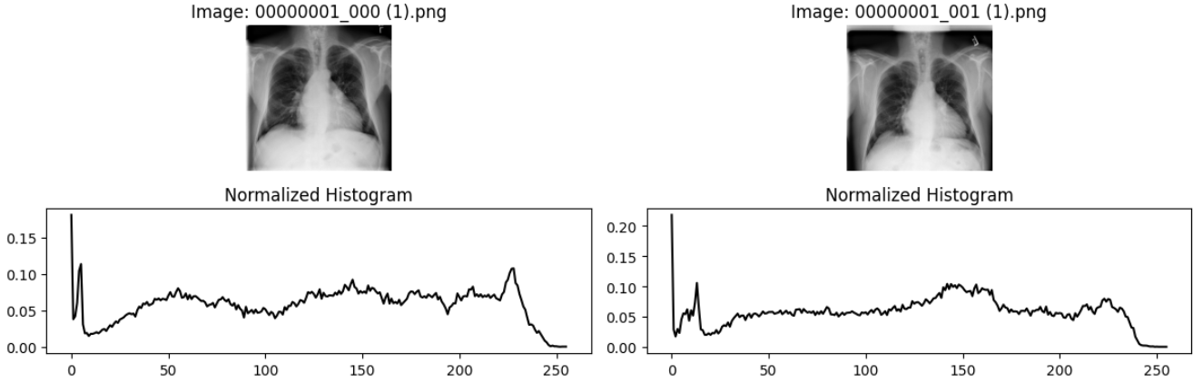
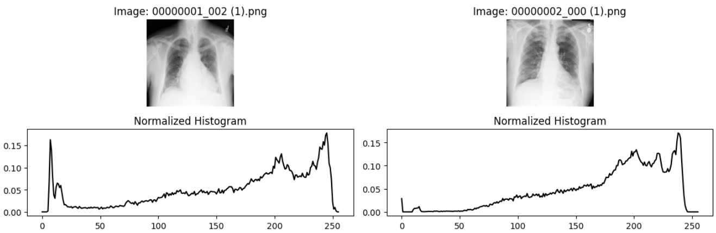
HISTOGRAM

Slide 8
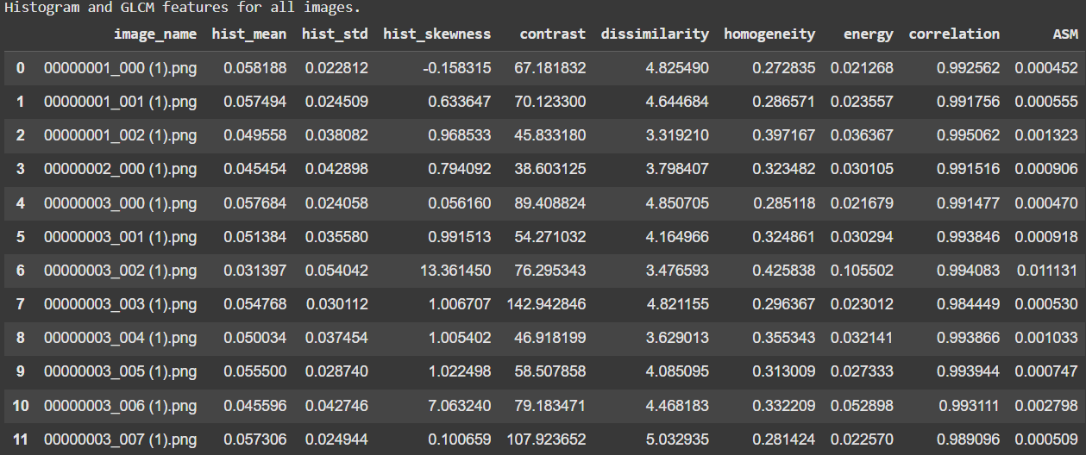
GLCM FEATURES

Slide 9
CONCLUSION
Histogram and GLCM provides comprehensive representation of intensity and texture characteristics of images.
The features can be helpful for tasks like sorting or recognizing different types of images.
Extracted features can be effectively used for image classification, retrieval and in general image analysis.
Useful extraction for CBIR system generation.

Slide 10
NEXT SET OF WORK
Implement similarity matching using Euclidean distance. After Histogram & GLCM value, will calculate the distance to know how much similar or different they are.
Retrieve and rank top similar images. After the distance calculation will sort the images to see to check near by / similar images to it.
Analyze retrieval performance using precision and recall metrics.
Next, will check the how well it is working

Slide 11
REFERENCES
“NIH Chest X-rays,” Kaggle, Feb. 21, 2018. https://www.kaggle.com/datasets/nih-chest-xrays/data
Paulo Mazzoncini de Azevedo-Marques, "Combination of Shape Histogram and Moment-Based Features," ResearchGate, [Online]. Available: https://www.researchgate.net/. [Accessed: Oct. 12, 2025].
R. C. Shivamurthy, M. B. Manjunatha, "CBIR using Statistical Texture Descriptors," Article14.pdf, 2025.
Python Libraries – OpenCV, scikit-image, NumPy, Matplotlib

Slide 12
THANK YOU
BY: GROUP 13
KRISSA GANDHI - AU2340055
PRISCILLA R - AU2340001
SHREYA DHUMAL - AU2340124
PRATIKSHA DONGARE - AU2340123

