Slide 1
SMART AGRICULTURE MONITORING SYSTEM USING IOT
By
Preethika M

Slide 2
ABSTRACT
Agriculture faces issues like water scarcity, soil degradation, and manual monitoring.
Proposed solution: IoT-based Smart Agriculture Monitoring System.
Core controller: ESP8266 NodeMCU with multiple sensors.
Monitors soil moisture, temperature, humidity, pH, and animal intrusion in real time.
Relay-driven pump automates irrigation based on soil conditions.
Data displayed on LCD and remotely accessible via Blynk IoT platform.
Ensures efficient irrigation, healthy crops, and optimized resource management.

Slide 3
PROBLEM STATEMENT AND NEED
Traditional farming relies on manual monitoring, which is time-consuming and inefficient.
Over-irrigation and fertilizer mismanagement reduce crop productivity.
Farmers lack real-time monitoring tools to track environmental conditions and soil quality.
Animal intrusion further damages crops, leading to economic losses.
Need: A low-cost, automated, real-time farm monitoring system that reduces manual effort, prevents water wastage, and improves crop productivity.

Slide 4
OBJECTIVES
Monitor soil moisture, pH, temperature, and humidity continuously.
Automate irrigation using a relay-controlled water pump.
Detect animal intrusion using a PIR sensor.
Display live data on LCD and mobile app (Blynk IoT).
Provide farmers with fertilizer suggestions based on pH levels.

Slide 5
LITERATURE SURVEY
Existing Systems
Manual irrigation → Requires labor, leads to water wastage.
Automatic timers → Irrigation is time-based, not soil-condition-based.
Single-sensor IoT projects → Focus only on soil or climate parameters.
Disadvantages
Lack of multi-parameter integration.
No real-time alerts for animal intrusion.
Limited remote accessibility.

Slide 6
PROPOSED SYSTEM
System Overview
The proposed system integrates multiple sensors with an ESP8266 (NodeMCU) microcontroller. Data processed and displayed locally on an LCD and remotely via IoT applications. Based on soil moisture and pH, the system triggers irrigation and fertilizer recommendations. PIR sensor ensures security against animal intrusion.
Key Components Integrated:
ESP8266 NodeMCU (control + Wi-Fi connectivity)
DHT11 Sensor (temperature & humidity)
Soil Moisture Sensor (soil water content)
pH Sensor (soil acidity/alkalinity)
PIR Sensor (animal detection)
Relay Module (pump control)
Water Pump (irrigation)
LCD 16x2 Display (local data display)
Blynk App (remote monitoring/control)

Slide 7
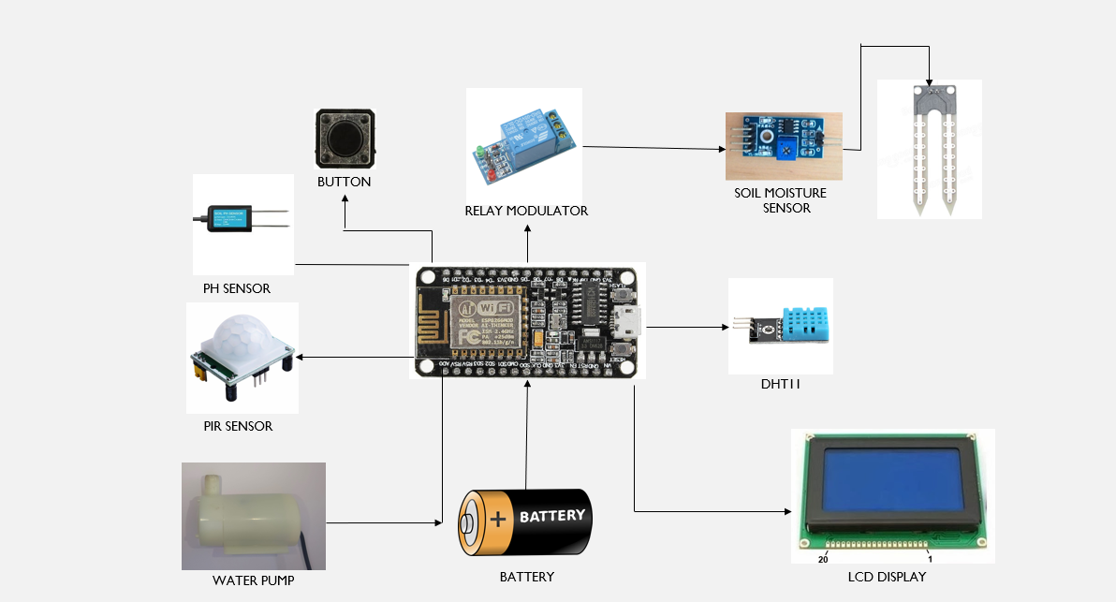
BLOCK DIAGRAM

Slide 8
HARDWARE AND SOFTWARE REQUIREMENTS
Hardware
ESP8266 NodeMCU
DHT11 Sensor
Soil Moisture Sensor
pH Sensor
PIR Sensor
Relay Module
Water Pump
LCD Display (16×2)
9V Battery / Power Supply
Software
Arduino IDE (ESP8266 board support)
Blynk IoT App (for mobile monitoring)
Libraries: DHT, LiquidCrystal_I2C, ESP8266WiFi, BlynkSimpleEsp8266

Slide 9
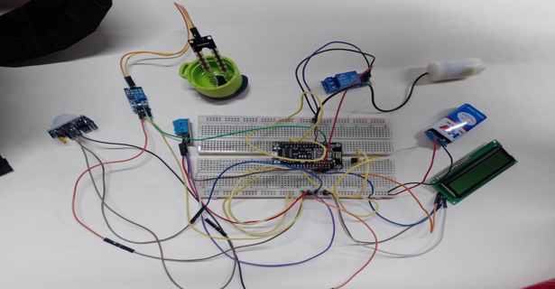
HARDWARE SETUP
Sensors placed in soil to measure moisture and pH.
PIR installed near crops for motion detection.
NodeMCU connected to relay module and pump.
LCD wired to show real-time values.
Power supplied by 9V battery

Slide 10
WORKING PRINCIPLE
Soil moisture is read → if below threshold → pump ON.
pH sensor checks soil → recommends fertilizer type.
DHT11 monitors temperature and humidity → displayed on LCD.
PIR sensor → detects animals → sends alert.
All data → displayed on LCD and uploaded to Blynk app

Slide 11
CODE SNIPPET
int soil = analogRead(SOILPIN);
float ph = map(analogRead(PHPIN), 0, 4095, 0, 14);
auto data = dht.getTempAndHumidity();
if (soil < 2000) digitalWrite(PUMPPIN, HIGH);
else digitalWrite(PUMPPIN, LOW);
lcd.print("T:");
lcd.print(data.temperature);
lcd.print("Soil:");
lcd.print(soil);

Slide 12
OUTPUTS
LCD shows live readings of temperature, humidity, soil, and pH.
Pump turns ON when soil is dry.
Serial monitor / IoT app shows intrusion alerts.
Farmers can control irrigation remotely using mobile app.

Slide 13
APPLICATIONS
Agricultural farms
Greenhouses
Gardens / plantations
Smart irrigation systems
FUTURE ENHANCEMENTS
Add LoRa / 5G for long-range farm communication.
Use solar power for sustainable operation.
Integrate AI/ML for crop disease prediction.
Build a cloud dashboard with analytics.

Slide 14
CONCLUSION
Proposed Smart Agriculture IoT system integrates multiple sensors with automation.
Provides real-time monitoring of soil, climate, and crop conditions.
Automates irrigation, reducing manual effort and saving water.
Enhances farm productivity and crop health.
Low-cost and scalable solution for sustainable smart farming.
Can be extended with future enhancements (AI, cloud, renewable power).

