Slide 1
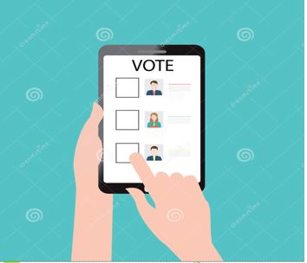
Digital Voting using Ethereum
Abheeshta Reddy
Deepika Reddy(1643290)
Naresh Kumar
Priscilla Imandi
Rajeshwari Ravi(1637406)

Slide 2
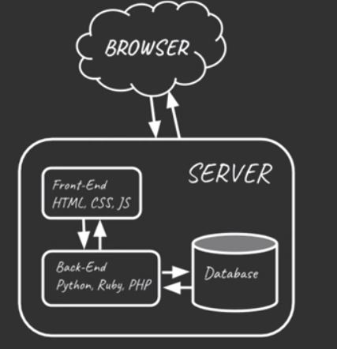
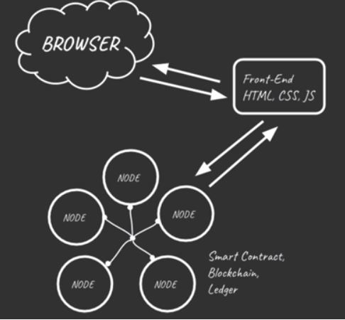
Why DAPP for Digital Voting?
Centralized Web Application
Centralized Web Application
Votes can change.
Election rules can change.
Decentralized Web Application
Count votes only once.
Don’t change the votes.
Most votes wins.

Slide 3
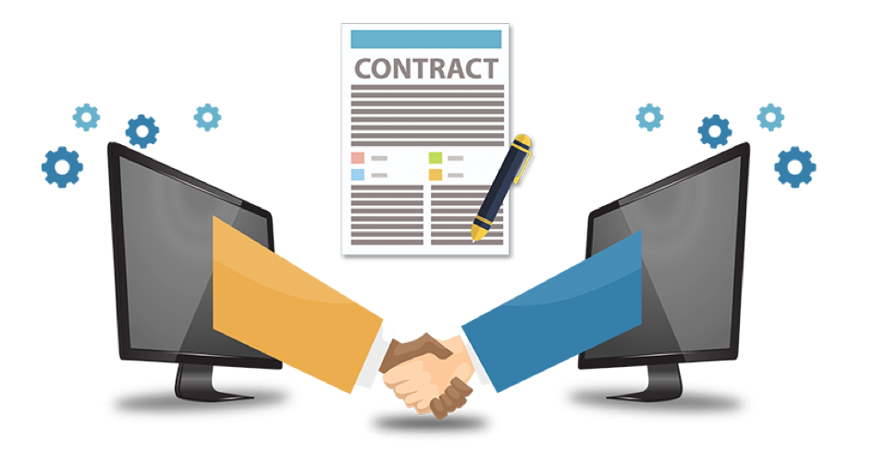
SMART CONTRACTS
Smart contracts are self-executing contracts.
The terms of the agreement are directly written into lines of code.
The code and the agreements contained therein exist across a distributed, decentralized blockchain network.
Solidity is a contract-oriented programming language used for writing smart contracts. It is used for implementing smart contracts on various blockchain platforms.

Slide 4

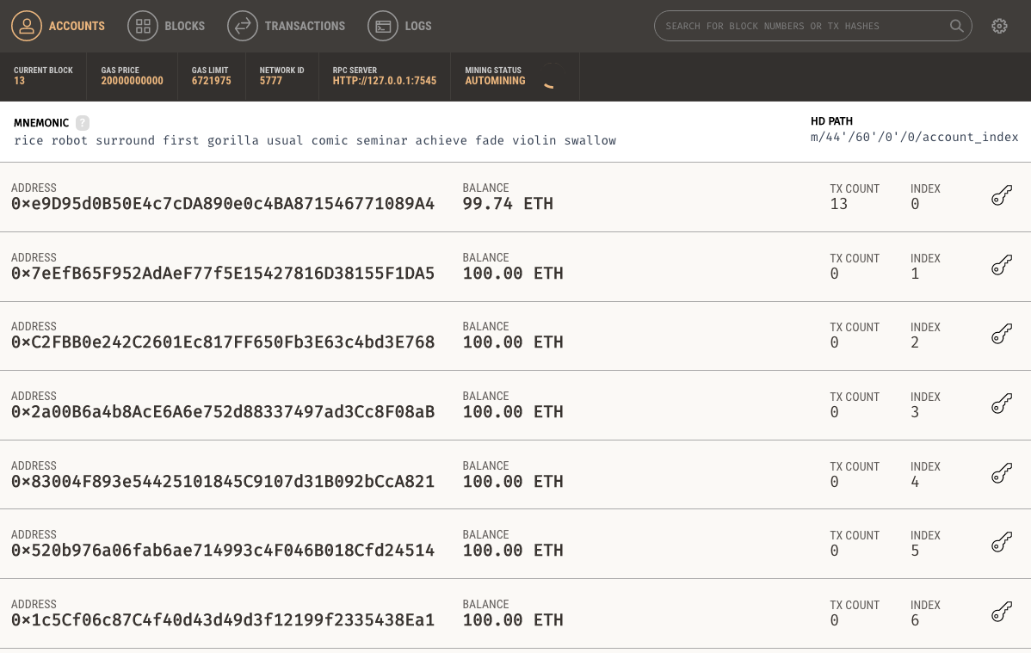
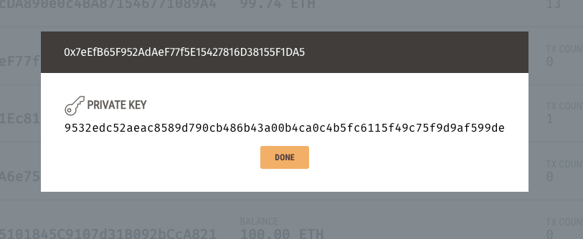
TECHNOLOGIES
Ganache:
Ganache is a personal block chain for Ethereum development.
It is used to deploy contracts, develop your applications, and run tests.

Slide 5
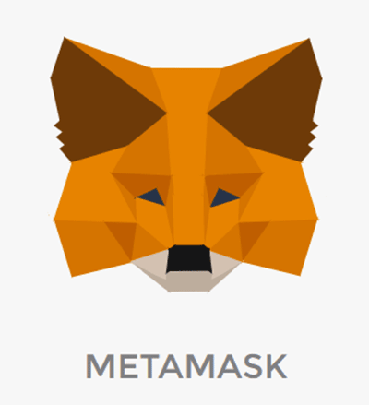
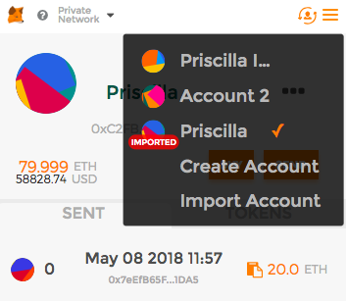
TECHNOLOGIES
MetaMask:
MetaMask is the bridge between the traditional internet and the decentralized economy on the Ethereum blockchain.
It allows you to run Ethereum dApps right in your browser without running a full Ethereum node.

Slide 6
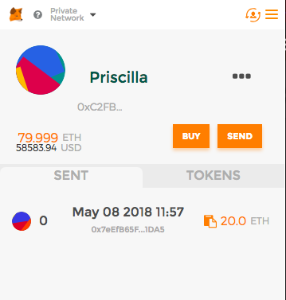
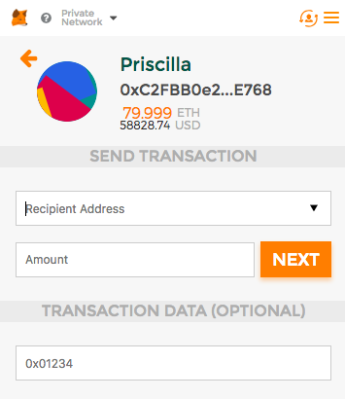
Meta Mask

Slide 7

TECHNOLOGIES
Truffle:
Truffle framework allows to create a decentralized application on the ethereum network.
We can perform migration to deploy our smart contract so that we can interact with the application using truffle or the app.
Test cases have been written in ‘Mocha’ and ‘Chai’ – frameworks built on Truffle.
Web3.js
Web3.js is the official Ethereum Javascript API. You use it to interact with your Ethereum smart contracts.

Slide 8
WORKING
Client side application written in HTML, CSS and JS. Instead of connecting this to backend web server we will connect it to local block chain(Ganache)
Write all the code to the decentralized app with the smart contract.
Complile smart contract and deploy to local block chain.
We will allow accounts in the network to use our application and vote.

Slide 9

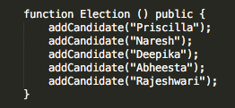
WORKING

Slide 10
LIMITATIONS
Rules of the election cannot be changed, once the smart contract is deployed.
Sometimes, changes may be inevitable like change in voter ID rules, change in candidates.
Smart contract code should be robust. Smart contracts are read sequentially and if a critical piece is missing, the contract won’t run. “Tiniest mistake can be very costly”.
Ethereum blockchain cannot be accessible by everyone.

Slide 11
FUTURE WORK
Timer to election, limited amount of time to vote as in real election.
Start the analysis, once the time runs out and display the votes publicly.
Restrict who can vote in the election based on whether they are registered or not.

Slide 12

CONCLUSION
Digital voting using DAPP allows us to see all the candidates in the election, keep track of how many votes each one is receiving.
Votes are recorded and counted only once. Votes cannot be changed.
“VOTE WITH CONFIDENCE”

Slide 13
Thank You ☺

