Slide 1
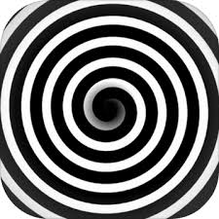

Sample 2
9701695897

Slide 2
Input the number

Slide 3
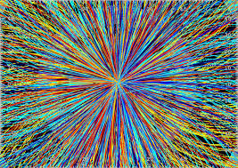
7135823198

Slide 4
Input the number

Slide 5

2031470628

Slide 6
Input the number

