Slide 1
EVENLY SPACED STREAMLINES
PRISCILLA LIKHITA ROY IMANDI
ABHEESHTA REDDY JAKKA

Slide 2
PROBLEM DEFINITION
3D streamlines when projected on to the screen become cluttered.
It becomes difficult for the viewer to understand the structure of the flow.

Slide 3
SOLU TION
Image Based Streamline Generation
Evenly-Spaced Streamlines

Slide 4
Image Based StreamLines
Generally placing of streamline seeds in 3D space is done.
And then generating of the streamline from the seed, projected onto the 2D space.
But here, seeds are dropped on 2D image plane first.
And then unproject the seeds back to3D object space before streamline integration.

Slide 5
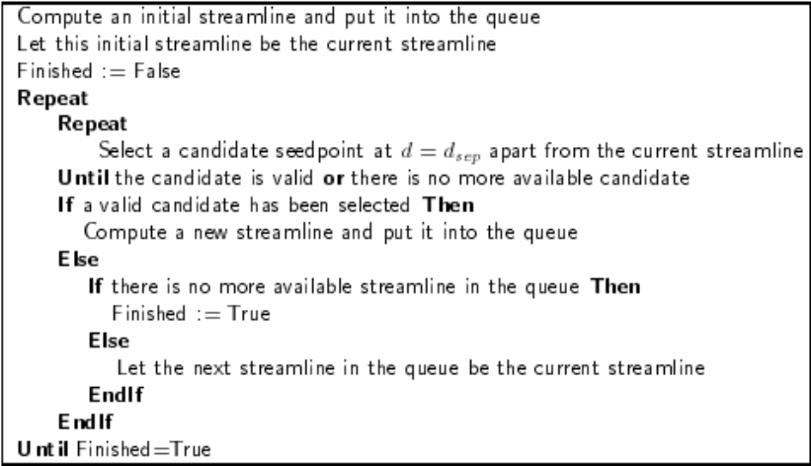
Evenly Spaced StreamLines

Slide 6
Data Structure Used
Queues are to be used to store the streamlines at a distance of dsep from the current chosen seed streamline.
And then these are popped and again streamlines at dsep distance from this chosen streamline are added into queue.
This process is repeated until there are no streamlines in the queue.

Slide 7
Visualisation
Done using Matlab Visualisation
An arbitrary sample dataset is taken from the Matlab datasets.

Slide 8
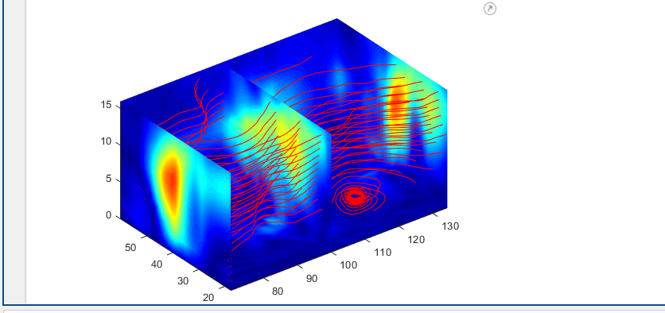
Results

Slide 9
Future Work
Working on Queues.

