Slide 1
OSF_MICROSURGERY_PROJECT
Team 8
Deepika Konreddy(1643290)
Priscilla imandi
Manju viswanathan

Slide 2
REGRESSION MODELS
Apart from the basic model, we developed additional linear models:
Basic Model:
sum1 <-lm(Score ~ PP + Sessions + Task + Age + Sex + Scorer ,data = df_MicrosurgeryPerformance)
Linear model including Time.
Linear model including random effect(1|Subjects)
Linear model including Number of Sutures.
Interaction model(Task*Sessions)

Slide 3
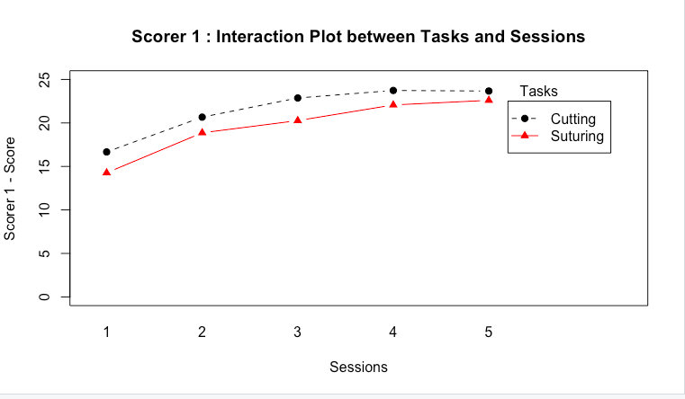
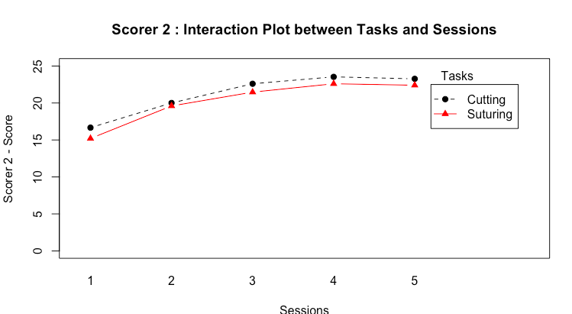
INTERACTION PLOTS
Interaction plot between Score, Task and Sessions

Slide 4
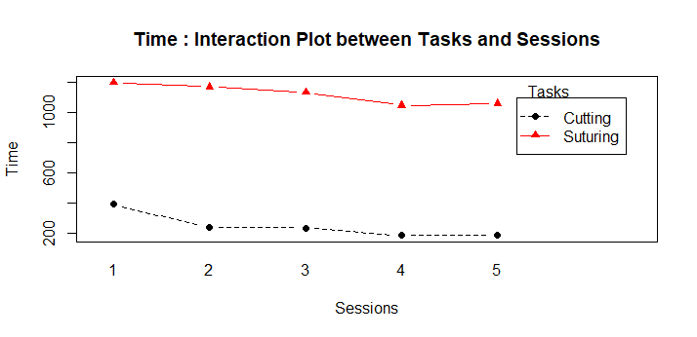
Interaction plot between Time, Task and Sessions

Slide 5
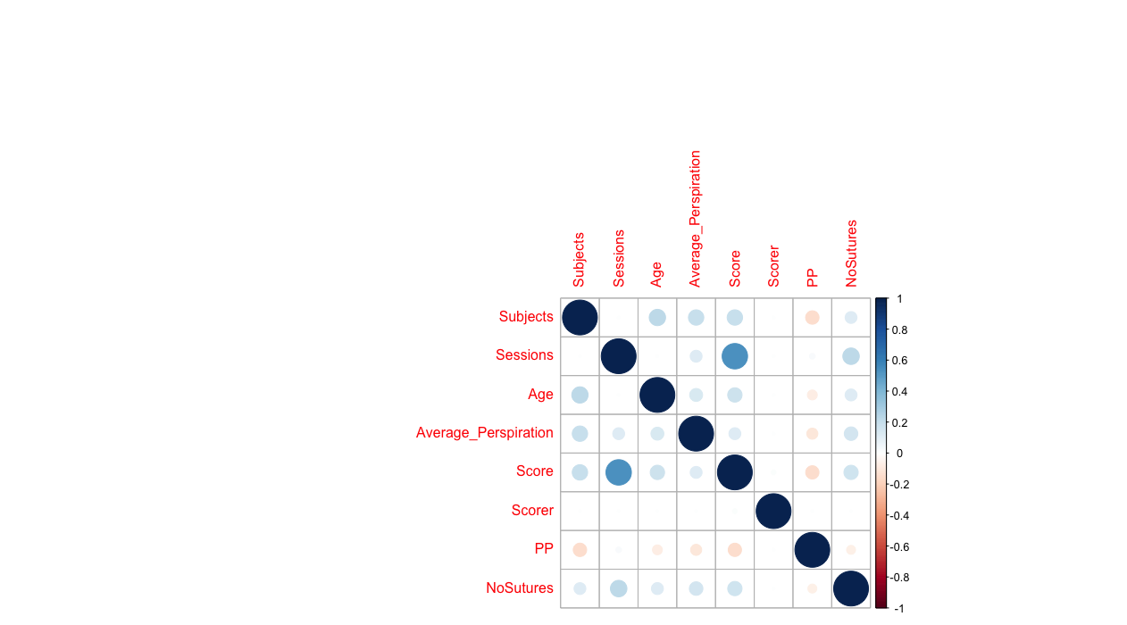
CORRELATION PLOT

Slide 6
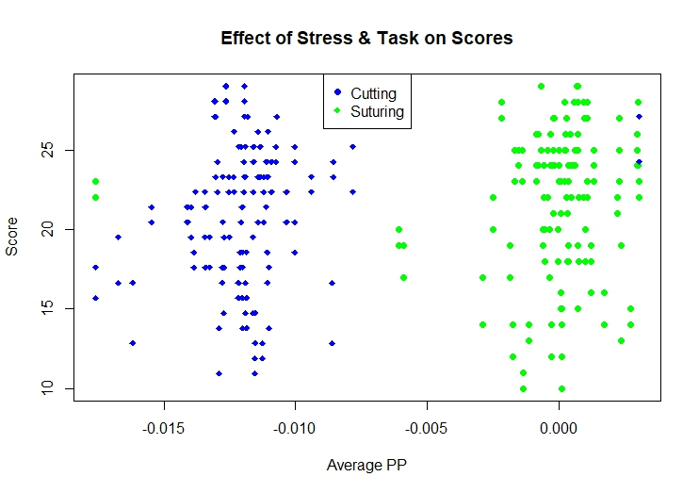
Effect of Stress and Task on Scores

