Slide 1
PROJECT REVIEW — 1
Realtime Web Attack Detection and Inline Blocking Using a Hybrid Rule-Based Transformer for Web Application Firewall
Conference Paper (AIS2C-2027) — and its Journal Extension
Priscilla Jospin G | Rahul R
Dept. of Data Science and Cyber Security
Karunya Institute of Technology and Sciences
Review 1 • Literature Survey & Mathematical/Algorithmic Formulation
1

Slide 2
OUTLINE
What This Review Covers
1
Motivation
Why signature-based WAFs fail and what a transformer changes
2
Literature Survey
13 reviewed works and the gap they leave open
3
Problem Statement & Objectives
What this project sets out to solve
4
Proposed Architecture
Inline hybrid rule + transformer pipeline
5
Mathematical & Algorithmic Formulation
Decision-fusion rule and evaluation metrics
6
Conference Results
What Phase 1 has already validated
7
Journal Extension
How the journal paper builds on the conference paper
Realtime Hybrid Rule-Transformer WAF
2

Slide 3
MOTIVATION
Signatures Match Syntax, Not Intent
SQL injection, XSS, path traversal, and command injection remain the top web risks year after year. The standard defence — a WAF built on signature matching (e.g. ModSecurity + OWASP CRS) — is fast and auditable, but matches surface syntax, not intent.
An inline comment, an encoding trick, or a case change lets a semantically identical payload slip past a fixed rule — and tightening the rule starts blocking real users instead.
SQLi
XSS
Injection via query parameters
Malicious script injection
Path Traversal
Cmd Injection
Unauthorized file access
OS command execution
Transformers learn what malicious structure looks like — instead of enumerating every way it can be spelled. But most transformer-WAF papers stop at offline accuracy and never test the model as a deployed, inline component.
OWASP Top-Ten class attacks used to evaluate the proposed system
Realtime Hybrid Rule-Transformer WAF
3

Slide 4
LITERATURE SURVEY
Two Threads: Rules, and Learned Detectors
A. Rule-Based & Classical ML
B. Transformers, Inline Deployment & Adversarial Robustness
OWASP CRS matches known syntactic patterns but generalises poorly to obfuscated payloads [1]. TF-IDF + SVM/RF/XGBoost improves on fixed rules but depends on hand-engineered features [2]. Deep learning on raw request text reports strong within-corpus results without deployment testing [3].
WADBERT, BERT–LSTM, BERT-IDS and E-WebGuard report >99% accuracy on CSIC 2010 [4]–[7] — but none measure latency, FPR, or reverse-proxy deployment. WAF-A-MoLE and AdvSQLi show ML WAFs can be mutated past [11],[12]. Cross-dataset studies report models collapsing on new traffic [15],[16] — untested for WAFs.
Realtime Hybrid Rule-Transformer WAF
4

Slide 5
LITERATURE SURVEY
Comparison Against Prior Work
Ref | Main Focus | Rule | ML/Tf | Inline | Latency | FPR | Adv. | Cross-DS
P1 OWASP CRS | Rule-based signature engine | ✓ | ✗ | ✓ | ✗ | ✗ | ✗ | ✗
P4 WADBERT | Dual-channel BERT detection | ✗ | ✓ | ✗ | ✗ | ✗ | ✗ | ✗
P7 E-WebGuard | Enhanced neural web detection | ✗ | ✓ | ✗ | ✗ | ✗ | ✗ | ✗
P9 WAF-A-MoLE | Adversarial evasion of ML WAFs | ✗ | ✓ | ✗ | ✗ | ✗ | ✓ | ✗
P10 AdvSQLi | Adversarial SQLi generation | ✗ | ✓ | ✗ | ✗ | ✗ | ✓ | ✗
P12 Cross-Dataset NID | Generalisation (network IDS) | ✗ | ✓ | ✗ | ✗ | ✗ | ✗ | ✓
P13 Cross-Dataset FI | Temporal/semantic generalisation | ✗ | ✓ | ✗ | ✗ | ✗ | ✗ | ✓
Proposed (This Work) | Hybrid rule-transformer inline WAF | ✓ | ✓ | ✓ | ✓ | ✓ | ✓ | ✓
Full 13-work comparison, gap analysis, and limitations are documented in the accompanying literature-survey report.
Realtime Hybrid Rule-Transformer WAF
5

Slide 6
RESEARCH GAP
What the Literature Leaves Unanswered
1
Offline-only evaluation
Transformer detectors are benchmarked on a static split; almost none run behind an actual reverse proxy.
2
No unified cost model
Latency, false-positive rate, and adversarial robustness are each studied separately — never together on one detector.
3
Single-corpus results
Reported accuracy is rarely tested against a second, independently collected traffic distribution.
4
Rule–transformer interaction untested
No reviewed work combines a deterministic rule layer with a transformer under an explicit, measurable fusion policy.
Realtime Hybrid Rule-Transformer WAF
6

Slide 7
PROBLEM STATEMENT
The Trade-Off No One Has Measured Together
!
Signature-based WAFs are auditable but generalise poorly to obfuscated payloads. Transformer-based detectors report high offline accuracy but are almost never evaluated as a deployed inline component — leaving latency cost, false-positive rate, adversarial robustness, and behaviour under distribution shift unmeasured.
There is a need for a WAF architecture that combines rule-based and transformer-based detection under an explicit fusion policy, deploys it inline in front of a real backend, and evaluates it end to end across accuracy, latency, false-positive cost, adversarial robustness, and cross-dataset generalisation.
Realtime Hybrid Rule-Transformer WAF
7

Slide 8
OBJECTIVES
Six Measurable Targets
1
2
3
Design an inline hybrid WAF via Nginx's sub-request authorization mechanism
Design a four-tier rule-transformer decision-fusion policy
Fine-tune a BERT detector and measure P/R/F1/FPR/AUC
4
5
6
Measure inline GPU inference latency and throughput
Test adversarial robustness against six mutation families
Evaluate cross-dataset generalisation on two unseen corpora
Realtime Hybrid Rule-Transformer WAF
8

Slide 9
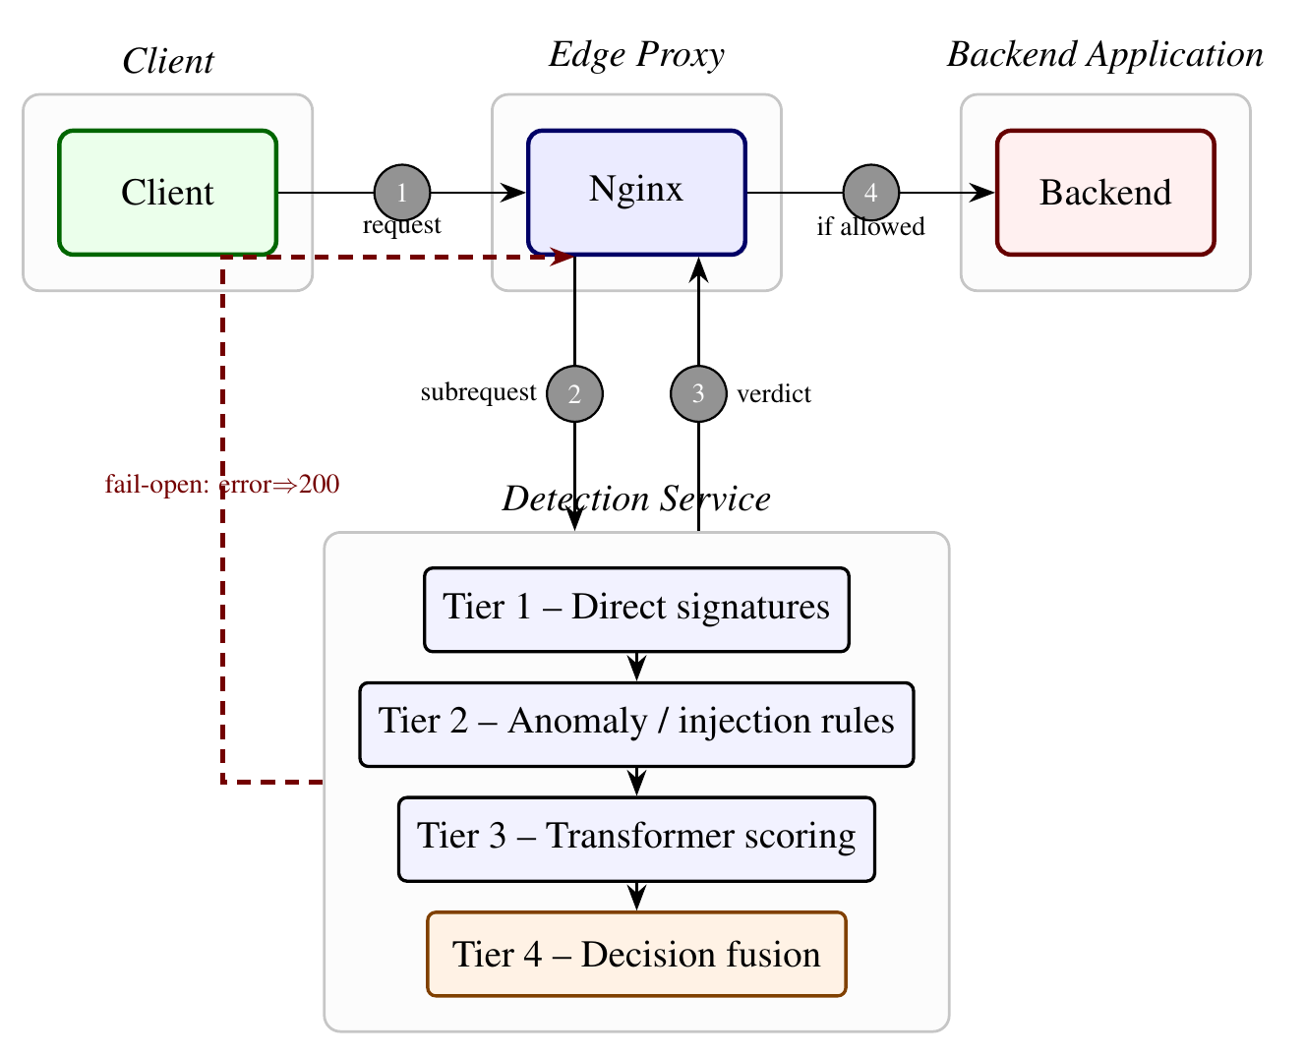
PROPOSED METHODOLOGY
Inline Enforcement Architecture
Fig. 1 — Client → Nginx edge proxy → Detection Service (Tiers 1–4) → Backend, with a dashed fail-open path.
Realtime Hybrid Rule-Transformer WAF
9

Slide 10
PROPOSED METHODOLOGY
Four-Tier Decision-Fusion Pipeline
Tier 1
Tier 2
Tier 3
Tier 4
Direct Signatures
Anomaly / Injection Rules
Transformer Scoring
Decision Fusion
Unambiguous known-attack patterns, checked after double URL-decoding
→
Keyword, injection-pattern, encoding, and character-anomaly signals
→
Fine-tuned BERT produces a calibrated malicious-class probability p(x)
→
Combines rule signals with confidence-banded model score → BLOCK / ALLOW
A fail-open safeguard degrades any unhandled detection-path error to ALLOW, so a fault in the WAF cannot take the backend down.
Realtime Hybrid Rule-Transformer WAF
10

Slide 11
MATHEMATICAL FORMULATION
Scoring and Decision-Fusion Rule
MALICIOUS-CLASS PROBABILITY (1)
p(x) = exp(w₁ᵀh + b₁) / [ exp(w₀ᵀh + b₀) + exp(w₁ᵀh + b₁) ]
h = BERT(φ(x)) ∈ ℝ⁷⁶⁸ is the pooled transformer representation of the preprocessed request.
MODEL-ONLY DECISION (2)
ŷ(x) = 1[ p(x) ≥ τ ]
DECISION-FUSION RULE (Tier 4) (3)
f(x) = 1 if s_dir(u)=1; 1 if (s_kw ∧ s_inj) ∨ s_enc; 1 if p(x) > τ_h ∧ s_has;
1 if τ_ℓ ≤ p(x) < τ_h ∧ (s_kw ∨ s_ca); 0 otherwise
Blocks on a direct signature, a strong rule combination, a high-confidence model score with rule corroboration, or a moderate-confidence score with a keyword/character-anomaly signal.
Realtime Hybrid Rule-Transformer WAF
11

Slide 12
MATHEMATICAL FORMULATION
Evaluation Metrics
P
R
F1
FPR
TP / (TP + FP)
TP / (TP + FN)
2PR / (P + R)
FP / (FP + TN)
Precision
Recall
F1 Score
False-Positive Rate
Per-class recall (4): R_a = (1/|X_a|) Σ 1[f(x)=1], x ∈ X_a
Inline throughput (5): RPS = 1000 / L_avg (L_avg = mean per-request latency, ms)
Adversarial evasion rate (6): E_m = (1/|B|) Σ 1[g(m(x))=0], x ∈ B
ROC–AUC is threshold-independent: the area under the TPR/FPR curve as τ sweeps from 1 to 0, complementing the four operating-point metrics above.
Realtime Hybrid Rule-Transformer WAF
12

Slide 13
ALGORITHMIC FORMULATION
Inline Decision-Fusion Algorithm
1
Forward the client request to the Nginx edge proxy.
6
Tier 3: tokenise and score the request with the fine-tuned transformer.
2
Nginx issues an internal sub-request to the detection service.
7
Tier 4: apply the fusion rule (Eq. 3) to reach BLOCK or ALLOW.
3
Double-decode the URI to expose encoded characters.
8
Return the verdict to Nginx; proxy to the backend only if ALLOW.
4
Tier 1: check direct signatures — match ⇒ BLOCK.
9
On any unhandled error: fail open and return ALLOW.
5
Tier 2: evaluate keyword / injection / encoding / char-anomaly rule signals.
Realtime Hybrid Rule-Transformer WAF
13

Slide 14
CONFERENCE PAPER — PHASE 1 (COMPLETED)
Results Already Validated
0.949
6.4%
12.7 ms
0%
F1 (BERT alone)
False-Positive Rate
Median GPU Latency
Hybrid Adversarial Evasion
Cross-dataset finding: the rule layer rescues a collapsing model on SR-BH 2020 (F1 0.601 → 0.971) but suppresses a well-generalising model on a newer 2025 production corpus (recall 0.999 → 0.151) — its value is corpus-dependent, not architectural.
Realtime Hybrid Rule-Transformer WAF
14

Slide 15
JOURNAL PAPER — PHASE 2
Extending the Conference Baseline
PHASE 1 — CONFERENCE (Done)
PHASE 2 — JOURNAL (This Review)
• 6-page inline architecture + fusion policy
• Detection, ablation, and threshold-sensitivity results
• Adversarial evasion (6 mutation families)
• Zero-shot test on SR-BH 2020
• Zero-shot test on 2025 production ModSecurity log
• Extended discussion of the accuracy–robustness–generalisation trade-off
• Deeper per-attack-class and error analysis
• Broader related-work coverage and positioning
• Calibrated fusion to replace the either/or rule (future work)
• Full 20-page treatment for journal-length rigor
→
Realtime Hybrid Rule-Transformer WAF
15

Slide 16
SUMMARY
Novel Contributions
1
Inline hybrid WAF architecture built on Nginx's sub-request authorization mechanism
2
Four-tier rule-transformer decision-fusion policy with fail-open safeguard
3
Deployment-oriented evaluation: accuracy, latency, FPR, and adversarial robustness together
4
Two-corpus cross-dataset study showing generalisation benefit is corpus-dependent
Thank you — Questions welcome
Realtime Hybrid Rule-Transformer WAF
16

