Slide 1
Prisha C
Final Project
3/21/2024 Annual Review

Slide 2
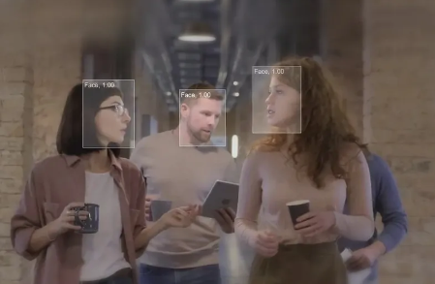
PROJECT TITLE-FACE EXPRESSION DETECTION
Face expression detection is a branch of computer vision and artificial intelligence focused on deciphering the emotional states conveyed through human facial expressions.
It involves the use of advanced algorithms and techniques to analyze and interpret the subtle cues present in facial features and movements.
By leveraging technologies such as deep learning and pattern recognition, face expression detection aims to accurately recognize a spectrum of emotions, including joy, sadness, anger, surprise, disgust, and fear, among others.
This technology has diverse applications across industries, including human-computer interaction, mental health assessment, security systems, and marketing.
3/21/2024 Annual Review

Slide 3


AGENDA
Clearly define the objectives and goals of the face expression detection system.
Select appropriate datasets with diverse facial expressions and ensure they are labeled correctly.
Preprocess the data by performing tasks such as face detection, alignment, and normalization to improve data quality.
Extract relevant features from facial images, such as facial landmarks, texture descriptors, and geometric features.
Choose suitable machine learning or deep learning models, such as Convolutional Neural Networks (CNNs), for face expression detection.
Split the dataset into training and testing sets, and train the model using the training data while adjusting hyperparameters for optimal performance.
Evaluate the trained model using testing data and metrics such as accuracy, precision, recall, and F1-score.
Fine-tune the model and experiment with different optimization techniques and regularization methods to improve performance.
Perform cross-validation to ensure the robustness of the model by training it on different subsets of data.
Deploy the trained model in real-world applications, ensuring the deployment environment supports real-time processing of facial images.
3/21/2024 Annual Review

Slide 4

PROBLEM STATEMENT
The objective of this project is to develop a robust and accurate system for automated detection and recognition of facial expressions from images or video streams.
The system aims to accurately identify a range of facial expressions, including but not limited to happiness, sadness, anger, surprise, disgust, and fear.
The primary challenge lies in designing an algorithm or model capable of effectively capturing subtle variations in facial features associated with different expressions, while also being robust to factors such as variations in lighting conditions, facial orientation, and individual differences in facial morphology.
Additionally, the system must be capable of real-time processing for deployment in various applications, such as human-computer interaction, emotion-aware systems, healthcare, marketing, and security.
3/21/2024 Annual Review

Slide 5

PROJECT OVERVIEW
The project aims to develop a comprehensive system for automated face expression detection, leveraging machine learning and computer vision techniques.
The system will be capable of accurately recognizing and classifying a range of facial expressions in real-time, enabling applications in diverse fields such as human-computer interaction, healthcare, marketing, and security.
Key Components:
Data Acquisition and Preprocessing:
Feature Extraction:
Model Development:
Evaluation and Validation:
Deployment and Integration:
Ethical and Privacy Considerations:
3/21/2024 Annual Review

Slide 6

WHO ARE THE END USERS?
The project aims to develop a comprehensive system for automated face expression detection, leveraging machine learning and computer vision techniques.
The system will be capable of accurately recognizing and classifying a range of facial expressions in real-time, enabling applications in diverse fields such as human-computer interaction, healthcare, marketing, and security.
Key Components:
Data Acquisition and Preprocessing:
Feature Extraction
Model Development
Evaluation and Validation
Deployment and Integration
Ethical and Privacy Considerations
3/21/2024 Annual Review

Slide 7

YOUR SOLUTION AND ITS VALUE PROPOSITION
Accuracy: Our solution employs state-of-the-art deep learning techniques to accurately detect facial expressions, achieving high precision and recall rates. This ensures reliable performance across various demographics and environmental conditions.
Real-time Processing: With optimized algorithms and efficient model architectures, our solution can process facial expressions in real-time, enabling applications in live video streams, video conferencing, and interactive experiences.
Versatility: Our facial expression detection system is versatile and can be integrated into diverse applications such as emotion recognition in human-computer interaction, sentiment analysis in market research, and mental health monitoring in healthcare settings.
Adaptability: The system is designed to adapt to different facial features, lighting conditions, and facial orientations, ensuring robust performance in dynamic environments and varied scenarios.
Privacy Preservation: We prioritize privacy by employing on-device processing or secure cloud-based solutions with end-to-end encryption, ensuring user data confidentiality while still delivering accurate results.
Scalability: Our solution is scalable, capable of handling large volumes of data and supporting deployment across various platforms including desktop, mobile, and IoT devices.
User Experience Enhancement: By accurately detecting facial expressions, our solution enhances user experiences in applications ranging from virtual assistants to entertainment platforms, enabling more personalized and responsive interactions.
3/21/2024 Annual Review

Slide 8

THE WOW IN YOUR SOLUTION
Emotion Granularity: Our solution doesn't just stop at the basic emotions; it goes beyond to detect nuanced expressions such as contempt, confusion, or determination, providing a deeper understanding of human emotions.
Adaptive Learning: Utilizing advanced machine learning techniques, our system continuously learns from user interactions and feedback, improving its accuracy and adaptability over time. This adaptive learning capability ensures that the system becomes more attuned to individual users' expressions and preferences, leading to a highly personalized experience.
Real-time Feedback and Interaction: Imagine a scenario where your device can detect not only what emotion you're expressing but also provide real-time feedback or adaptive responses based on those emotions. Whether it's adjusting the tone of a virtual assistant's voice to match the user's mood or customizing content delivery in a game based on player emotions, our solution enables dynamic and interactive experiences like never before.
Multimodal Integration: Our solution integrates multiple modalities such as facial expressions, voice tone, and body language to provide a holistic understanding of human emotions. By analyzing these various cues together, our system achieves unparalleled accuracy in emotion detection and interpretation.
Cross-platform Compatibility: From smartphones and tablets to smart glasses and IoT devices, our solution seamlessly integrates across various platforms and devices, ensuring a consistent and immersive user experience regardless of the technology being used.
3/21/2024 Annual Review
8

Slide 9
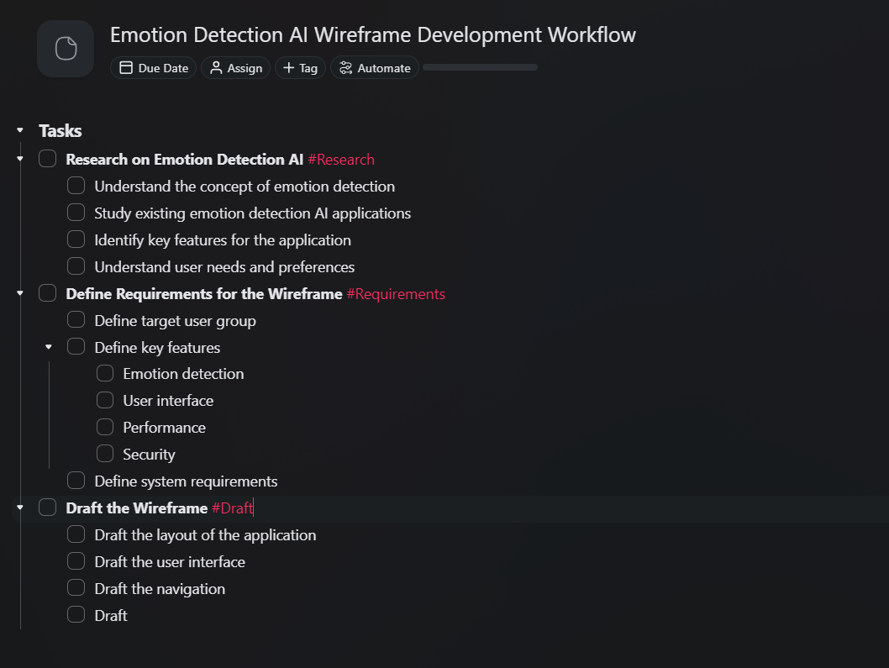
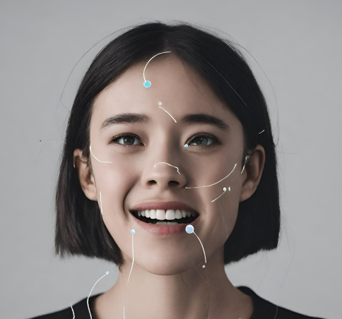
MODELLING
3/21/2024 Annual Review
9

Slide 10
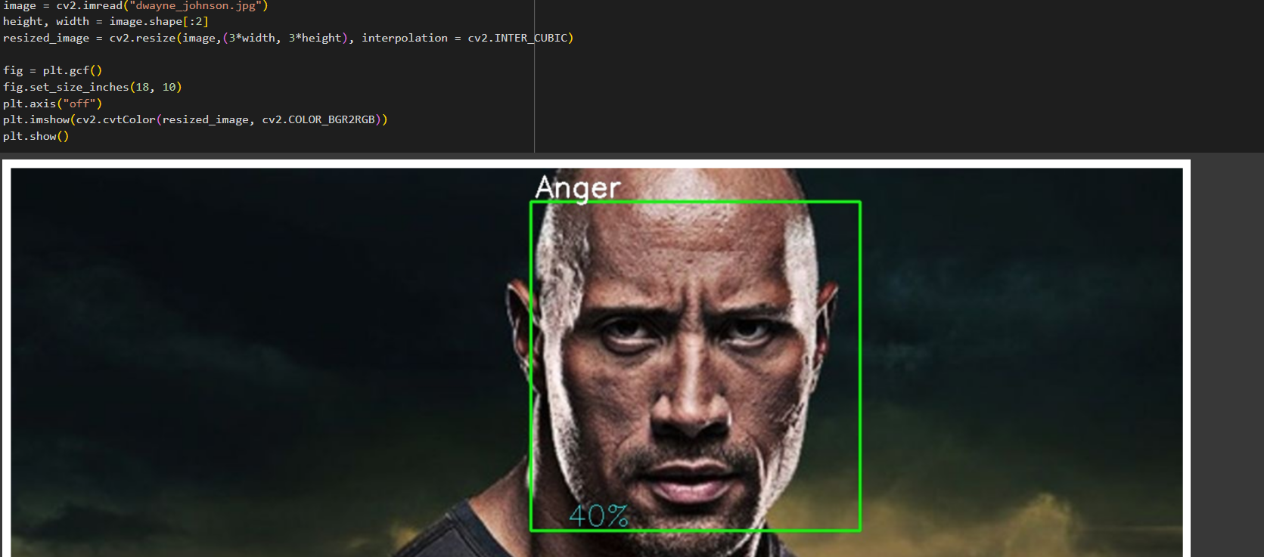
RESULTS
https://colab.research.google.com/drive/1QkklTl6e4fRQtbjvLpsnJROndCCSAQQj?usp=sharing
3/21/2024 Annual Review
10

