Slide 1

Can medium-term train delays be predicted?
Dom White
27/01/2020
Notes:
Hey guys, I’m Dom White.
My dissertation is on train delay prediction. I self-proposed this topic after catching one too many delayed trains, and reading Atlas Shrugged, which I strongly recommend.
A note on terminology first. A train delay is, in the UK, a positive difference of greater than 5 minutes between the scheduled time of a train activity – an arrival, departure, or a pass - and the actual time of that activity.
Train delay prediction can be broadly broken down into three timeframes: real-time (or short-term), medium-term, and long-term.
Real-time delay prediction is where the majority of the literature focuses. It uses the performance of a train at previous checkpoints to predict performance at subsequent checkpoints.
Medium-term delay prediction is concerned with predicting the delays of trains up to a specific point in time. The distance of this threshold depends on the forecast of some variable, some exogenous data. This is typically weather, but could be planned engineering works, strikes, national holidays, or levels of demand.
Long-term delay prediction is less about delay prediction and more about timetable / schedule optimisation, so I won’t dwell on it here.
The goal of the project is to predict, with a reasonable accuracy, the likelihood of a train being delayed, and to what extent.

Slide 2
Background
14 million minutes of delay in 2006 – 2007, costing > £1 billion just in terms of time lost
Delays reduces consumer confidence and thus usage of train services
22,000 passenger trains and 2,000 freight trains daily
Mishmash of outdated legacy systems
Short-, medium-, and long-term
Rail network models
Notes:
Train delay is a big problem. An report by the National Audit Office over 2006 – 2007 found that there were 14 million minutes of delay, costing over £1 billion just in terms of time lost to passengers.
An analysis of the 2018 - 2019 data reveals now 35 million minutes of delay. The cost to train operating companies – TOCs – is difficult to know: you may be aware that under the ‘Delay Repay’ scheme, you can get your ticket refunded if your train is more than half an hour late. What about overtime? Crews or trains in the wrong place at the wrong time?
Delays reduce customer confidence in services and thus actual usage; people turn to alternatives such as air or road travel, with substantially greater environment impact. Trains are cheaper and greener, but reliability is an impediment to their popularity. So there is a strong commercial application to medium-term delay prediction.
Part of the problem is the sheer number of trains: 24,000 daily, operated by just under 30 different companies, now that the government is re-nationalising Northern Rail for shoddy performance.
Network Rail opened up their data feeds in 2010. There are lots and lots of potential data sources available; only those used are listed here. The Office of Road and Rail (ORR), for instance, publishes station usage statistics, which might provide an insight into passenger numbers, and therefore dwell time, a key predictor of delay. NR itself publishes historical delay attribution data, which could be used to better predict the causes of delay, an industry which, I am told, consumes a significant portion of TOC expenditure.
The systems in use are main, varied, and old, often with the only interoperability between them a single ID identifying a train, or set of trains (that is, a schedule). The earliest system still in use is a mainframe-based one from the 80s. Much of the difficulty I’ve had so far has been working with these systems, which are riddled with obscure bugs. One, for instance, requires output train speeds to be multiplied by 2.24 to get actual speeds, or key indicators manually overwritten.
I’ve covered the differences between short-term, medium-term, and long-term already, I’ll come onto models on the next slide, because they are inextricably linked to the two types of delay – primary and secondary.

Slide 3
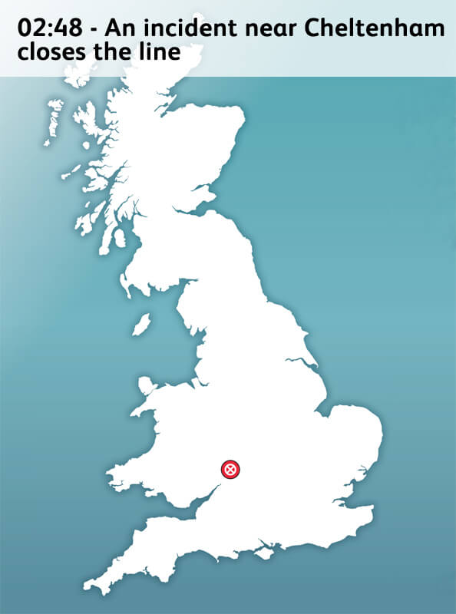
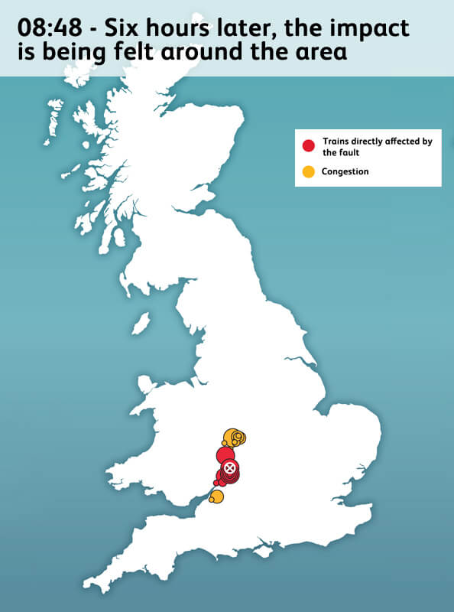
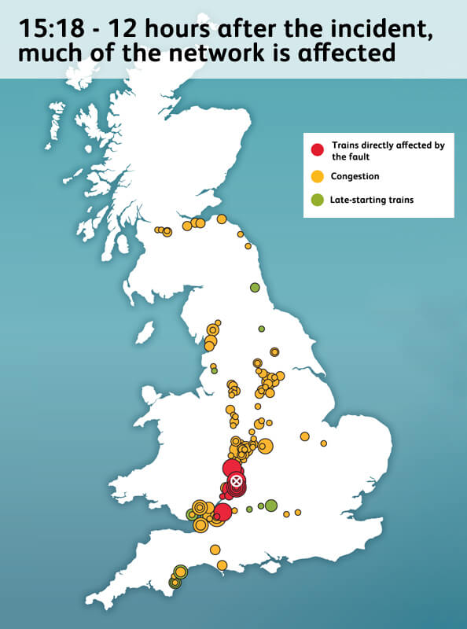
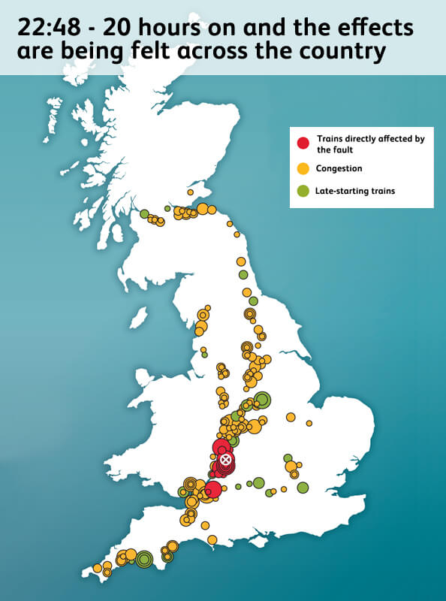
Primary and secondary delays
Notes:
A primary delay is caused by an external disturbance: a landslide, hail, a strike, an ill passenger, engineering works, a train malfunction. A large part of ML research into the rail industry in general is predictive maintenance, spearheaded by Siemens.
A secondary or knock-on delay is caused by a delayed train. If one train is delayed, crews and trains aren’t in the right place at the right time. Trains must wait for connections, or at designated passing points, for longer than necessary, and so delays propagate. This is extremely difficult to model.
This is a neat graphic provided by Network Rail. It shows the impact of a track closure at 3am in the morning. Throughout the day trains are cancelled or delayed as far afield as Scotland. Impacts are still being felt 20 hours later.
Secondary delays depend on innumerable factors: track infrastructure, scheduling priorities, the decisions of individual line operators, the current state of the rail network. Modelling this has been the major challenge for short-term train prediction systems. Earlier work created separate time-series forecast models for each train, for example, where inputs were the entire state of the rail network at the time, a computational nightmare.
Later, more advanced work uses messages to build up an infrastructure map and predict responses by rail operators to delays to model propagation.
Fortunately, we can bypass the complexity of secondary delays by focusing on primary delays and constructing dummy variables to represent key factors – the ‘busyness’ of a line, for instance. This, however, means the short-term delay prediction is an infeasible goal, as they are simply too important.
Hence my focus on medium-term delays, which are primarily primary in nature. This approach uses the historical performance of similar trains as well as forecasted weather data to predict delays.
This could have a very practical use, as I mentioned earlier – how much less would you have to pay for a train with an 80% chance of being delayed, for instance? If this prediction could be made, could train operating companies (TOCs) divert resources or manpower to prevent such a delay by better utilising existing assets?
There’s a bit of a dearth of research into this area. Real-time train delay prediction is a fairly well-studied area, with both theoretical and stochastic models developed over the past 50 years. Recently, machine learning has made an appearance, with two schools of thought, one aiming to capture the human characteristics of a system – such as the routing and signalling decisions made by individual line operators – and the other the graphical / infrastructure nature of the system.
Only two of the papers that I have reviewed try to predict this. One predicts delays up to 10 days’ in advance. The other use a slight modification of their real-time model to predict delays up to 2 days’ in advance. Both find disappointing results. The former places blame on a limited dataset covering only 3 months. The latter manages only 55% accuracy – it is entirely possible that medium-term train delays can’t be predicted. That is what I am exploring.

Slide 4
Deliverables
Construction of a data set (ETL)
Exploratory data analysis / identification of suitable machine learning models
Refinement / development of selected ML model
Testing on unseen data in real-time
Notes:
So: onto my deliverables.
They have constantly evolved as I’ve encountered (many) unforeseen issues.
This is my current roadmap:
The first deliverable is the construction of a dataset from a variety of sources, mostly Network Rail (NR), but also CEDA, the Centre for Environment Data Analysis, and ORR, the Office for Road and Rail.
The second is an exploratory data analysis of this dataset, in conjunction with the identification of suitable ML models for predicting delays
The third is the selection and refinement of a ML model
The fourth and final, advanced deliverable is the development of a system to predict delays in real-time, that is, on non-historical data, actually using weather forecasts and train schedules as inputs.
I’m currently on my basic objectives; I’ll talk you through my progress next.

Slide 5
Dataset construction (ETL)
TRUST
Darwin
MIDAS / CEDA
TSR
LTP / STP / VSTP
KB
BPLAN
Notes:
Construction of the dataset has thus far been the primary focus of this project. It has been unexpectedly time-consuming, with many hard decisions to make. It’s difficult to overstate just how much work this has been, in truth. I have waded through more obscure documents than I care to mention, and terabytes of data. I feel like I now know more about the UK rail network than anyone else in Durham.
I’ve put all the relevant acronyms I could find on this slide. These are all data sources I’ve considered using.
TRUST and Darwin provide train messages
MIDAS / CEDA is weather dataset
TSR is a weekly update of temporary speed restrictions, due to engineering work
LTP / STP / VSTP are sources of train schedules
KB and BPLAN are repositories of infrastructure information: track gauges, connections, station details, locations of gantries and the like,
Much of the work thus far has been an extract-transform-load (ETL) task. Much of the data is a complex legacy formats that has required considerable parsing, cleaning, and formatting to be usable, with an especially great overhead on actually figuring out what the data means. This should, however, put me in good stead for future deliverables: I’m my own subject matter expert at this point.
Several rail enthusiasts have been archiving these feeds, some from as earlier as 2015, although most start in 2017, and some (TSR and VSTP in particular) not at all.
Darwin and TRUST produce hundreds of thousands of messages a day. Each is at a specific TIPLOC, or timing point location, which allows them to be geographically located, and mapped to scheduled arrival, departure, and pass times, provided from LTP and STP, along with metadata like seat reservations, number of carriages, engine type, expected speed, and so on.
MIDAS / CEDA is a Met Office dataset that provides hourly data for some 150 stations in the UK with over 200 fields. By mapping MIDAS stations to TIPLOCs, we can obtain the weather at a given TIPLOC at a given time, and so add a weather component to our dataset. Oneto around a 15% improvement in performance with the incorporation of weather.
Indeed, a possible alternative direction for this dissertation would be the publishing of a high-quality pre-processed dataset for use by other researchers. Existing papers use proprietary data from national railway managers like RFI, the Italian Network Rail, Deutsche Bahn, or Amtrak. An open-source dataset would therefore be of great value to the research community.
I have had to make many simplifying assumptions. In particular, I’ve considered schedules from a set of points to a single record containing just the arrival and departure TIPLOC. There’s just too much data to handle otherwise, and too many irregularities. For instance, a train should always start with a DEPARTURE. What should be done with a train which starts with a PASS? Or a train that finishes with a PASS?
I have also been unable to find archived data for VSTP, which is for trains scheduled less than 48 hours before they are due to run. The founder of RealTimeTrains has recently set up a comprehensive mirror of ALL feeds; if I were to do this project again, I would use his repository, as I’ve had to deal with missing files and corrupted data in spades.
But I’m getting a bit worked up.
My final output is a 1 GB CSV for the 2018 - 2019 financial year. Various irregularities precluded me from using data earlier than this date, and as weather is expected to play a significant part in this project, it seems inappropriate to use anything other than year increments to account for seasonal variations.

Slide 6
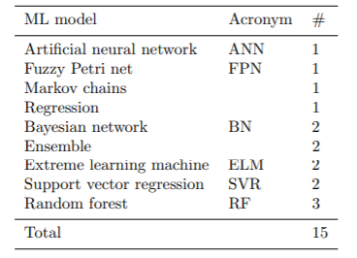
ML models
Wide variety of models applied
Most popular include:
Random forests
Support vector regression
Bayesian network
PyTorch / TensorFlow
Notes:
Now that the dataset has been constructed, I’m starting the actual machine learning component.
However, as I previously mentioned, most of these models have been tested on real-time problems with a very different structure to how I’ve formulated the problem, so there may not be much overlap in this regard. This gives me free rein to experiment. These models are those used in my literature review. I have left out ‘Ensemble’ as these models are simply too complex – state-of-the-art systems developed by research groups at IBM for Deutsche Bahn, for instance – for my dissertation.
I’ll probably take my lead from our current submodule and go from there, so I imagine that I’ll use PyTorch.
I plan to conduct simple trials for a sample of models and select the one with the most promise. From there, I’ll see how I can tweak parameters, and even the dataset, to improve results. My data position is somewhat unique, I think, in that I’ve generated it myself, and so this gives me great flexibility.

Slide 7
Real-time application
Registration of various clients to various feeds via STOMP / ActiveMQ / Kafka
Parsing of streams to input format
Meaningful output of data
Notes:
The final, advanced deliverable is necessary for the system to be of practical rather than theoretical use.
It would require a server to:
A) Receive the relevant NR feeds and weather forecast feeds: LTP, STP, VSTP, TSR, and MIDAS, and go from there
B) Map those feeds into rows in the same format as the dataset
C) Output those predictions in a meaningful way.
I have laid some of the groundwork for this stage already. For instance, I have already mapped the MIDAS / CEDA dataset to the same variables available in a forecast. Many of the functions I have written to parse the historical data could be re-used as well.
There’s a very in-depth blog post that focuses on using Apache Kafka for a streaming ETL solution, but that really has more of a real-time focus.

Slide 8
Questions?
Notes:
Seek clarification for ambiguous or unclear questions
Answer clearly
Make suggestions if I don’t know the answer
Alright guys, thanks for listening!

