Slide 1
Real or not?

Slide 2

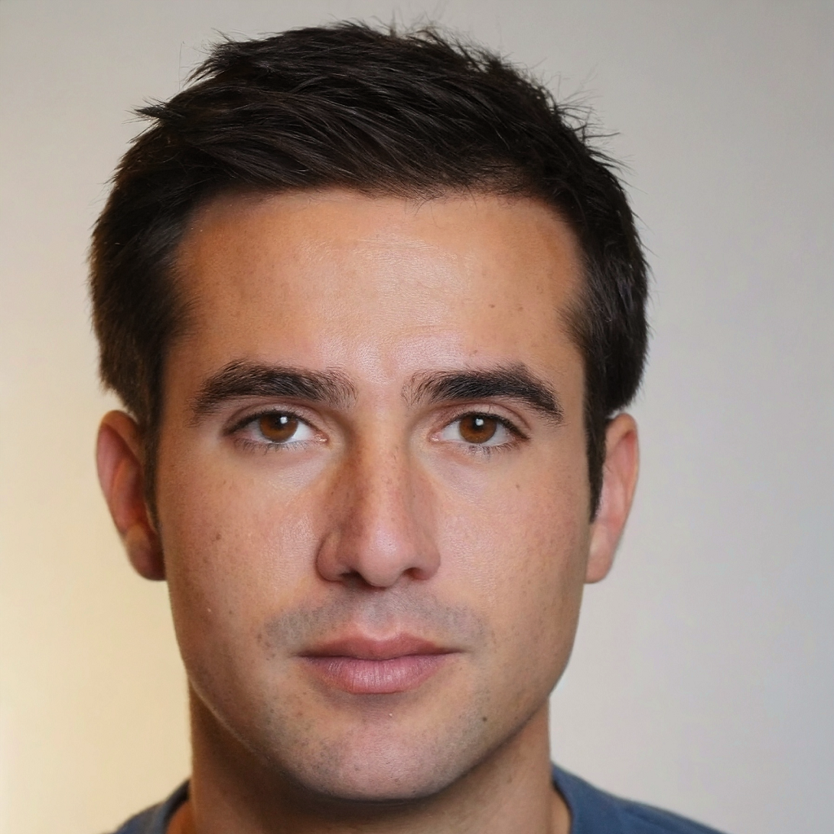
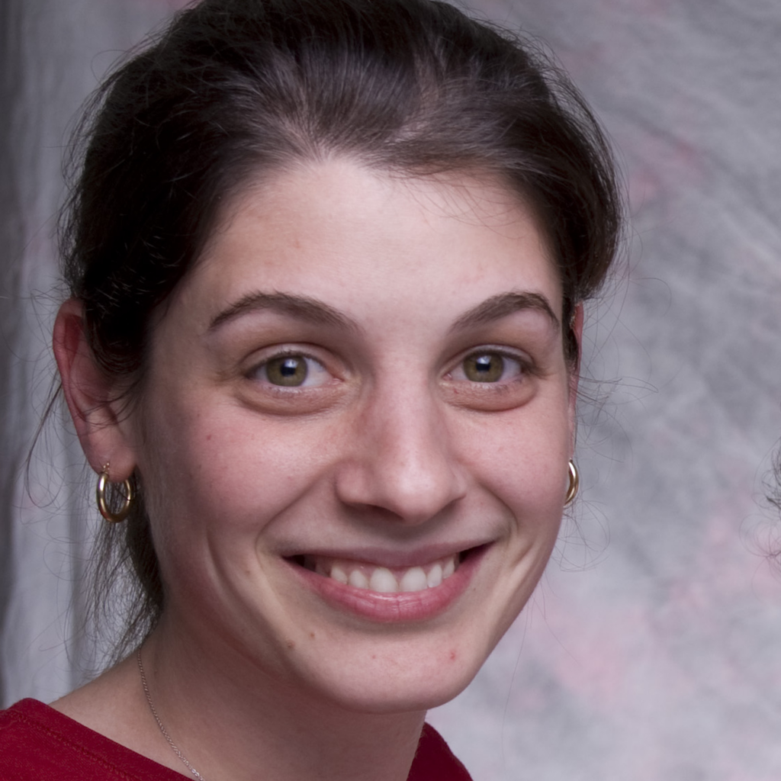

Slide 3



Slide 4
Generative
Artificial
Intelligence

Slide 5
Audio
Text
Generative
Artificial
Intelligence
Video
Images

Slide 6
Text

Slide 7
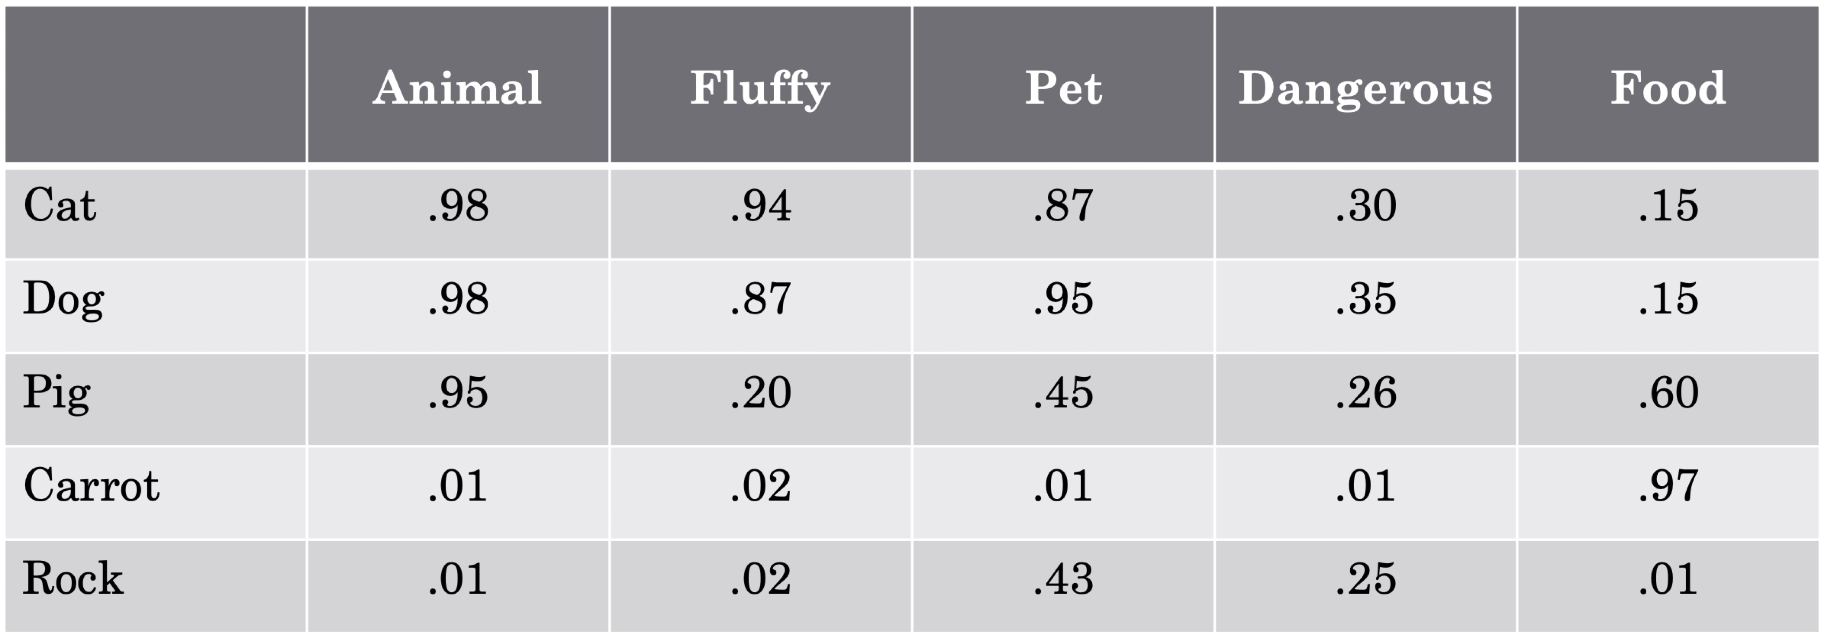
Text: Embeddings
King = Queen – Woman + Man

Slide 8
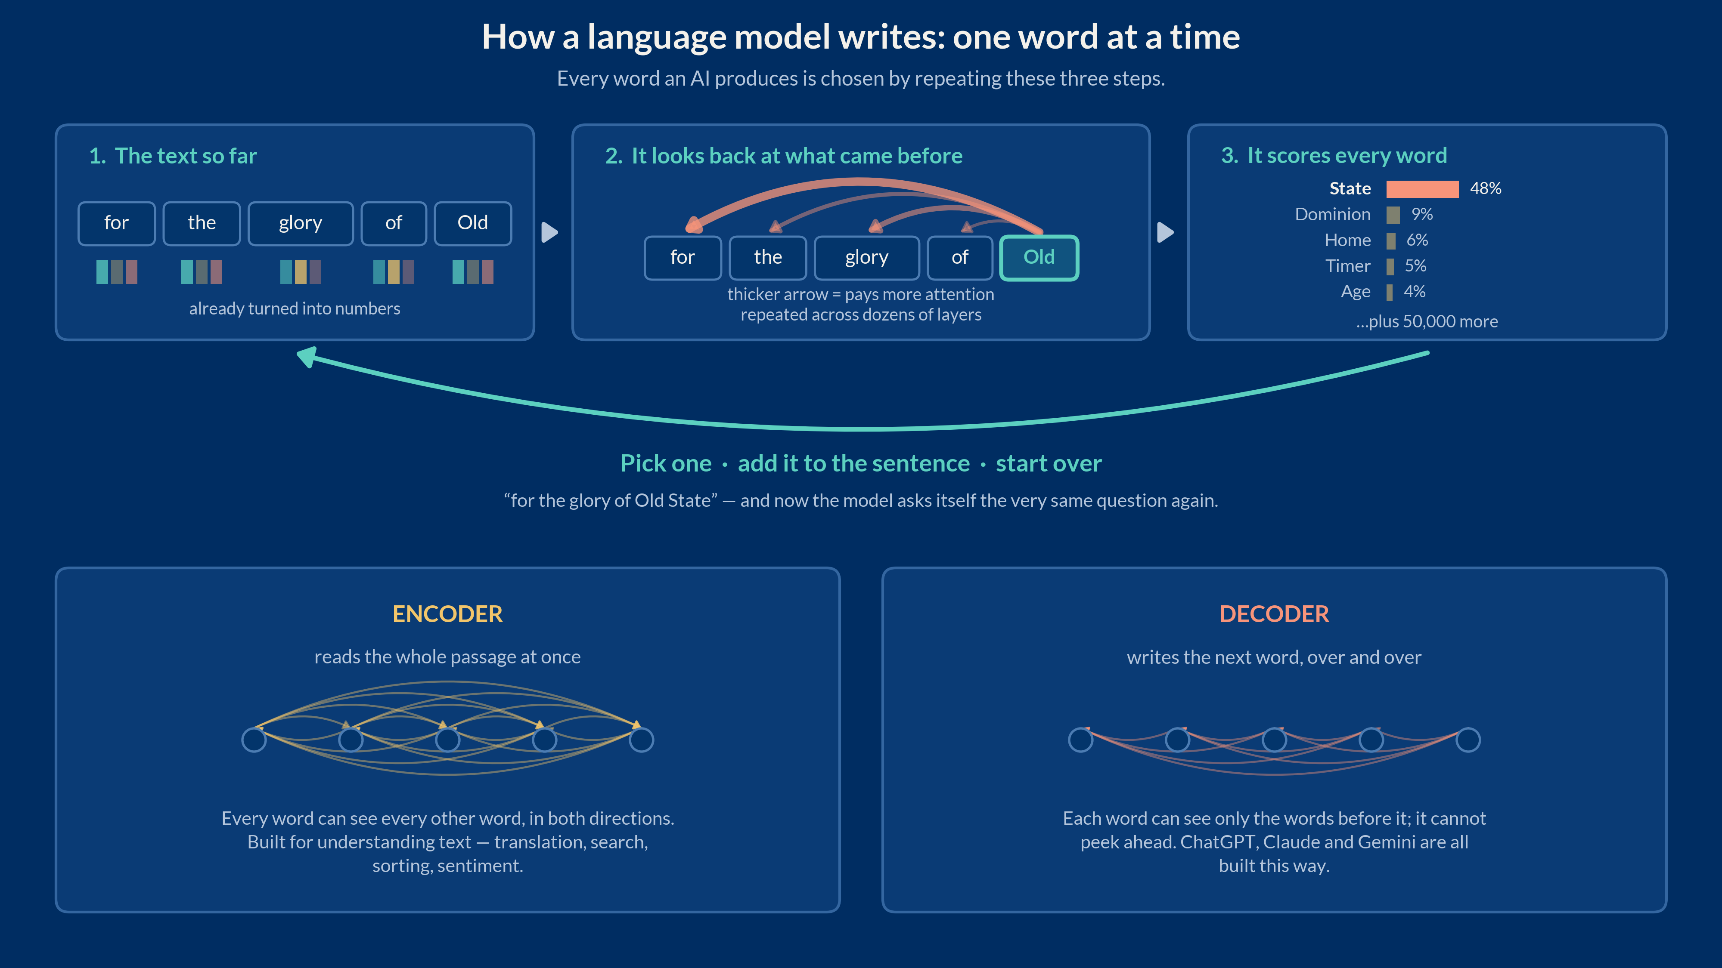

Slide 9
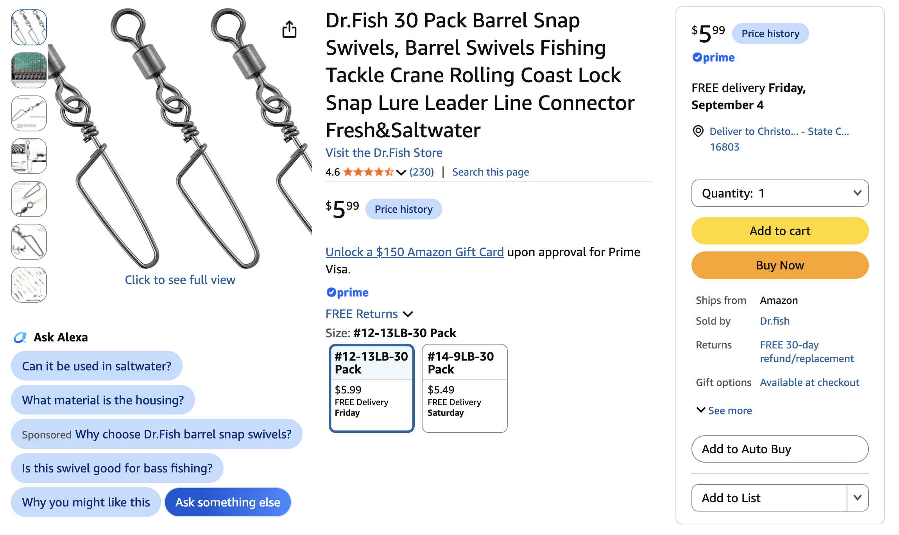

Slide 10
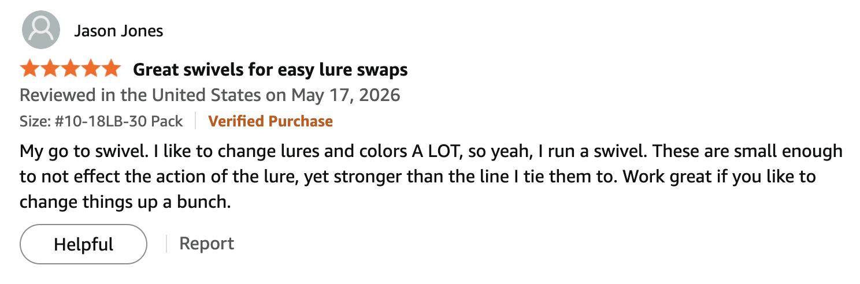

Slide 11

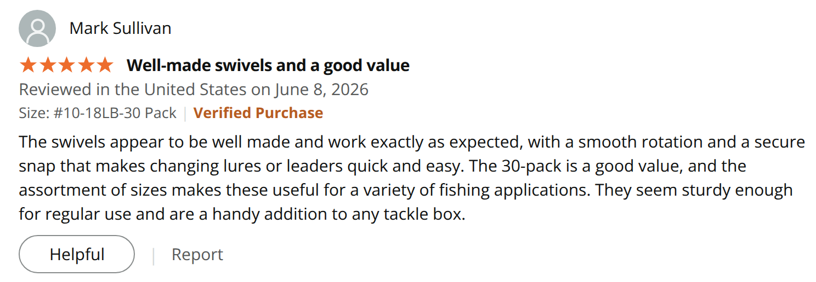

Slide 12
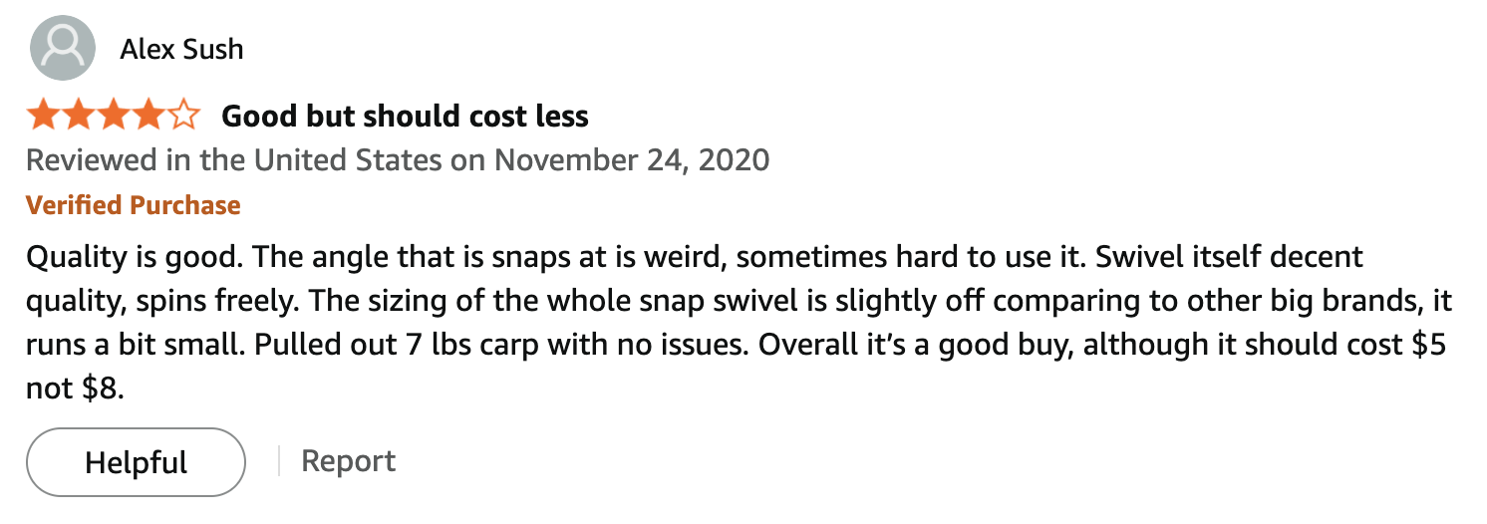

Slide 13
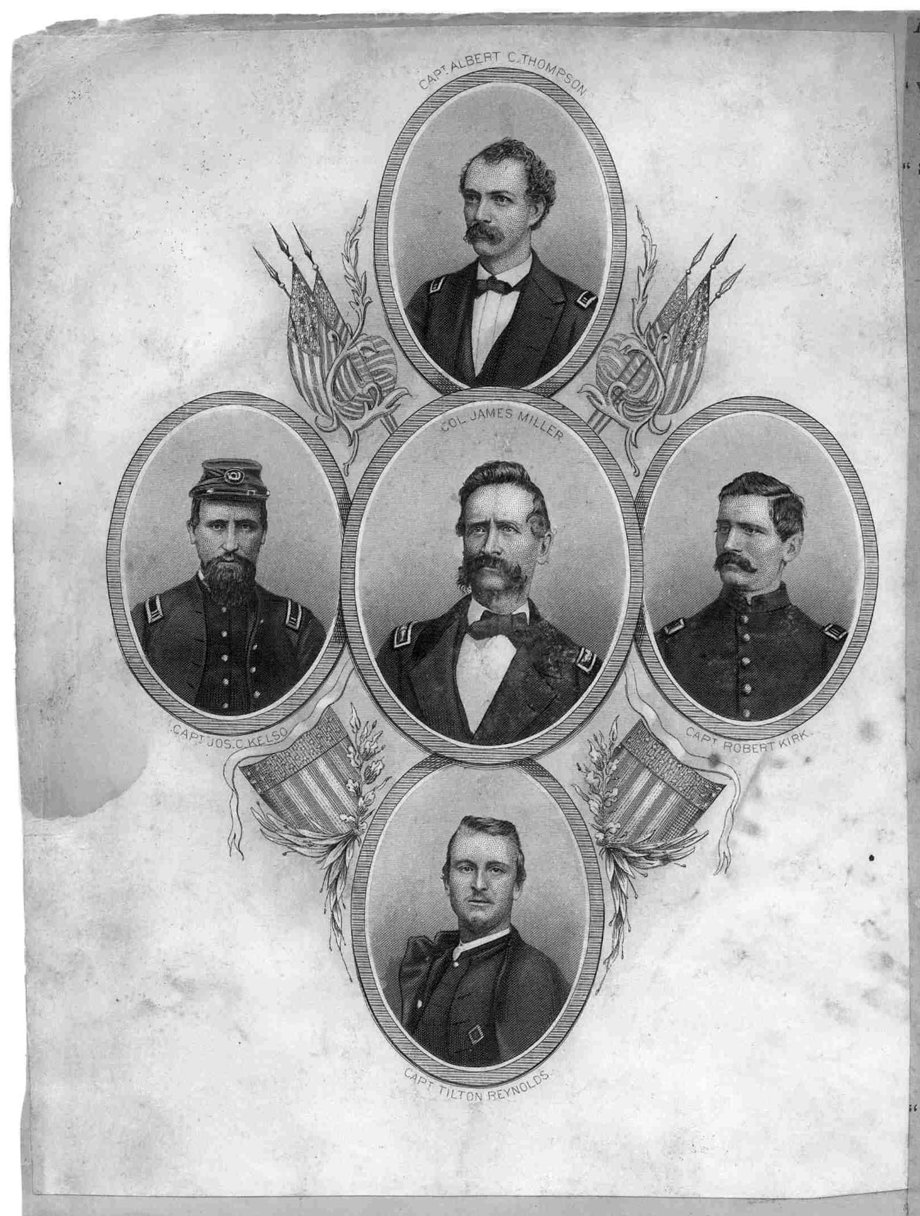
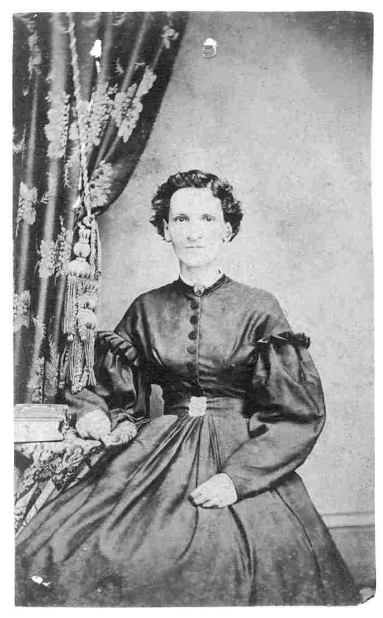

Slide 14
Camp Griffin Jan 9th 1862
Dear Mother,
I received your letter of the 2nd and was glad to hear you are all in good health as this leaves me at present. We have had a hard week of it here with the cold. The tents are poor Shelter when the wind gets up in the night and a good many of the Boys have taken cold. I keep warm enough with the Blankets you Sent and the overcoat So you need not worry on that acct.
There is not much doing here. We drill in the fore noon when the ground will bear It and the rest of the time a man has to find his own amusement. Some of the Boys have got up a Debating Society and meet in the Chaplains tent of an evening. I went once But it was mostly the Same three or four talking and I had rather write letters.
Our rations are Better than they were. We drew fresh Beef twice this week which is a great improvement on the Salt. I have not been Sick a day Since I came out which is more than most can Say.
Jacob Wolfe got a Box from home and there was a fruit cake in It that had gone Bad. We ate the rest of It any way. If you Send one do not put in any thing that will not keep for they are Slow in coming.
Write when you can and tell me how Father is getting on with the Stock.
Your affectionate Son
Tilton

Slide 15
Headquarters 105th Reg't. Co. H
Camp Jameson Nov 24th 1861
Dear Mother,
Again I take up my pen to write a few lines to you though I have told Clarinda nearly all the news I could think off. But if have no news I will write any way. Bill Green has Spent nearly all the money he had left So there is a poor Sight of him Sending any to you which he Should have done in the first place...There is one thing I have been going to tell you for a long time that is concerning our Col. I never Seen a man So Universaly hated as he is. There is not a man in the Regt that likes him. He is hard on his men puts them on the Ring (ie) (a circle for them to walk round in with a guard in the middle with his Bayonet to make them travel) for every little thing they do. I dont want you to circulate this or let any one know from what Source you got it But it is a fact he Stands too much on his Dignity. Some of the Capts here (if they could) would take their companies away in a Short time. But this will do for the Col Business.
You Said if you could you would keep that money until I came home. Now you need not do any Such a thing. I Sent It Because I wanted you to have It to use for Such things as you need. So you will not Save It any on my acct. Uncle Orlando is writing a letter to Aunt Rebecca. We are going to get a Store tomorrow and then we can live as comfortable as you please. I thought Some of getting my Likeness taken large on paste Board and put in a frame and Send It home By Express. How would you like It? That way you could hang It up in the room or some place where you could see it any time. I have Seen Several taken on cards they are verry nice too. I will in my next letter Send you a likeness of Gen Jameson (our Brig Gen). It will be out next week. He is a fine looking man. I will also send you a likeness of Gen Heintzelman (Maj Gen) who commands our division.
But I must quit for it is getting late. Good By Dear Mother from your affectionate son.
Tilton

Slide 16
Headquarters 105th Reg't. Co. H
Camp Jameson Dec 1st 1861
Dear Mother,
I got your letter of the 26th and was glad to hear you are all well as this leaves me at present. You wanted to know about my Boots. The pair I brought from home are nearly done for the Soles have parted from the uppers on the right one and there is a poor Sight of them lasting out the month. There is no mending them here that is worth any thing. The Sutler has a fair article at $4.00 which is a verry great price But the Shoes the government gives out are miserable Stuff and a man might as well go Bare foot in this mud. Uncle Orlando Says I had Better pay the money once and be done with It than to Buy twice.
I have $6.50 By me yet after paying Wm Hays what I owed him and Some little dribs Besides So I can manage It without asking you for any thing. Now I dont want you to Say any thing to Father about what I gave for them for he will think I have been foolish and there is no use in It.
Some of the Boys Say they will go to Alexandria for their Boots But I think By the time they pay for the going they will Save nothing. But this will do for the Boot Business.
Uncle Orlando is well and Sends his respects. I have not heard from Clarinda this week.
But I must quit for it is getting late. Good By Dear Mother from your affectionate son.
Tilton

Slide 17
There is a quiet hush that falls,
When evening shades draw near,
A stillness in the air that calls,
To those who pause to hear.
The world around us fades away,
As darkness takes its hold,
And in this moment, we may pray,
Or simply sit and fold.
For in this hush, we may find peace,
And let our worries go,
And in the silence, we release,
All that we cannot know.

Slide 18
Not knowing when the Dawn will come,
I open every Door,
Or has it Feathers, like a Bird,
Or Billows, like a Shore —

Slide 19
I speak of love that comes to mind:
The moon is faithful, although blind;
She moves in thought she cannot speak.
Perfect care has made her bleak.
I never dreamed the sea so deep,
The earth so dark; so long my sleep,
I have become another child.
I wake to see the world go wild.

Slide 20
Pigeons shake their wings on the copper church roof
out my window across the street, a bird perched on the cross
surveys the city's blue-grey clouds. Larry Rivers
'll come at 10 AM and take my picture. I'm taking
your picture, pigeons. I'm writing you down, Dawn.
I'm immortalizing your exhaust, Avenue A bus.
O Thought, now you'll have to think the same thing forever!

Slide 21
Images

Slide 22
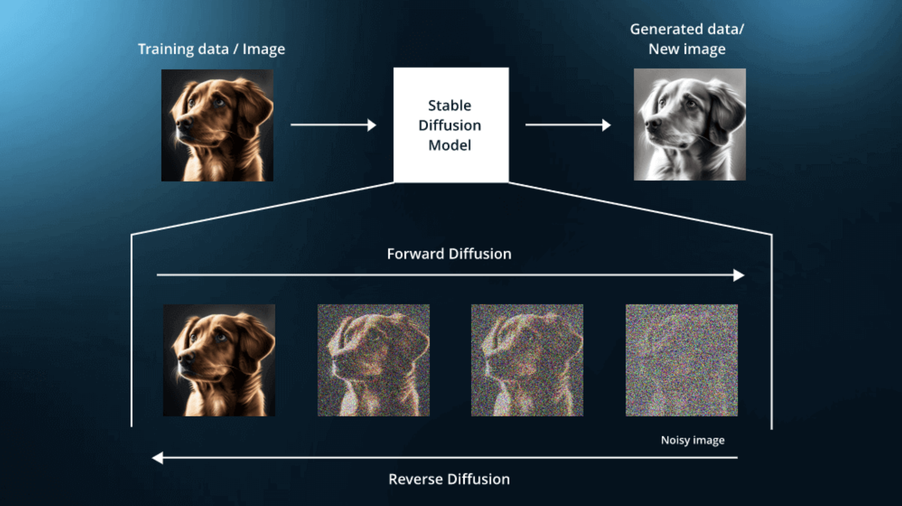
Images: Diffusion Models
https://poloclub.github.io/diffusion-explainer/

Slide 23
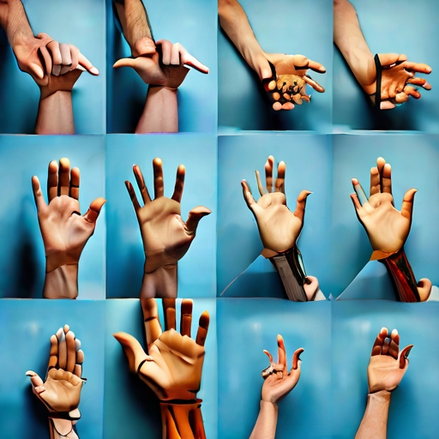
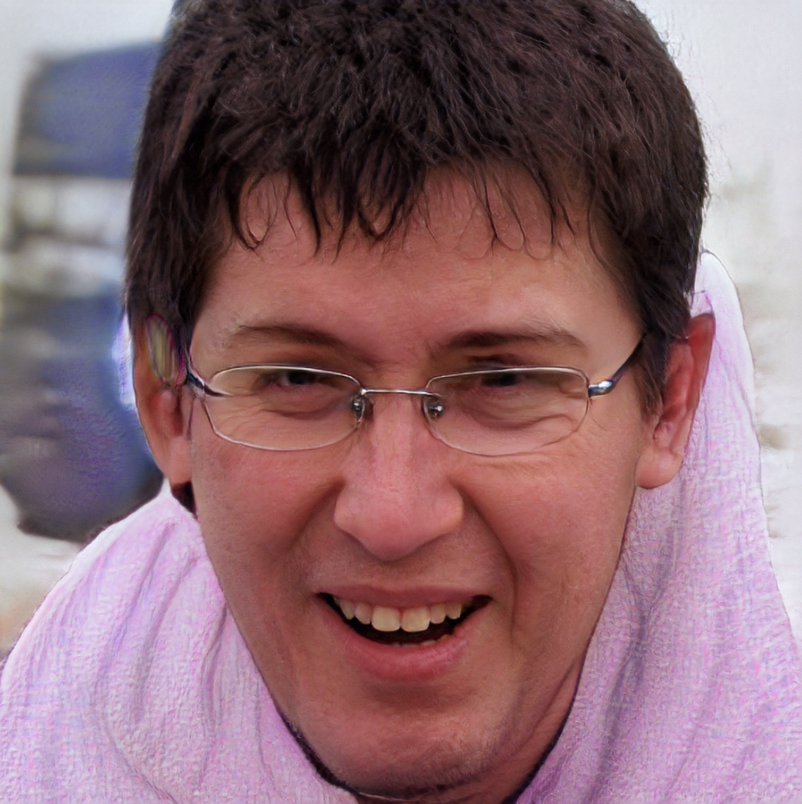

Slide 24
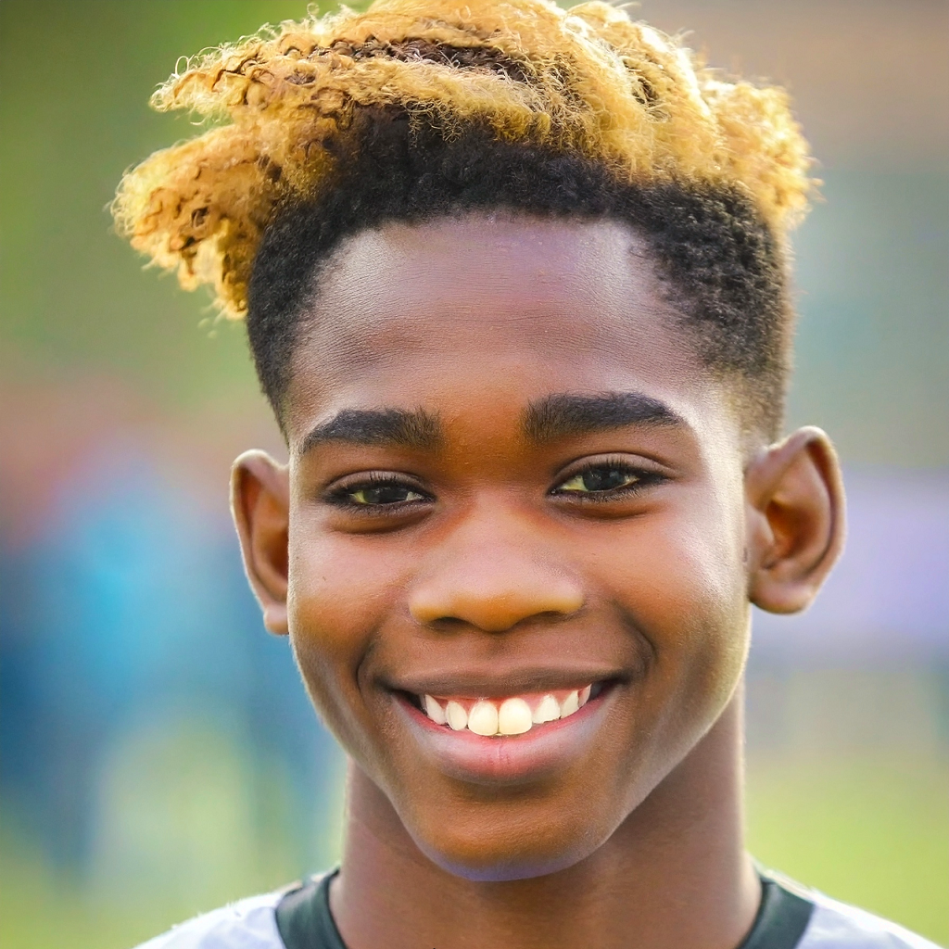


Slide 25
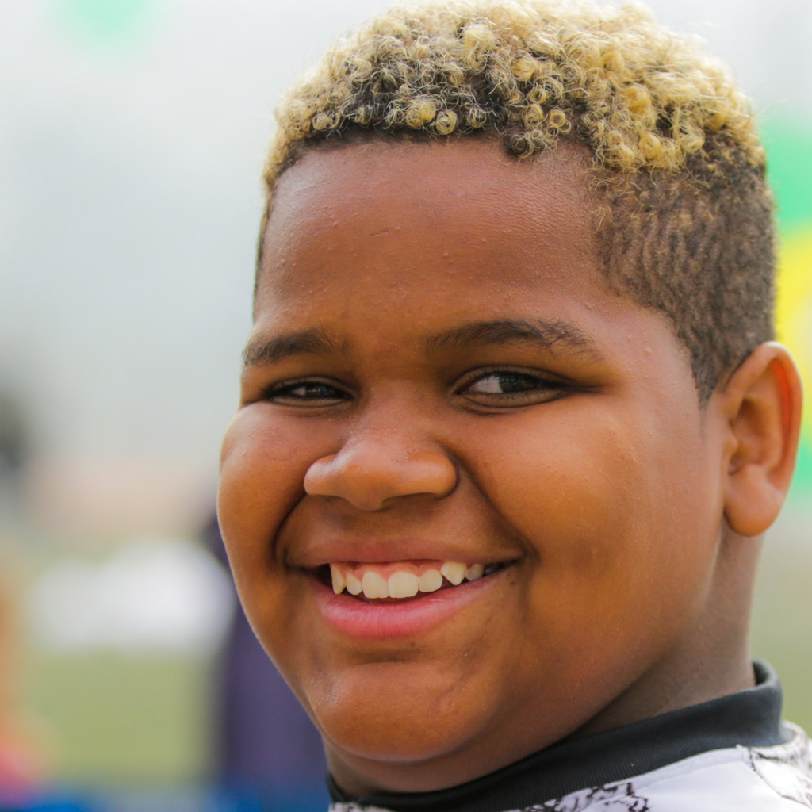
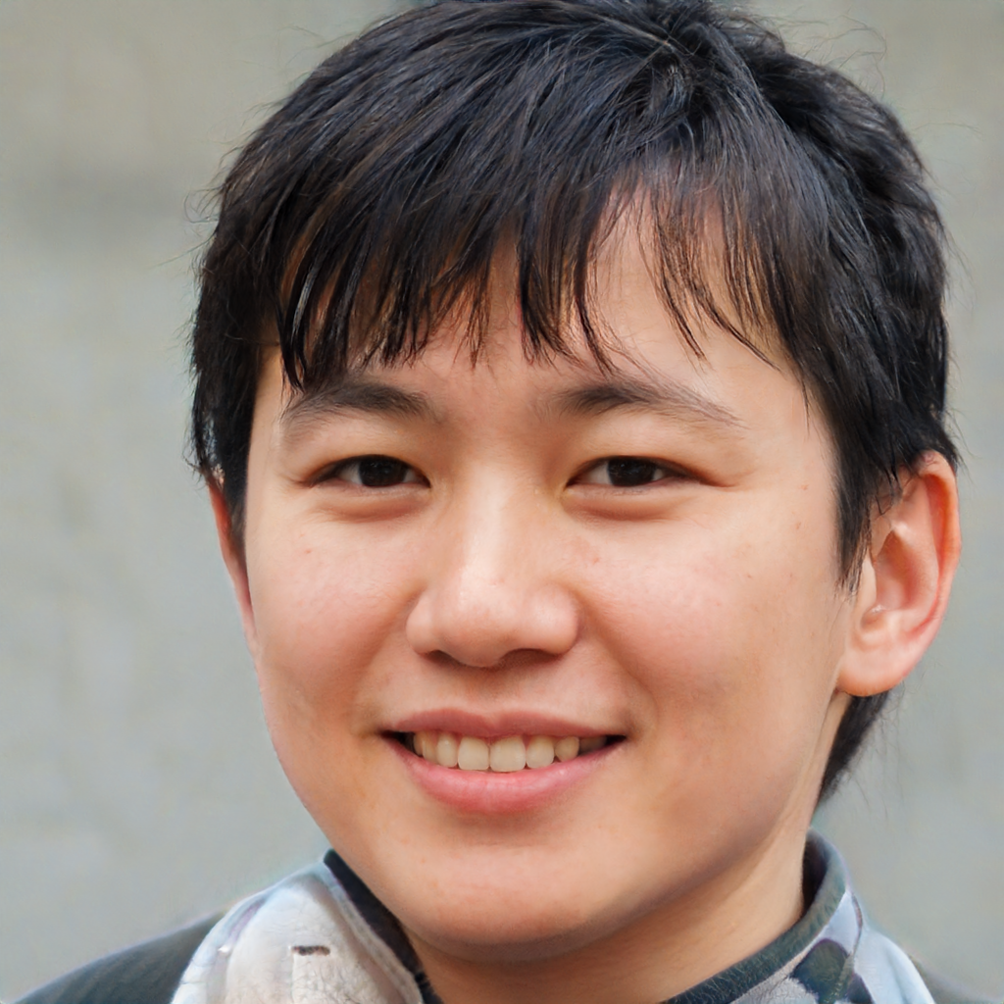

Slide 26

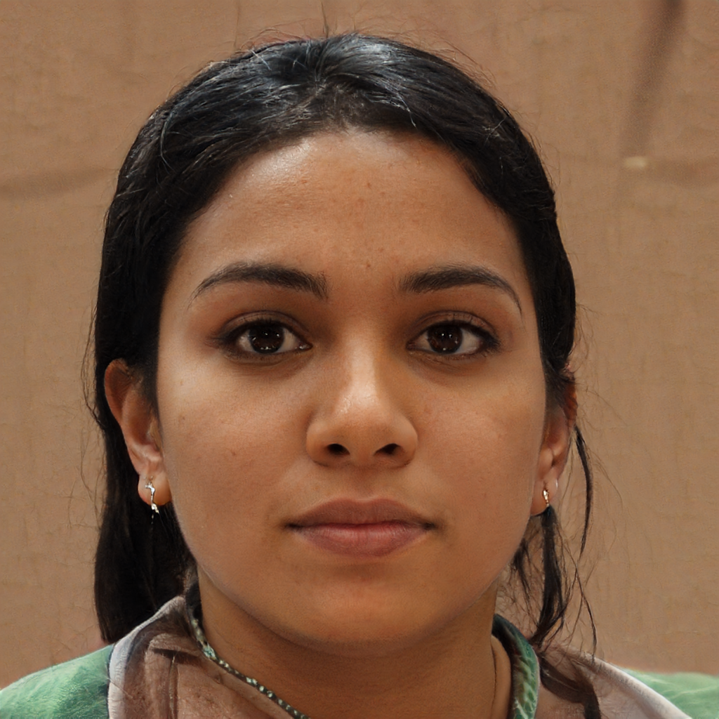

Slide 27

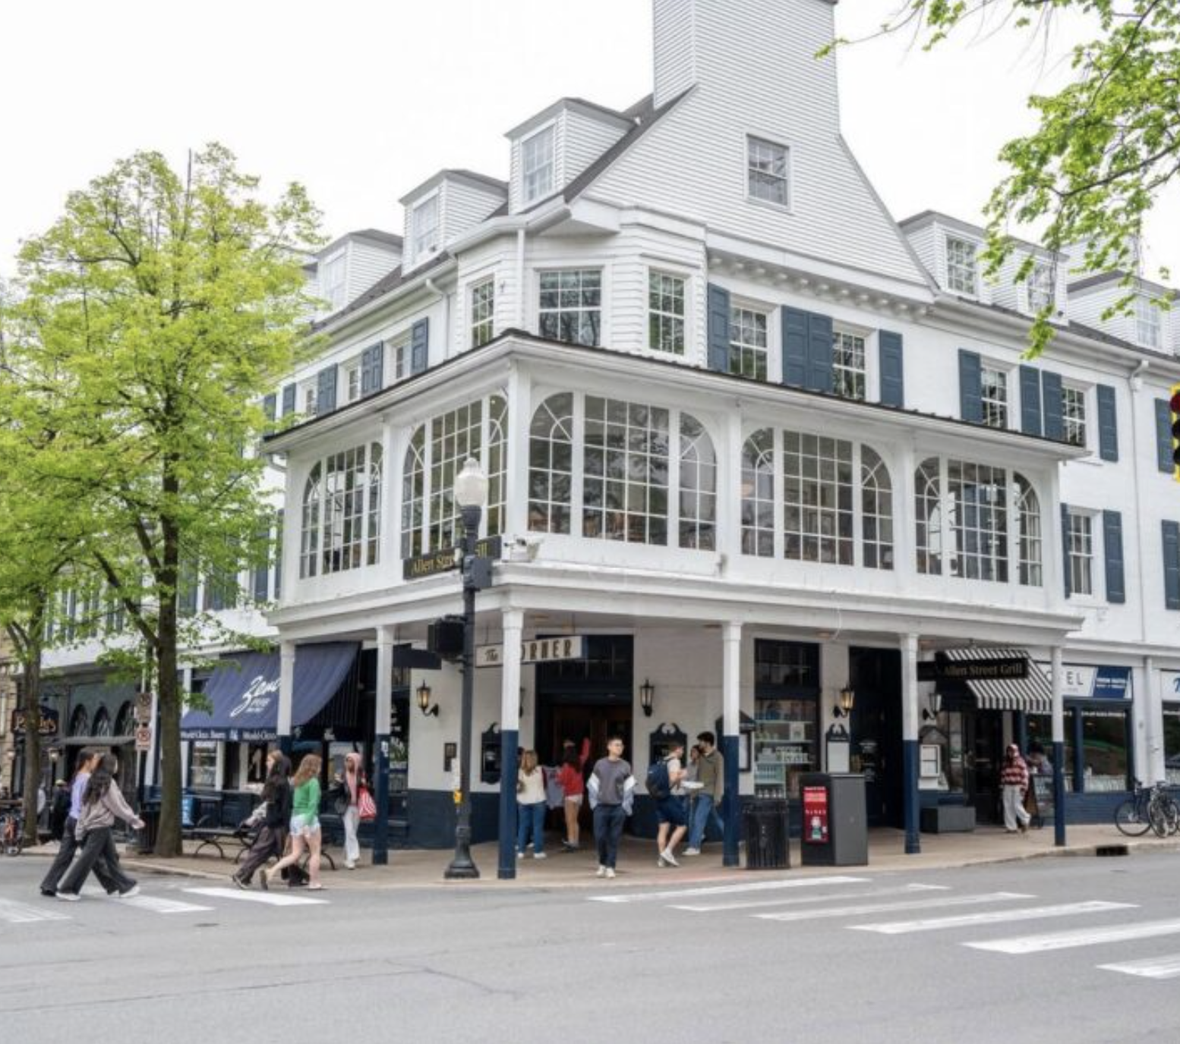

Slide 28
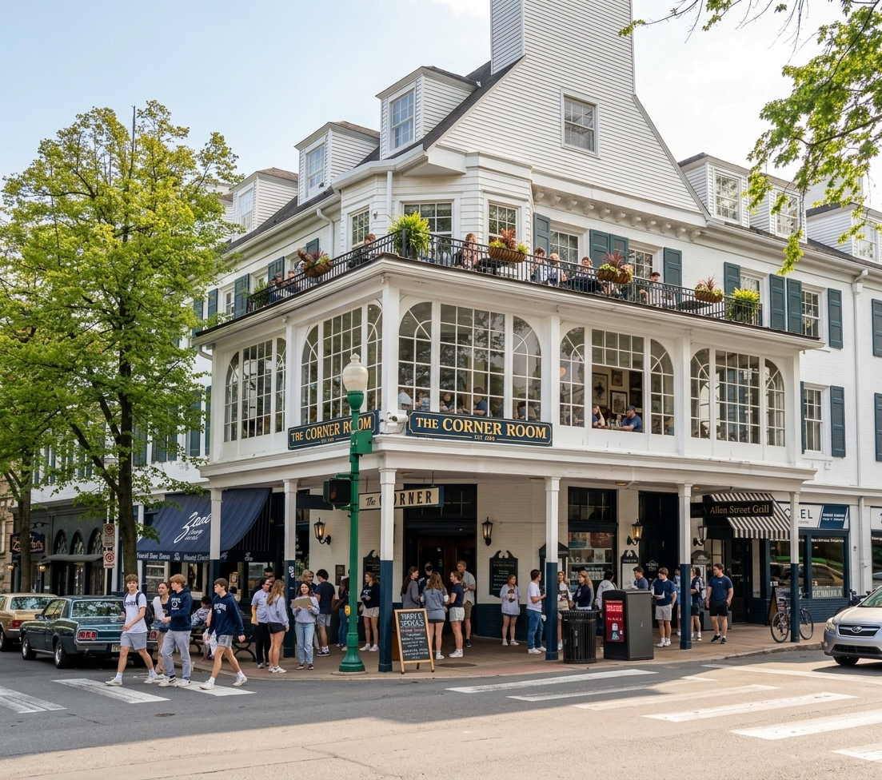

Slide 29
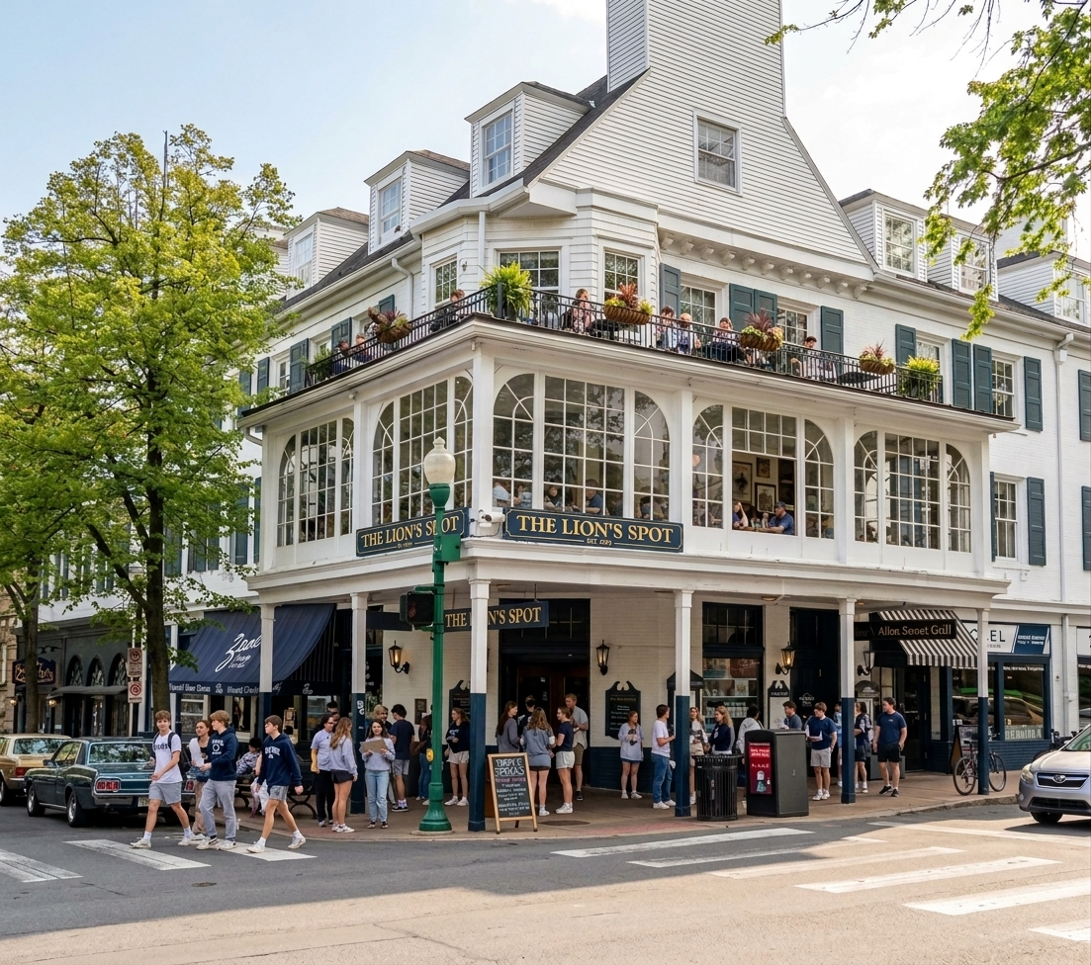

Slide 30
Audio

Slide 31
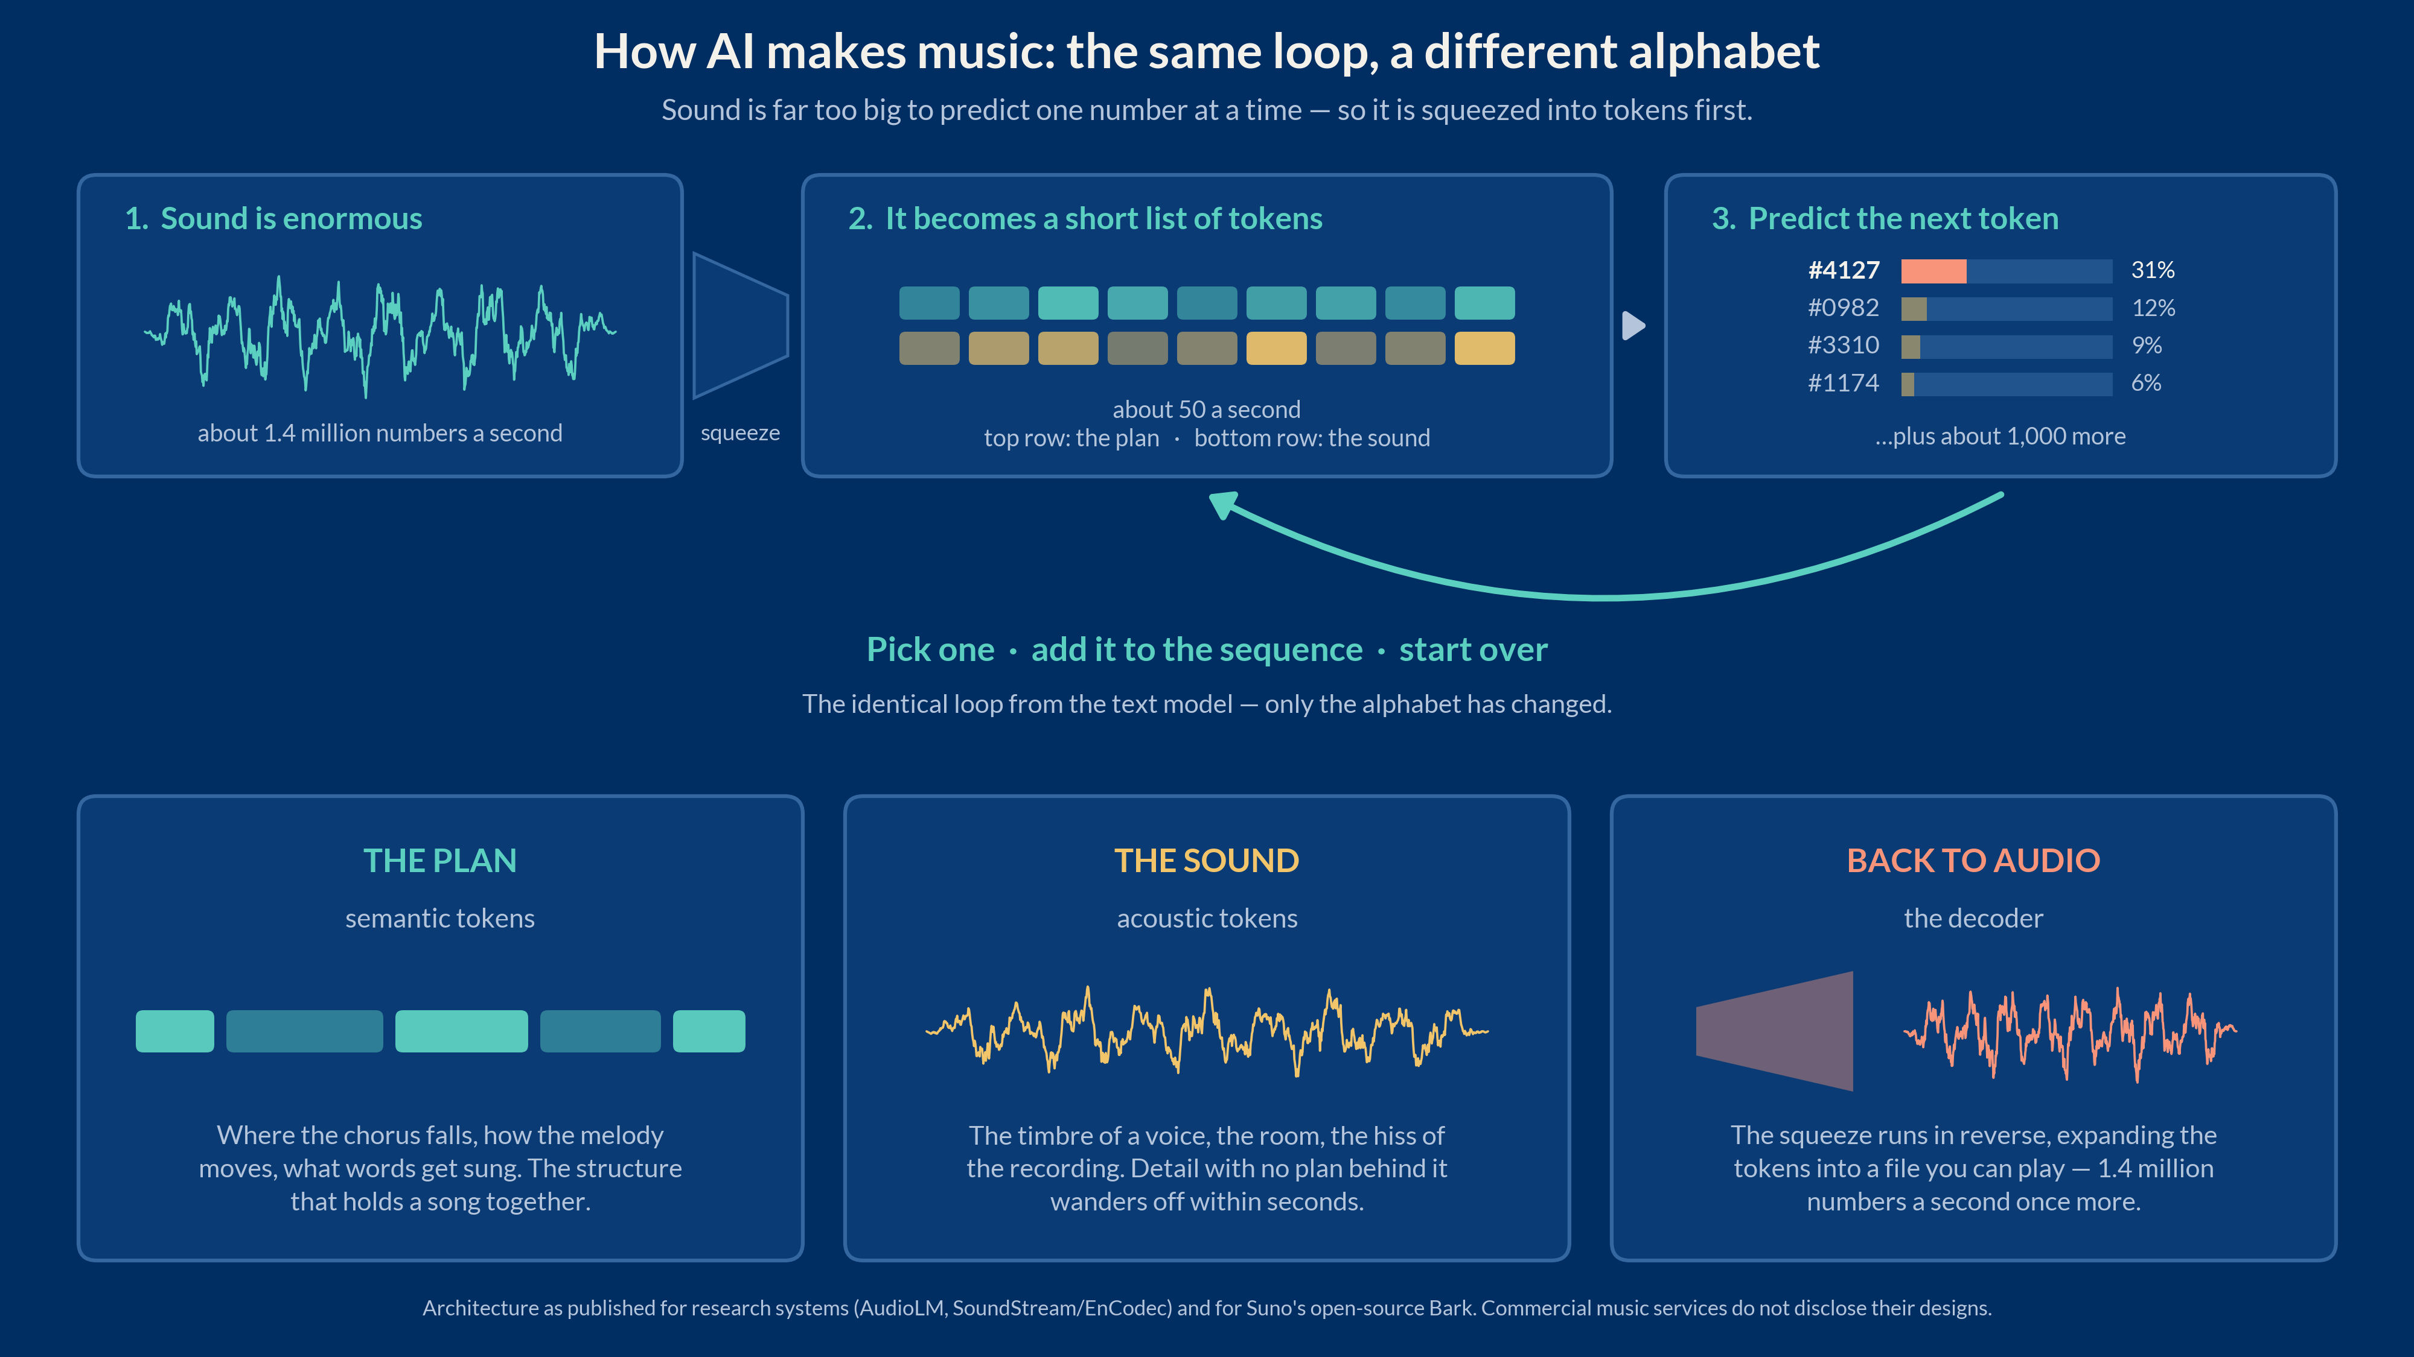

Slide 32


Slide 33
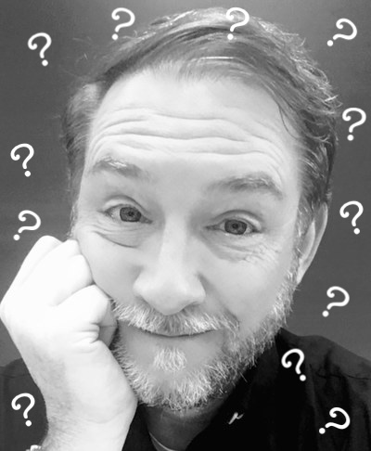

Slide 34
https://sightengine.com/ai-or-not-music

Slide 35
Video

Slide 36
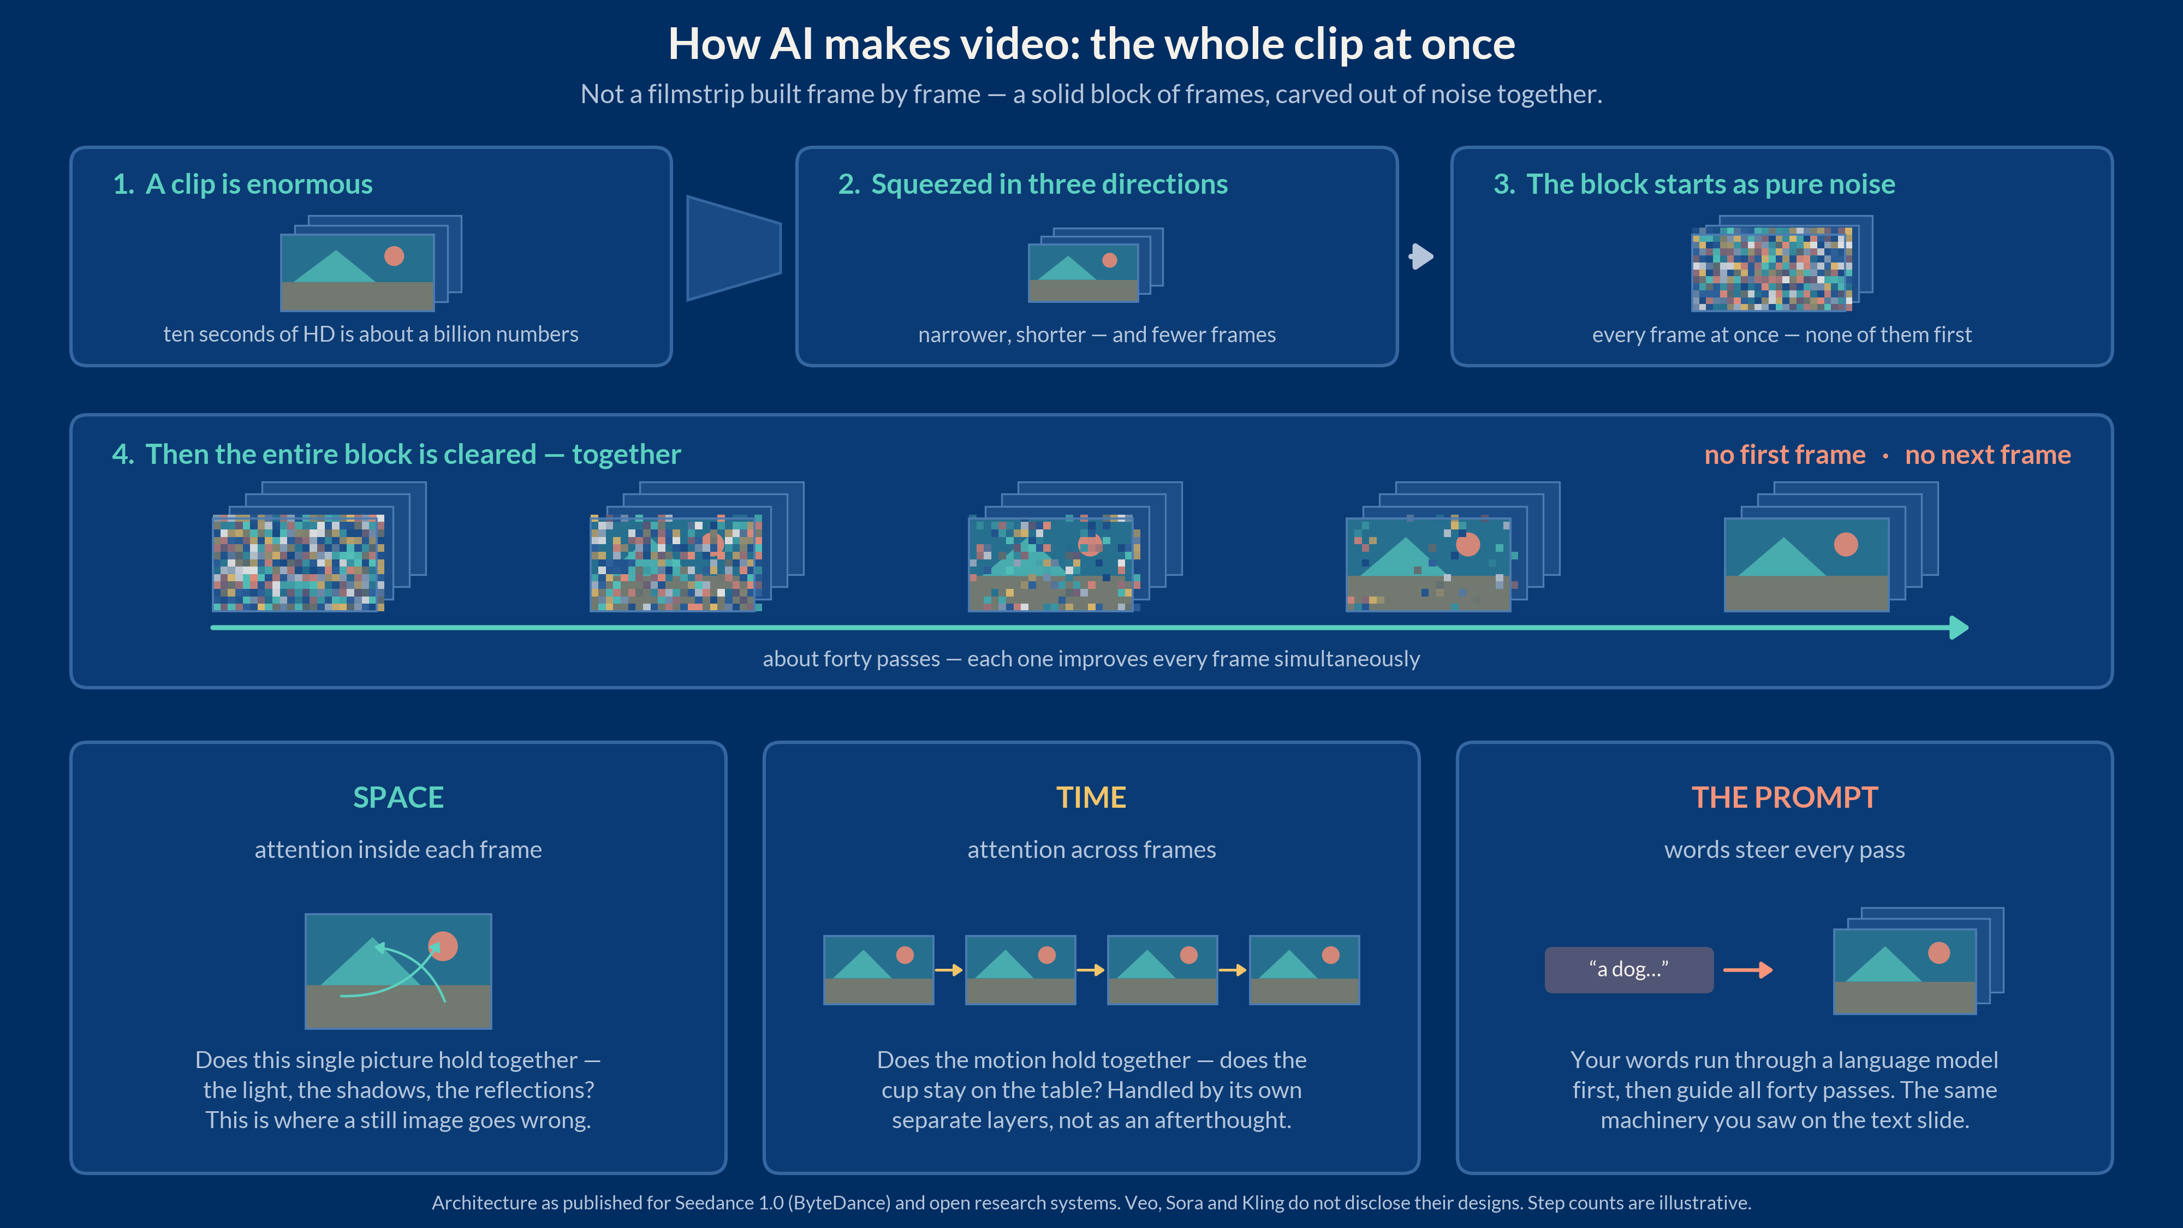

Slide 37


Slide 38
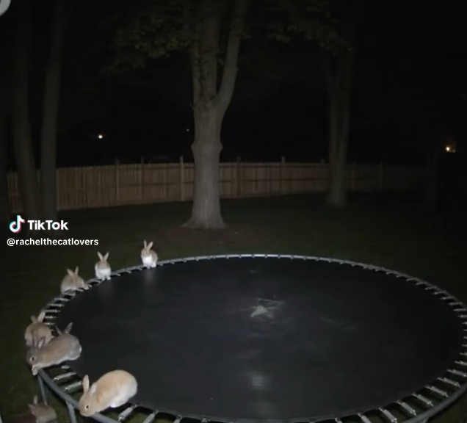

Slide 39
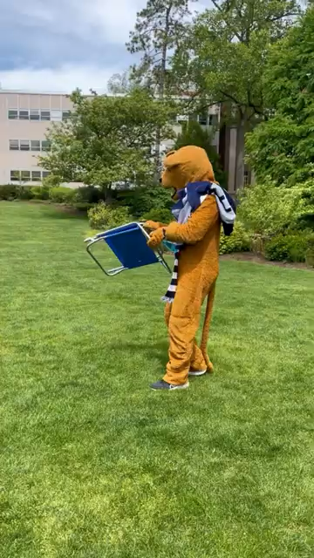

Slide 40
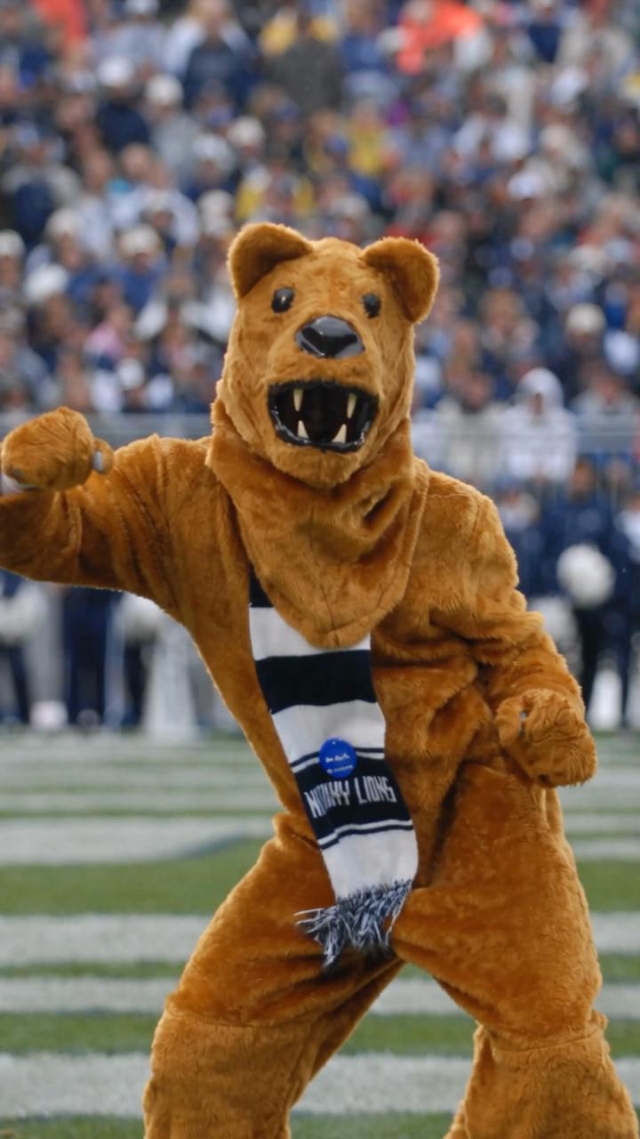

Slide 41
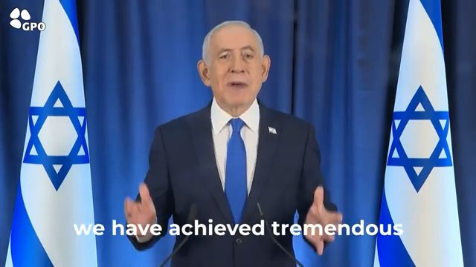

Slide 42
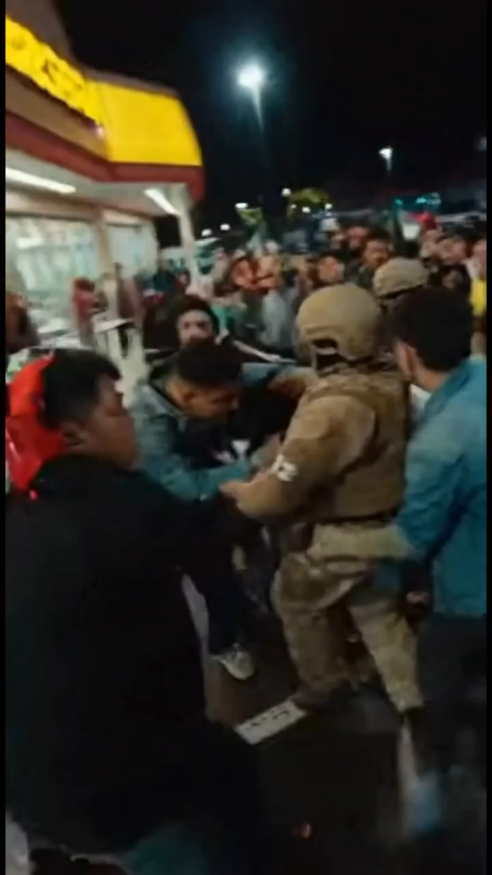

Slide 43
So?...
Discernment – pay attention
How should we know what
we know?
Avoid being discouraged...

Slide 44
Thank you!
Christopher Zorn
zorn@psu.edu

Slide 45
My sources:
My tools:
“AI or Not?” (faces)
Not Knowing When The Dawn Will Come
An Eastern Ballad
“AI-Generated Poetry is Indistinguishable from Human-Written Poetry and is Rated More Favorably,” Nature Scientific Reports (2024)
Dr. Fish Snap Swivels (on Amazon)
Civil War Soldier in the Wild Cat Regiment: Selections from the Tilton C. Reynolds Papers (Library of Congress)
Diffusion Explainer (MIT Polo Club)
“AI or Not? (music)
The Will Smith Eating Spaghetti Test (Wikipedia)
Bunnies Jumping on a Trampoline (TikTok)
Nittany Lion @ the Pool (YouTube)
Netanyahu Remarks (YouTube)
ICE video (Instagram)
Claude Opus 5 (general use + text)
Midjourney (images)
Suno 5.5 (music)
Seedance 2.5 (videos)
Downr.org (video downloads)

