Slide 1
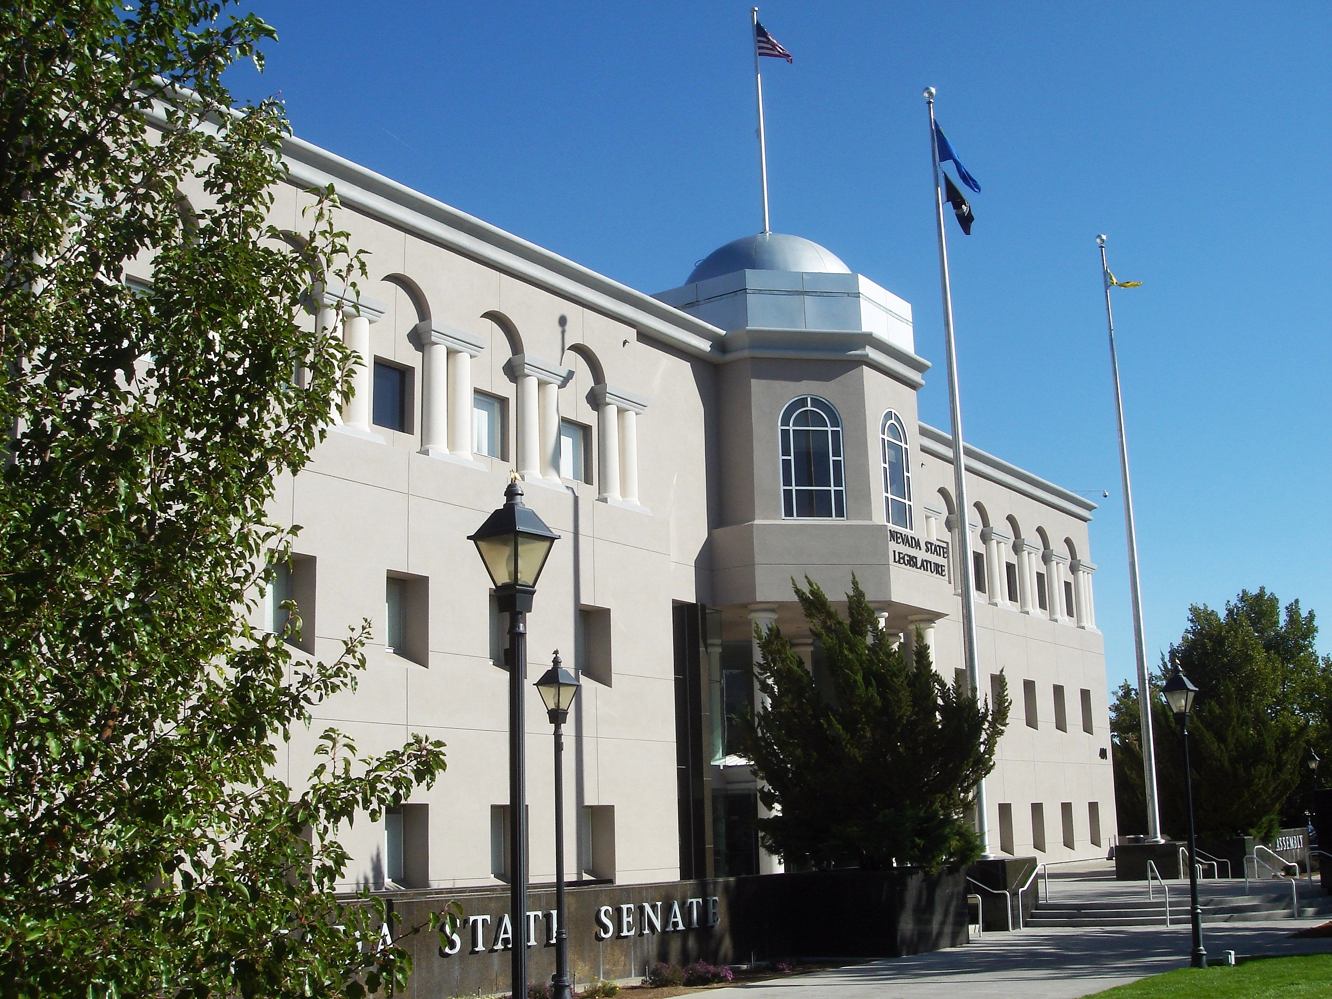
Legislating in the First Female-Majority State Legislature: Gendered Power, Leadership, and Patterns of Sponsorship and Cosponsorship
Jennie Sweet-Cushman Chatham University | Rebecca Gill UNLV | Christopher Zorn Penn State
March 30, 2024

Slide 2
Timeline
1918: Sadie Hurst (R - Washoe) is the first woman elected to the Nevada Legislature
1920: Hurst presides over Nevada’s ratification of the 19th Amendment
1947: Most recent legislative session in which all legislators were male
1951: First woman in leadership (Speaker Pro Tempore Louise Aloys Smith, D - Pershing)
2001: First all-female leadership team (Democratic minority, Nevada Senate)
2007: First woman Speaker of the Assembly (Barbara Buckley, D - Clark)
2019: First female legislative majority
First woman Senate Majority Leader (Nicole Cannizzaro, D - Clark)
2023: First female majorities in both the Assembly and the Senate
Source: “Women in the Nevada Legislature,” https://www.leg.state.nv.us/Division/Research/Content/items/women-in-the-nevada-legislature

Slide 3
Gender, Leadership and (Co)Sponsorship
Framework: Feminist Institutionalism
How institutions shape and reflect gender roles, gendered power dynamics, and inequities within and emerging from the institution
Potentially important roles for:
Majority control (Waylen 1994; Beckwith 2005)
“Critical actors” (Childs and Krook 2006, 2009; Thompson 2018)
Suggests that legislative effectiveness may be related to:
Fraction of women in the legislature
Women occupying key leadership roles in the Assembly and Senate

Slide 4
Majorities, Leadership, and Sponsorship, 2013-2023

Slide 5
Design and Methods
Quantitative:
Data: Combine sponsorship / cosponsorship data (LegiScan) + Legislator characteristics (Legislator Diversity Project) + Leadership (collected by authors)
Legislator-level analysis: Number of Primary / Cosponsored Bills, Cosponsor “Position”
Bill-level analysis: Number of Cosponsors + Percentage of Female Cosponsors
Predictors: Female Legislator, Leadership Position, Legislative Session (trend), interactions + controls (party majorities)
Qualitative (not shown):
In-depth interviews with N = 25 legislators serving in the 2019 session
18 women / 7 men, from both parties / chambers

Slide 6
Summary of Findings
General trend toward greater female legislative effectiveness over time
Partisan effects (GOP vs. Democratic majorities)
Support for the majoritarian perspective:
As majorities grew, women legislators became more effective, but
Women in leadership positions (or the fact thereof) isn’t associated with female legislative effectiveness at the margin

Slide 7
Our Project: Women in the Nevada Legislature
A “Critical Case Study” for feminist institutionalism
Focus on changes brought on by both incremental and rapid change in the legislature’s composition
Moving parts:
A History of Women in the NV Legislature
Feminist Institutionalism in Nevada State Politics
The Elections of 2018, 2020, and 2022 (and 2024?)
Leadership: Chambers, Committees, and Parties
Policy Work: Bills, Laws, and Agendas
Governing Women: Collaboration and Copartisanship
Constituencies, Campaigns, and Cash
The Future Is Female

Slide 8
Thank you!
Paper: https://bit.ly/SCGZ24

Slide 9
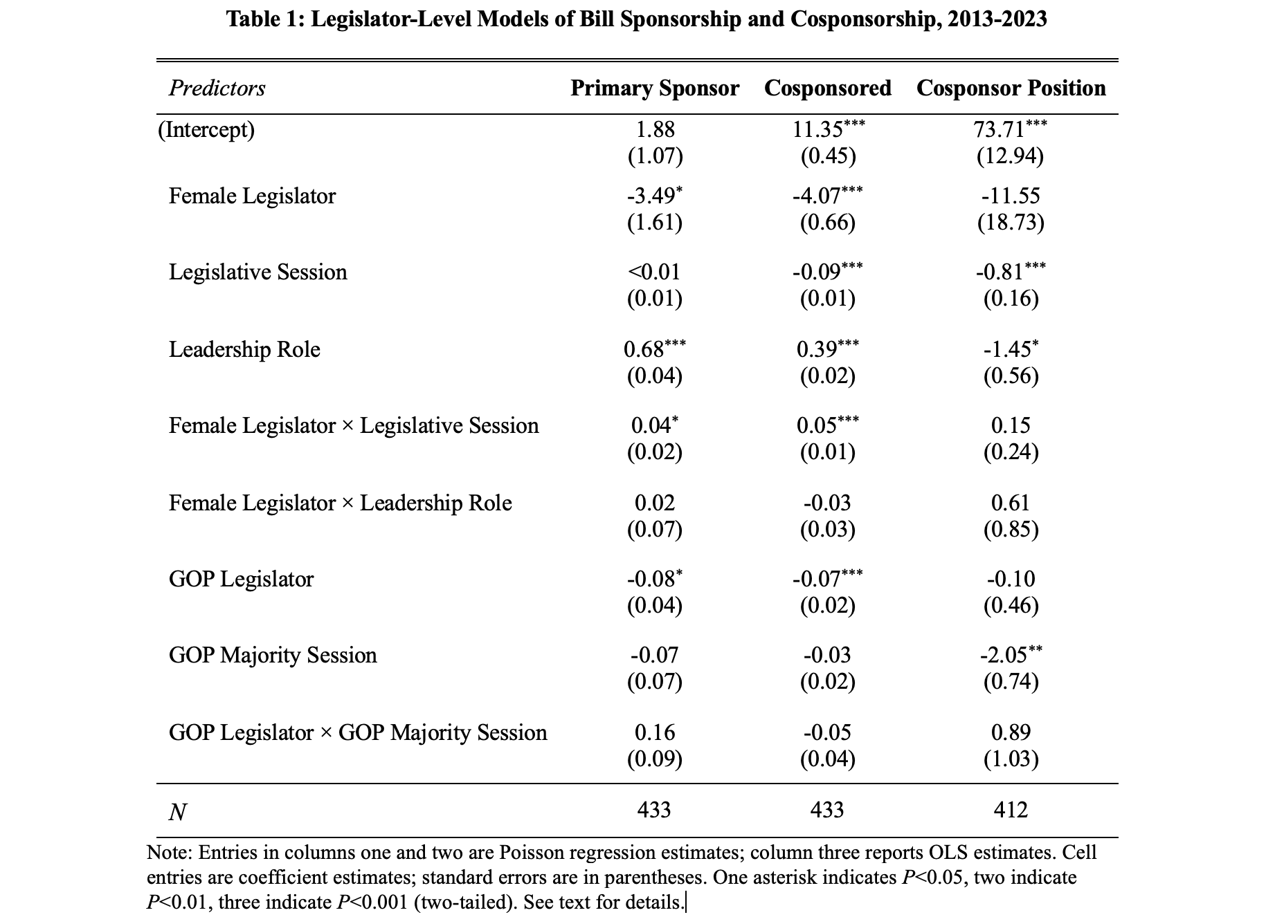
Table 1: Member-Level Analysis

Slide 10
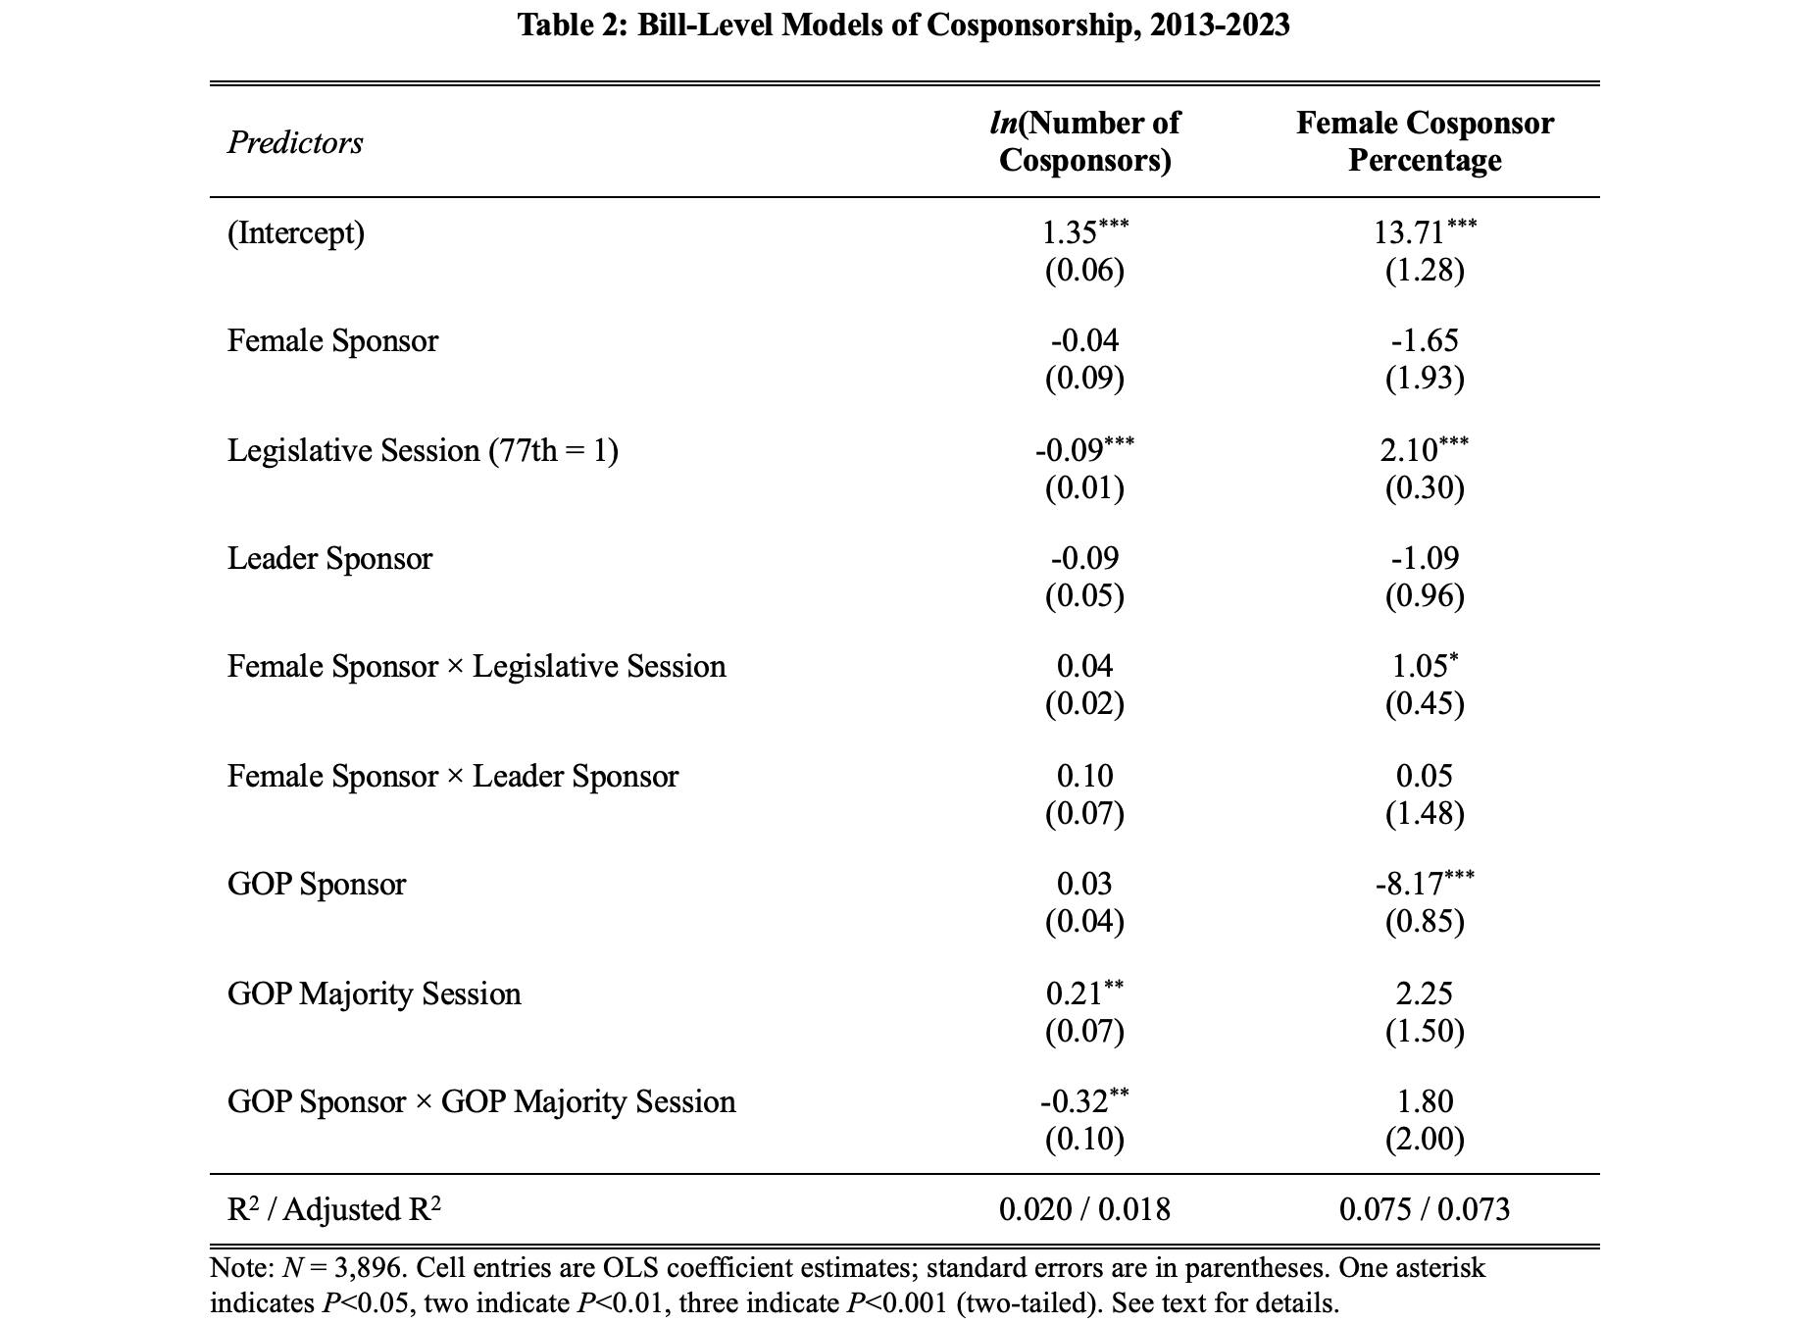
Table 2: Bill-Level Analysis

