Slide 1
FRAMEWORK
A framework is a structure that provides a foundation for building something, such as a software program or application.
A framework is like a structure that provides a base for the application development process.
(ex: Two Wheeler , Auto, Man)

Slide 2
FRAMEWORK IN COMPUTER PROGRAMMING:
In computer programming, a framework is a foundational structure that provides a set of tools, libraries, and guidelines to facilitate the development of software applications.

Slide 3
CSS FRAMEWORK:
A CSS framework is a collection of pre-written CSS styles that developers can use to quickly build website layouts and user interfaces without having to write all the styling code from scratch.
( CSS FRAMEWORK – BOOTSTRAP )

Slide 4
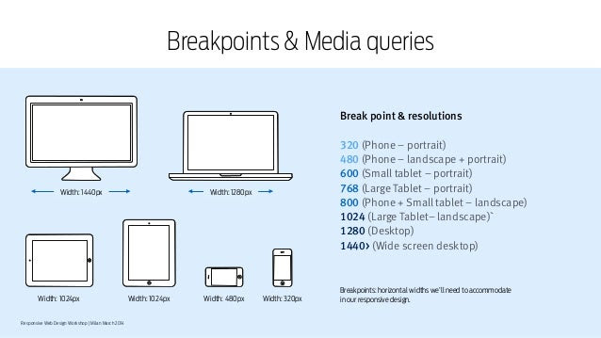

Slide 5
JAVASCRIPT
A JavaScript framework is a collection of code libraries and templates that help web developers build applications more efficiently.

Slide 6
PYTHON FRAMEWORK
A Python framework is a collection of Python modules that provides a structure for building applications.
Oops
Class
Object
Inheritance
Encapsulation
Abstraction
Polymorphism

Slide 7
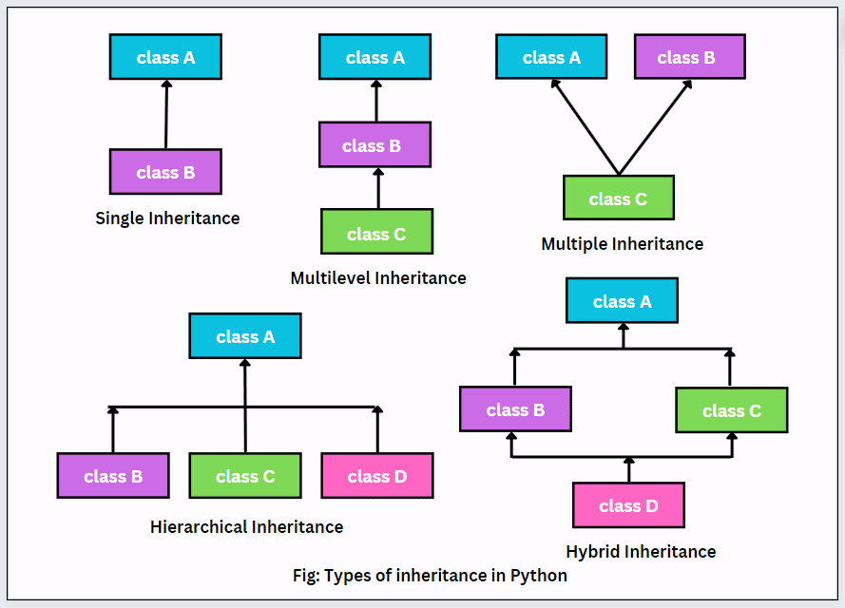

Slide 8
PHP FRAMEWORK
PHP is an acronym for Hypertext Preprocessor. PHP frameworks are essential tools for web developers, providing a structured foundation for building applications efficiently. It is an open-source server-side language used for web development

Slide 9
.NET FRAMEWORK
The .NET Framework is a software development framework developed by Microsoft that provides a runtime environment and a set of libraries and tools for building and running applications on Windows operating systems.

