Slide 1


AI DEPARTMENT
DeepLog
AI-Powered HDFS Log Anomaly Detection
Real-time anomaly detection using LSTM deep learning on 1.5 GB of HDFS system logs
Prit · Ujjwal · Ashish
AI Department | 2026
1.5 GB Log Data

Slide 2

THE PROBLEM
Why Log Monitoring is Hard
Manual analysis of millions of system logs is slow, error-prone, and simply does not scale.
Current Challenges
1.5 GB
Log file size
Manual review is impossible at 11 million lines
~11 M
Rule-based alerts miss novel failure patterns
Log lines generated
Silent failures go undetected for hours
29
No per-block tracking across distributed nodes
Unique event templates
Need automated, intelligent real-time detection

Slide 3



OUR SOLUTION
What is DeepLog?
An end-to-end AI system that learns normal log behavior and flags deviations in real time.
Dataset
LSTM Model
Detection
API Backend
1.5 GB HDFS log file from
Hadoop distributed cluster
with 11 M entries
Deep learning sequence
model trained to predict
next log event
Real-time anomaly flagging
per block ID with Top-K
prediction scoring
FastAPI REST endpoints
for live logs, stats
and streaming output

Slide 4

SYSTEM ARCHITECTURE
End-to-End Pipeline
Five stages from raw log stream to live API — all running concurrently.
HDFS Logs
Parser
LSTM Inference
Scorer
FastAPI
logs.txt
1.5 GB stream
Template regex
29 EventIds
Window=10
Top-K=9
NORMAL /
ABNORMAL
REST API
db.json store
stream_worker.py continuously tails logs.txt → parser classifies events → LSTM scores each window → anomalies saved to db.json → FastAPI exposes /logs and /stats

Slide 5
LOG PARSING
Template-Based Log Parser
parser.py converts free-text HDFS lines into structured event IDs using regex templates.
Sample Event Templates
1
Block ID extraction
Regex blk_-?\d+ pulls every
HDFS block reference from the line
ID | Template
E1 | Adding an already existing block
E2 | Verification succeeded for
E3 | Served block * to *
E4 | Got exception while serving
E9 | Receiving block * src: * dest: *
... | ( 29 total templates )
2
Template matching
29 event templates from
HDFS.log_templates.csv matched via regex
3
EventId assignment
Line gets label E1–E29 or UNK;
unknown events are handled gracefully

Slide 6
THE MODEL
DeepLog — LSTM Architecture
model.py defines a compact but powerful sequence model trained on HDFS event streams.
Hyperparameters
Embedding Layer
Event index → 32-dimensional dense vector
embedding_dim
32
LSTM Layer 1
hidden_dim
64
hidden_dim=64 | batch_first=True
num_layers
2
LSTM Layer 2
Stacked recurrence for deeper patterns
window_size
10
Linear (FC) Output
top_k
9
Maps hidden state → num_classes logits
device
CPU
Inference: if actual_next_event NOT in Top-9 predicted events → ABNORMAL

Slide 7

DETECTION LOGIC
Sliding Window Anomaly Detection
Each HDFS block keeps its own event history; windows of 10 feed the LSTM continuously.
Event Window for Block blk_-1608999687919862906
E9
E3
E2
E3
E9
E3
E2
E3
E5
E2
?
1 Parse
2 Window
3 Predict
4 Classify
Classify each log line into
an EventId using template
regex matching
Maintain a sliding window
of 10 events per
HDFS block ID
LSTM outputs Top-9
most-likely next events
for the sequence
Actual event NOT in
Top-9 → ABNORMAL;
otherwise NORMAL

Slide 8

BACKEND SYSTEM
Streaming Worker & FastAPI
Two processes run together: stream_worker tails logs in real time, FastAPI exposes results.
stream_worker.py
app.py — FastAPI Endpoints
File-tail loop
/
GET
Continuously reads new lines from logs.txt with 200ms polling
Health check — confirms DeepLog API is live
Per-event inference
/logs
GET
Each parsed (block_id, event) fed to DeepLog model immediately
Returns last 100 log entries from db.json store
10-second summaries
/stats
GET
Aggregated NORMAL/ABNORMAL status saved every 10 seconds
Returns total, normal, and abnormal event counts

Slide 9
LIVE RESULTS
Real-Time Monitoring Output
Anomalies logged instantly; 10-second summaries track overall health of the cluster.
live_moniter.py
output.csv (sample)
🚀 DeepLog Monitor (Template-Based)
time | event | status
19:04:07 | E24 | ABNORMAL
19:04:09 | E2 | NORMAL
19:04:17 | SUM | ABNORMAL
19:04:22 | E5 | NORMAL
📡 Listening...
🚨 19:04:07 | blk_-1608999… | E24 | ABNORMAL
🚨 19:04:07 | blk_-1608999… | E24 | ABNORMAL
✅ 19:04:09 | blk_9934512… | E2 | NORMAL
📊 19:04:17 | SUMMARY (10s): ABNORMAL
✅ 19:04:22 | blk_1234567… | E5 | NORMAL
✅ 19:04:24 | blk_8812345… | E3 | NORMAL

Slide 10
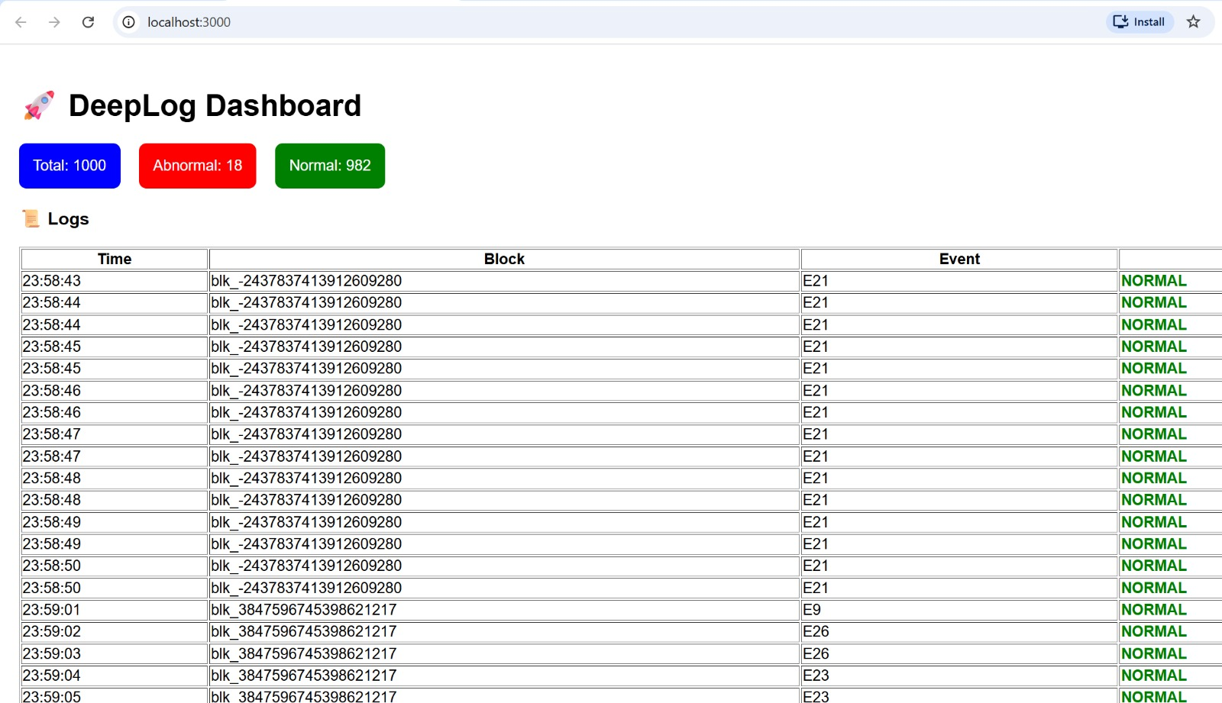

FRONTEND DASHBOARD
React Live Dashboard
Auto-refreshing UI polls the FastAPI backend every 10 seconds for real-time log data.
Stat badges
Total / Abnormal / Normal counts shown as coloured pills at the top
Live log table
Last 100 entries: Time, Block ID, EventId and colour-coded Status
Auto-refresh
setInterval polls /logs and /stats every 10 seconds — no page reload
Anomaly highlight
ABNORMAL rows appear in red; SUMMARY rows highlighted in light blue

Slide 11
FRONTEND ARCHITECTURE
React Frontend Breakdown
A minimal, dependency-free React app that connects directly to the FastAPI backend.
File Structure
Data Flow
App.js
1
React App Loads
useEffect + setInterval(10s)
Root component — fetches data, renders stat badges + log table
2
fetchLogs() called
api.js
GET http://127.0.0.1:8000/logs
fetchLogs() and fetchStats() — thin wrappers over fetch()
3
fetchStats() called
GET http://127.0.0.1:8000/stats
App.css
4
State updated
Minimal global styles; layout handled inline
setLogs() / setStats()
index.js
5
UI re-renders
Table + badges refresh instantly
ReactDOM.render entry point

Slide 12
LIMITATIONS
Current Limitations
Honest assessment of what DeepLog cannot yet do — and why it matters.
01
HIGH
02
HIGH
No Retraining on New Patterns
Fixed Window Size
The LSTM is trained once on historical HDFS logs. If the cluster behaviour changes (new software versions, new event types), the model silently degrades until manually retrained.
Window size is hardcoded at 10 events per block. Anomalies that only emerge over longer sequences (e.g., 30–50 events) are invisible to the current model.
03
MED
04
MED
CPU-Only Inference
Single Log File Input
Inference runs on CPU with map_location='cpu'. At very high log ingestion rates (>50 k lines/sec), this becomes a bottleneck causing detection lag.
stream_worker.py tails a single flat file (logs.txt). Real Hadoop clusters write to many rotating, compressed log files across multiple nodes simultaneously.

Slide 13

LIMITATIONS & FUTURE WORK
More Limitations & Road Map
Known constraints and concrete next steps to make DeepLog production-ready.
Additional Limitations
Future Road Map
05
No UI Authentication
Online retraining
The React dashboard and FastAPI endpoints have no auth layer — any user on the network can access all log data and anomaly results.
Periodic fine-tuning on recent logs to adapt to cluster evolution
Multi-source ingestion
Kafka / Fluentd integration to ingest from all HDFS nodes at once
06
In-Memory Block State
Auth & RBAC
Sliding windows per block_id are held in a Python dict. A worker crash loses all state; long-running blocks restart their window from scratch.
JWT-based authentication and role-based access to the dashboard
Richer analytics
07
HDFS-Only Log Format
Block-level anomaly timelines, event heatmaps, trend charts
The parser templates are built exclusively for HDFS. Applying DeepLog to other systems (e.g., Linux syslog, Apache) requires new template sets and retraining.
Generalise to other logs
Plug-in template system for Linux syslog, Apache, Spark, k8s

