Slide 1
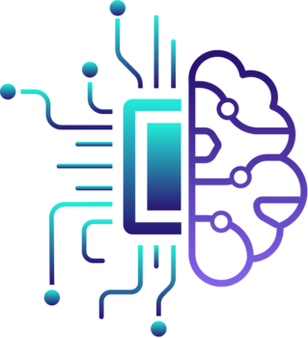
SilentSignal

Slide 2

Empowering the Deaf and Dumb Community
This project aims to revolutionize communication for the deaf and dumb community by enabling them to easily create and use their own customized sign language.

Slide 3

Challenges Faced by Deaf and Dumb People
1
Language Barriers
2
Social Isolation
Deaf and dumb individuals often face significant challenges in accessing and using traditional forms of communication.
The inability to communicate effectively can lead to feelings of isolation and exclusion from mainstream society.
3
Limited Education Opportunities
A lack of accessible learning resources and specialized teaching methods hinders the educational progress of deaf and dumb students.

Slide 4

The Importance of Sign Language
1
Visual Communication
Sign language allows deaf and dumb individuals to express themselves and interact with others through dynamic, expressive hand gestures and body language.
2
Community Empowerment
The use of sign language fosters a sense of community and belonging among deaf and dumb people, enabling them to share experiences and ideas.
3
Cognitive Development
Learning and using sign language has been shown to enhance cognitive skills, such as problem-solving and critical thinking, in deaf and dumb individuals.

Slide 5
Developing a Custom Sign Language Solution
Personalized Approach
User-Friendly Interface
Collaborative Learning
This project empowers deaf and dumb individuals to create their own unique sign language based on their needs and preferences.
The platform features an intuitive, easy-to-use interface that allows users to design and catalog their own signs.
Users can share their custom signs with the community, fostering collaboration and the growth of a comprehensive sign language database.

Slide 6




Building the Sign Language Platform
User Research
Extensive user research to understand the needs and challenges of the deaf and dumb community.
Interface Design
Intuitive and accessible user interface, optimized for touch-based interaction and visual learning.
Sign Language Model
Development of a comprehensive, crowdsourced model to store and organize the custom signs created by users.

Slide 7



Key Features of the Platform
Sign Creation
Collaboration
Sign Dictionary
Users can easily design and save their own unique signs using a visual, drag-and-drop interface.
The ability to share custom signs with the community and contribute to the growing sign language database.
A comprehensive, searchable dictionary of signs that users can access and learn from.

Slide 8
Benefits for the Deaf and Dumb Community
Improved Communication
Enhanced Education
The platform empowers deaf and dumb individuals to express themselves and connect with others more effectively.
Accessible educational resources and specialized learning tools support the academic and personal growth of deaf and dumb students.
Increased Inclusion
Empowerment and Advocacy
The platform fosters a sense of community and belonging, reducing social isolation and promoting integration into mainstream society.
The ability to create and share custom signs encourages deaf and dumb individuals to take an active role in their own development.

Slide 9
Future Developments and Expansion
Multilingual Support
Expansion of the platform to accommodate multiple sign languages, enabling global connectivity.
Augmented Reality
Integration of augmented reality features to enhance the learning and communication experience.
Mobile Integration
Development of a mobile app to provide seamless access to the sign language platform on-the-go.
Partnerships
Collaboration with educational institutions, advocacy groups, and technology leaders to drive further innovation and impact.

Slide 10
Thank You

