Slide 1
Intel® Unnati Industrial Training 2025
Problem Statement - Problem Statement 1- Bug Detection and Fixing
Submitted by: Pritam Chakrabortty

Slide 2
Introduction
Objective: Develop an AI-powered tool to detect and fix bugs in code.
Problem: Debugging is time-consuming for developers.
Solution: AI-driven bug detection and fixing.

Slide 3
Features
✅ Automatic bug detection
🤖 AI-powered bug fixing using Gemini API
🖥️ User-friendly interface
⚡ Real-time error detection

Slide 4
Tech Stack
Frontend: HTML, CSS, JavaScript, Flask
Backend: Python, Flask, Gemini-2.0-Flash
Deployment: Render

Slide 5
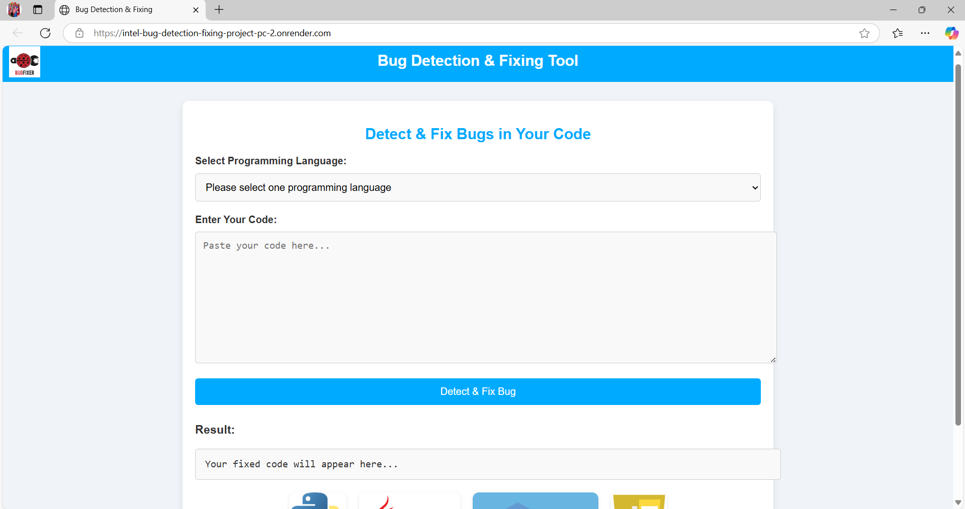
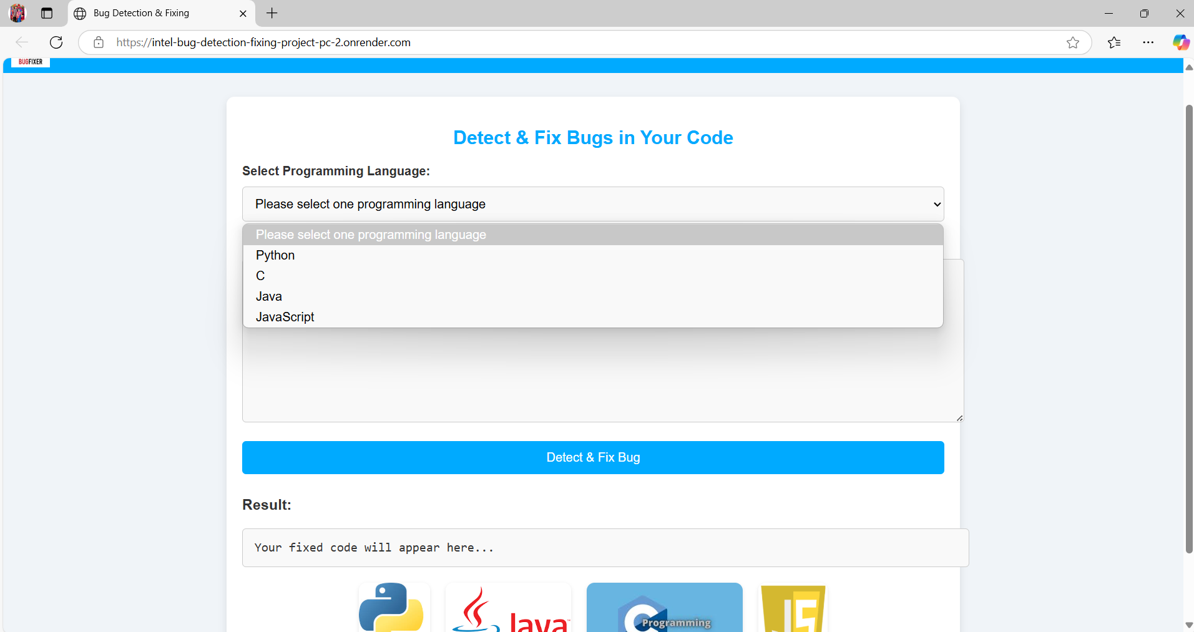
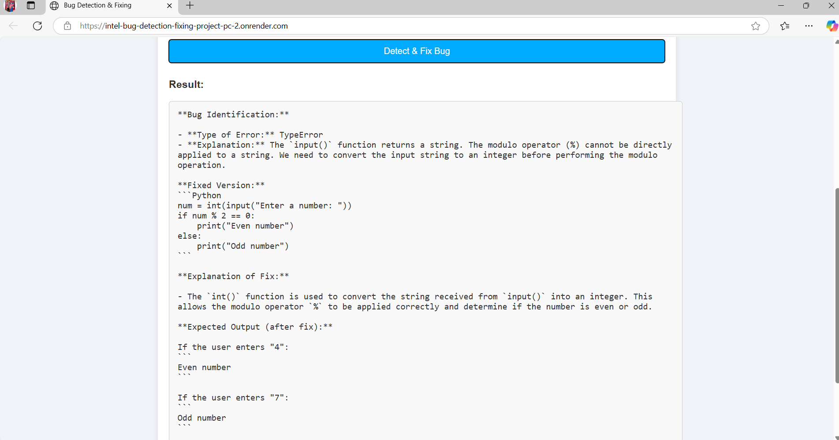
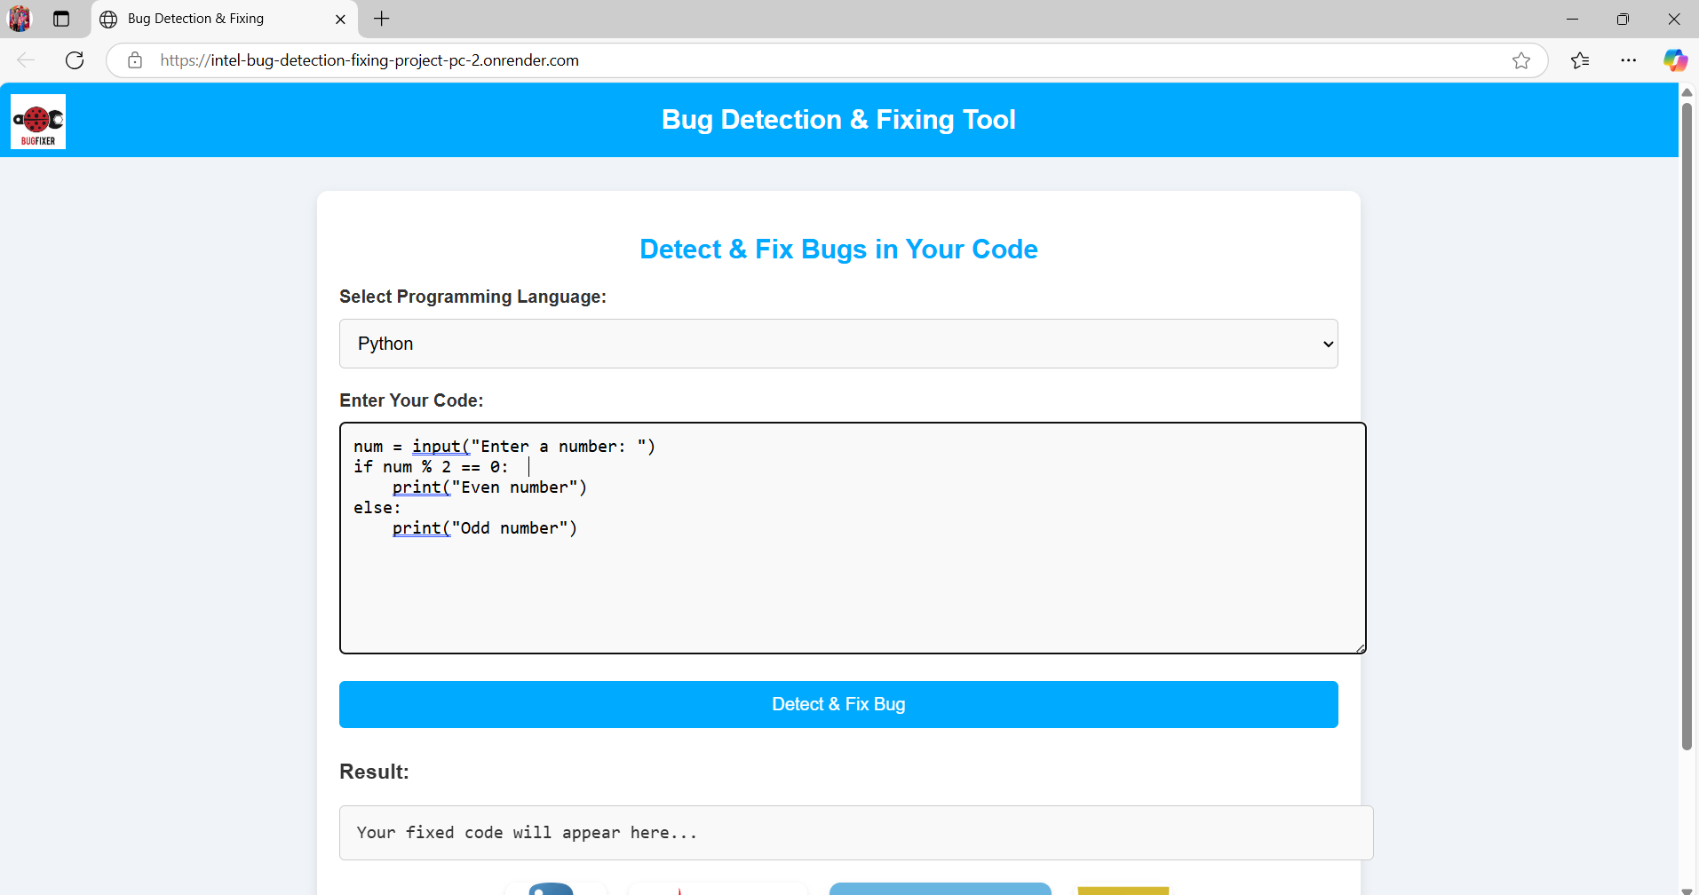
Live Demo
🔗 Project Link: https://intel-bug-detection-fixing-project-pc-2.onrender.com

Slide 6
Project Structure
INTEL-BUG-DETECTION---FIXING-PROJECT-PC/
│── __pycache__/ → Compiled Python files
│── static/ → Static assets (images, downloads)
│ │── images/
│── templates/ → HTML templates
│ │── index.html
│── app.py → Main application file
│── bug_fixer.py → Bug detection and fixing logic
│── requirements.txt → Dependencies list
│── README.md → Project documentation
│── demo.mp4 → Demo video
│── Bug_Detection_and_Fixing[1].docx → Project report/documentation
│── Intel_Bug_Detection_Fixing_Project_Presentation(P.C).pptx → Project presentation slides
│── .gitignore → Git ignore file
│── LICENSE → License file
│── .env → Environment variable file (API keys)

Slide 7
Installation & Setup
1. Clone repo: git clone https://github.com/Pritam-Chakrabortty/INTEL-BUG-DETECTION---FIXING-PROJECT-PC
cd INTEL-BUG-DETECTION---FIXING-PROJECT-PC
2. Install dependencies:
pip install -r requirements.txt
3.
4. Run: python app.py
5. Open: http://127.0.0.1:5000
Set up the environment variables:
Open the .env file in the root directory.
Update the values as needed. Example:
GEMINI_API_KEY=your_actual_api_key_here
Save the file.
3.

Slide 8
Usage
1. Select a Programming Language
2. Enter Code
3. Click 'Detect & Fix Bug'
4. View Fixed Code
5. Copy Fixed Code

Slide 9
Future Enhancements
- Implement CI/CD for real-time feedback
- Improve accuracy with more training data
- Add unit testing

Slide 10
Conclusion & Contact
✔ AI-Powered Bug Detection System
This system leverages advanced AI models to analyze code across multiple programming languages, including Python, C, Java, and JavaScript.
It efficiently detects bugs, suggests fixes, and enhances debugging accuracy, reducing development time.
The tool provides an intuitive user interface where users can select their preferred language, input code, and receive instant feedback.
By automating bug detection and correction, this project aims to improve software reliability and streamline development workflows.
✔ GitHub: https://github.com/Pritam-Chakrabortty
✔ Email: bwubta22388@brainwareuniversity.ac.in

Slide 11


