Slide 1
Stock Trading Models
Suresh Tamminiedi and Jacob Eckhardt

Slide 2
Problem Statement
Use ML Models to optimize trading of a given stock

Slide 3
Approach
Get stock price data from Yahoo Finance
Get stock sentiment data from Quandl
Use FinTA library for various Technical Indicators
Use Sagemaker Autopilot to analyze regression models
Run LSTM model for various combinations to analyze results
Run Reinforcement Learning model against price data to analyze results

Slide 4
Data
Price: Used Yahoo Finance to get basic stock price data like Open, High, Low, Close, Volume
Sentiment: Used data from provider called ‘FinSentS News Sentiment’. This has sentiment indicators ranging from -5 to 5 based on various sources and applying ML models on them.
Technical Indicators: Used FinTA for various technical indicators like EMA, RSI, Bollinger Bands, EVWMA, VAMA and MOM

Slide 5
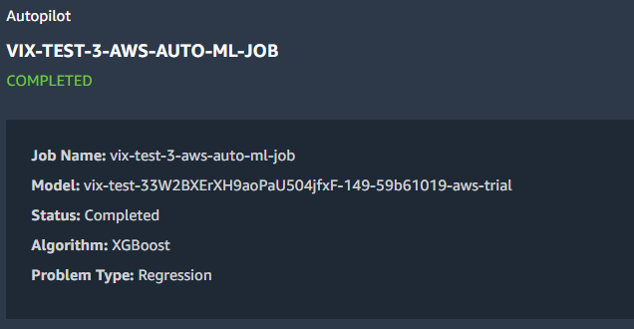
Sagemaker

Slide 6
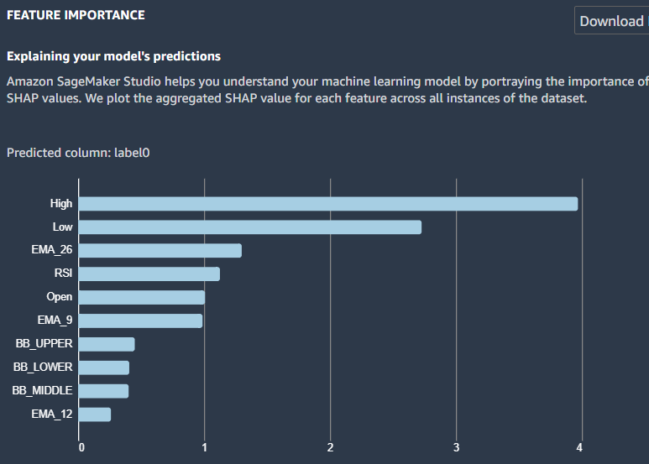
Sagemaker

Slide 7
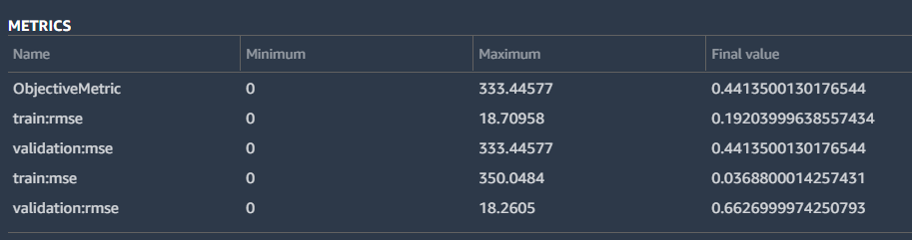
Sagemaker

Slide 8
Long Short Term Memory (LSTM)
The Long Short-term Memory (LSTM) model was used to utilize the functionality of past decisions in future decision-making situations.
The LSTM model contains 3 hidden layers in an attempt to optimize performance without creating redundancies.
Optimizer used for this is ‘Adam’ and the loss is set to ‘Mean Square Error’
Hyper Parameters: Number of Units=10, Dropout=0.2, Epochs=10-20, Batch Size=10 and ran the model for different hyper parameters
Calculated ‘Accuracy’ based on actual vs predicted prices for trends (up/down) in a given day

Slide 9
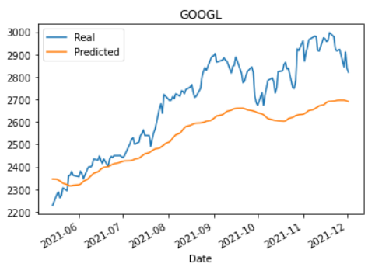
Long Short Term Memory (LSTM)

Slide 10
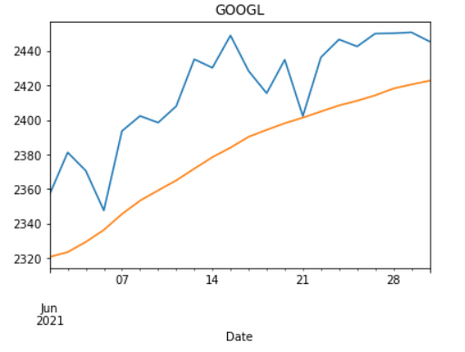
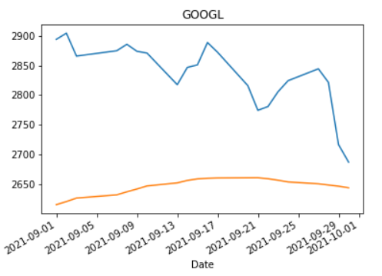
Long Short Term Memory (LSTM)

Slide 11
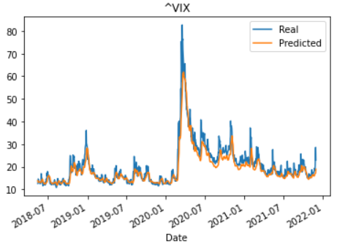
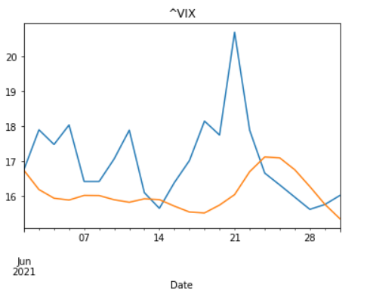
Long Short Term Memory (LSTM)

Slide 12
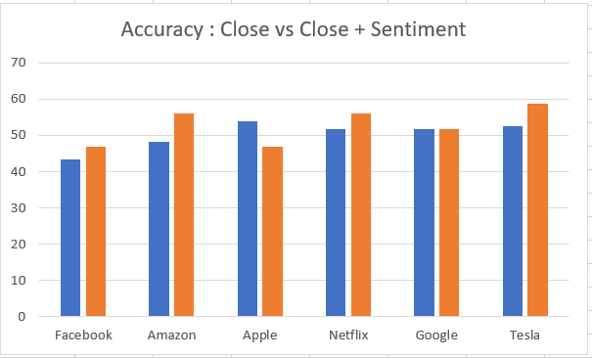
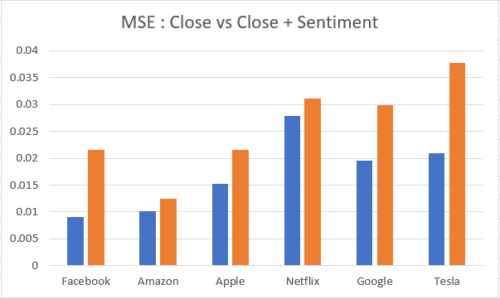
Long Short Term Memory (LSTM)

Slide 13
Reinforcement Learning
Reinforcement Learning model was used to see how the reward based system would perform in relation to other models
Q Learning is used and is based on just price data with buy/sell actions while only rewarding when there is a profit on a long call.
Model is composed of Dense Neural Network with Adam optimizer
Hyper Parameters: Gamma=0.95, Epsilon=1.0, Epsilon Decay=0.995, Epsilon Final=0.01

Slide 14
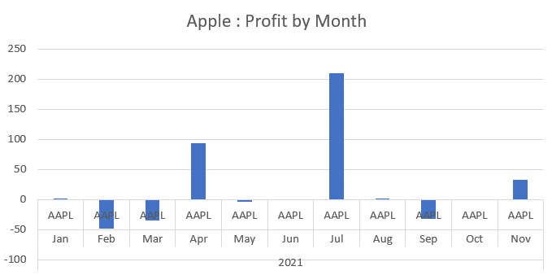
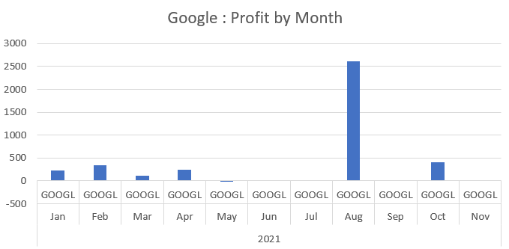
Reinforcement Learning

Slide 15
Learning Points
None of the technical indicators by themselves are good enough
Increase of number of features would not result to better output
Increase of MSE with increase of Epochs indicates over fitting

Slide 16
Conclusion
Just using ML models with basic price data is not good enough to get even reasonable results
Will have to combine custom logic based on domain expertise along with different ML models for different scenarios to get reasonable results
When it comes to ML models, combination of Reinforcement Learning and LSTM can potentially give better results

Slide 17

Conclusion
AI → Artificial Intelligence
AI →Automation Improvisation

Slide 18
Q & A

