Slide 1
Task 2
Cross site scripting vulnerability From :- Pritam Raj

Slide 2
Summary
Vulnweb website http://testasp.vulnweb.com/ has an Input in search section that has a vulnerability that add one more input area, also known as Reflected Cross Site Scripting.
As per OWASP's definition: "Cross-Site Scripting (XSS) attacks are a type of injection, in which malicious scripts are injected into otherwise benign and trusted websites. "
It Happen because the input box on search section does not sanitise user input, allowing an injection to occur.

Slide 3
Steps To Reproduce
Prepare a javascript payload that he can input it into the search section input bas and make the page show a additional input area, which in case lead to bad user interface as well as allow others to know that it has not implemented proper sanitation for text input, leading to some major risk.
Code
<span id=x tabindex=1 onbeforedeactivate=alert(1)></span><input autofocus>

Slide 4
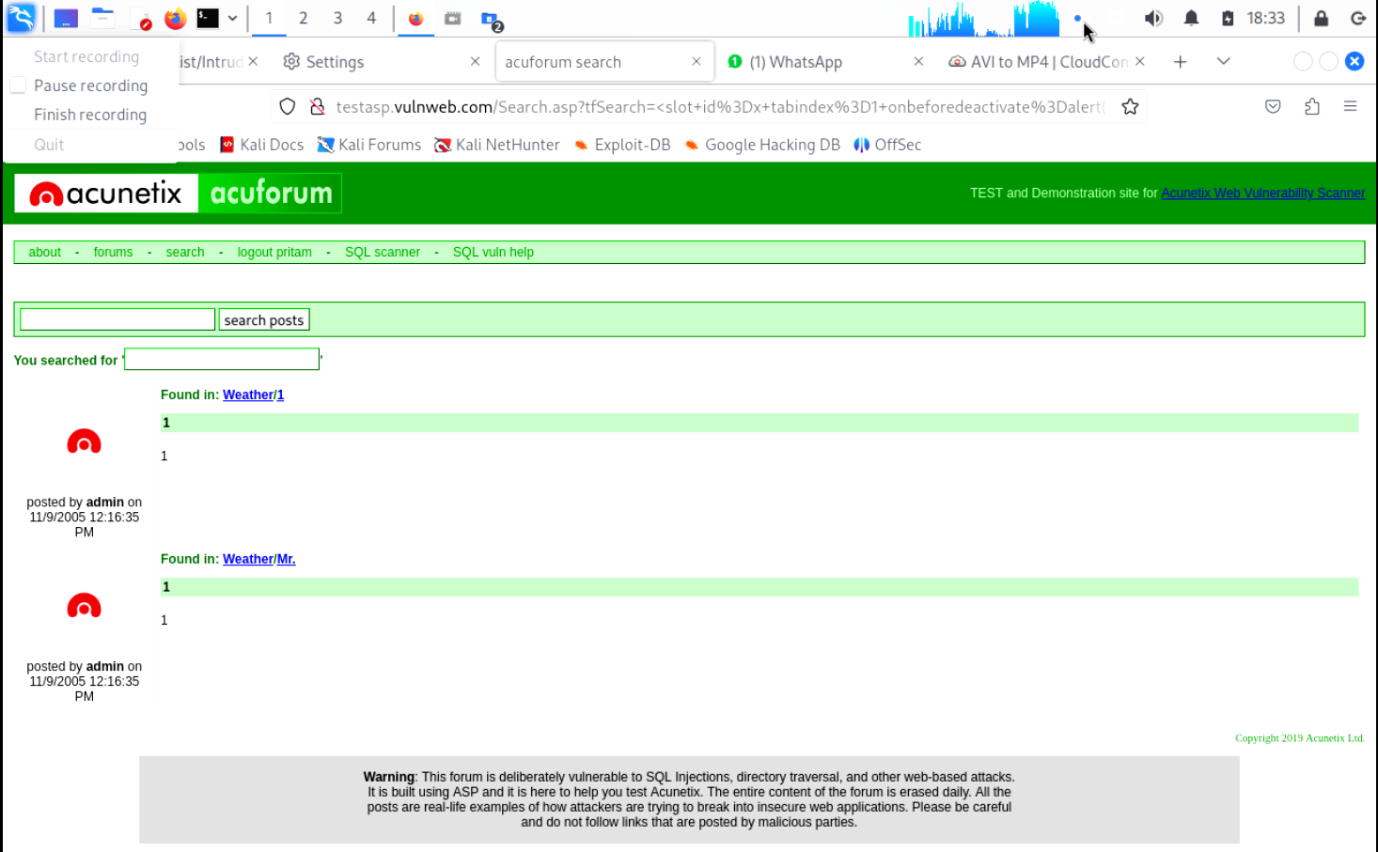
Injecting this code allow it to modify the HTML file and add a span tag that allow this UI Issue.
Here how it looks

Slide 5
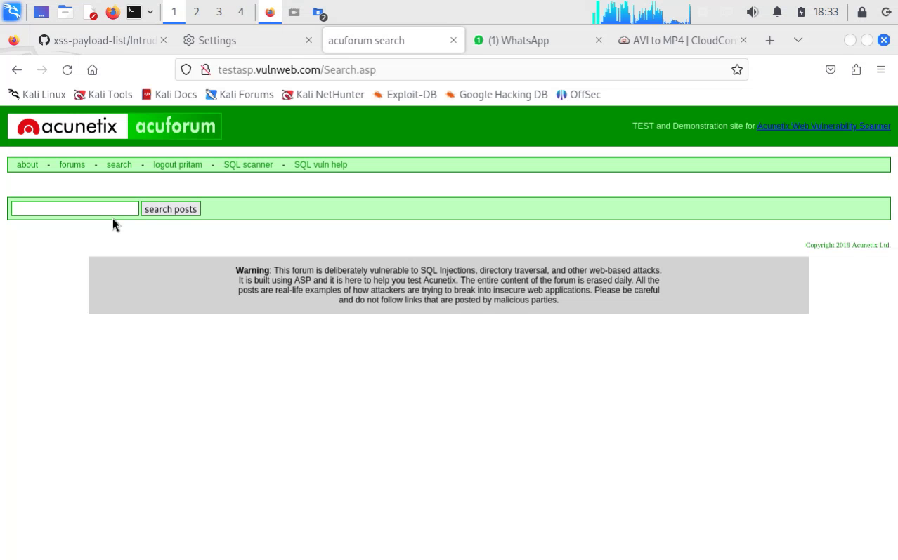
Video Demonstration
Click on the video to See

Slide 6
Thank You
THANK YOU

