Slide 1
Enhancing Operational Efficiency and Patient Experience at HealthFirst Care
Final Case Study Presentation
Pritam Kar Junior Data Analyst September 2026

Slide 2
Executive Summary
The analysis identifies three operational bottlenecks and a focused digital improvement program.
41.4 min
Average patient wait
32
Double-booking incidents
42.7%
Resource availability deficit
6.3 / 10
Average satisfaction
Scheduling is fragmented, with manual availability checks and legacy booking workflows.
Peak demand is concentrated around 17:00–18:30, increasing pressure on the scheduling system.
Patients need timely delay notifications and easier self-service rescheduling.
The proposed solution combines automated conflict prevention, live resource tracking, patient notifications, and operational dashboards.
HealthFirst Care Initiative • Capstone Project

Slide 3
Requirements Gathering & Stakeholder Needs
Patients
Reduce waiting and booking friction
Receive live delay updates
Use accessible self-service portal
Doctors & Nurses
Prevent double bookings
Balance workloads
See room/equipment availability
Administrative Staff
Reduce manual entry errors
Centralize scheduling
Prevent calendar overlaps
IT & Operations
Integrate with legacy data
Ensure scalability at peak
Maintain security & HIPAA compliance
HealthFirst Care Initiative • Capstone Project

Slide 4
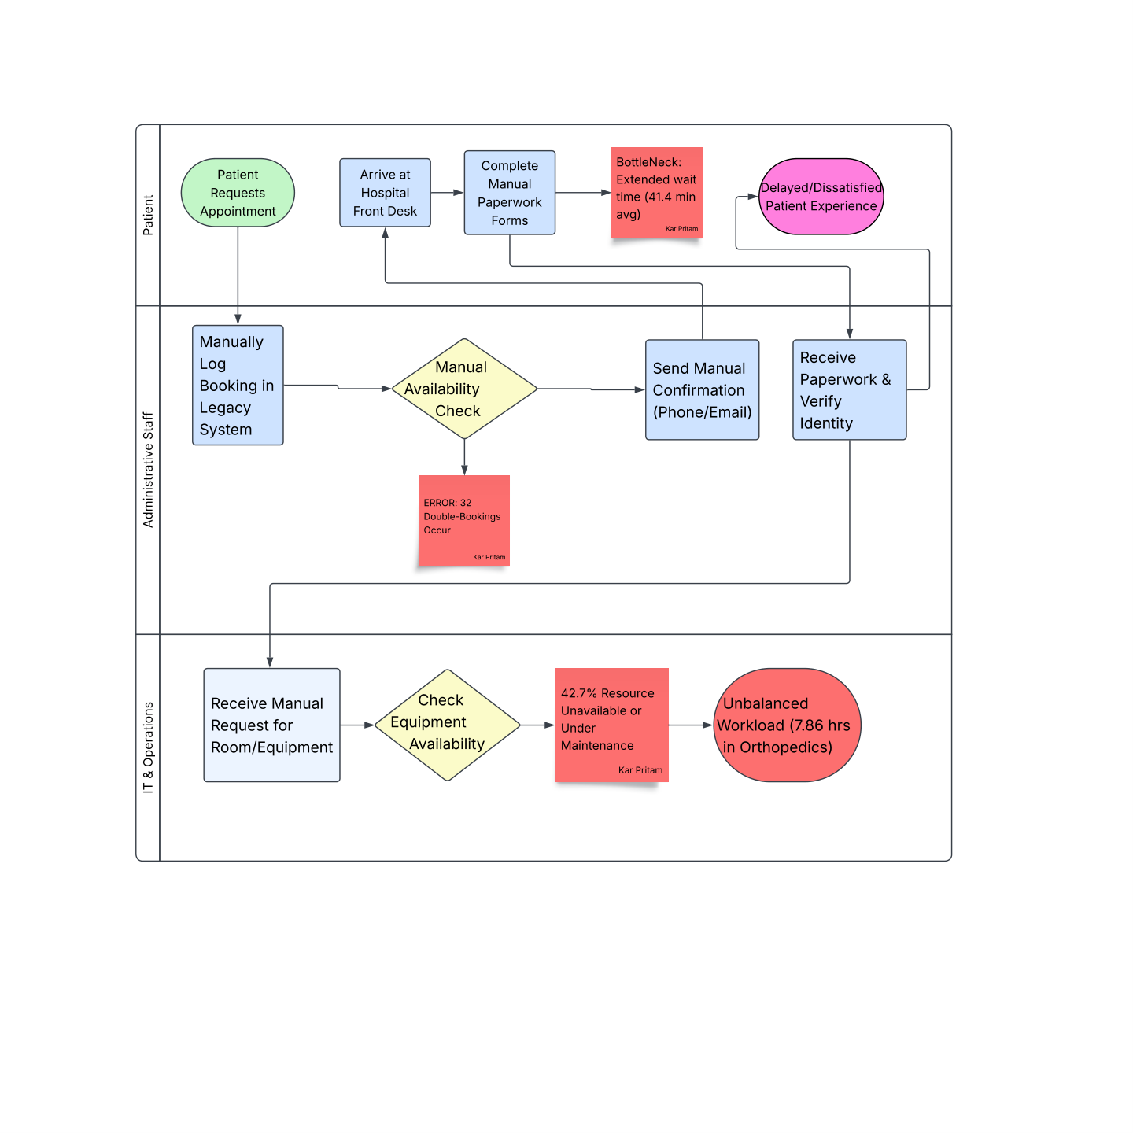
Current-State Process: Where Bottlenecks Occur
Manual paperwork and booking entry add friction at the front desk.
Manual availability checks create scheduling delays and conflicts.
The current model records 41.4 minutes average wait time.
32 double-bookings and 42.7% unavailable/maintenance resources indicate control gaps.
Source: As-Is Process Model + BRD

Slide 5
Process Improvement: Future-State Workflow
Automate the highest-friction steps while keeping clinical decisions under staff control.
1
2
3
4
5
Request / Reschedule
Patient portal or staff entry
Validate
Check doctor + room + equipment availability
Confirm
Automated conflict prevention; no occupied slots
Notify
SMS/Email confirmation, reminders, delay alerts
Track
Live queue + resource dashboard
Future state synthesized from BRD/RTM functional requirements

Slide 6
Data Analysis Insight 1: Peak Appointment Demand
The workbook shows 18:00 as the busiest hour, with 27 appointments.
The BRD identifies 17:00–18:30 as the peak booking window.
Peak-load performance is therefore a key scalability and scheduling-control requirement.
NFR-01 targets 99.9% uptime during peak booking windows.
Source: appointment_data workbook; BRD/RTM

Slide 7
Data Analysis Insight 2: Wait Time & Satisfaction
Workbook cleaned data; BRD acceptance baseline: 41.4 min wait and 6.3/10 satisfaction

Slide 8
Data Analysis Insight 3: Resource Utilization
Workbook analysis shows Pediatric with the highest average usage hours (4.85).
The BRD reports a 42.7% resource availability deficit.
Orthopedics is highlighted in the BRD for workload strain at 7.86 usage hours/day.
FR-02 requires real-time status for doctors, rooms, and equipment.
Source: resource_data workbook + BRD/RTM

Slide 9
Risk Management: Priority Risks & Mitigation
Legacy interoperability | Likelihood: High | Impact: High
Mitigation: Secure interface; phased integration; avoid forced full migration
Peak-hour performance | Likelihood: High | Impact: High
Mitigation: Cloud scalability; load testing; monitor 17:00–18:30
Staff adoption | Likelihood: Med | Impact: High
Mitigation: Mandatory training; workflow demos; weekly feedback loops
Impact
Data security / HIPAA | Likelihood: High | Impact: High
Mitigation: RBAC, encryption, compliance validation
Budget constraints | Likelihood: Med | Impact: High
Mitigation: Prioritize Must-Have requirements; phased rollout
Low
Medium
High
Likelihood
Risk themes are based on documented BRD constraints/requirements; no separate Risk Management Plan was provided.

Slide 10
Recommendations & Target Outcomes
1. Automate scheduling — Deploy conflict validation before confirmation to target 0 double bookings.
2. Introduce live resource tracking — Show Available / In Use / Under Maintenance and rebalance peak workloads.
3. Improve patient communication — Send 24-hour reminders plus immediate schedule-change and delay alerts.
4. Build operational dashboards — Monitor wait time, satisfaction, appointment outcomes and resource availability.
5. Roll out in phases — Prioritize Must-Have requirements, train staff, and validate acceptance criteria.
HealthFirst Care Initiative • Capstone Project

Slide 11
Success Measures: Acceptance Criteria
ID
Objective
Baseline
Target
Success definition
AC-01
Patient wait
41.4 min
≤ 33.1 min
At least 20% reduction
AC-02
Double bookings
32 incidents
0
100% automated conflict prevention
AC-03
Patient satisfaction
6.3 / 10
≥ 8.0 / 10
Improve experience
AC-04
Resource availability
45.1% available
≥ 70%
During peak hours
Note: AC-04 baseline/target wording follows the BRD. The workbook contains cleaned resource records, while the BRD acceptance criteria use the project baseline.
Source: BRD acceptance criteria

Slide 12
From fragmented workflows to measurable operational improvement

Slide 13
From fragmented workflows to measurable operational improvement
≤ 33.1 min
Wait-time target
0
Double bookings
≥ 8.0/10
Satisfaction target
≥ 70%
Resource availability
Thank you

