Slide 1

ECOMMERCE SALES
DATA ANALYSIS

Slide 2
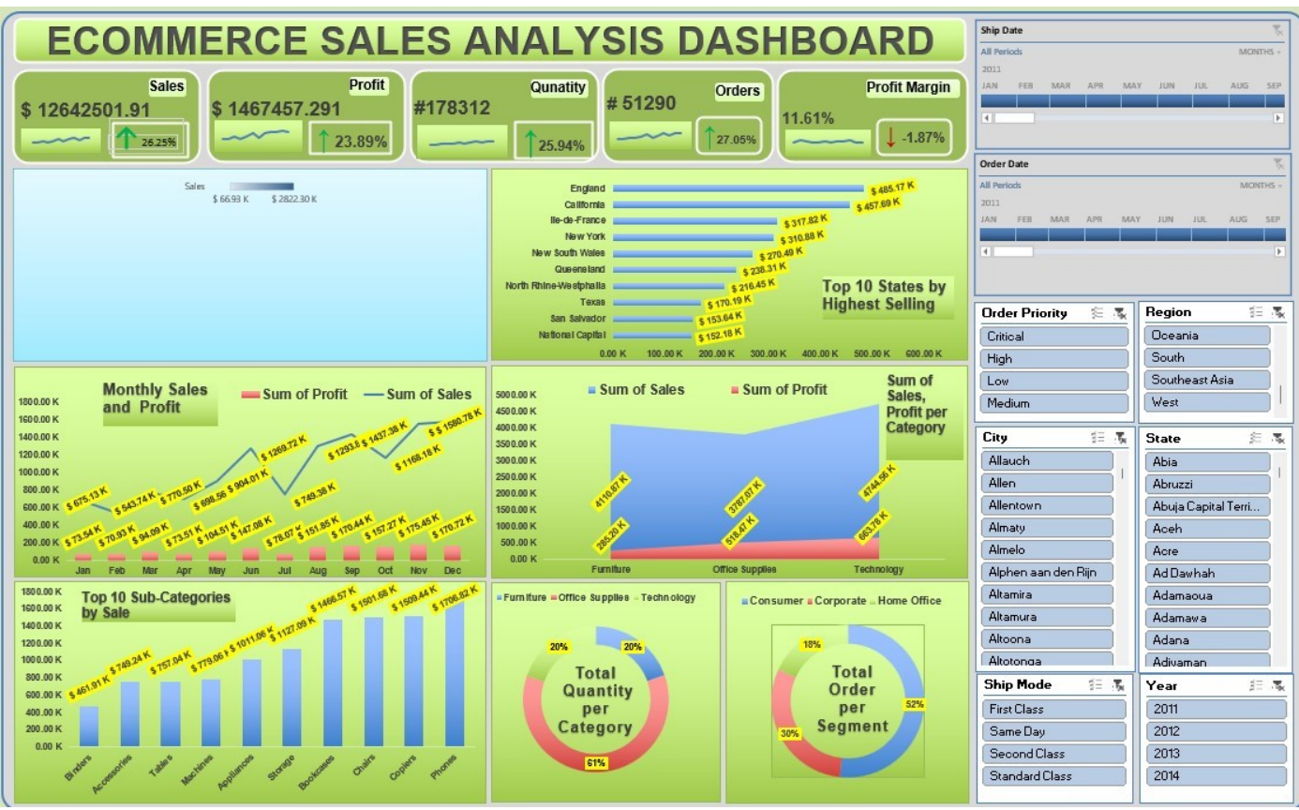
Dashboard

Slide 3
General Overview
Following are the questions, we will be seeking an answer for.
What is the total quantity sold over time?
How much sales has been made so far?
What’s the total profit?
How much orders were made?
How many types of products were sold?
How many modes of shipping were available?
What were the orders priority?
How many customers are there?
Different segments of the customers?
What is the Profit Margin?

Slide 4
Total Sold Quantity: 1778312,
Total Sales: $ 12.64+M,
Total Profit: $ 1.46+M,
Total Orders made: 51290,
Types of Product: Furniture, Office Supllies, & Technology,
Modes of Shipping: Same Day, First Class, Second Day, Standard Class,
Order Priority: Critical>High>Medium>Low,
Total Customers: 51290,
Different Segments of Customers: Consumer. Corporate, & Home Office.
The Profit Margin is 11.61%

Slide 5
Sales
Analysis
The months of “June”, “September”, and “December” show the maximum amount of sales, where “December month has the highest amount sold” throughout the whole year.
In terms of Profit obtained, though the month of “May and June” shows a “temporary pick” in overall monthly upsurge, still the “months between August and December” shows an almost consistent uprise in Profit.
If we consider the sub-categories, “Phone” is sold with maximum selling, followed by “Copiers”, “Charis”, and “Bookcases”.
As per Categories sold, “Office Supplies” is the highest in demand (60%), followed by “Furniture” and “Technology” (both 20%).
Most of the customers lie in the “Consumer” segment (52%), followed by “Corporate” (30%), and “Home Office” (18%).
“England”, Followed by “California”, “Ille-de-France”, and “New York” are the Top Cities in terms of highest selling.

Slide 6
Thank you.
Pritam Banerjee.

