Slide 1

Employee Attrition
Rate Analysis

Slide 2
Employee Attrition: Contents
2. Research and Analysis Department
4. Human and Resource Department
3. Sales Department
1. Overview

Slide 3
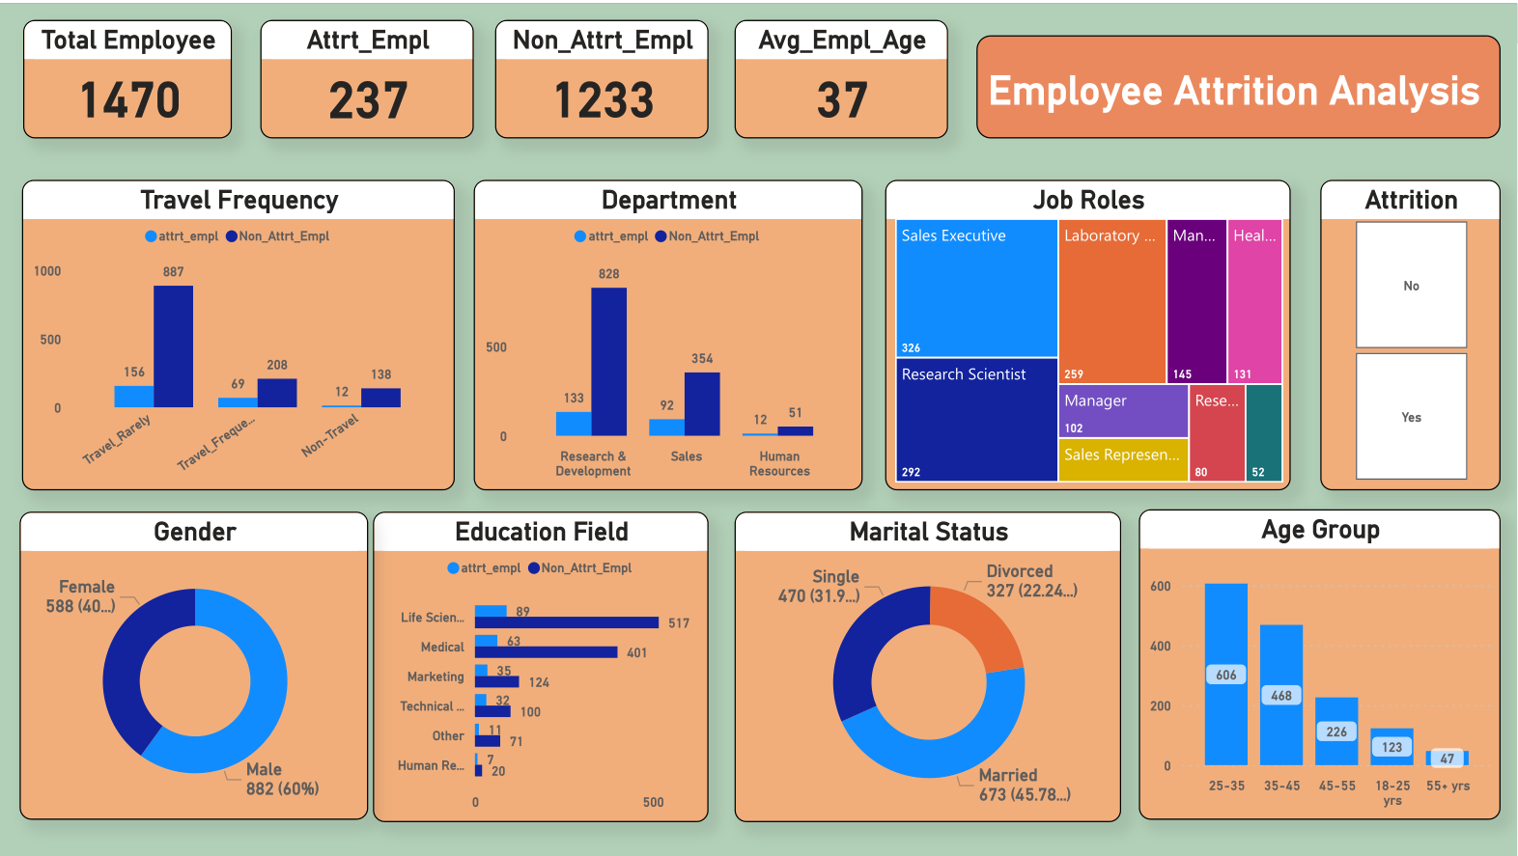
1. Overview

Slide 4
Total Employee: 1470,
Attrition vs Non-Attrition = 237 : 1233
Avg Employee Age = 37 Years
Observation
Male = 882 (60%),
Female = 588 (40%).
Travel Frequency of all employees:
Most of the employees travel rarely ( = 1043).
Life Science (=606), followed by Medical (=464), followed by Marketing (=159), are three ducational back ground of most of the employees.
Department: R&D, Sales, & HR.
R&D has most of the employees (= 961).
Married (= 647) > Single (=470) > Divorced (=327)
Job Roles: Sales Executive (=324), followed by Research Scientist (=292), followed by Lab Tech (=259), has the most no of employees.
25-35 years is where most employees belong (= 606), followed by 35-45 years (= 448), followed by 45-55 years (=226).

Slide 5
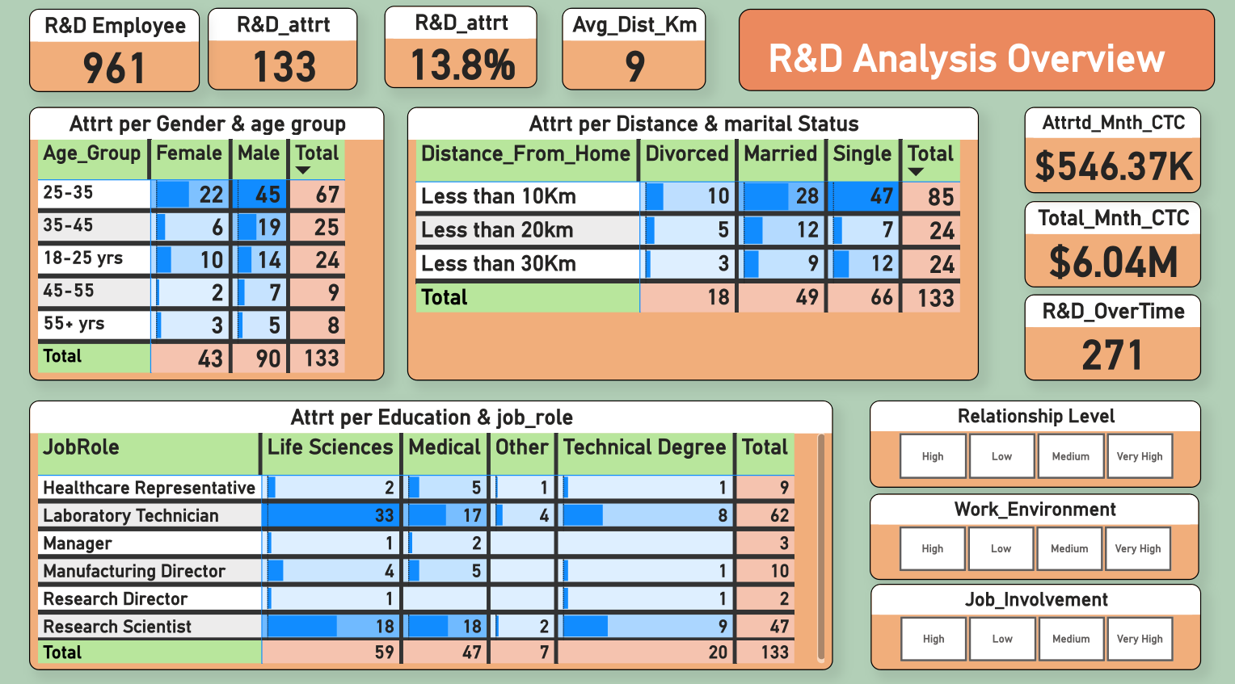
2. R&D Analysis

Slide 6
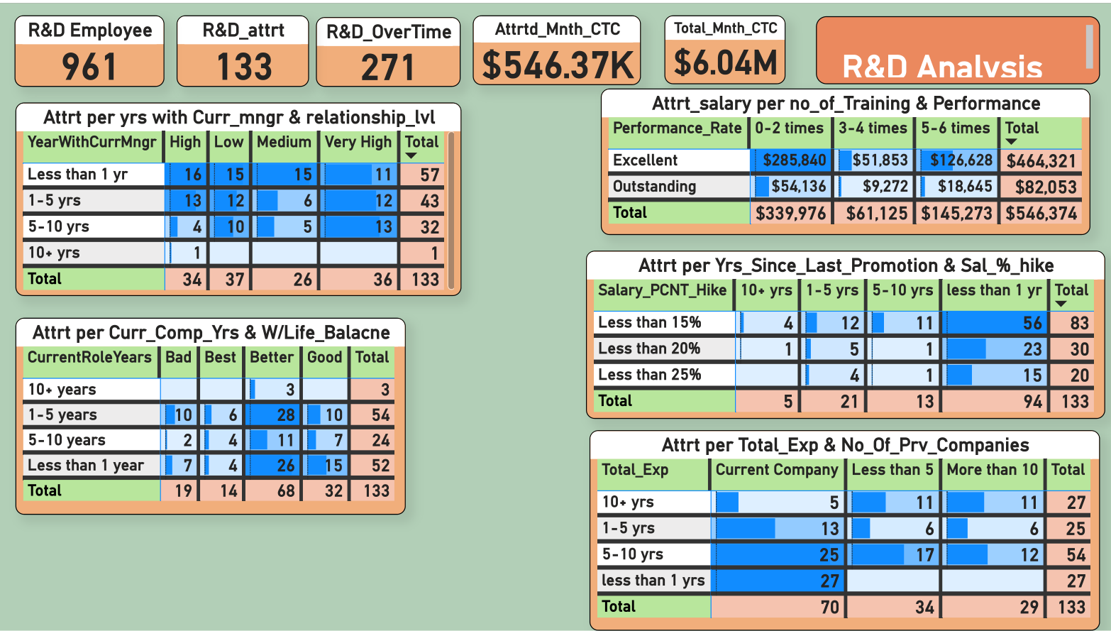
2. R&D Analysis

Slide 7
Total Employee: 961,
Attrition vs Non-Attrition = 133: 828
Attrition percentage = 13.8%,
Total Monthly CTC = $ 6.04M,
Attrition employees monthly CTC = $ 546.37K
R&D Analysis Observation
90 Males and 43 Females left the company, out of which employees between 25-35 years and 35-45 years are most likely to quit.
As per Marital Status, Single Employees ( =66) are most likely to leave, followed by Married (=49). Employees, whereas employees living within 10Km distance from office is most likely to quit.
Employees with Life Science, and Medical are seen to quit the company, followed by Technical Degree holders , with Laboratory Technician job role is showing the highest attrition rate followed by Research Scientist.
Employees working with current manager for less than 1 year is more likely to leave, followed by those having 5-10 years exp and 10-15 years exp, whereas employees showing both, Very High and Low level of Relationship, are more likely to quit.
Performance wise both, Excellent and Outstanding, employees are more likely to quit.
Employees with less than 1 year experience with less than 15% Salary Hike is likely to quit, followed by those with less than 20% and 25% Salary Hike .
Employees with “Better” work-life balance working in the company for 1-5 years are more likely to quit, followed by those who are working for less than 1 year.
Employees who are working within the same company for 5-10 years, followed by those who are working for less than 1 year are more likely to quit.

Slide 8
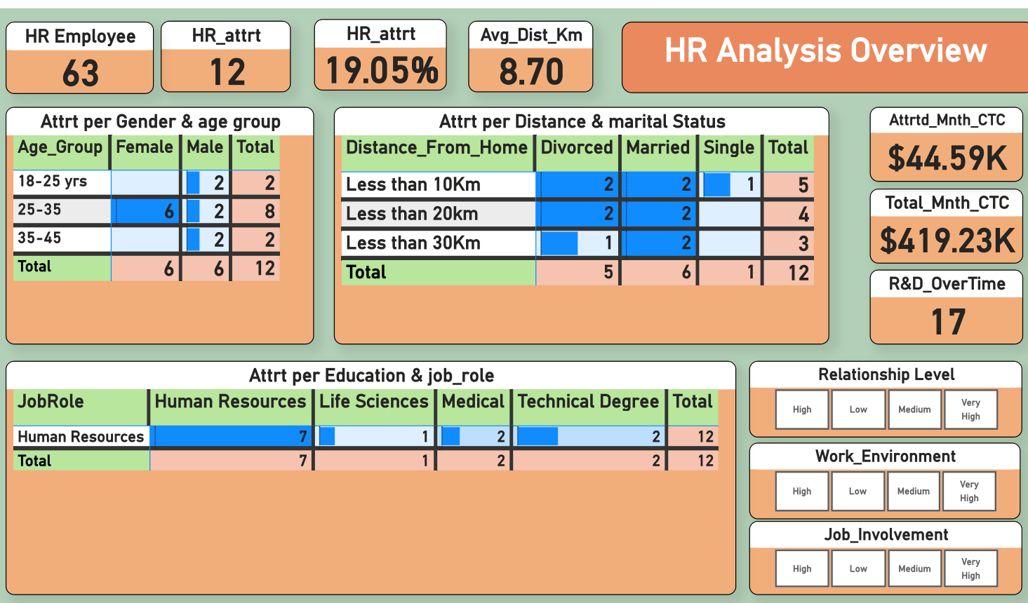
3. HR Analysis

Slide 9
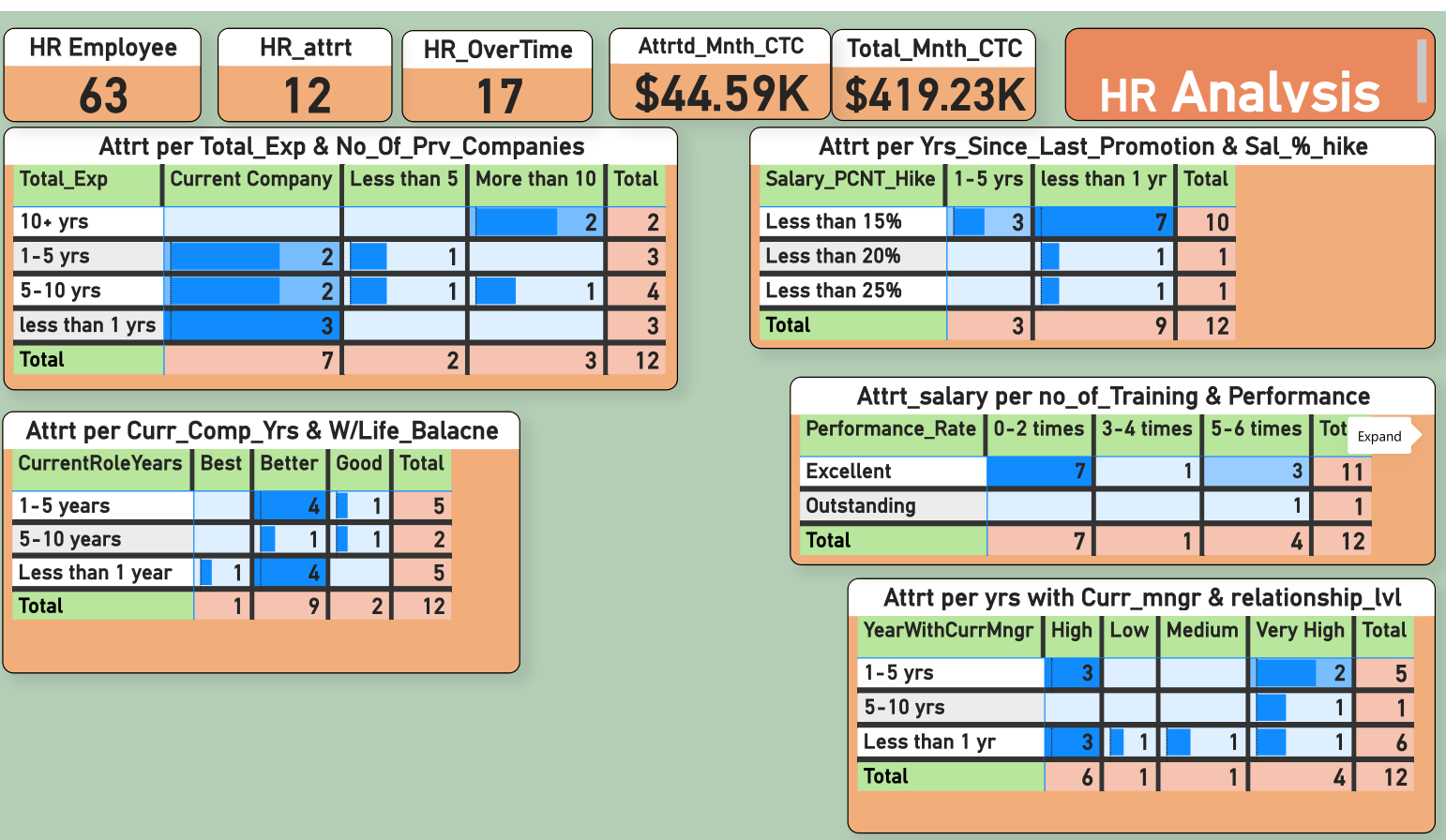
3. HR Analysis

Slide 10
Total Employee: 63,
Attrition vs Non-Attrition = 12:51
Attrition percentage = 19.05%,
Total Monthly CTC = $ 419.23K,
Attrition employees monthly CTC = $ 44.59K
HR Analysis Observation
6 Males and 6 Females left the company, out of which employees between 18-25 years are most likely to quit.
As per Marital Status, Both Married and Divorced are most likely to leave, followed by Single Employees, whereas employees living within both 10Km & 20 Km distance from office is most likely to quit.
Employees with Human Resoruces are seen to quit the company, with HRjob role is showing the highest attrition rate.
Employees working with current manager for Less than 1 year is more likely to leave, followed by those having 1- 5 years exp, whereas employees showing both, Very High and High Level of Relationship, are more likely to quit.
Performance wise both, Excellent and Outstanding, employees are more likely to quit, whereas training given between 0-2 times.
Employees with less than 1 year experience with less than 15% Salary Hike is likely to quit.
Employees with “Better” work-life balance working in the company for 1-5 years in the current role are more likely to quit, followed by those who are working for less than 1 year.
Employees who are working within the same company for 5-10 years, followed by those who are working for Less than 1 years are more likely to quit.

Slide 11
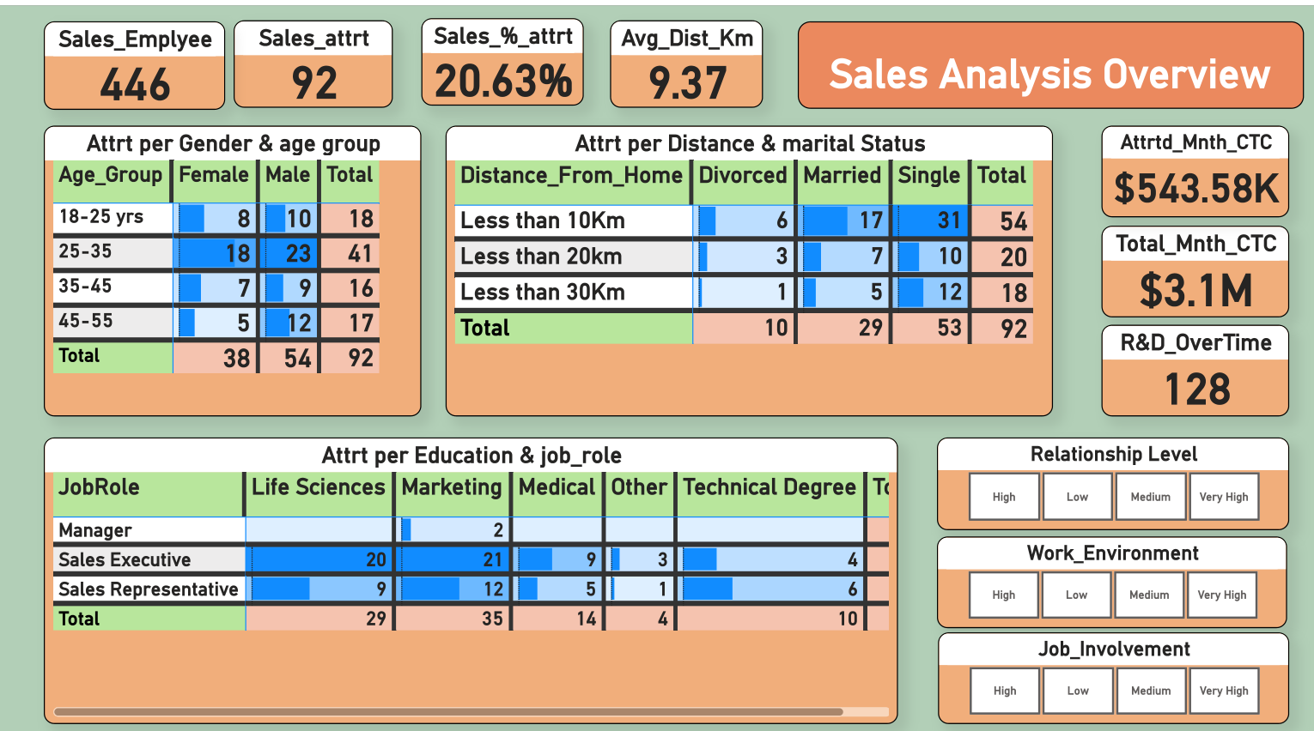
3. Sales Analysis

Slide 12
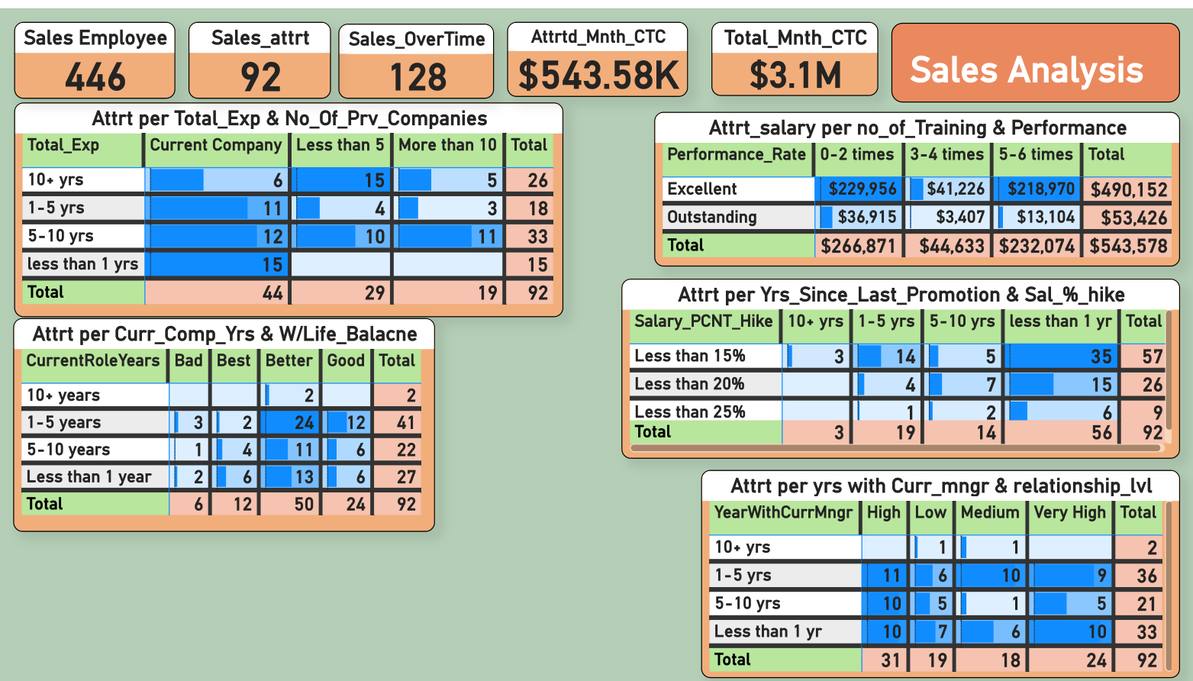
3. Sales Analysis

Slide 13
Total Employee: 446,
Attrition vs Non-Attrition = 92: 354
Attrition percentage = 20.63%,
Total Monthly CTC = $ 3.1M,
Attrition employees monthly CTC = $ 543.58K
Sales Analysis Observation
54 Males and 38 Females left the company, out of which employees between 25-35 years and 18-25 years are most likely to quit.
As per Marital Status, Single Employees ( =53) are most likely to leave, followed by Married (=49). Employees, whereas employees living within 10Km distance from office is most likely to quit.
Employees with Life Science, and Medical are seen to quit the company, followed by Technical Degree holders , with Laboratory Technician job role is showing the highest attrition rate followed by Research Scientist.
Employees working with current manager for less than 1 year is more likely to leave, followed by those having 5-10 years exp and 10-15 years exp, whereas employees showing both, Very High and Low level of Relationship, are more likely to quit.
Performance wise both, Excellent and Outstanding, employees are more likely to quit.
Employees with less than 1 year experience with less than 15% Salary Hike is likely to quit, followed by those with less than 20% and 25% Salary Hike .
Employees with “Better” work-life balance working in the company for 1-5 years are more likely to quit, followed by those who are working for less than 1 year.
Employees who are working within the same company for less than 1 year, followed by those who are working for 5-10 years are more likely to quit.

Slide 14
Total Employee: 1470,
Attrition vs Non-Attrition = 237: 1233
Attrition percentage = 16.12%.
Summarization
Gender: Male employees are more likely to quit than Female employees.
Age Group: mostly 25-35 years employees are more likely to quit company.
Marital Status: Mostly Single and Married Employees are likely to quit.
Education Background: Life Science, Medical, Technical Degree, and Marketing are the four fields where employees quit most often.
Job Role: Sales Executive & representative, along with HR, and Research Scientist and Lab Technician are the job roles where employees quit mostly.
Working with Current Manager: Those who worked with current manager for Less tan 1 year, and between 1-5 years are more likely to quit.
Salary Hike and Promotion: Those were promoted within 1 year and having a salary hike of less than 15% are more likely to quit.
No years of Experience: Employees with Less than 1 year, 1-5 years, and 5-10 years of total experience are more likely to quit.
No of Previous Companies worked: Those who are working within the same company, and those who have worked with at least 5 companies are more likely to quit.
Performance Level: Employees having Excellent and Outstanding performance level are likely to quit more often

Slide 15
Thank You.
Pritam Banerjee.

