Slide 1


Unsupervised Customer Segmentation and Psychological traits of Credit Card Users
Department: Statistics
Subhrajit Dasgupta
(Reg no. 100438 of 2020-2021 Roll - 96/STA No. 200028)
Ankan Ghosh
(Reg no. 100360 of 2017-2018 Roll - 96/STS No. 170002)
Pritam Saha
(Reg no. 100421 of 2020–2021 Roll - 96/STA No. 200014)
Under the supervision of Dr. Sushovan Jana (Maulana Abul Kalam Azad University of Technology, West Bengal)

Slide 2



CONTENTS:-
Acknowledgement
Introduction
Objective of the study
Methodology Used
Data Description
Data Analysis
Conclusion

Slide 3
Acknowledgement:- We would like to express our deepest gratitude to our project supervisor Dr. Sushovan jana (Maulana Abul Kalam Azad University of Technology, West Bengal) for his continuous support and guidance. Without him, it would not have been possible for us to shape and frame this project well enough in this particular field of study. We would also wish to express our sincere thanks to our respected HOD Dr. Chandranath Pal (Department of Statistics, University of Kalyani) for his constant cooperation in completing our project. Finally, we are thankful to university of Kalyani for accepting us into the graduate program and nurturing us with the knowledge.

Slide 4
INTRODUCTION:-
A credit card is a payment card issued to users (cardholders) to enable the cardholder to pay a merchant for goods and services based on the cardholder's accrued debt. The card issuer (usually a bank or credit union) creates a revolving account and grants a line of credit to the cardholder, from which the cardholder can borrow money for payment to a merchant or as a cash advance. There are two credit card groups: consumer credit cards and business credit cards.
Credit card providers usually target users using their behavior and demographic information. The behavior of the customers are described by the reports of purchases and pays made by customers. Customer segmentation is a technique of separating a customer base into groups which allows consumers to efficiently discriminate between themselves and provides issuers to decide on marketing plans and strategies.
Clustering is a famous machine learning tool used for various data analysis. Among all the clustering algorithms K means clustering is widely used. One drawback of K means is that it can not separate the non-linearly separable data. Recent approaches have showed to work better to separate clusters that are non-linearly separable in input space. One of them is Kernel K means approach and other one is Spectral Clustering.
Kernel K means maps the points to a higher dimensional space using some non-linear functions (e.g Gaussian Kernel, Polynomial Kernel, Sigmoid Kernel etc.) and then separates the points by linear separators in the new space.
Spectral Clustering algorithm considers the datapoints as nodes of an undirected graph and constructs an affinity matrix based on some similarity measure and hence uses the eigenvectors of the affinity matrix along with k means algorithm to partition the points in different clusters. The new approach uses grouping by splitting vertices of the graph into disjoint sets and keeping the similarity high within a set and low between sets. The partitions are then evaluated based on loss known as normalized cut.

Slide 5
Objective of the study:-
Customer segmentation, which gives insight to card issuing company about the natures of the customers. Card issuers can not only make high-priced proposals, but can discover groups that have poorly serviced by present offers using improved segmentation.
Finding the common factors among the subpopulation of customers as their behavioral style can help study these groups and provide better alternatives and strategies to meet their demands

Slide 6
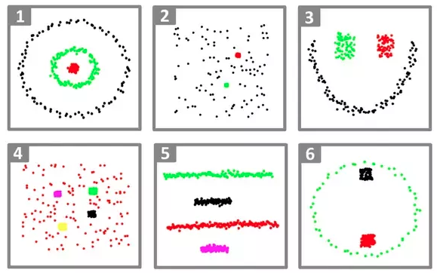
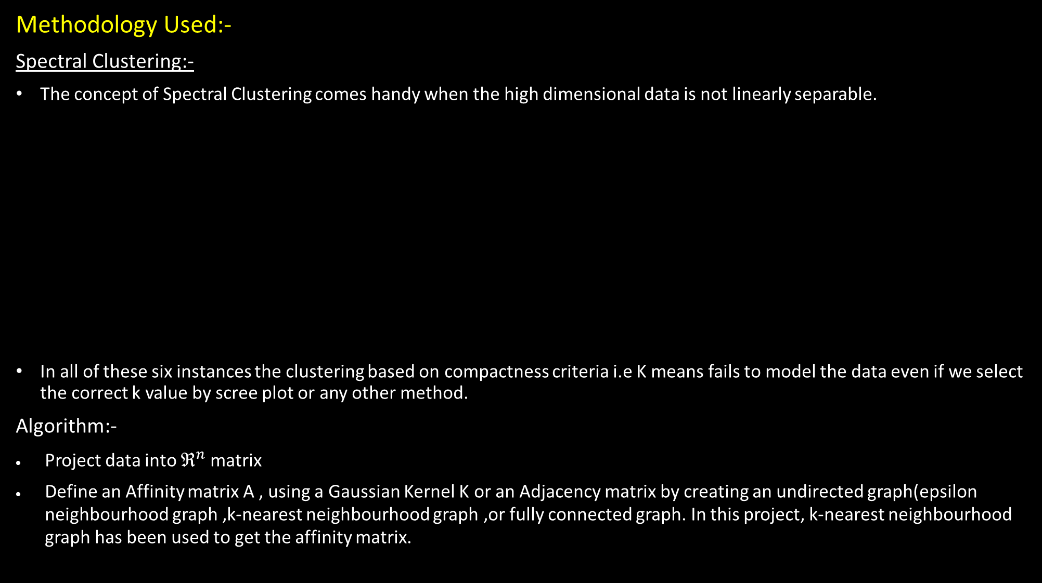
Methodology Used:-
Spectral Clustering:-
The concept of Spectral Clustering comes handy when the high dimensional data is not linearly separable.
In all of these six instances the clustering based on compactness criteria i.e K means fails to model the data even if we select the correct k value by scree plot or any other method.
Algorithm:-
Project data into $ℜ^{n}$ matrix
Define an Affinity matrix A , using a Gaussian Kernel K or an Adjacency matrix by creating an undirected graph(epsilon neighbourhood graph ,k-nearest neighbourhood graph ,or fully connected graph. In this project, k-nearest neighbourhood graph has been used to get the affinity matrix.

Slide 7

Construct the normalised Graph Laplacian $L_{N}$= $D^{−1/2}$L${ D}^{−1/2}$, L=D-A where D is degree matrix from A
Solve the Eigenvalue problem of normalised Graph Laplacian
Select k eigenvectors corresponding to the k lowest (or highest) eigenvalues to define a k-dimensional subspace.The value of k is chosen either by eigen gap heuristic method or manually(In this case, the value of k is chosen by trying different combinations of hyperparameters and hereby selecting the combination for which silhouette score is maximum).
Form clusters in this subspace using k-means.

Slide 8
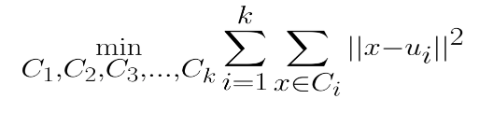
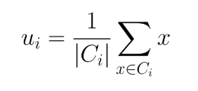
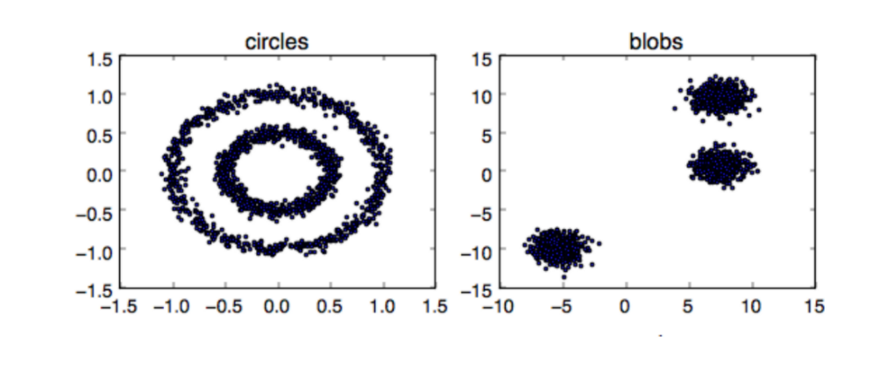
Kernel k-means:-
K-Means aims to partition N observations into K clusters in which each observation belongs to the cluster with the nearest mean (cluster centroid). In other words, it minimizes within-cluster dissimilarity using the following objective function:
where
The objective function is minimized using an iterative approach that converges to a locally optimal solution. We alternate between (a) treating the cluster centroids (uᵢ’s) as fixed and computing cluster assignments (Cᵢ’s) and (b) treating the cluster assignments as fixed and computing cluster centroids.
Now Kernel K-means is an extension of the standard k-means clustering algorithm that identifies nonlinearly separable clusters. where in the calculation of distance, kernel method is used instead of the Euclidean distance. In kernel k-means before clustering, points are mapped to a higher-dimensional feature space using a nonlinear transformation Φ, and then kernel k-means partitions the points by linear separators in the new space.
K-Means performs best when clusters are spherical, dense, and linearly separable, like in the image on the right in Figure 1. For non-linearly separable clusters, like in the image on the left in Figure 1, we project our data into a higher dimensional space to make the resulting clusters linearly separable. Projecting to a higher dimension directly and calculating the objective for K-Means can be computationally expensive, as this requires calculating XᵀX where X denotes the Input Space. Kernel trick allows us to project our data into a higher dimensional space to achieve linear separability and solve the K-Means problem in a more efficient way.
Fig: 1 Example data points for clustering. Where the left is non-linearly separable, and the right is linearly separable

Slide 9

TABLE I
EXAMPLES OF KERNEL FUNCTIONS
Polynomial Kernel | κ(a,b)=(a·b+c)^{d}
Gaussian Kernel | κ(a,b)=exp (−||a−b || ^{2/}2σ²)
Sigmoid Kernel | κ(a,b)=tanh(c(a·b)+θ)
The mechanics of kernel methods:-
Kernel methods allow us to get the result of XᵀX where X may be in a higher dimension without actually calculating X in that higher dimension. Hence anytime X exists in an objective function only in the form of XᵀX, we can apply kernel tricks to easily expand the feature set to higher dimensions.
The objective function that Kernel k-means tries to minimize is the equivalent of the clustering error in the feature space
E (u₁, u₂, u₃, …..., u_{k) =} $\sum_{i = 1}^{N}{\sum_{j = 1 }^{K}{I}} \left(x_{i } ∈ C_{j}\right)\left|\left|φ\left(x_{i}\right) − u_{j}\right|\right| where u_{j }=\frac{\sum_{i=1}^{N}{I\left(x_{i } ∈ C_{j}\right)φ\left(x_{i}\right)}}{\sum_{i=1}^{N}{I\left(x_{i } ∈ C_{j}\right)}}$ _{…... (i)}
We can define a kernel matrix where $K ∈ ℝ^{N×N}whereK_{ir}=φ{\left(x_{i}\right)}^{T}φ\left(x_{r}\right)$ and by taking advantage of the kernel trick, we can compute the squared Euclidian distances in (i) without explicit knowledge of the transformation using
${\left|\left|φ\left(x_{i}\right) − u_{j}\right|\right|}^{2} = K_{ii} − \frac{2\sum_{r = 1}^{N}{I\left(x_{r }∈ C_{j}\right)K_{ir}}}{\sum_{r = 1}^{N}{I\left(x_{r }∈ C_{j}\right)}} + \frac{\sum_{r = 1}^{N}{\sum_{l= 1}^{N}{I\left(x_{r }∈ C_{j}\right)I\left(x_{l }∈ C_{j}\right)K_{rl}}}}{\sum_{r = 1}^{N}{\sum_{l= 1}^{N}{I\left(x_{r }∈ C_{j}\right)I\left(x_{l }∈ C_{j}\right)}}}……\left(ii\right)$
It must be noted that, by associating a weight with each data point, the weighted kernel k-means algorithm is derived and it is proven that its objective function is equivalent to that of many graph partitioning problems such as ratio association, normalized cut etc. if the weights and kernel are set appropriately.

Slide 10
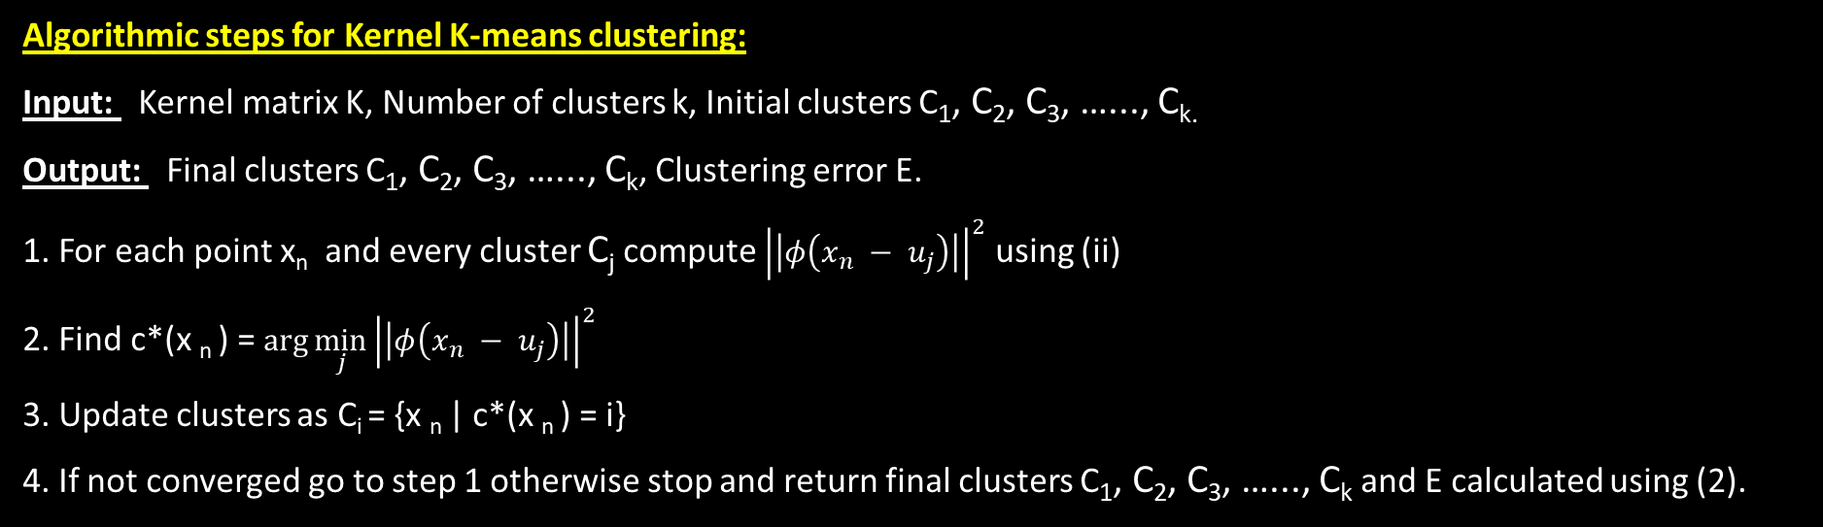
Algorithmic steps for Kernel K-means clustering:
Input: Kernel matrix K, Number of clusters k, Initial clusters C₁, C₂, C₃, …..., C_{k.}
Output: Final clusters C₁, C₂, C₃, …..., C_{k}, Clustering error E.
1. For each point x_{n} and every cluster C_{j} compute ${\left|\left|φ\left(x_{n} − u_{j}\right)\right|\right|}^{2}$ using (ii)
2. Find c*(x _{n} ) = $\arg{{\min_{j}\left|\left|φ\left(x_{n} − u_{j}\right)\right|\right|}^{2}}$
3. Update clusters as C_{i} = {x _{n} | c*(x _{n} ) = i}
4. If not converged go to step 1 otherwise stop and return final clusters C₁, C₂, C₃, …..., C_{k} and E calculated using (2).
Advantages
1) Algorithm is able to identify the non-linear structures.
2) Algorithm is best suited for real life data set.
Disadvantages
1) Number of cluster centers need to be predefined.
2) Algorithm is complex in nature and time complexity is large.

Slide 11
Data Description:- The sample Dataset summarizes the usage behavior of about 9000 active credit card holders during the last 6 months. The file is at a customer level with 17 behavioral variables. Following is the Data Dictionary for Credit Card dataset :-
CUSTID : Customer ID is a Individual Identification number of Credit Card holder which is associated with the bank account. Although it is of numerical type, actually it is an identifier.
BALANCE : Balance amount left in the credit card holders account to make purchases.
BALANCEFREQUENCY : How frequently the Balance is updated, score between 0 and 1 (1 = frequently updated, 0 = not frequently updated).
PURCHASES : Amount of purchases made from account of Credit Card holder.
ONEOFFPURCHASES : Maximum purchase amount done in one-go using the credit card. INSTALLMENTSPURCHASES : Amount of purchase done in installments using the credit card.
CASHADVANCE : When you withdraw money from your credit card account, it's known as a cash advance. Card issuers typically limit the amount of money you can withdraw to a portion of your total credit limit.
PURCHASESFREQUENCY : How frequently the Purchases are being made, score between 0 and 1 (1 = frequently purchased, 0 = not frequently purchased). ONEOFFPURCHASESFREQUENCY : How frequently Purchases are happening in one-go (1 = frequently purchased, 0 = not frequently purchased).

Slide 12
ONEOFFPURCHASESFREQUENCY : How frequently Purchases are happening in one-go (1 = frequently purchased, 0 = not frequently purchased).
PURCHASESINSTALLMENTSFREQUENCY : How frequently purchases in installments are being done (1 = frequently done, 0 = not frequently done).
CASHADVANCEFREQUENCY : How frequently the cash in advance being paid.
CASHADVANCETRX : Number of Transactions made with "Cash in Advanced".
PURCHASESTRX : Total number of purchase transactions made.
CREDITLIMIT : Credit limit, as the name indicates, is the purchase limit set by the credit card company or a bank on a particular credit card. The limit, which is usually in terms of money, is the maximum amount the user can spend using the credit card.
PAYMENTS : Amount of Payment done by user through credit card.
MINIMUM_PAYMENTS : A minimum payment is the smallest amount of money one has to pay each month to keep his account current.
PRCFULLPAYMENT : Percent of full payment paid by user.
TENURE : Tenure of credit card service for user.

Slide 13
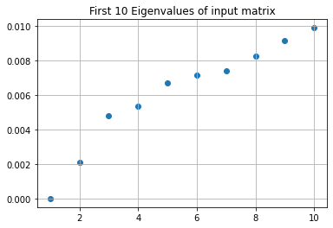
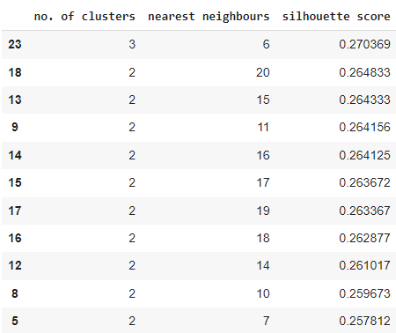
Data Analysis:-
Based on Spectral Clustering:-
In this plot we see that the eigen gap heuristic fails to determine the appropriate number of clusters because there is presence of overlapping and noise in the data.

Slide 14
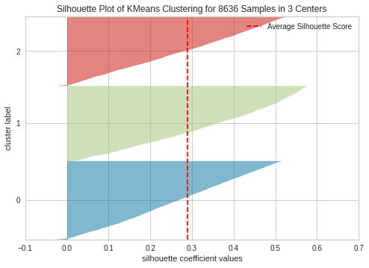
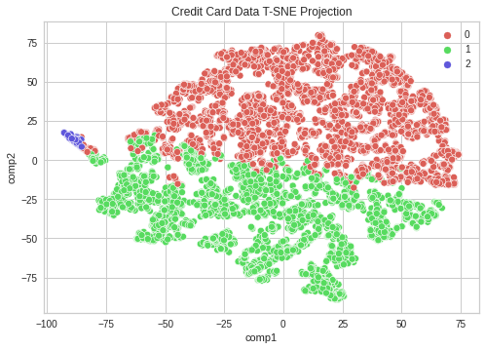
Therefore, for this data, the selected no. of k-nearest neighbour is 6 and the no. of clusters is 3.
The plot shows that our average Silhouette Score is close to 0.3 which is 0.270369 indeed.
To get a visualization of the clustering labels one can use PCA(Principal Component Analysis) to project the data in lower dimension and visualize how the data is clustered. Below is the two dimensional such plot done with first two principal components.
Below is the t-SNE plot of our data with clustering labels labelled by the Spectral Clustering algorithm.

Slide 15
Summary of different clusters corresponding to important characteristics of the customers:-
KMO Test Results:
KMO test is conducted to check whether our subpopulations are appropriate for factor analysis. Overall MSA below 0.6 is unacceptable. For cluster 1 and cluster 2 our overall MSA are 0.65 and 0.61 respectively. But for third cluster the overall MSA was 0.57.
The variables with individual MSA <0.55 were dropped off before choosing the number of factors by Parallel Analysis.
 | Cluster 1 | Cluster 2 | Cluster 3
Purchases_TRX | At least 50% people have done 10 transactions | At least 50% people have done 6 transactions | At least 50% people have done 6 transactions
Credit Limit | Mean credit limit of card 6874 | Mean credit limit of card 1769 | Mean credit limit 3373
PRC Full Payment | Mean percent of full payment is 0.1743 | Mean percent of full payment is 0.1446 | Mean percent of full payment is 0.003
Cash Advance | Mean amount withdrawn from credit limit 1548.17 | Mean amount withdrawn from credit limit 342.9 | Mean amount withdrawn from credit limit 869.45
Balance | At least 50% of people have 1562.7 amount of money left for use | At least 50% of people have 528.22 amount of money left for use | At least 50% of people have 2473.5 amount of money left for use
Payments | Mean amount of payment done by card is 2699.31 | Mean amount of payment done by card is 719.31 | Mean amount of payment done by card is 1050.04

Slide 16
Bartlett Sphericity Test results:-
Cluster | Eliminated Variables
Cluster 1 | ONEOFF_PURCHASES, INSTALLMENT_PURCHASES
Cluster 2 | TENURE,CREDIT_LIMIT,INSTALLMENTS_PURCHASES,ONEOFF_PURCHASES, PURCHASES,ONEOFF_PURCHASES_FREQUENCY
Cluster 3 | BALANCE,ONEOFF_PURCHASES_FREQUENCY,BALANCE_FREQUENCY,CREDIT_LIMIT,ONEOFF_PURCHASES
 | Statistic | DF | P value
Cluster 1 | 91656.952 | 136 | <2.22e-16
Cluster 2 | 69487.29 | 136 | <2.22e-16
Cluster 3 | 1260.437 | 120 | <2.22e-16
For all the clusters the Bartletts test rejects the null hypothesis which means all of them are ready to be passed to factor analysis.
Results of Parallel Analysis:
Subpopulation | Number of Factors
Cluster 1 | 5
Cluster 2 | 4
Cluster 3 | 3

Slide 17
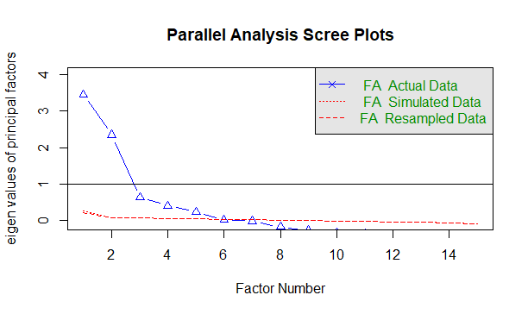
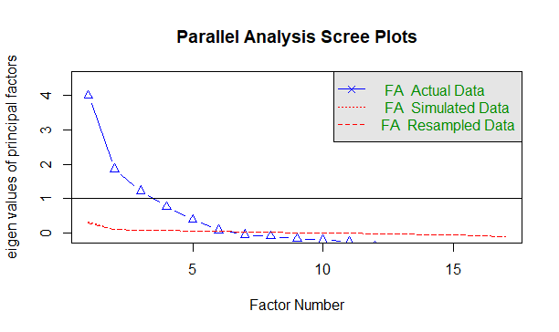
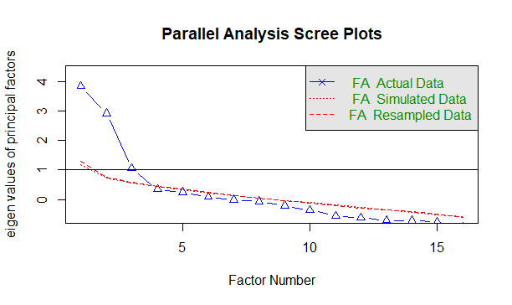
For Cluster 1
For Cluster 2
For Cluster 3
Factor Analysis Results:
The analysis was executed by R’s psych library by selecting the parameter estimation method ‘maximum likelihood’ and the factor scores are calculated by regression method.
For each of the three clusters h2, u2 and com represents the communality, uniqueness and Hoffman’s complexity. We can think of the communalities as value of R-square for regression models predicting the variables of interest from chosen number of factors for each cluster. In a nutshell, communalities represent the proportion of variance in a variable explained by the factors Communalities help us to assess how well the model performs. Total of communalities divided by the number of variables for each cluster shows proportion of total variance explained by the factors.

Slide 18
 | Number of Factors | Proportion of Total Variation Explained
Cluster 1 | 5 | 0.636
Cluster 2 | 4 | 0.672
Cluster 3 | 3 | 0.606
Next three tables represent the proportion of variance explained by the factors for each three clusters. Proportion of variance explained is calculated by subtracting Proportion variance(how much overall variance the factors accounts) from the Proportion variance and dividing it by sum of proportion variances of factors.
 | Factor 1 | Factor 2 | Factor 3 | Factor 4 | Factor 5
Proportion of Variance | 0.16 | 0.15 | 0.13 | 0.11 | 0.09
Proportion of Variance Explained | 0.24 | 0.23 | 0.21 | 0.17 | 0.14
 | Factor 1 | Factor 2 | Factor 3 | Factor 4
Proportion of Variance Explained | 0.33 | 0.30 | 0.22 | 0.14
Proportion of Variance | 0.22 | 0.20 | 0.15 | 0.09

Slide 19
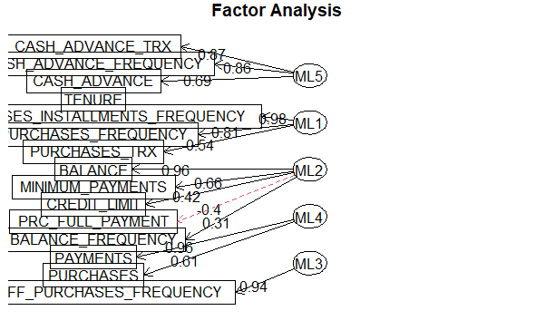
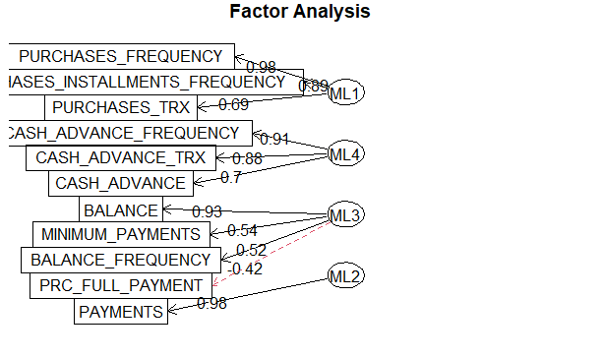
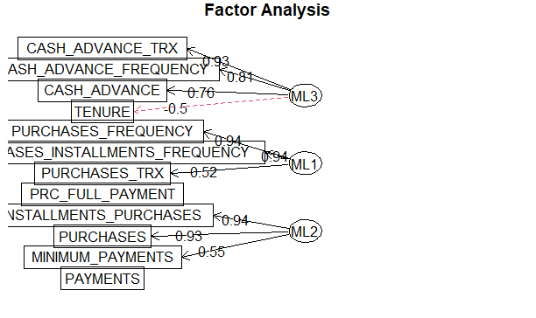
 | Factor 1 | Factor 2 | Factor 3
Proportion of Variance Explained | 0.34 | 0.33 | 0.32
Prop of Variance | 0.21 | 0.20 | 0.20
Following diagrams show that how the different factors for each cluster summarizes the features
For Cluster 1
For Cluster 2
For Cluster 3

Slide 20
Measures of Lack Of Fit:
 | Tucker-Lewis Index | RMSEA Index | Root Mean Square Residuals | BIC
Cluster 1 | 0.822 | 0.119 | 0.03 | 2325.53
Cluster 2 | 0.978 | 0.048 | 0.01 | 29.1
Cluster 3 | 0.954 | 0.079 | 0.13 | -94.07
Here our chosen method is maximum likelihood among other alternatives the maximum likelihood was free from Heywood problem which makes the loadings of the correlation matrix of features and factors more than 1 plus this method gives us reduction of BIC than any other method. Moreover it is better than principal component method because it gives us measures of model’s lack of fit which is essential to see how well our model performs. The root mean square of residuals value below 0.08 is considered good. The Tucker Lewis Index > 0.9 suggests very good fit of the model, the value near 0.5 indicates moderate fit of the model. And the suggested value of RMSEA Index for good fit is <0.08.

Slide 21
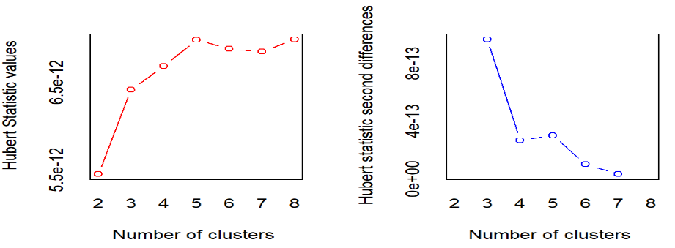
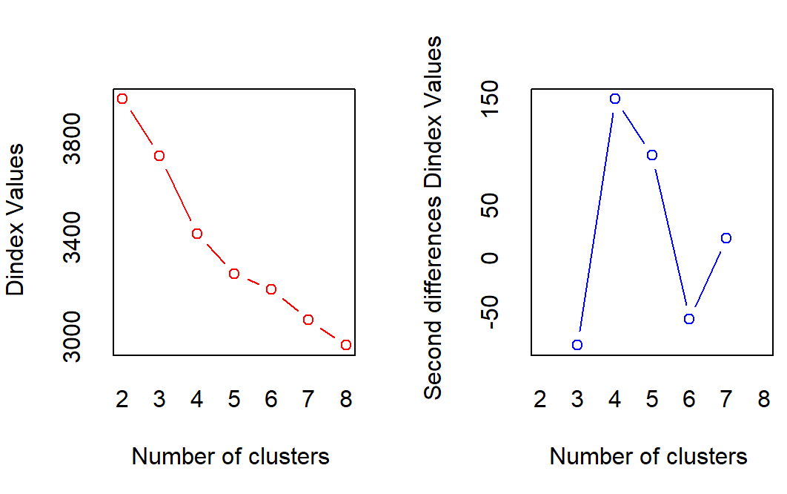
Based on Kernel k-Means:-
Data Preparation: Data Preparation is done in two steps.
Firstly, Customer ID is an unique id for each customer and hence won't play any role in determining the clusters. So, we have dropped it. Secondly, we drop the rows corresponding to the missing value in any column.
Determining no. of clusters:-
i)Analytical Method:-
For determining the best no. of clusters, we have used NbClust Package of R Programming language. Here, we have found the best no. of clusters to be 3 based on the majority rule.
ii)Graphical Method:-
a)Hubert Index Method:-
The Hubert Index is a graphical method of determining the number of clusters. In the plot of Hubert index, we seek a significant knee that corresponds to a significant increase of the value of the measure i.e., the significant peak in Hubert index second differences plot. Here, we have found the no. of clusters to be 3.
b) D Index Method:-
The D Index is a graphical method of determining the number of clusters. In the plot of D index, we seek a significant knee (the significant peak in D index second differences plot) that corresponds to a significant increase of the value of the measure. Here, we have found the no. of clusters to be 3.

Slide 22
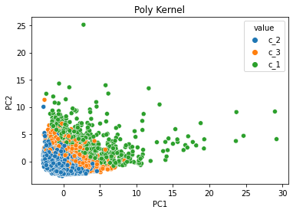
Using both the analytical method and the graphical methods, we come to a conclusion that the optimal number of clusters is 3. In the next step, setting the number of clusters as 3, we applied three most popular kernel transformations to the dataset. For evaluating the density and separation between the clusters we calculated the corresponding Silhouette Scores (lies between -1 to 1 where score near 1 implies high separation, score near 0 indicates overlapping and score near -1 indicates wrong cluster assignment) for these 3 non-linear splitting of the dataset. The scores are given below
Kernel | Silhouette Score
Polynomial | 0.33422278610924916
Radial Basis Function (Gaussian) | 0.035308683417481106
Hyperbolic | -0.012615015542211127
The silhouette coefficients suggests that the Gaussian Kernel and Hyperbolic kernel methods will be having high overlapping among the clusters whereas the Polynomial Kernel performs better separation than the previous Kernel functions. From these results we select the Polynomial Kernel as the best kernel transformation for this dataset and proceed with our further analysis.
The cluster sizes we get for this splitting,
Cluster 1 | Cluster 2 | Cluster 3
758 | 4794 | 3084
To get a visualization of the clustering labels one can use PCA (Principal Component Analysis) to project the data in lower dimension and visualize how the data is clustered. To the right, it is the two dimensional such plot done with first two principal components.

Slide 23
Factor Adequacy Check:
Kaiser-Meyer-Olkin (KMO) Test results
Cluster 1 | Cluster 2 | Cluster 3
Overall MSA = 0.67 | Overall MSA = 0.62 | Overall MSA = 0.68
Overall MSA below 0.6 is unacceptable. Here for all the clusters overall MSA is higher than 0.6. Hence the clusters can be passed to the further treatment of Factor Analysis. The variables with individual MSA $≤$0.50 were dropped off before choosing the number of factors by Parallel Analysis.
Cluster | Eliminated Variables
Cluster 1 | INSTALLMENT_PURCHASES, CREDIT_LIMIT, MINIMUM_PAYMENTS
Cluster 2 | TENURE, CREDIT_LIMIT, ONEOFF_PURCHASES, INSTALLMENTS_PURCHASES, ONEOFF_PURCHASES_FREQUENCY
Cluster 3 | CREDIT_LIMIT, ONEOFF_PURCHASES, INSTALLMENTS_PURCHASES
Bartlett’s Test of Sphericity Results:
Cluster | Chi – square statistic | DF | P - value
Cluster 1 | 7329.476 | 91 | 2.22e-16
Cluster 2 | 30184.393 | 66 | 2.22e-16
Cluster 3 | 23976.578 | 91 | 2.22e-16
For all the clusters the p value is smaller than our level of significance (say 0.05). So, we reject the null hypothesis and conclude that all the subpopulations are suitable for Factor Analysis.

Slide 24
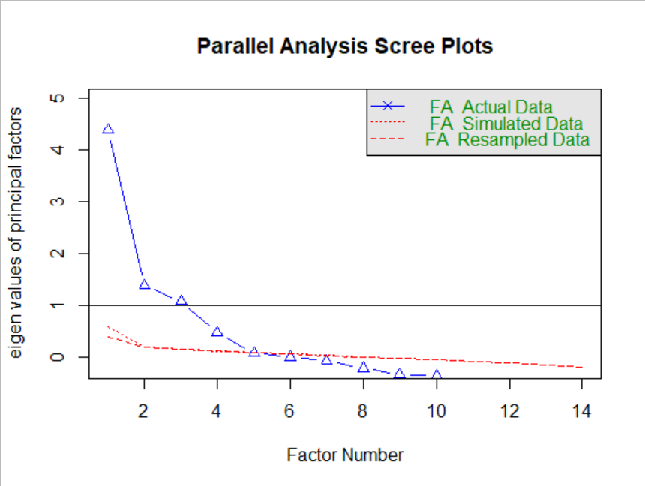
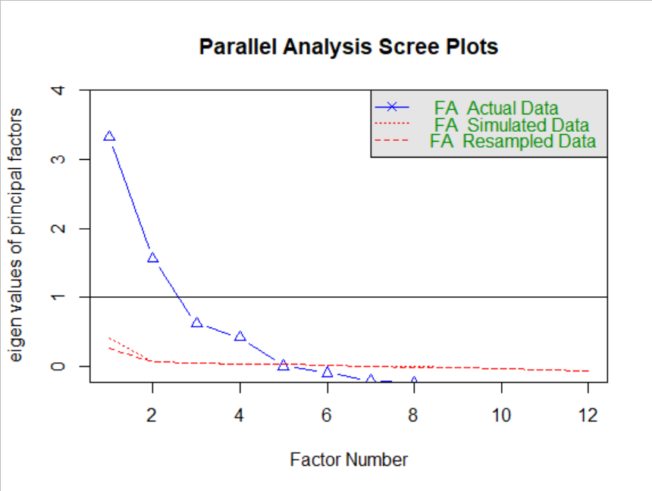
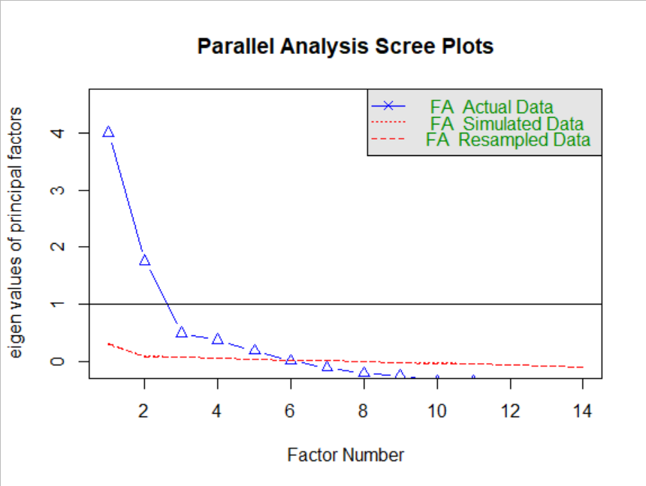
Results of Parallel Analysis:
Cluster 1: Cluster 2:
Cluster 3:
Cluster 1: Parallel analysis suggests that the number of factors = 4
Cluster 2: Parallel analysis suggests that the number of factors = 4
Cluster 3: Parallel analysis suggests that the number of factors = 5
Factor Analysis results:
The analysis was executed by selecting the parameter estimation method ‘maximum likelihood’ and the factor scores are calculated by regression method. For each of the three clusters h2, u2 and com represents the communality, uniqueness and Hoffman’s complexity.

Slide 25
Next three tables represent the proportion of variance explained by the factors for each three clusters. Proportion of variance explained is calculated by subtracting Proportion variance (how much overall variance the factors accounts) from the Proportion variance and dividing it by sum of proportion variances of factors.
Cluster 1:
 | Factor 1 | Factor 2 | Factor 3 | Factor 4
Proportion of Variance Explained | 0.30 | 0.29 | 0.25 | 0.16
Proportion of Variance | 0.19 | 0.19 | 0.16 | 0.10
Cluster 2:
 | Factor 1 | Factor 2 | Factor 3 | Factor 4
Proportion of Variance Explained | 0.21 | 0.30 | 0.20 | 0.29
Proportion of Variance | 0.13 | 0.19 | 0.13 | 0.18
Cluster 3:
 | Factor 1 | Factor 2 | Factor 3 | Factor 4 | Factor 5
Proportion of Variance Explained | 0.23 | 0.19 | 0.16 | 0.27 | 0.15
Proportion of Variance | 0.13 | 0.11 | 0.09 | 0.16 | 0.09

Slide 26
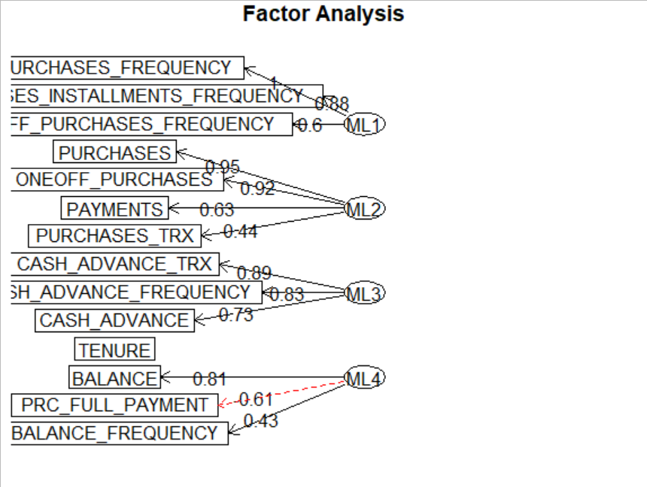
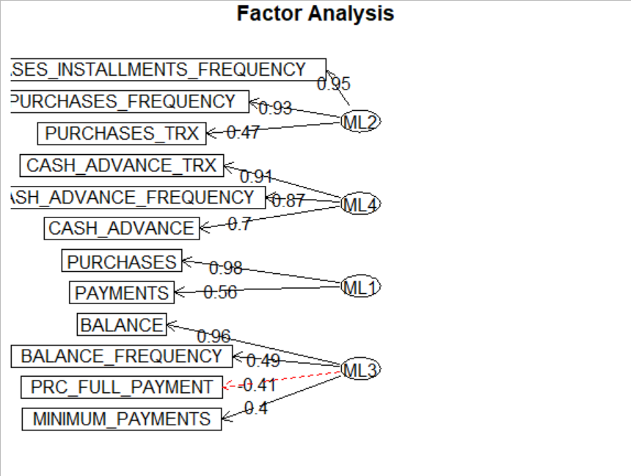
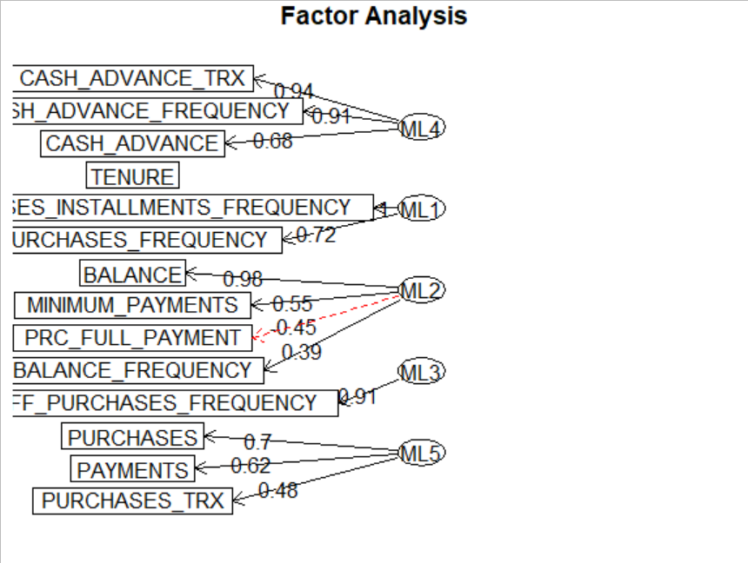
Following diagrams show that how the different factors for each cluster summarizes the features:
Cluster 2
Cluster 3
Cluster 1
Measures of Lack of Fit:
Cluster | Tucker – Lewis Index | RMSEA index | Root Mean Square Residuals | BIC
Cluster 1 | 0.746 | 0.163 | 0.04 | 593.2
Cluster 2 | 0.913 | 0.091 | 0.03 | 775.38
Cluster 3 | 0.906 | 0.084 | 0.03 | 582.67
Here we have chosen the method of maximum likelihood among other alternatives to avoid the Ultra - Heywood problem which makes the loadings of the correlation matrix of features and factors more than 1 plus this method gives us reduction of BIC than any other method. Moreover, it is better than principal component method because it gives us measures of model’s lack of fit which is essential to see how well our model performs.

Slide 27
Conclusion:-
Conclusion From Spectral Clustering:-
The persons belonging to first cluster uses credit card more often and they use this medium for transaction more than other two clusters, moreover they have higher credit limit that two clusters because they purchase through credit card more than other two clusters which is clear by their mean amounts of payments done by credit card or they are the customers who have high salary. Cluster 2 has lowest mean credit card limit and mean payments made by the card is also lowest. People belonging to first cluster tend to withdraw money from the credit limit more than other two clusters which may mean that they use that money for some business purpose and in a requirement of loan. As often the credit card issuing companies have a motive to convince the customers to take loan these customers can be target of the company as part of their business strategy. So the summary of three clusters provide us a good insight about the persons belonging to the different clusters.
Above histograms show that the persons in first cluster have higher credit limit than other two which means that they either have high salary structure, less burden of loan on them proportionate to the salary or they have high CIBIL score than other two clusters. Persons belonging to first cluster frequently purchase through credit card than other two clusters. Around 21.5% people very frequently purchases through installments, the figure is 17.8% and 28.57% for cluster 2 and 3 respectively. Persons of cluster 1 make payments of high magnitude through the card than other two clusters. Moreover total number of transactions are high among persons of cluster 1. Around 69.06% of persons of cluster 1 make 0 to 0.1% of full payments, while for cluster 2 around 70% of people make 0 to 0.1% of full payment. Surprisingly around 90.90% of the people in cluster 3 only makes 0.0 to 0.01% of full payment.
For cluster 1 the third factor 4 can be named ‘Saving Habits’ because it represents good correlation with payments and purchases. Many customer make online payments with credit cards instead of debit cards because of discounts. Second factor can be named ‘Parsimony’ because customers who pay minimum payments every month to avoid penalties and who don’t prepay percent of full payment to avoid additional charges and have a good amount of balance left in card can show this trait due to their financial discipline. Factor 3 represents how frequently customers spends in one go, the factor can be named ‘Cost Effectiveness’ because they may do online shopping in bulk for availing discount. Factor 1 can be named ‘Lack of Affordability’ because it represents installment purchases frequency and purchases. Factor 5 can be named ‘Financial Burden’ they represent cash advance, cash advance frequency and cash advance transaction, if all these three variables are high for some customers it may mean that they use the credit card to pay home loans, car loans etc because through credit cards they can convert large amount of loan money into EMIs.

Slide 28
For cluster 2 the first Factor is named ‘Lack of Affordability’, second factor is named ‘Saving Habits’, third factor is named ‘Parsimony’, fourth factor is named ‘Financial Burden’,
For cluster 3 first factor can be named ‘Lack Of Affordability’. Second factor can be named ‘Financial Discipline’ because it represents that the customers purchase through installments and timely pay minimum amount every month to escape penalty charges and third factor can be named ‘Financial Burden’.
Cluster 1 and cluster 2 have all the factors common except ‘Cost Effectiveness’. Cluster 3 has only Factor 1 and Factor 3 common with other two clusters. The factor ‘Financial Burden’ is intense in persons of cluster 2 because the loading of cash advance frequency is highest for this cluster. The factor ‘Lack of Affordability’ may have deeper effect on cluster 1 as the loading of installment purchase frequency is high for this cluster. The ‘Saving Habits’ of cluster 1 and 2 are nearly same as the loadings i.e correlation of the factors with payments through credit cards are close. Persons of Cluster 1 looks more parsimonious as the loadings of Balance and Minimum Payments are higher than cluster 2 though percent of full payment is close for both cases, moreover loading corresponding to balance update frequency is very low for cluster 1 which means their balance is updated few times because they tend to spend less in comparison to cluster 2.
Persons in first clusters have high balances and cash advances with low purchase frequency and high credit limit, which are evident from summary and histogram. These customers use credit cards as loans it will be wise to offer them ‘Business Credit Cards’. Persons in second cluster are spenders with low purchases . Our strategy will be to offer them ‘Rewards Credit Cards’ or ‘Cashback Credit Cards’ to influence their spending habits. Persons in cluster 3 have medium balances and moderate purchase frequency with moderately high credit limit. The credit card issuing company may instigate their spending habits by increasing their credit limit. ‘Low Interest Credit Cards’ often offer high credit limits with low interest rate on what a person spend that’s why card holders may make transactions of high purchase. This may increase the purchases of the persons of this cluster from ‘moderate’ to ‘high’.

Slide 29
Conclusion from Kernel k-Means:-
Summary of different clusters corresponding to important characteristics of the customers:-
Variables | Cluster 1 | Cluster 2 | Cluster 3
Balance | 5408.9 RS. is the Mean balance amount left for use. | 777.8 RS. is the Mean balance left for use. | 1945.2 RS. is the Mean balance left for use.
Purchases | 3832.9 Rs. is the mean amount spent in purchases. | 485.8 Rs. is the mean amount spent in purchases. | 1174.1 Rs. is the mean amount spent in purchases.
ONEOFF_PURCHASES | 2547.1 Rs. Is the mean Amount of purchase done in one-go. | 229.9 Rs. Is the mean Amount of purchase done in one-go. | 710.4 Rs. Is the mean Amount of purchase done in one-go.
Frequency | 0.599 is the mean purchase frequency, 0.386 is the mean One-off purchase frequency and 0.464 is the installment purchase frequency. | 0.453 is the mean purchase frequency, 0.124 is the mean One-off purchase frequency and 0.350 is the installment purchase frequency. | 0.537 is the mean purchase frequency, 0.289 is the mean One-off purchase frequency and 0.373 is the installment purchase frequency.
PURCHASES_TRX | 40.2 is the mean number of purchase transactions made. | 9.3 is the mean number of purchase transactions made. | 17.8 is the mean number of purchase transactions made.
CREDIT_LIMIT | 11000 Rs is the median credit limit. | 1800 Rs is the median credit limit. | 6000 Rs is the median credit limit.
PAYMENTS | 7228.08 Rs. is the mean amount of payment done. | 866.5 Rs. is the mean amount of payment done. | 1873.4 Rs. is the mean amount of payment done.
PRC_FULL_PAYMENT | 15.1 % is the mean percentage of full payment. | 15.2 % is the mean percentage of full payment. | 17.2 % is the mean percentage of full payment.

Slide 30
Cluster 1 has the smallest size among all the clusters. The persons belonging to cluster 1 uses the credit card for purchases more often than the other two clusters with higher credit balance and using cards with higher credit limits. We can assume that this Customer segment uses credit card for business purpose or for loan. Cluster 2 has the minimum purchase record among these subpopulations with credit limit much lower than the other two. Persons of cluster 2 is quite inclined towards installment purchase compared to one-off purchases which indicates that they might have a low salary compared to other customer segments. Persons of cluster 3 use credit cards moderately. The credit limit and the number of transactions is lower than cluster 1 but higher than cluster 2. The summary of three clusters provides us a great insight of the customer segmentation from the point of view of the companies.
Cluster 1: Factor 1 of cluster 1 includes the frequency measures of the purchases, so we can name it as ‘Purchase regularity ‘. The second factor of cluster 1 includes the factors related to purchase amount and one-off purchase amount. So, this factor mainly indicates how much one customer is likely to spend in one go or for any purchase. We can name this factor as ‘Impulsive spending’. Factor 3 includes all the term related to Cash Advance. This might happen due to regular requirement of physical money which is an indication of offline spending. So, this factor can be named as ‘Cash requirement ‘. Factor 4 deals is related to the features of maintaining the credit card account. This factor can be named as ‘Account maintenance’.
Cluster 2: The first factor includes Purchases and Payments. This indicates the amount of money getting used with the help of Credit Card. So this factor can be named as ‘Amount of Expenditure’. The second factor is named as ‘Purchase regularity’. The third factor is named as ‘Account maintenance’. Factor 4 can be named as ‘Cash requirement’.

Slide 31
Cluster 3: The first factor includes the terms Purchases Installments frequency and purchases frequency. This indicates that the persons are regularly purchasing things in installments which indicated their financial constraints. So this factor can be named as ‘Lack of Affordability’. The second factor is named as ‘Account maintenance’. The third factor includes the frequency of One-off purchases. In this case the customers are probably are using the credit card for online shopping to avail some offers or discounts. This factor can be named as ‘Credit benefits’. Factor 4 can be named as ‘Cash requirement’. Factor 5 can be named as ‘Amount of Expenditure’.
In terms of ‘Purchase regularity’, persons of cluster 1 can be considered as the most regular spender as they might be using the card for some business purposes and the persons of cluster 2 are the least regular spenders as they might be suffering from low salary or some financial constraints and they are mostly inclined towards installment purchases. This also suggests that persons of Cluster 2 are most influenced cluster by the factor ‘Lack of Affordibility’. Persons of Cluster 1 has the tendency of ‘Impulsive spending’. Persons of cluster 1 uses the credit card for cash withdrawal more than the persons of other clusters. As the persons of first cluster are the most frequent users of the Credit card, they are usually most concerned about Account maintainance. Persons of cluster 3 are mostly balanced spenders. They make one-off purchases for availing discounts and also they also make payments in Installments for ‘Lack of Affordability’.
Persons in first clusters have high balances and cash advances with high purchase frequency and high credit limit. These customers use credit cards for business purposes. it will be wise to offer them ‘Business Credit Cards’. Persons in second cluster are spenders with low purchases and usually make payments in installments. Our strategy will be to offer them ‘Low Interest Credit Cards’ which might help them to make more purchases without having fear of high interest and debts. Persons in cluster 3 have medium balances and moderate purchase frequency with moderately high credit limit. The credit card issuing company may instigate their spending habits by offering them ‘Rewards Credit Cards’ or ‘Cashback Credit Cards ’or ‘Lifestyle credit cards’.

Slide 32

Thank You!

