Slide 1


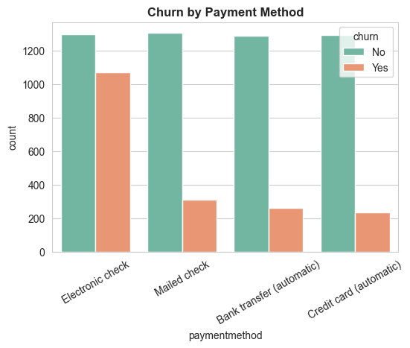
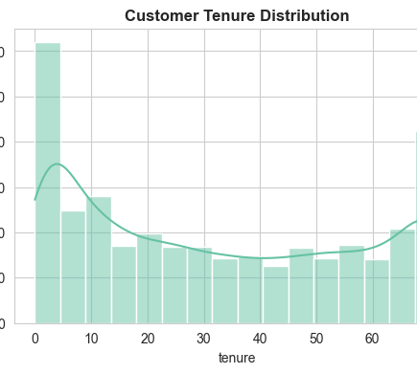
Customer Churn Analysis
End-to-End Data Analytics Case Study
Tools: SQL | Python | Power BI
Focus: Customer Retention & Business Insights

Slide 2
Business Problem
High customer churn reducing revenue
Lack of visibility into churn drivers
Goal: Identify patterns & reduce churn

Slide 3
Dataset Overview
7000+ customers
Features: Demographics, Services, Billing
Target Variable: Churn (Yes/No)
Dataset represents telecom customer behavior and subscription patterns

Slide 4
Data Pipeline
Raw Data → SQL Cleaning
KPI Calculation & Churn Analysis
Python EDA & Feature Engineering
Power BI Dashboard

Slide 5

Key KPIs
Churn Rate: 26.5%
Retention Rate: 73.5%
Total Revenue: 16M+
ARPU: 64.76

Slide 6
Key Insights
Month-to-month customers show highest churn (~40%+)
New users (low tenure) are high risk
Electronic check users show higher churn
Fiber optic users have higher churn

Slide 7

Advanced Insights
High-value customers are at risk → potential revenue loss
Lack of service bundling increases churn
Long-term contracts reduce churn significantly

Slide 8
Dashboard Overview
Interactive Power BI dashboard
Segment-based filtering (contract, payment, tenure)
Real-time business insights

Slide 9
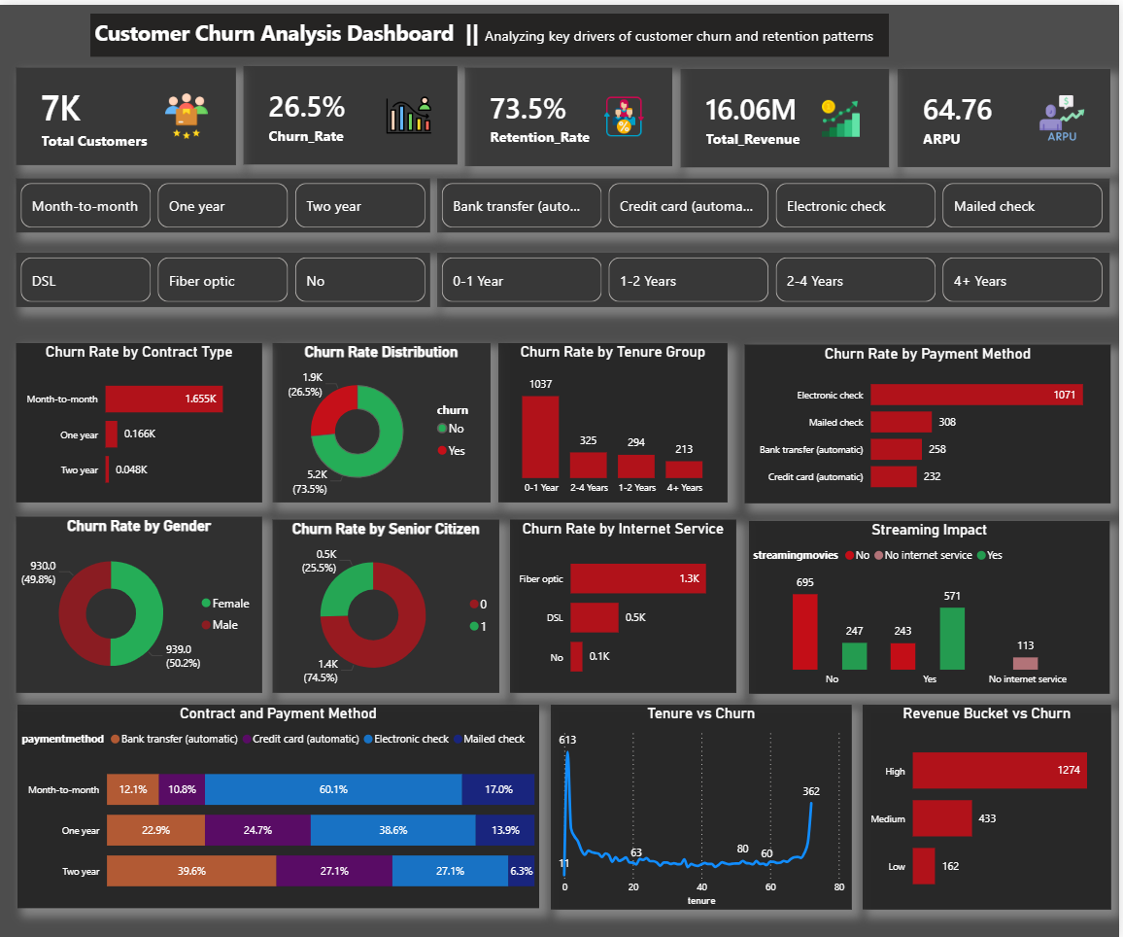
Customer Churn Analysis Dashboard
Designed using Netflix-inspired dark theme for better visual storytelling

Slide 10
Business Recommendations
Promote long-term contracts
Improve onboarding for new users
Target high-risk users with offers
Enhance customer support services

Slide 11
Conclusion
Data-driven decisions can reduce churn
Improves customer retention and drives revenue growth
Scalable solution for business teams
This project demonstrates end-to-end analytics including data cleaning, feature engineering, visualization, and business decision-making.

