Slide 1
Time Optimal Gathering of Myopic Robots on an Infinite Triangular Grid
Pritam Goswami, Avisek Sharma, Satakshi Ghosh and Buddhadeb Sau
Jadavpur University, Kolkata-700032,India

Slide 2
Outline
Introduction
Problem Definition and Background
Our Contribution
Algorithm Overview
Conclusion

Slide 3
Introduction
Robot Swarm: A collection of small inexpensive, homogeneous robots that can do a specific task collaboratively by following one distributed algorithm.
Example of some task: Arbitrary Pattern Formation, Gathering, Dispersion etc.
Goal of Research: To find the minimal capabilities robots should have to do a specific task.

Slide 4

Outline
Introduction
Infinite Triangular Grid

Slide 5
Introduction
Myopic Robots
V
Myopic robot on Plane having visibility radius V
Myopic robot on grid having visibility range of 2-hop

Slide 6
Introduction
What is Gathering Problem for a robot swarm?
Some gathering Algo

Slide 7
Introduction
Now the question is
Can we design a gathering algorithm with myopic robots on an infinite triangular grid?
If yes then,
what are the minimal capabilities the robots shall have?

Slide 8
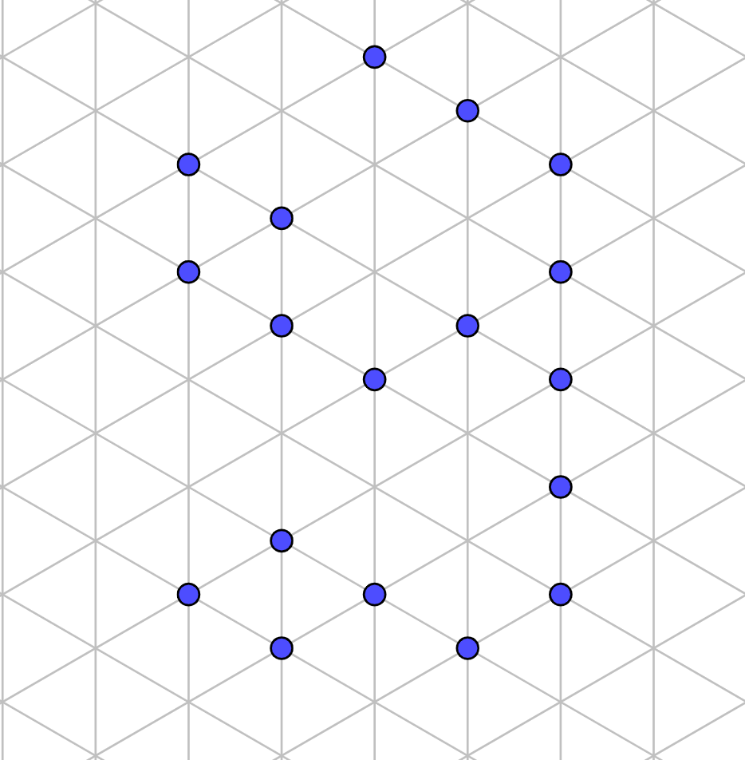
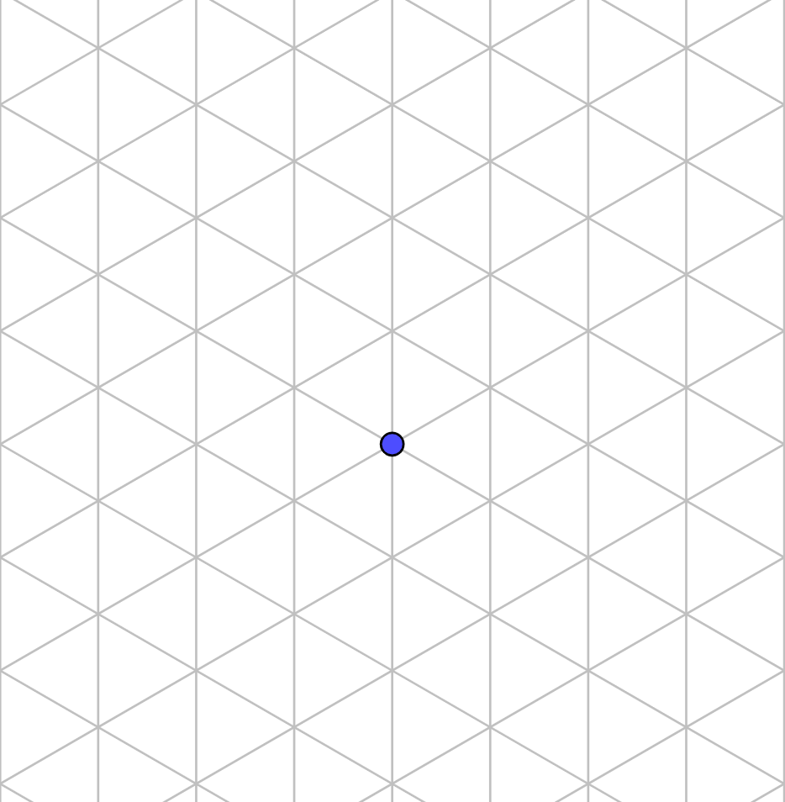
Problem Definition
n robots are on the vertices of an infinite triangular grid.
The robots have k-hop vision.
Initially the visibility graph is connected.
Algorithm A

Slide 9
Lets look into some works that motivated us to solve this problem.

Slide 10
Background
In [CFPS03]¹, authors showed that gathering is possible from any configuration for more than 2 robots on plane and provided an algorithm for a swarm of k robots (k>4) it.
In [KMP08]², Klasing et al. provided algorithms for gathering on a ring from some feasible configurations. He also showed that without multiplicity detection it is impossible to gather on a ring.
In [DDKN16]³ authors has provided a distributed algorithm for gathering on a grid without multiplicity detection.
Note that none of these works work if the robots are myopic !

Slide 11

Background
Limitation of non myopic Robots
A
B
$$∞$$

Slide 12
Background
So naturally Researchers studied gathering considering myopic robots.
In [FPSW05]¹, Flocchini et al. provided an gathering algorithm on plane with Oblivious and silent and myopic robots having two axis agreement.
In [KLOT+19]², Kamei et al. showed that in a ring Gathering is possible for some initial configuration for robots having visibility = 1 or 2 hop with 4 or 3 colours.
In [PS21]³ authors have provided two algorithms for gathering on infinite grid
        Robots gather with 2 hop vision under two axis agreement.
        Robots gather (relaxed gathering configuration) with 3 hop vision and one axis agreement.

Slide 13
Background
Considering Infinite triangular grid,
In [CDDN21]¹, authors have provided an algorithm for arbitrary pattern formation that allows multiplicity points in target configuration. So this algorithm is capable of gathering on an infinite triangular grid.
But this work did not considered myopic robots !

Slide 14
Now the question is what is the minimal capabilities the robots should have to solve this problem ?

Slide 15
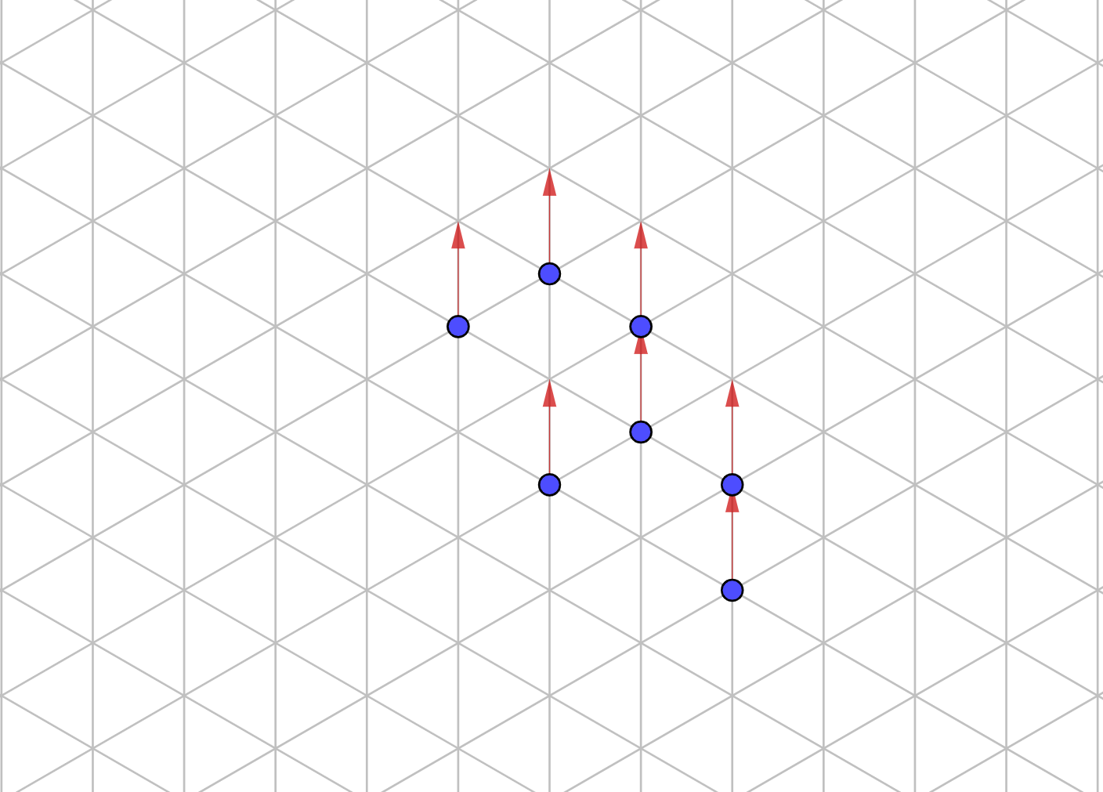
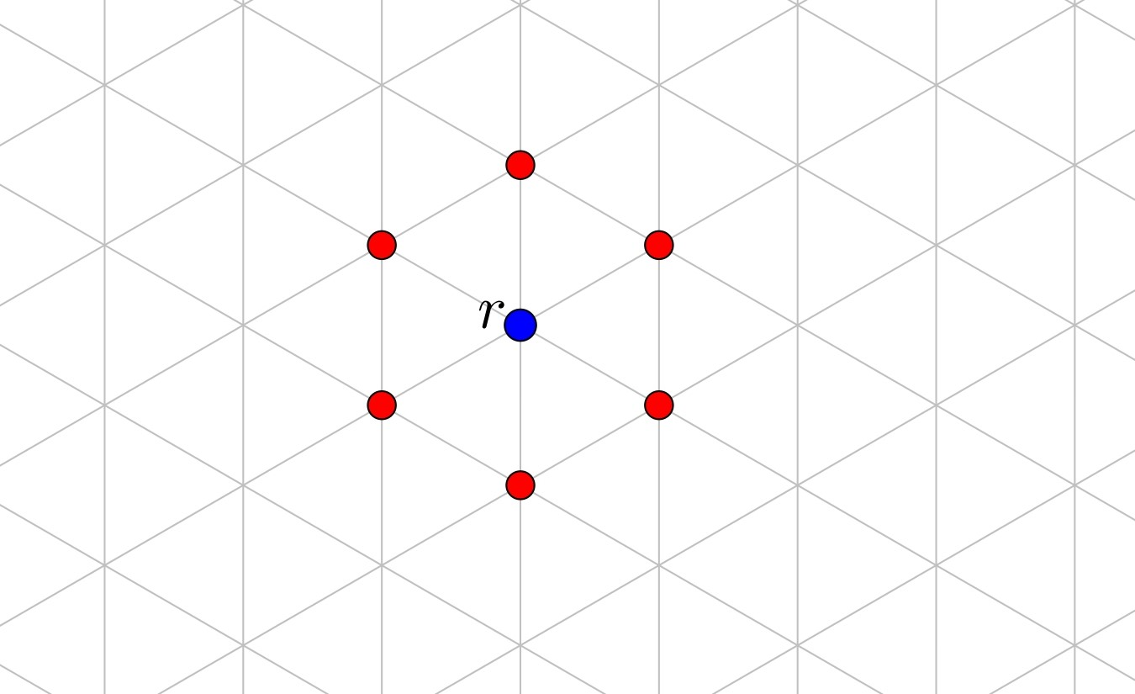
Model
Autonomous:
Anonymous:
Homogeneous:
Identical:
Oblivious:
Silent:
No central Control.
No unique Identifier.
Runs same algorithm.
Physically indistinguishable.
No memory to remember past steps.
No communication
OBLOT
Dimensionless:
1-Hop Visibility:
One-Axis Agreement:
Robots are points
Only sees neighboring vertices.
Agree on
direction of any one line that generates the triangular grid
an orientation along it.
considers it as direction of positive Y-axis.

Slide 16
Model
Look
Move
Compute

Slide 17
Model
Takes a snapshot of the positions of all the robots it sees.
Look
Move
Compute

Slide 18
Model
Look
Performs
computations
according to a
deterministic
algorithm to
decide a
destination
Move
Compute

Slide 19
Model
Look
Move
Compute
Moves to the computed
destination

Slide 20
How robots are activated?
Or
Who controls the activation?
Scheduler

Slide 21
Scheduler
Fully-Synchronous (FSYNC) Scheduler
Time is divided into rounds of equal lengths.
In the beginning of each round all of robots get activated and perform LCM cycle synchronously.
Activated
Activated
Activated
Activated
Activated
Fig: The activated robots perform LCM in a given round. They Look together, Compute together and Move together.

Slide 22
Scheduler
Semi-Synchronous (SSYNC) Scheduler
Time is divided into rounds of equal lengths.
In the beginning of each round a subset of robots get activated and perform LCM cycle synchronously.
Idle
Activated
Activated
Activated
Idle
Fig: Only the activated robots perform LCM in a given round. They Look together, Compute together and Move together.

Slide 23
Scheduler
Asynchronous (ASYNC) Scheduler
There is no sense of global rounds.
The amount of time spent in Look, Compute, Move or the idle state is different and unpredictable for different robots.
Idle
Look
Move
Compute
Idle

Slide 24
Our Contribution
We have two Contributions,
One-axis agreement is necessary and sufficient to gather point robots with
      OBLOT Model
      1-Hop Visibility
  on an infinite triangular grid under semi synchronous scheduler.
The algorithm “1-Hop 1-Axis Gather” provided for the sufficiency part is time optimal.

Slide 25
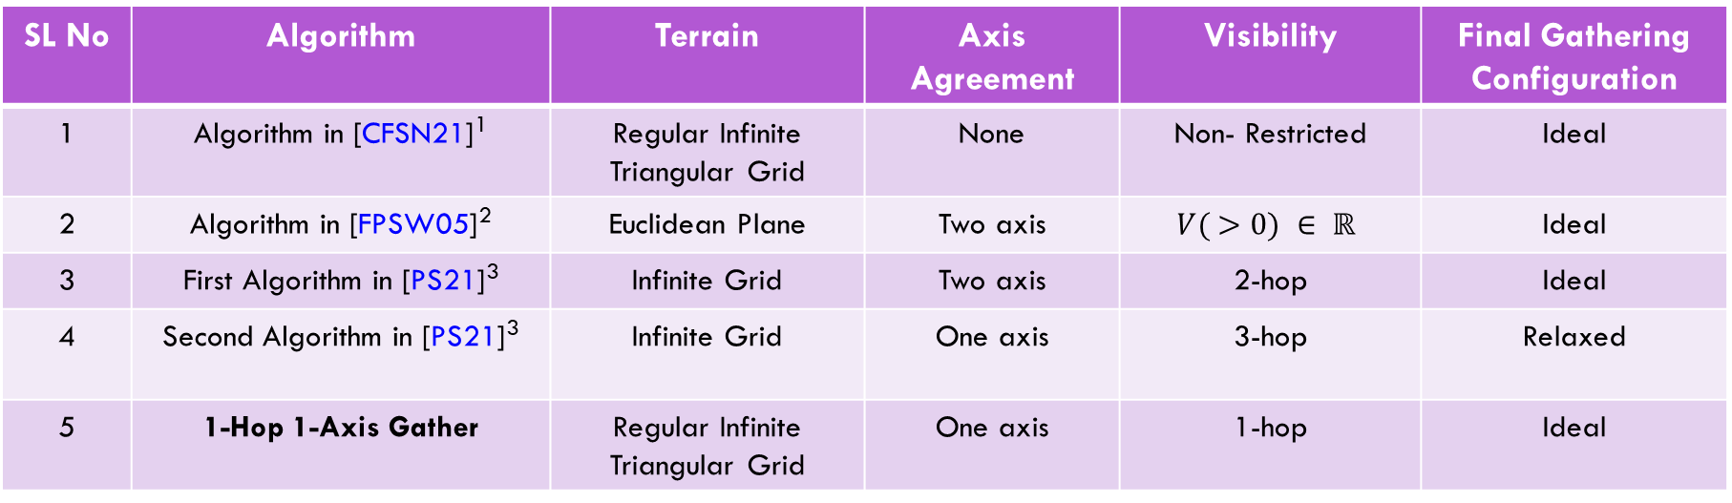
Comparison With Other works
SL No | Algorithm | Terrain | Axis Agreement | Visibility | Final Gathering Configuration
1 | Algorithm in [CFSN21]¹ | Regular Infinite Triangular Grid | None | Non- Restricted | Ideal
2 | Algorithm in [FPSW05]² | Euclidean Plane | Two axis | $$V( >0) ∈ ℝ$$ | Ideal
3 | First Algorithm in [PS21]³ | Infinite Grid | Two axis | 2-hop | Ideal
4 | Second Algorithm in [PS21]³ | Infinite Grid | One axis | 3-hop | Relaxed
5 | 1-Hop 1-Axis Gather | Regular Infinite Triangular Grid | One axis | 1-hop | Ideal

Slide 26
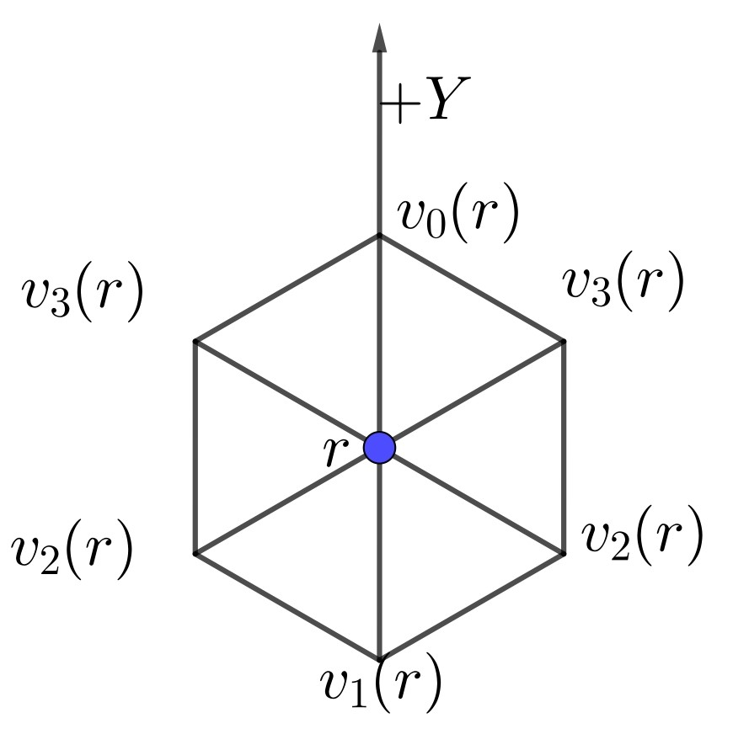
Algorithm Overview: Preliminaries
Robot r sees 6 vertices with 4 different Y-coordinate values of -1, -0.5, 0.5 and 1.

Slide 27
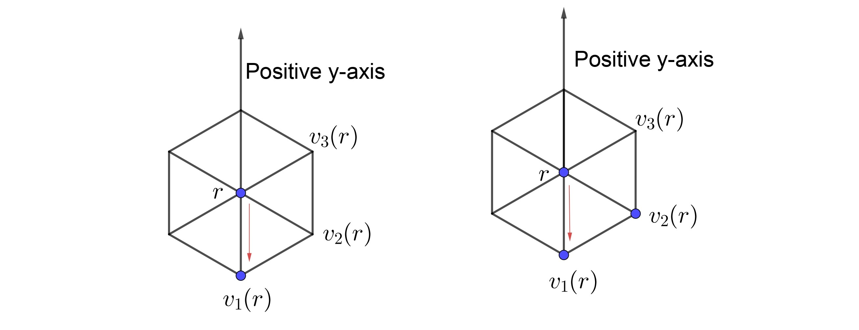
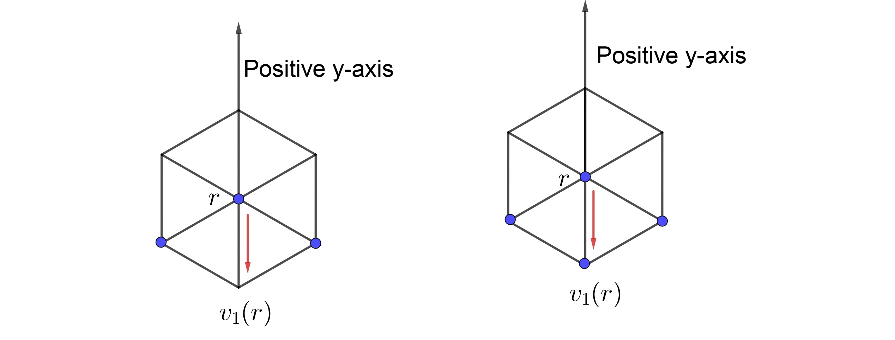
Algorithm Overview

Slide 28
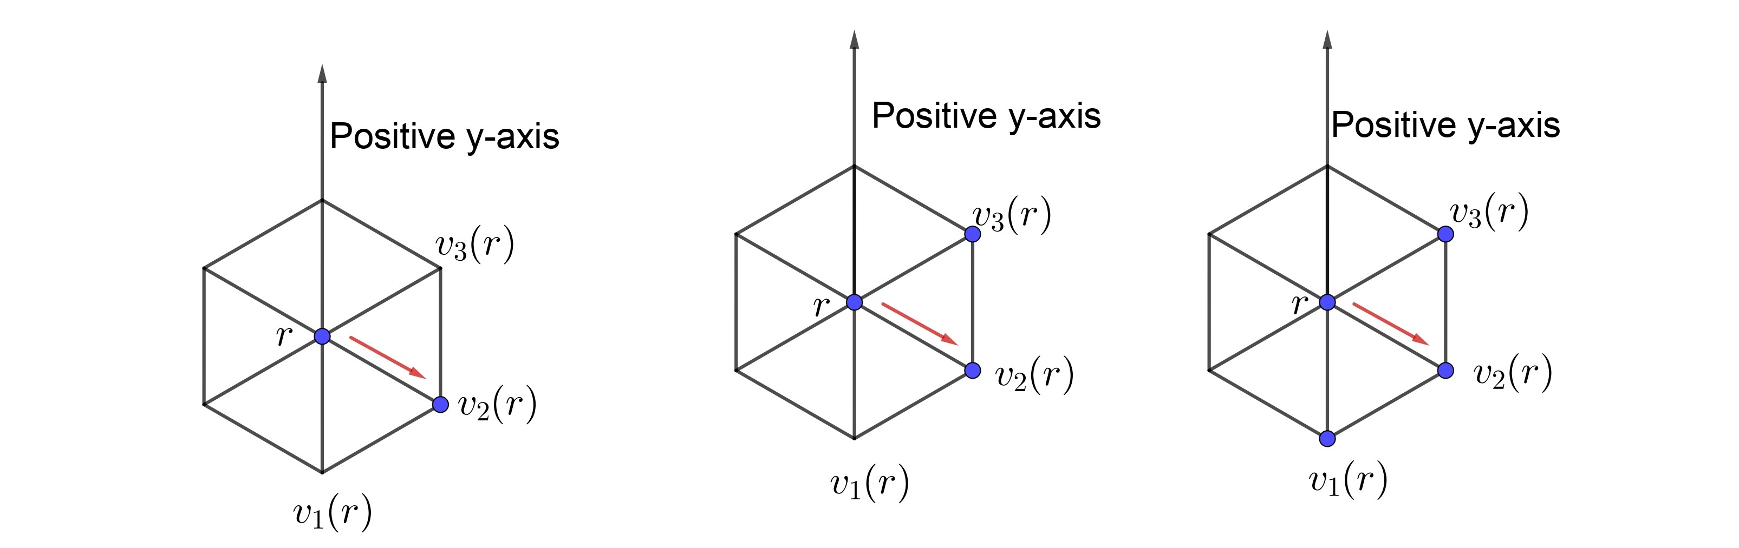
Algorithm Overview

Slide 29
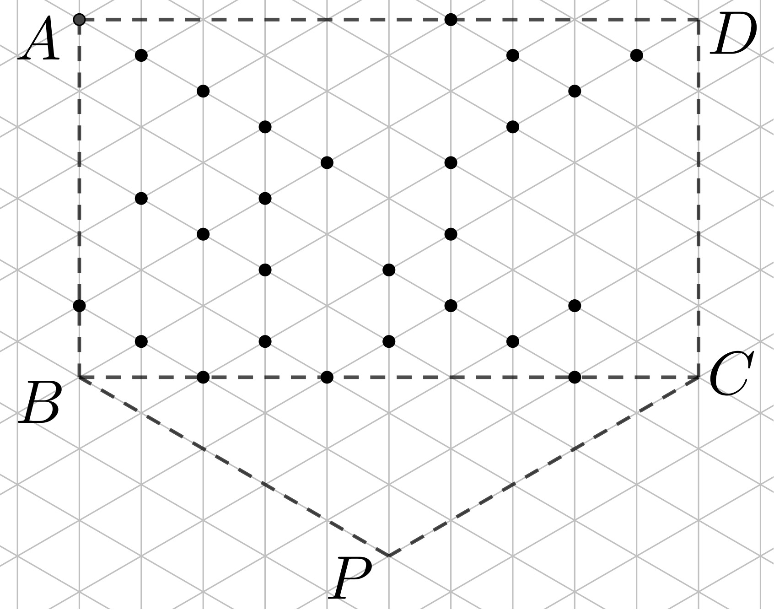
Correctness Overview
Lemma 1 Visibility graph remains connected.
Lemma 2 Top layer shifts down always in one epoch.
Lemma 3 No robot ever goes out of the bounding polygon.
If already not gathered,
  By Lemma 2: in 2(length of AB+ Height of Δ CBP) epoch top layer contains single vertex (i.e, P).
  By Lemma 3: all robots must be on P.

Slide 30
Correctness Overview
Theorem 1
Algorithm 1-Hop 1-Axis Gather guarantees that there exists a round t>0 such that a swarm of n myopic robots on an infinite triangular grid G with 1-hop visibility and one axis agreement will always gather after completion of round t under semi-synchronous scheduler starting from any initial configuration for which visibility graph G_{c} is connected.
Theorem 2
The algorithm 1-hop 1-axis Gather takes at most O(n) epochs to gather all the robots.
Theorem 3
Any gathering algorithm on a triangular grid takes Ω(n) epoch.

Slide 31
Conclusion
In Conclusion,
One-axis agreement is necessary an sufficient for gathering OBLOT point robots having 1-Hop vision on an infinite triangular grid.
Algorithm designed to show the sufficiency part is time optimal.
For future course of research,
Considering Asynchronous Scheduler.
Designing a collision less gathering algorithm (i.e., Collision is accepted only at the gathering vertex) with k-hop vision (k>1).
Finding certain class of configuration for which axis agreement may not be necessary.

Slide 32
Thank You

