Slide 1



MAJOR PROJECT
NSHM COLLEGE OF MANAGEMENT & TECHNOLOGY
Group Members
Soham Mukherjee
Srishti Karmakar
Pritam Banerjee
Roll no: 23478123013
Roll no: 23478123019
Roll no: 23478123026

Slide 2
AI-Powered Career Development with Smart Resume Analysis

Slide 3
Introduction
In today’s rapidly evolving job market, individuals struggle to keep up with changing skill requirements and industry expectations, making career planning more complex than ever.
Existing career guidance systems are often rule-based and lack the intelligence to offer personalized, actionable insights based on a candidate’s unique profile.
This project introduces an AI-powered platform that uses advanced language models and retrieval-based agents to analyze resumes, identify skill gaps, and recommend targeted learning pathways through an interactive chatbot interface.

Slide 4
Problem Statement
Traditional resume screening systems rely heavily on keyword matching and static rule-based filters, often missing out on capable candidates due to poor semantic understanding.
They lack the ability to identify skill gaps, offer learning suggestions, or adapt to the ever-evolving demands of the job market.
As a result, candidates are left with limited guidance, unclear pathways for improvement, and generic feedback that fails to support meaningful career development.

Slide 5
Resume Parsing Extract user data using AI models
01
Project Objectives
Skill Gap Analysis Compare profile with industry demands
02
This AI-driven system follows a structured four-step pipeline — from intelligent resume parsing to real-time skill gap analysis, personalized learning path generation, and interactive chatbot-based career guidance — ensuring tailored support at every stage of a candidate’s career journey.
Learning Path Generation Recommend personalized courses & content
03
Chatbot Guidance Interactive, resume-aware career help
04

Slide 6


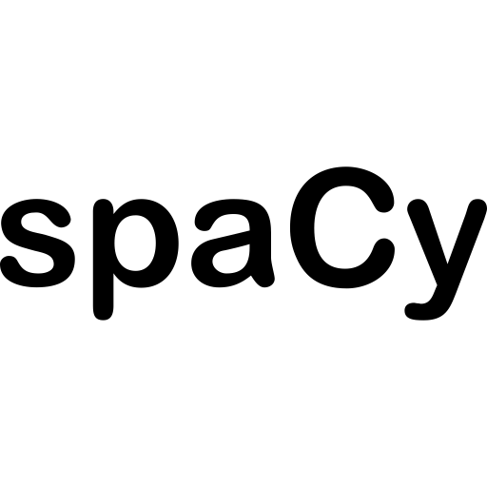

Core Technologies Used
LangGraph
Google Gemini
Spacy
HuggingFace
A powerful framework for orchestrating multi-agent workflows with memory and state control.
An advanced multimodal language model used for semantic understanding and personalized guidance.
An industrial-strength NLP library for fast and accurate text processing and entity extraction.
A vast collection of pre-trained language models used for embeddings, classification, and more.

Slide 7

Key Features / Modules
Resume Parsing & Validation
ATS Scoring System
Uses AI to extract structured information from resumes across formats like PDF and DOCX, ensuring clean, usable input for further analysis.
Matches resumes against job descriptions using semantic similarity, keyword relevance, and skill alignment to compute a compatibility score.
Skill Gap Detection & Learning Recommendations
Interactive Career Chatbot
A resume-aware chatbot powered by RAG (Retrieval-Augmented Generation) that provides personalized career guidance using LangGraph and Gemini.
Compares extracted skills with current job market demands and recommends targeted learning content from platforms like Coursera and YouTube.

Slide 8
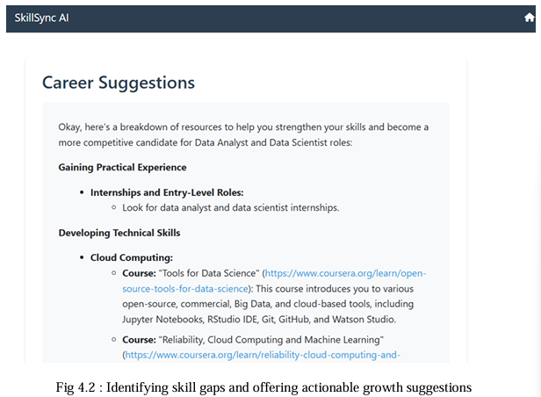
Skill Gap & Learning Recommendations
The system compares the user's extracted skills with the skills required for selected job roles using real-time data from job listings and industry benchmarks.
Based on the identified gaps, it fetches curated learning materials like YouTube tutorials, Coursera courses, or documentation that directly address missing competencies.
Recommendations are ranked based on relevance, difficulty level, and credibility, ensuring the user receives personalized, actionable learning paths.

Slide 9
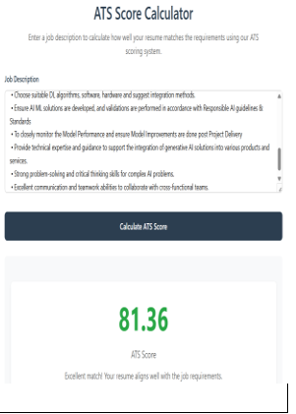
ATS Scoring System
Uses the MiniLM-L6-v2 model to generate dense embeddings for resumes and job descriptions, enabling precise semantic matching.
Applies spaCy-based tokenization, lemmatization, and cleaning to standardize inputs for improved embedding accuracy.
Combines semantic similarity , skill matching and keyword matching to compute a comprehensive compatibility score.
Provides detailed feedback on matched skills and keywords to help candidates improve their resumes effectively.

Slide 10
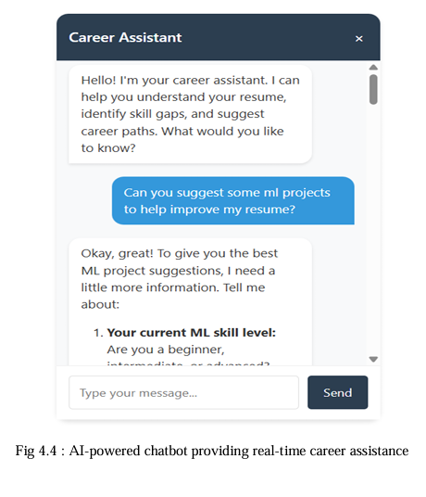
Chatbot Interface
The system includes a context-aware chatbot that leverages the user's parsed resume data to provide personalized career guidance in real time.
It uses LangGraph to orchestrate memory-aware multi-agent workflows and integrates FAISS for efficient retrieval of relevant resume and job context.
The chatbot can handle queries related to skill improvement, job readiness, missing qualifications, and recommended next steps — making it an interactive, intelligent companion in the career journey

Slide 11

Limitations
API & Platform Constraints
Recommendation Subjectivity
Limited API quotas and changing policies on platforms like Coursera or YouTube can restrict learning resource access.
Despite data-driven efforts, suggestions may still reflect subjective bias when multiple valid options exist.
ATS Scoring Limitations
Tool Selection Challenges
The system focuses solely on IT resumes and does not consider work experience, CV formatting, or structural layout in the scoring process.
Suboptimal tool choices by the agent can reduce task effectiveness, even when better tools are available.

Slide 12
Conclusion
This project presents a comprehensive AI-powered solution that bridges the gap between resume analysis, skill assessment, and personalized career development. By combining advanced language models, real-time industry data, and interactive chatbot support, the system empowers users to identify their strengths, improve on weaknesses, and make informed career decisions.It not only enhances the traditional job application process but also acts as a proactive guide in an individual's upskilling journey — adaptable, intelligent, and truly user-centric.

Slide 13
Thank you!

