Slide 1



UNIVERSITY CERTIFICATION PROJECT
AI Product Manager using OpenAI Agents SDK
A Multi-Agent AI System that automates product management workflows — from customer feedback analysis to sprint planning — through intelligent agent collaboration.
Student: Pritam Chhetri | Course: Summer Internship IIT JAMU
Speaker Notes: This project demonstrates how the OpenAI Agents SDK enables multi-agent collaboration to automate complex product management workflows. The presentation will cover the problem, architecture, agents, tools, memory management, and results.
Notes:
1

Slide 2


PROBLEM STATEMENT
The Product Manager's Workload is Overwhelming
Product managers juggle multiple high-stakes tasks daily — analyzing customer feedback, researching competitors, prioritizing features, writing PRDs, and planning sprints. These activities consume hours of focused effort and are prone to inconsistency.
⏱ Time-Intensive
🔀 Fragmented Tools
Manual research and analysis consume significant time that could be spent on strategy.
Teams use disconnected tools, leading to information silos and missed insights.
⚡ Need for Speed
Competitive markets demand faster decision-making without sacrificing quality.
Speaker Notes: Emphasize the pain points product managers face daily. The manual nature of feedback analysis, competitor research, and PRD writing creates bottlenecks. This system introduces AI agents to handle these tasks collaboratively and efficiently.
Notes:
2

Slide 3


PROJECT OBJECTIVES
What We Set Out to Build
This project defines six clear objectives to demonstrate the power of multi-agent AI systems in a real-world product management context.
1
2
Automate Workflow
Multi-Agent System
End-to-end automation of the product management pipeline from feedback to sprint plan.
Deploy multiple specialized AI agents, each with a distinct role and responsibility.
3
4
Shared Memory
Agent Collaboration
Implement a shared memory layer enabling agents to access and update collective context.
Agents pass structured outputs sequentially, building on each other's work.
5
6
Structured Outputs
Human Approval
Generate well-formatted, actionable documents including PRDs and sprint plans.
Insert human-in-the-loop checkpoints before critical strategic decisions are finalized.
Speaker Notes: Walk through each objective. Highlight that human approval is a deliberate design choice — AI assists, but humans retain control over strategic decisions. Shared memory is the key enabler for agent collaboration.
Notes:
3

Slide 4




TECH STACK
Technologies Used
OpenAI Agents SDK
Architecture Pattern
Core framework for building, orchestrating, and managing AI agents with built-in memory and tool support.
Multi-Agent Architecture with sequential handoffs and a shared memory bus. Each agent operates as an independent unit while contributing to a unified product planning pipeline.
TypeScript + Node.js
Type-safe backend runtime ensuring reliable, maintainable agent logic and API integrations.
The architecture ensures loose coupling between agents while maintaining strong data consistency through the shared memory layer.
Zod + dotenv
Zod provides runtime schema validation for structured outputs; dotenv manages environment configuration securely.
Shared Memory Architecture
A centralized memory store allowing all agents to read, write, and reference shared product context.
Speaker Notes: The OpenAI Agents SDK is the centerpiece — it provides agent orchestration, memory management, and tool calling out of the box. TypeScript and Zod ensure type safety and output validation. Shared memory is what makes multi-agent collaboration possible.
Notes:
4

Slide 5
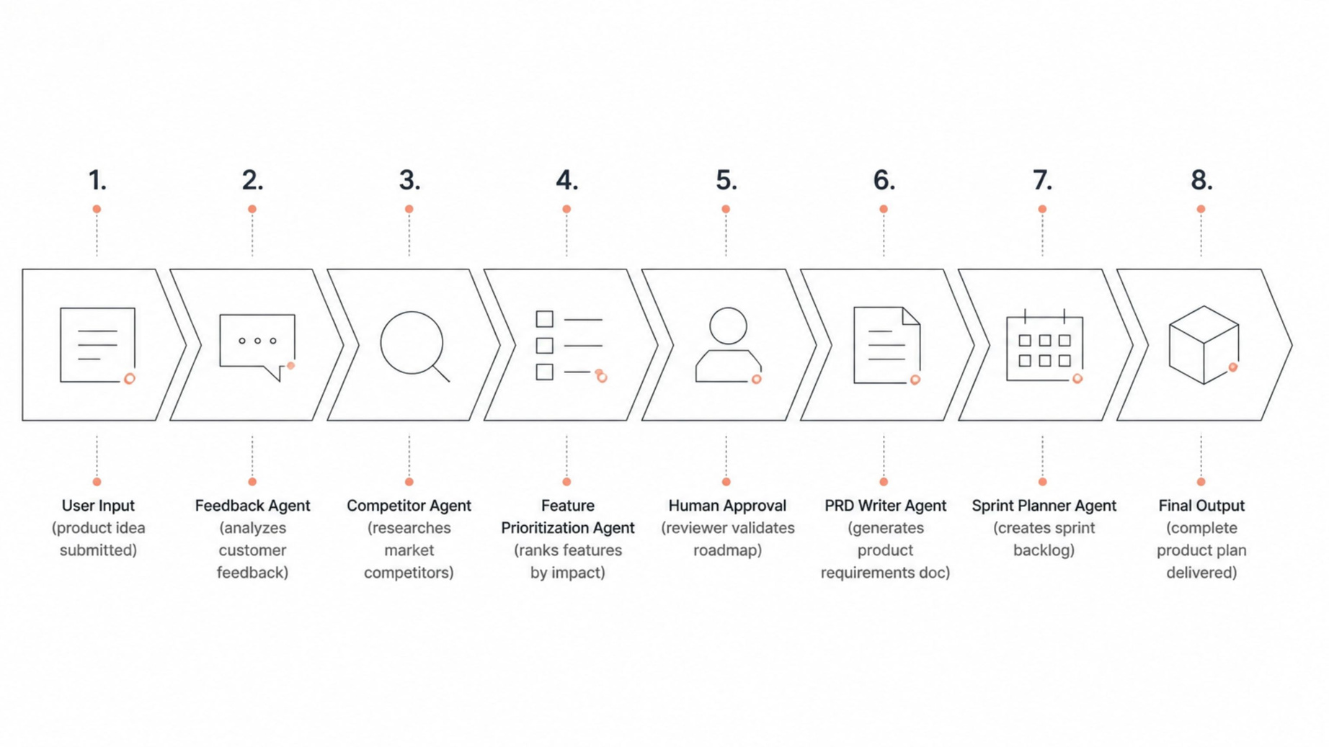
SYSTEM ARCHITECTURE
End-to-End Agent Workflow
Notes:
5

Slide 6

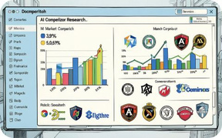
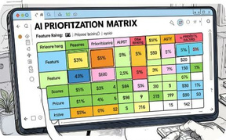

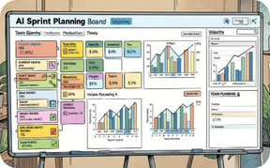
AI AGENTS
The Five Specialized AI Agents
Each agent has a focused role, a defined set of tools, and produces structured output consumed by downstream agents.
Feedback Analysis Agent
Competitor Research Agent
Feature Prioritization Agent
PRD Writer Agent
Processes raw customer feedback, identifies recurring themes, and extracts actionable insights using sentiment analysis.
Researches competing products, analyzes feature gaps, and identifies market opportunities and threats.
Combines feedback insights and competitor data to rank features using RICE or MoSCoW scoring frameworks.
Generates a structured Product Requirements Document including problem statement, user stories, and acceptance criteria.
Sprint Planning Agent
Breaks the PRD into sprint-sized tasks, estimates effort, and generates a prioritized sprint backlog ready for execution.
Speaker Notes: Each agent is a specialist. The Feedback Agent handles qualitative data, the Competitor Agent handles market intelligence, and the Prioritization Agent synthesizes both. The PRD Writer and Sprint Planner translate strategy into execution-ready artifacts.
Notes:
6

Slide 7

TOOLS & MEMORY
Tools & Shared Memory Layer
Five Core Tools
Shared Memory Contents
Customer Feedback Tool
All agents read from and write to a unified memory store, ensuring consistent context across the pipeline.
Fetches and parses customer feedback from surveys, reviews, and support tickets.
📦 Product Idea
💬 Feedback Insights
Competitor Research Tool
Queries market data sources to gather competitor feature sets and positioning.
🏆 Competitor Analysis
🗺️ Roadmap
Shared Memory Tool
Read/write interface for agents to access and update the shared product context.
📄 PRD
📋 Sprint Plan
Roadmap Generator Tool
Formats prioritized features into a structured, time-phased product roadmap.
Human Approval Tool
Pauses execution and surfaces decisions for human review before proceeding.
Speaker Notes: Tools are the interfaces agents use to interact with the external world and each other. Shared memory is the backbone — it stores every artifact produced during the pipeline, making context available to all agents at any stage.
Notes:
7

Slide 8

SAMPLE EXECUTION
System Output: From Input to Sprint Plan
The following represents the structured outputs generated at each stage of the pipeline when processing a sample product idea.
📊 Feedback Analysis Output
🔍 Competitor Analysis Output
🗺️ Product Roadmap Output
Identified top 5 user pain points with sentiment scores and frequency metrics. Key theme: onboarding friction cited by 68% of respondents.
Compared 4 competing products across 12 feature dimensions. Gap identified: no competitor offers AI-assisted onboarding workflows.
Generated a 3-phase roadmap: Phase 1 (Core Onboarding), Phase 2 (AI Assistant), Phase 3 (Analytics Dashboard). Each phase includes success metrics.
📄 PRD Output
📋 Sprint Plan Output
Full PRD with problem statement, target users, user stories, acceptance criteria, and non-functional requirements — all Zod-validated.
Sprint 1 backlog with 14 tasks, story point estimates, and owner assignments. Ready for direct import into Jira or GitHub Projects.
Speaker Notes: These outputs demonstrate the end-to-end value of the system. Each artifact is structured, validated, and immediately actionable. In a live demo, these would be replaced with actual terminal or UI screenshots.
Notes:
8

Slide 9
RESULTS & FUTURE ROADMAP
Results Achieved & What's Next
✅ Key Results
🚀 Future Enhancements
Real APIs — Replace mock data with live Customer Feedback and Market Research APIs
Jira Integration — Push sprint plans directly to Jira projects via REST API
GitHub Integration — Auto-create issues and epics from the sprint backlog
Slack Notifications — Alert stakeholders at each pipeline milestone
RAG Knowledge Base — Enable agents to query internal product documentation
Automated Planning
Better Prioritization
Full pipeline from idea to sprint plan with minimal manual intervention.
Data-driven feature ranking replaces guesswork with structured scoring.
Reduced Manual Effort
Human-in-the-Loop
Hours of research and documentation condensed into minutes.
Strategic decisions require explicit human approval before execution.
Speaker Notes: Summarize the key results — automation, better decisions, and human oversight. Then outline the future roadmap. Real API integrations and project management tool connections are the natural next steps to make this production-ready.
Notes:
9

Slide 10
CONCLUSION
Conclusion: Multi-Agent AI for Product Management
This project demonstrates that the OpenAI Agents SDK provides a powerful foundation for building intelligent, collaborative AI systems that can handle complex, multi-stage workflows.
🤝 Multi-Agent Collaboration
🧠 Memory Management
Five specialized agents working in sequence, each contributing unique expertise to a shared goal.
Shared memory ensures consistent context flows seamlessly across all agents and pipeline stages.
📐 Structured Outputs
✅ Human Approval
Zod-validated PRDs, roadmaps, and sprint plans ready for immediate team consumption.
Human-in-the-loop checkpoints preserve strategic oversight and build trust in AI-assisted decisions.
The AI Product Manager is not a replacement for product thinking — it is an intelligent co-pilot that amplifies a PM's ability to make faster, better-informed decisions.
Speaker Notes: Close by reinforcing the core message: this system demonstrates real multi-agent collaboration using the OpenAI Agents SDK. Emphasize that AI augments human decision-making rather than replacing it. Invite questions about the architecture, agents, or future roadmap.
Notes:
10

