Slide 1
Network Anomaly Detection Using Machine Learning
MLC Network Detection System | IoT-23 Dataset | Streamlit Deployment
Department of Computer Science and Engineering, ITER, SIKSHA O ANUSANDHAN
1

Slide 2
Cybersecurity Overview
Internet-connected systems produce massive network traffic.
Cyberattacks are increasing across IoT, cloud, and enterprise systems.
Security teams need automated tools to identify abnormal behavior quickly.
2

Slide 3
Network Anomaly Detection
Network traffic describes communication between devices.
An anomaly is behavior that differs from expected normal traffic.
IDS systems monitor traffic and flag suspicious connections.
3

Slide 4
Problem Statement
Signature-based systems detect known attacks only.
Zero-day attacks do not have predefined rules.
Large traffic logs are difficult to inspect manually.
The goal is to classify traffic as Benign or Malicious.
4

Slide 5
Motivation
IoT devices are common malware and botnet targets.
Attackers change behavior to bypass fixed rules.
Machine learning can learn traffic patterns from historical data.
A deployed app makes the model usable for testing.
5

Slide 6
Proposed Solution
Use ML models to detect abnormal network traffic.
Compare supervised and anomaly detection algorithms.
Save the best model as a .pkl file.
Deploy the model in Streamlit for prediction and visualization.
6

Slide 7
Objectives
Clean and understand the IoT-23 dataset.
Perform EDA and feature engineering.
Train Bagging, Boosting, and anomaly detection models.
Evaluate with accuracy, precision, recall, and F1-score.
Build an interactive Streamlit app.
7

Slide 8
Existing System
Signature IDS and rule-based firewalls depend on known patterns.
Manual rule updates reduce adaptability.
Single-model systems may overfit or miss evolving attack behavior.
8

Slide 9
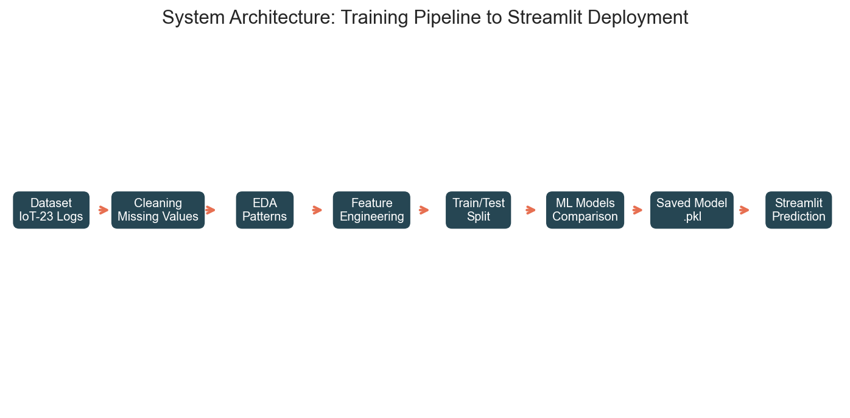
System Architecture
Data flows from IoT-23 logs to preprocessing, modeling, saved .pkl, and Streamlit prediction.
Training and deployment are separated so the app does not retrain the model.
9

Slide 10
Dataset Used: IoT-23
IoT-23 contains labeled benign and malicious IoT traffic.
Features include ports, protocol, service, duration, bytes, packets, state, and label.
50,000 rows were used for efficient experimentation.
10

Slide 11
Data Understanding
Numeric features measure traffic volume and timing.
Categorical features describe protocol, service, connection state, and packet history.
The raw label was converted into Benign and Malicious classes.
11

Slide 12
Data Preprocessing
Missing values were handled using imputation.
Categorical variables were encoded using OneHotEncoder.
Numeric values were scaled using StandardScaler.
A ColumnTransformer pipeline kept training and prediction consistent.
12

Slide 13
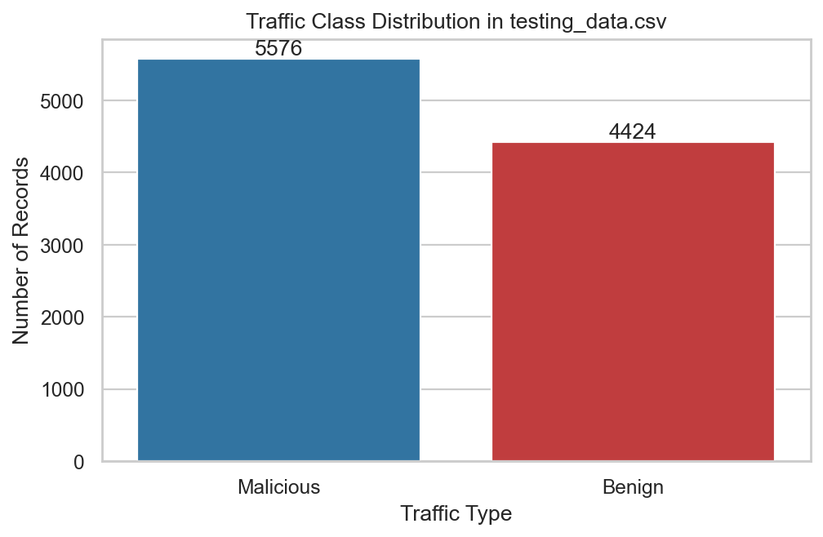
EDA: Class Distribution
Class distribution shows the balance between benign and malicious records.
This helps interpret accuracy and recall correctly.
13

Slide 14
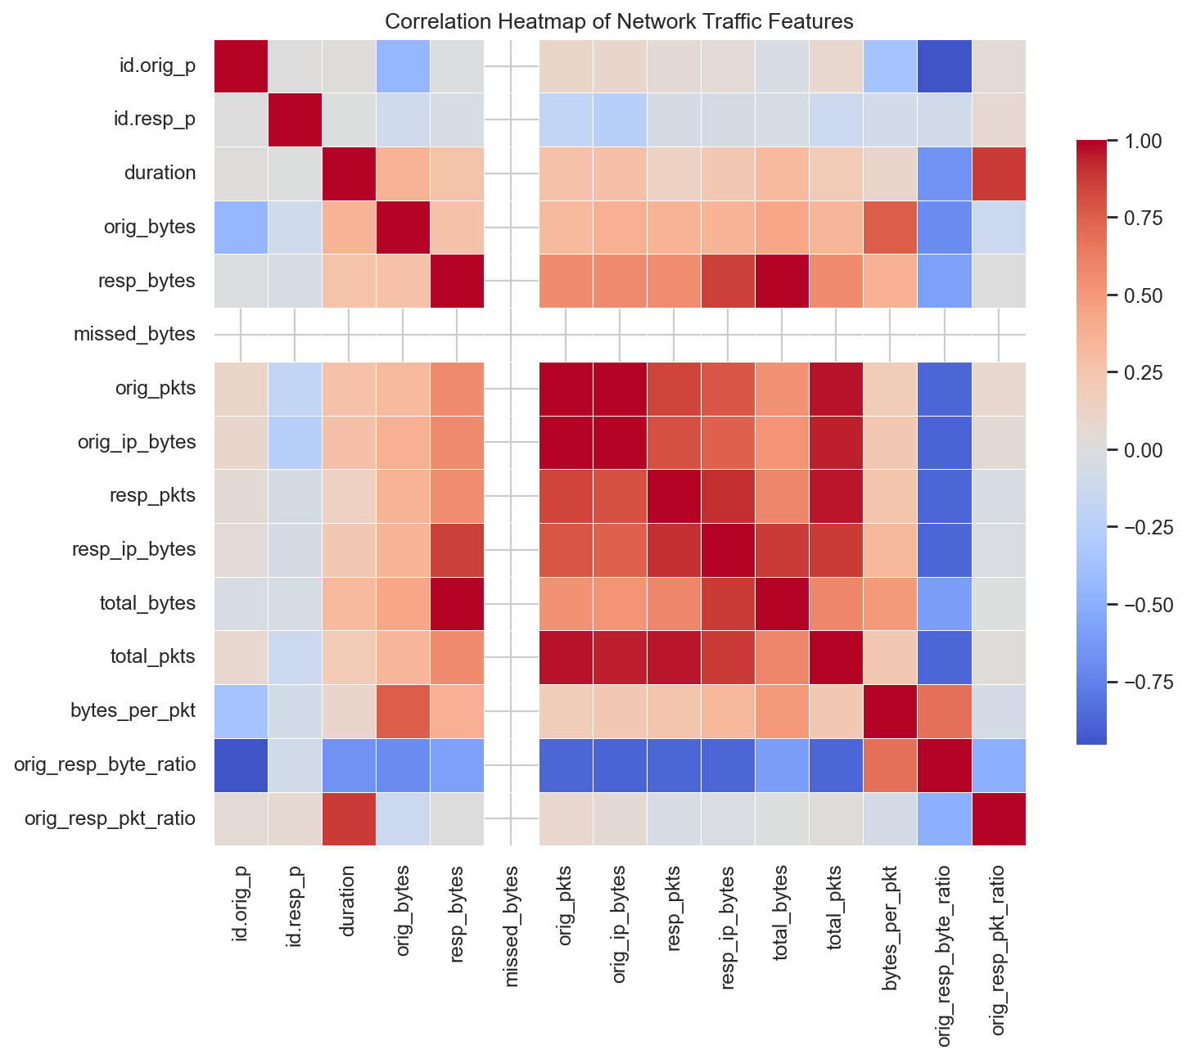
EDA: Feature Behavior
Bytes, packets, duration, and ratios show traffic behavior.
Correlation analysis reveals related network features.
14

Slide 15
Feature Engineering
New features convert raw logs into behavior signals.
Examples: total bytes, total packets, bytes per packet, traffic ratios, hour, and port type.
These features make attack patterns easier for models to learn.
15

Slide 16
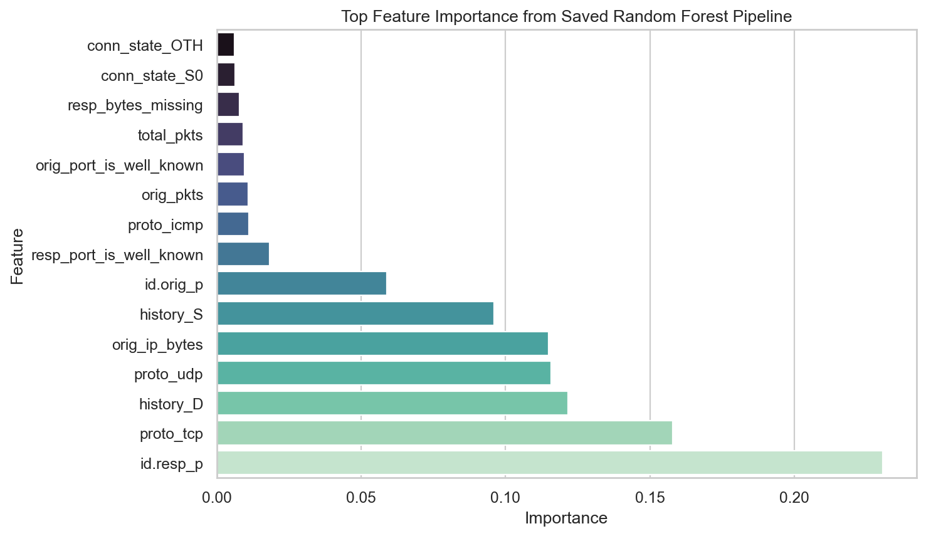
Feature Importance
Random Forest feature importance explains model decisions.
Port behavior, connection state, packet counts, and byte values are strong indicators.
16

Slide 17
Models Used
Isolation Forest detects unusual records by isolation.
One-Class SVM learns a normal-traffic boundary.
Autoencoder detects high reconstruction error.
Random Forest gives strong supervised classification.
17

Slide 18
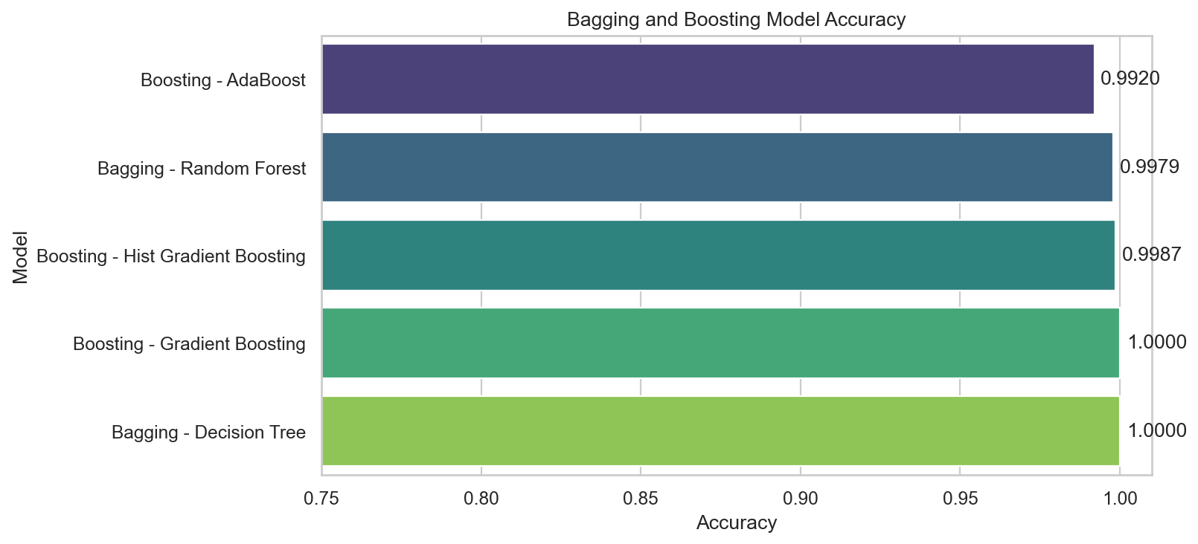
Bagging and Boosting
Bagging reduces variance by combining many learners.
Boosting corrects earlier mistakes sequentially.
Both improve stability and prediction performance.
18

Slide 19
Training Pipeline
80 percent data used for training and 20 percent for testing.
The preprocessing and model were connected through sklearn Pipeline.
The best model was saved as best_network_anomaly_model.pkl.
19

Slide 20
Evaluation Metrics
Accuracy measures overall correctness.
Precision reduces false alarms.
Recall is critical because missed attacks are dangerous.
F1-score balances precision and recall.
20

Slide 21
Ensemble Results
Decision Tree Bagging and Gradient Boosting reached perfect accuracy in the test split.
AdaBoost performed slightly lower but still strong.
Model | Acc. | Prec. | Recall | F1
Bagging DT | 1.0000 | 1.00 | 1.00 | 1.00
Gradient Boosting | 1.0000 | 1.00 | 1.00 | 1.00
Hist Gradient | 0.9987 | 1.00 | 1.00 | 1.00
Random Forest Bagging | 0.9979 | 1.00 | 1.00 | 1.00
AdaBoost | 0.9920 | 0.99 | 0.99 | 0.99
21

Slide 22
Independent Model Results
Random Forest was selected as the best saved model.
Isolation Forest and One-Class SVM had perfect recall but more false positives.
Model | Acc. | Prec. | Recall | F1
Random Forest | 0.9979 | 0.9962 | 1.0000 | 0.9981
Isolation Forest | 0.7797 | 0.7168 | 1.0000 | 0.8350
One-Class SVM | 0.7771 | 0.7144 | 1.0000 | 0.8334
Autoencoder | 0.8158 | 0.9462 | 0.7100 | 0.8113
22

Slide 23
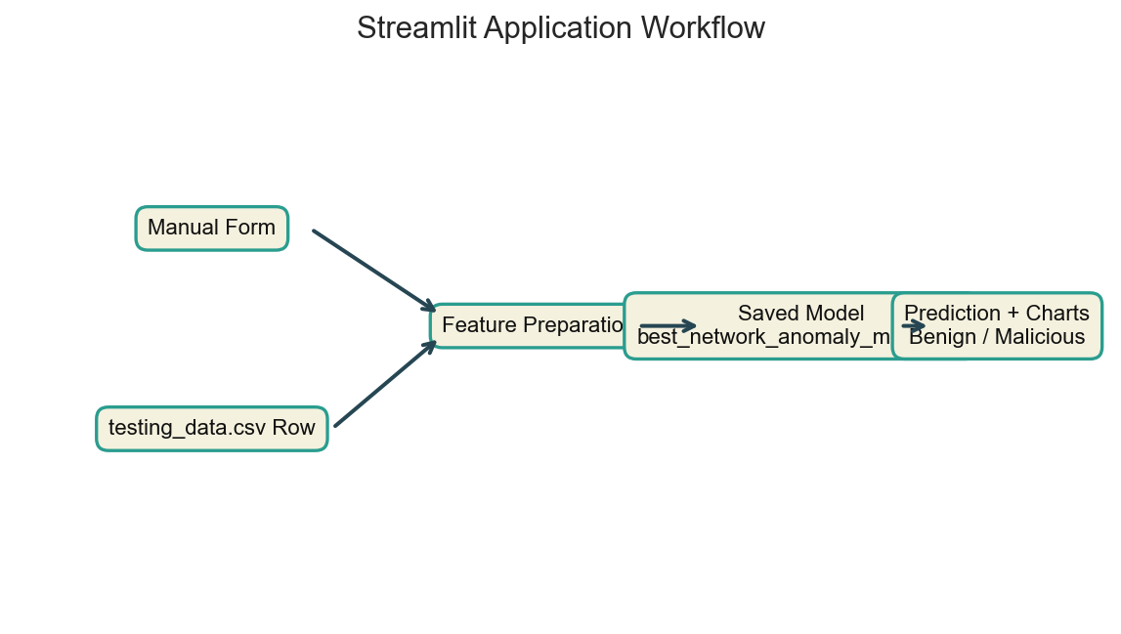
Streamlit Application
The app loads the saved .pkl model using joblib.
Users can enter manual traffic or select one testing_data.csv row.
The app displays prediction, confidence, and traffic charts.
23

Slide 24
Applications and Future Scope
Applications: enterprise security, IoT protection, cloud monitoring, education.
Future work: live packet capture, batch CSV prediction, cloud deployment, XAI, alerting, SIEM integration.
24

Slide 25
Conclusion
The project implements a complete ML workflow from data to deployment.
Random Forest achieved 0.9979 accuracy and 0.9981 F1-score.
Streamlit turns the saved model into an interactive prediction system.
Final output: usable MLC Network Detection System.
25

Slide 26
References
IoT-23 dataset: Stratosphere/CTU references.
Streamlit documentation: docs.streamlit.io.
Scikit-learn documentation: RandomForestClassifier and preprocessing tools.
KDD Cup 1999 dataset: ACM SIGKDD benchmark.
26

