Slide 1
Airbnb Case Study - 2
Pritam Shetty

Slide 2
Table of Content
Objective
Background
Important Findings
Assumptions
Conclusion
Appendix

Slide 3
Objective
Airbnb has seen a major decline in revenue due to COVID-19 travel restriction . Now that the restrictions have started lifting and people have started to travel more, Airbnb wants to make sure that it is fully prepared for this change.

Slide 4
Background Summary
Airbnb is operating short- and long-term homestays and experiences in New York city, with major of the listing covered in following neighborhood group
Bronx
Brooklyn
Manhattan
Queens
Staten Island
With total 349K no’s of listings
The business aims to strategically position itself by analyzing the data from 2019 and determining the optimal number of listings and room types to offer.

Slide 5
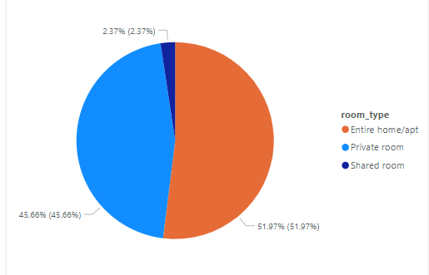
Favorite Host Among Customer
Based on the distribution, it can be concluded that Airbnb should consider onboarding hosts who can provide entire homes/apartments.

Slide 6
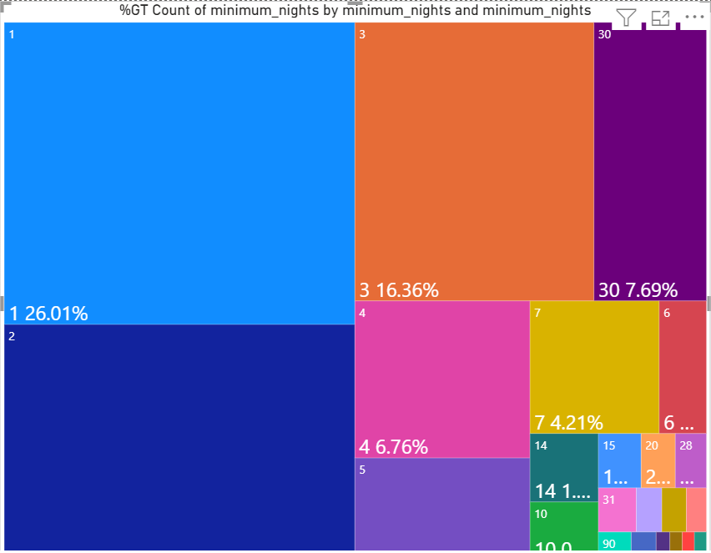
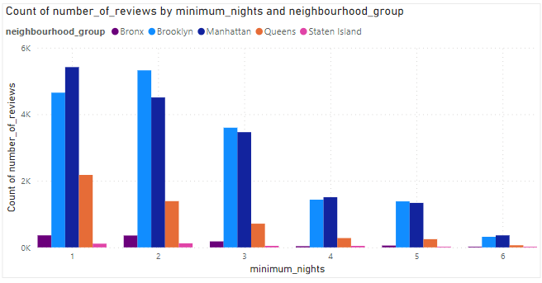
Minimum Nights Analysis
Out of all the minimum night options available, the highest demand is observed in listings with a minimum of 1 night
In addition to the listings with a minimum of 1 night, there is also a high demand for listings with minimum nights ranging from 1 to 7

Slide 7
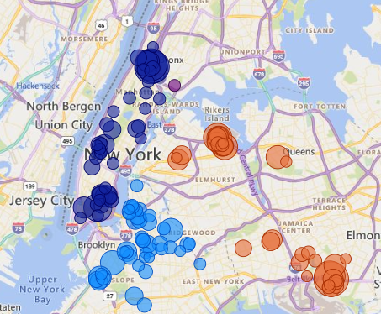
Neighborhood in Demand
Considering the sum of reviews received, it can be concluded that Manhattan and Brooklyn are the neighborhoods in demand

Slide 8
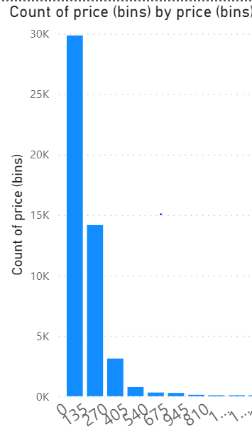
Price Range
Listings with a price range of 0 to 135 are highly preferred

Slide 9
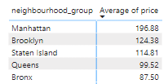
Average Price
Among the five neighborhoods, it can be observed that Manhattan has the highest average price for listings, while the Bronx has the lowest average price among all

Slide 10
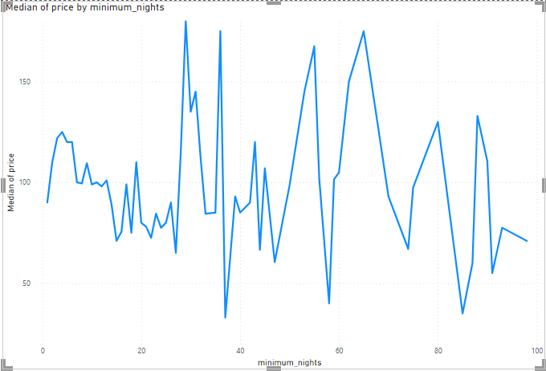
Price Variation
The median price of listings generally decreases as the number of minimum nights increases, with a few exceptions

Slide 11
Assumptions
Review received are all positive and indicates actual post after stay at one of the listing
All data are actual and missing or NULL values has no significance

Slide 12
Conclusion
Listing which offers entire home/apt has high demand
Profit margins are high when customers books for 1 night
Manhattan and Brooklyn are the neighborhood where business can be expanded
The most acceptable price range among customers is 0 to 135
It has been observed that, with a few exceptions, the price tends to decrease as the number of minimum nights increases

Slide 13
Appendix
Methodology File

Slide 14
Thank You

