Slide 1
Airbnb Case Study - 1
Pritam Shetty

Slide 2
Table of Content
Objective
Background
Important Findings
Assumptions
Conclusion
Appendix

Slide 3
Objective
Airbnb has seen a major decline in revenue due to COVID-19 travel restriction . Now that the restrictions have started lifting and people have started to travel more, Airbnb wants to make sure that it is fully prepared for this change.

Slide 4
Background Summary
Airbnb is operating short- and long-term homestays and experiences in New York city, with major of the listing covered in following neighborhood group
Bronx
Brooklyn
Manhattan
Queens
Staten Island
With total 349K no’s of listings
The business aims to strategically position itself by analyzing the data from 2019 and determining the optimal number of listings and room types to offer.

Slide 5
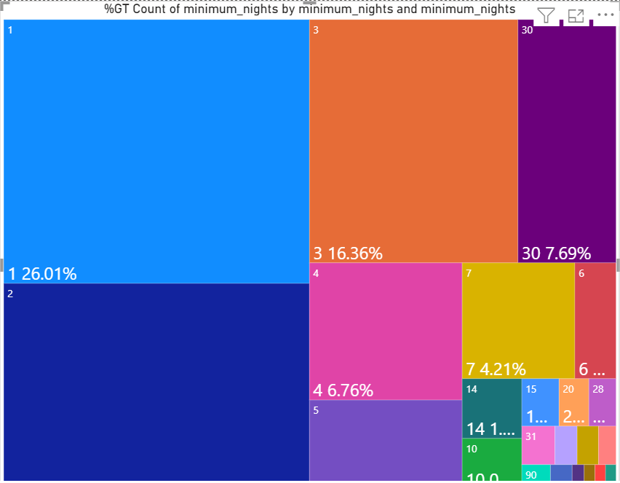
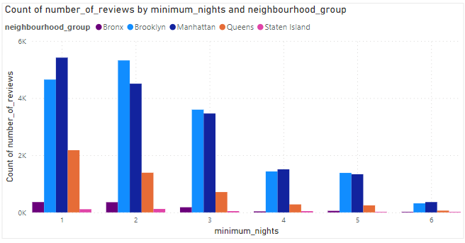
Minimum Nights Analysis
Out of all the minimum night options available, the highest demand is observed in listings with a minimum of 1 night
In addition to the listings with a minimum of 1 night, there is also a high demand for listings with minimum nights ranging from 1 to 7

Slide 6
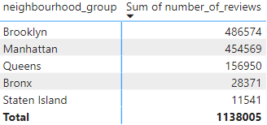
Reviews for Improvement
It has been observed that customers who visit the neighborhoods of Brooklyn and Manhattan are willing to share their feedback.
Customers who visit these neighborhoods should be encouraged to provide feedback so that areas for improvement can be shared with other listings.

Slide 7
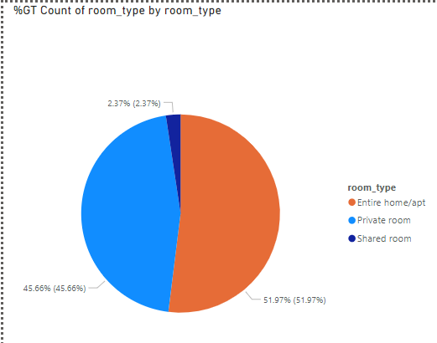
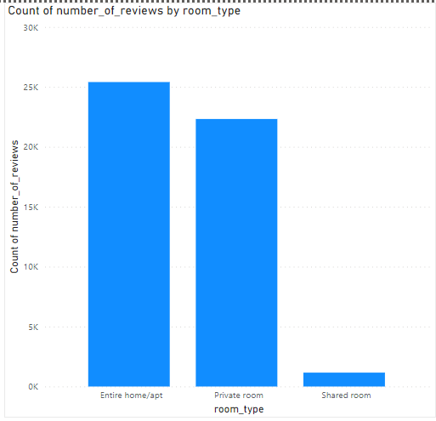
Preferred Room Type
Based on total number of listing as reviews received from customers, it can be concluded that Entire Home/Apt is preferred stay.

Slide 8
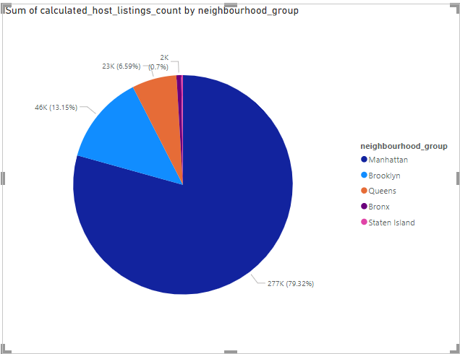
Famous Neighborhood Group
Manhattan Neighborhood has the maximum number of listing for Airbnb.

Slide 9
Assumptions
Review received are all positive and indicates actual post after stay at one of the listing
All data are actual and missing or NULL values has no significance

Slide 10
Conclusion
While acquiring new listing, preference should be given to property which can provide minimum nights of 1-7
Feedback system should be reviewed in order to have more reviews from Bronx and Staten Island
Manhattan should be given preference while expanding the service
Listing which can provide Entire Home/Apt should be given preference

Slide 11
Appendix
Methodology File

Slide 12
Thank You

