Slide 1
Data Science Job Ssalary: SQL Analysis
By – Pritam Shetty

Slide 2
Approach
Creating Database
Adding data to table from CSV file
Checking data in each column
Writing SQL queries for 16 questions

Slide 3
Questions to be answered
1.How many job title was included in the dataset?
2.Which experience level has the highest salary?
3.Does the employment type affect salary?
4.What is the average salary per job title in USD?
5.What is the highest salary per job title in USD?
6.What is the highest paying entry-level data science job?
7.What is the highest paying mid-level data science job?
8.What is the highest paying senior-level data science job?

Slide 4
9.What is the highest paying Executive level data science job?
10.What is the average salary per experience level?
11.What is the lowest paying entry-level data science job?
12.What is the lowest paying Mid-level Data Science Job?
13.What is the lowest paying Senior level data science job?
14.What is the lowest paying Executive level data science job?
15.Does company size affect salary?
16.Does company location affect Salary?

Slide 5
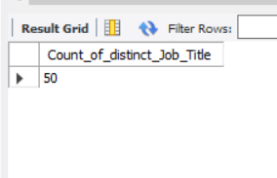
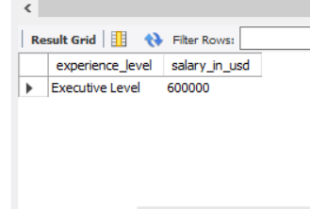
Solution
How many job title was included in the dataset?
Which experience level has the highest salary?

Slide 6
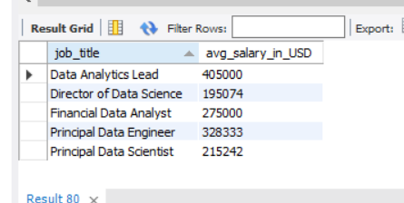
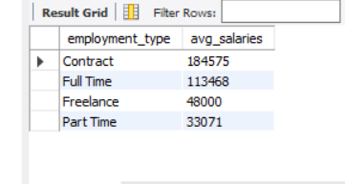
Contd.
Does the employment type affect salary?
What is the average salary per job title in USD?

Slide 7
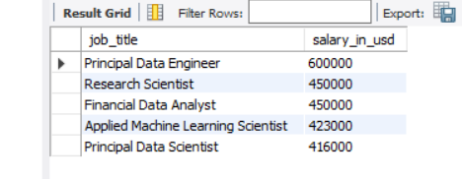
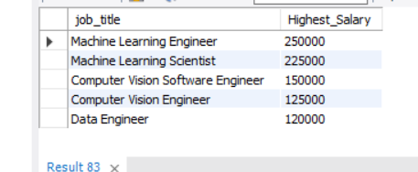
Contd.
What is the highest salary per job title in USD?
What is the highest paying entry-level data science job?

Slide 8
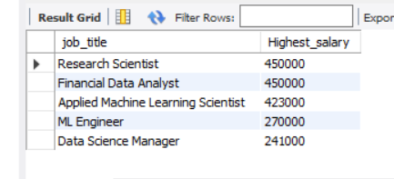
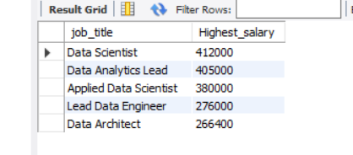
Contd.
What is the highest paying mid-level data science job?
What is the highest paying senior-level data science job?

Slide 9
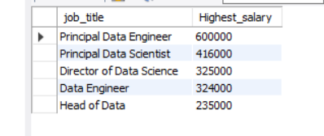
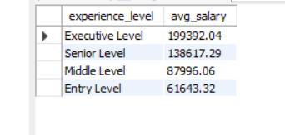
Contd.
What is the highest paying Executive level data science job?
What is the average salary per experience level?

Slide 10
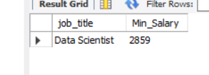

Contd.
What is the lowest paying entry-level data science job?
What is the lowest paying Mid-level Data Science Job?

Slide 11
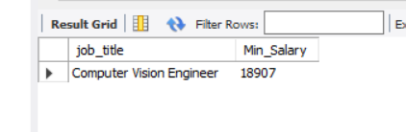
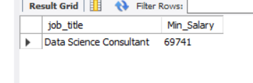
Contd.
What is the lowest paying Senior level data science job?
What is the lowest paying Executive level data science job?

Slide 12
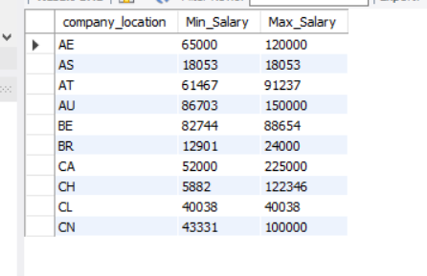
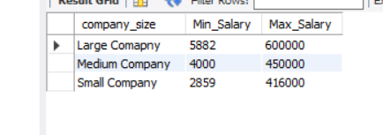
Contd.
Does company size affect salary?
Does company location affect Salary?

Slide 13
Thank You

