Slide 1
Insights from Consumer Goods Domain

Slide 2
Problem Statement
Atliq Hardwares (imaginary company) is one of the leading computer hardware producers in India and well expanded in other countries too. However, the management noticed that they do not get enough insights to make quick and smart data-informed decisions. They want to expand their data analytics team by adding several junior data analysts.

Slide 3
Approach
Creating Database
Creating Tables and updating data into the tables.
Building SQL statements to generate the output for the request Ad-Hoc request.
Tool Used
MySQL Workbench

Slide 4
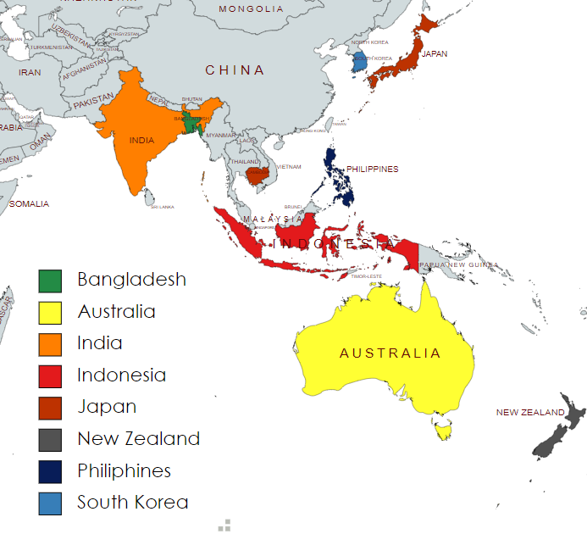
Observations
Request - 1
Markets in which customer "Atliq Exclusive" operates.

Slide 5
Contd.
Request – 2
What is the percentage of unique product increase in 2021 vs. 2020?
unique_products_2020 | unique_products_2021 | percentage_chg
245 | 334 | 36.33

Slide 6
Contd..
Request – 3
Provide a report with all the unique product counts for each segment.

Slide 7
Contd…
Request – 4
Which segment had the most increase in unique products in 2021 vs 2020.
segment | product_count_2020 | product_count_2021 | difference
Accessories | 69 | 103 | 34
Notebook | 92 | 108 | 16
Peripherals | 59 | 75 | 16
Desktop | 7 | 22 | 15
Storage | 12 | 17 | 5
Networking | 6 | 9 | 3

Slide 8
Contd….
Request – 5
Get the products that have the highest and lowest manufacturing costs.
product_code | product | manufacturing_cost
A6120110206 | AQ HOME Allin1 Gen 2 | 240.54
A2118150101 | AQ Master wired x1 Ms | 0.89

Slide 9
Contd…..
Request – 6
Generate a report which contains the top 5 customers who received an average high pre_invoice_discount_pct for the fiscal year 2021 and in the Indian market.
customer_code | customer | average_discount_percentage
90002009 | Flipkart | 0.31
90002006 | Viveks | 0.3
90002002 | Croma | 0.3
90002003 | Ezone | 0.3
90002016 | Amazon | 0.29

Slide 10
Contd……
Request – 7
Get the complete report of the Gross sales amount for the customer “Atliq Exclusive” for each month.

Slide 11
Contd…….
Request – 8
In which quarter of 2020, got the maximum total_sold_quantity.
Months between Oct- December observed highest sold quantity.

Slide 12
Contd……..
Request – 9
Which channel helped to bring more gross sales in the fiscal year 2021 and the percentage of contribution.
Retailers contributed the max in gross sales.

Slide 13
Contd………
Request – 10
Get the Top 3 products in each division that have a high total_sold_quantity in the fiscal_year 2021
division | product_code | product | total_sold_quantity | rank_order
N & S | A6720160103 | AQ Pen Drive 2 IN 1 | 1159222 | 1
N & S | A6818160201 | AQ Pen Drive DRC | 1128104 | 2
N & S | A6419160301 | AQ Clx1 | 729696 | 3
division | product_code | product | total_sold_quantity | rank_order
P & A | A2319150302 | AQ Gamers Ms | 683634 | 1
P & A | A2219150204 | AQ Master wireless x1 Ms | 682321 | 2
P & A | A2319150306 | AQ Gamers Ms | 681531 | 3
division | product_code | product | total_sold_quantity | rank_order
PC | A4218110202 | AQ Digit | 26012 | 1
PC | A4319110306 | AQ Velocity | 25978 | 2
PC | A4118110107 | AQ Aspiron | 25963 | 3

Slide 14
Conclusion
Quarter 4 (Oct- Dec) has been best quarter.
Maximum sales have come from Retailer section.

Slide 15
Thank You

