Slide 1
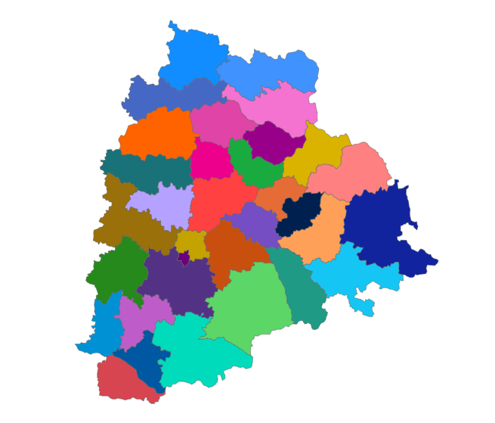
Telangana Growth Analysis

Slide 2
Challenge - Analyze Growth and Present Insights to the Telangana Government
Telangana is one of the fastest-growing states in India and is known for its open data policy. Analyze Telangana's growth across various sectors quantitatively and provide valuable insights to the Telangana government. These insights will assist them in making data-informed decisions to further bolster the state's growth

Slide 3
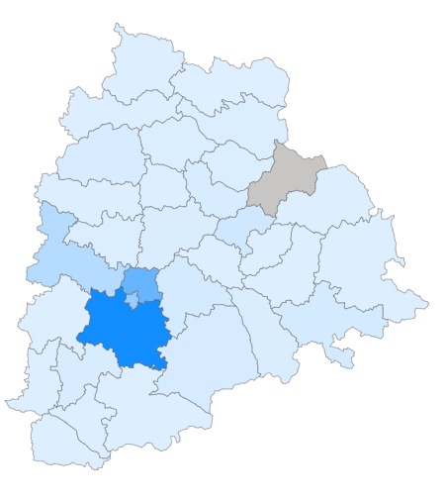
Document Registration Revenue (FY 2019-22)
During FY 2019-22, the following five districts showed the highest revenue collection from document registration
Rangareddy
Medchal_Malkajgiri
Hyderabad
Sangareddy
Hanumakonda

Slide 4
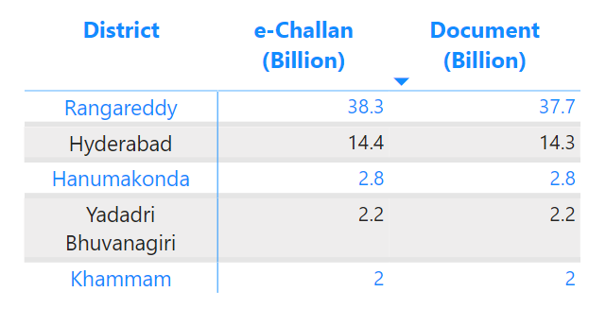
Document Registration vs. E-Stamp Challans Revenue (FY 2022)
While e-Stamp technology has been implemented and used in all districts, the revenue generated by both methods is nearly identical across the board.
The exception to this trend is Rangareddy district, which has shown higher revenue exclusively from e-Stamps

Slide 5
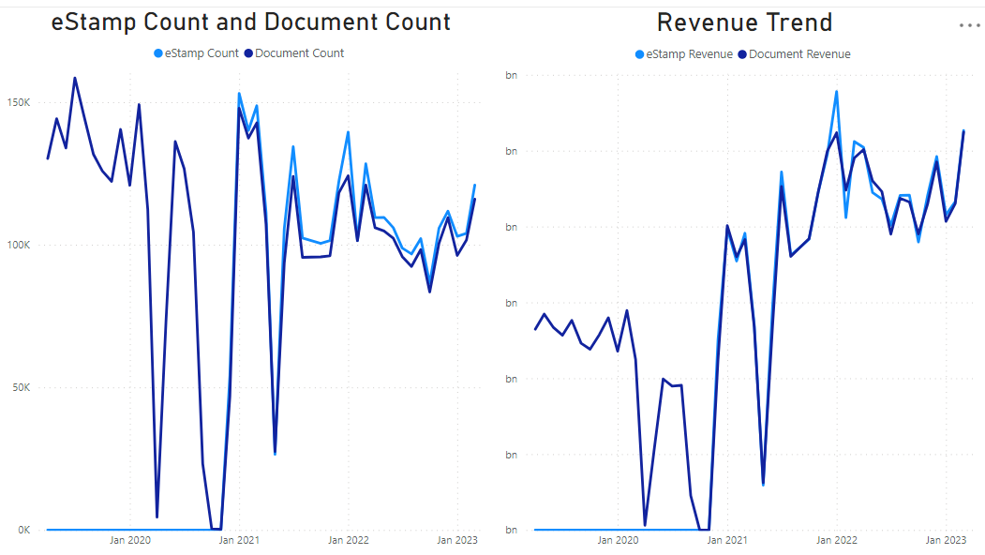
Impact of E-Stamp Implementation
E-Stamp challans have consistently outnumbered document registrations. Notably, three districts have consistently demonstrated higher e-Stamp counts:
Rangareddy
Yadadri Bhuvanagir
Hyderabad
These districts can serve as valuable examples for implementing best practices in the following areas:
Siddipet
Medak
Nizamabad
Warangal
This recommendation is particularly relevant because the count of document registrations remains

Slide 6
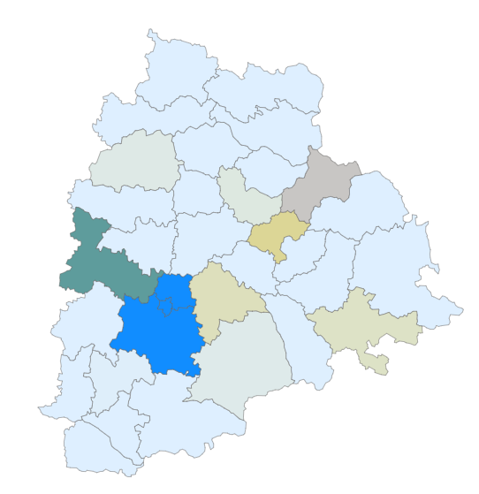
District Segmentation by Stamp Registration Revenue (FY 2021-22)
The districts have been categorized as follows:
1. Revenue greater than 10 Billion (Dark Blue on map)
There are 3 districts in this category
2. Revenue between 1 – 10 Billion
There are 10 districts under this category
3. Revenue less than 1 Billion (Districts with light blue color)
19 districts in this category

Slide 7
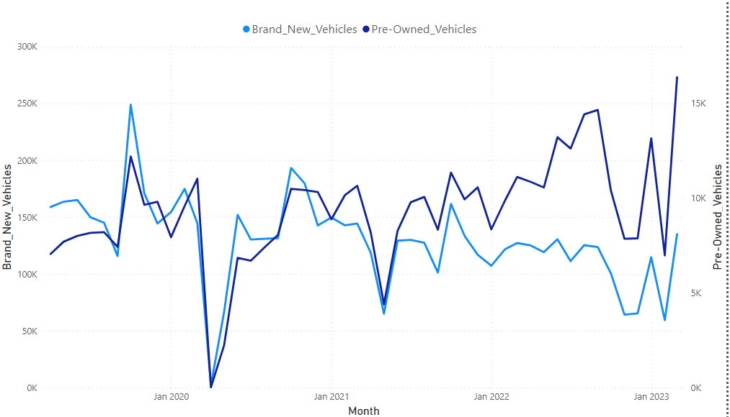
Analyzing Seasonal Trends in Vehicle Sales Across Districts
A common trend across districts has been observedthe sale of new vehicles has seen a decline.
However, there are exceptions. Rangareddy and Sangareddy are the two districts that have maintained consistent figures in new vehicle sales.
Another notable highlight is that new vehicle sales peaked in October every year and hit their lowest point in May.

Slide 8
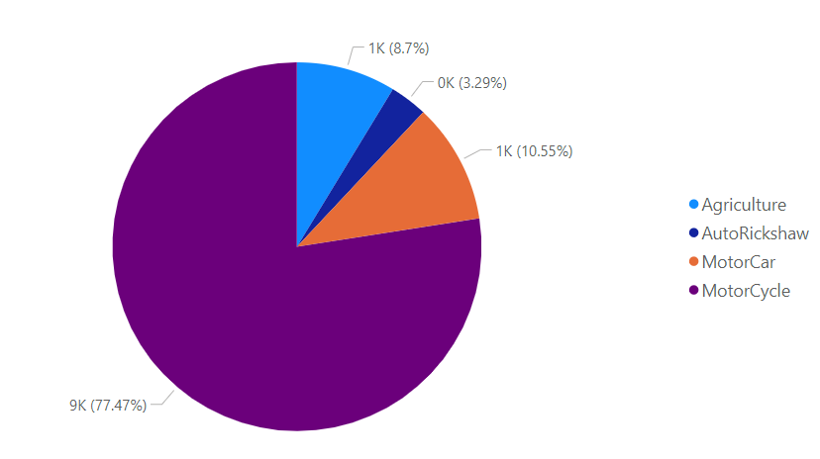
Vehicle Class Distribution Across Districts in FY 2022
Here are the observations regarding vehicle class distribution across districts:
Hyderabad: There are no agricultural vehicles in the district
Kumurambheem Asifabad: Motorcycles account for 87% of the vehicles in this district
Medchal_Malkajgiri: Only motorcars and motorcycles are observed in this district
Rangareddy: Rangareddy tops the list with the highest number of motorcars

Slide 9
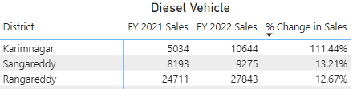
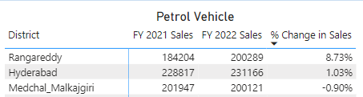
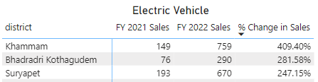
Districts with Highest and Lowest Vehicle Sales Growth (FY 2022 vs. FY 2021)
In the table, you can see the districts with higher sales in each category
However, there are also districts where lower sales are observed in specific vehicle types:
Diesel Vehicle
Warangal
Mahabubabad
Jangoan
Petrol Vehicle
Warangal
Nirmal
Jagtial
Electric Vehicle
Wanaparthy
Rajanna Sircilla
Mancherial

Slide 10
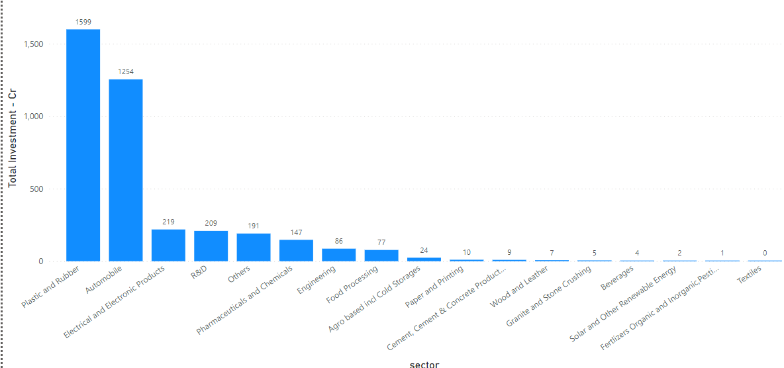
Top 5 Sectors with Highest Investments in FY 2022
The following are the sectors that saw the highest investment in the FY 2022
Plastic and Rubber
Automobile
Electrical and Electronic Products
R&D
Others

Slide 11
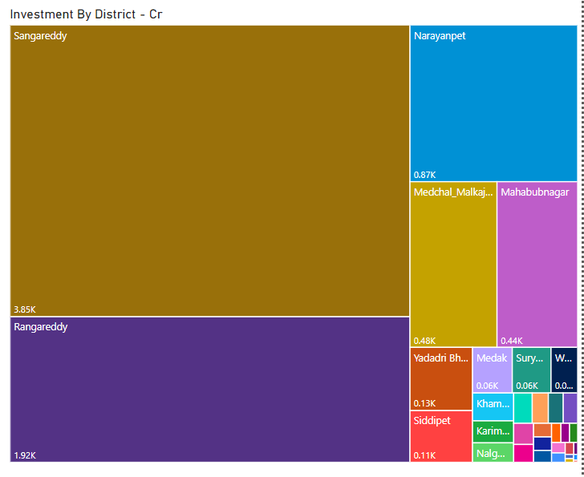
Districts with Highest Sector Investments (FY 2019-22)
Sangareddy district leads the list with the highest sector investment
followed closely by Rangareddy and Narayanpet districts

Slide 12
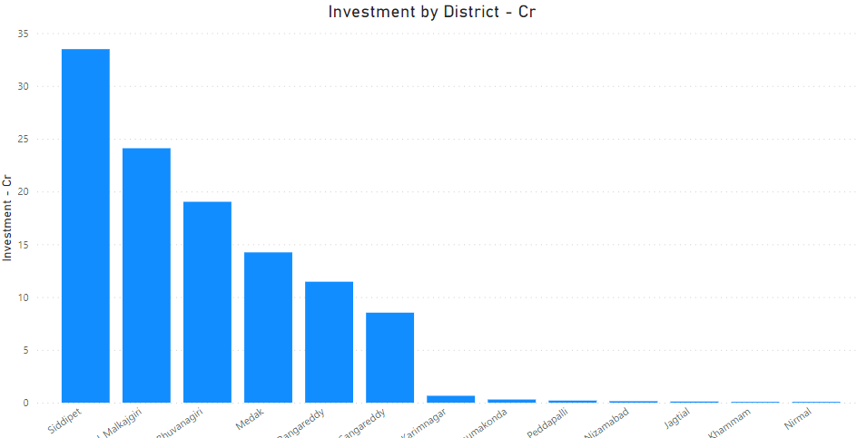
Sectors with Cross-District Investment Growth
Food Processing – 20 Districts
Cement & Concrete Products – 18 districts
Agro based – 8 districts
Engineering – 6 districts
Wood and leather -5 Districts
Pharmaceuticals – 5 Districts
Textiles – 4 Districts

Slide 13
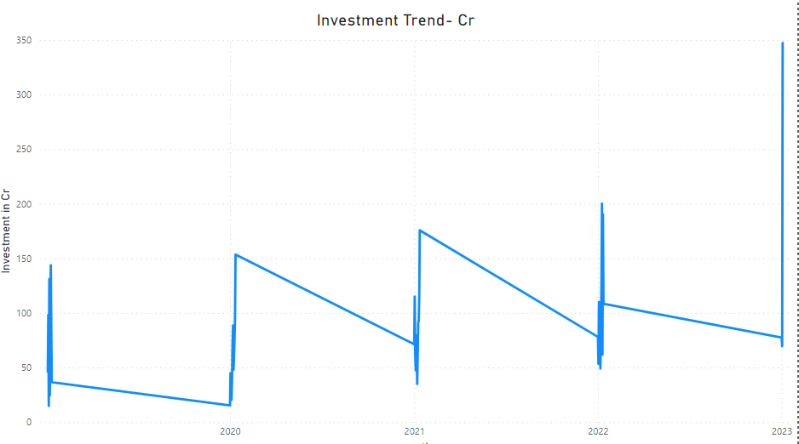
Seasonal Patterns in Sector Investments
Food Processing - investments are typically received in January, and there is a consistent YOY increase in investment
Pharmaceuticals - there has been a downward trend in investment
Engineering - investment started to pick up from the year 2022
Electrical & Electronics - witnessed a significant increase in investment in 2023
Automobile - also experienced a major increase in investment in 2023
Agro-based - has consistently received investment

Slide 14
Thank You

